Slide 1
CS174A Lecture 7

Slide 2
Announcements & Reminders
Project #2 due on Sunday 10/20/19 midnight
Midterm: Oct 29

Slide 3
Last Lecture Recap
Examples of Transformations:
Rotation about a random point
Rotation about a random axis/vector
Spaces:
Model space
Object/world space
Eye/camera space
Screen space

Slide 4
Next Up
Spaces:
Model space
Object/world space
Eye/camera space
Screen space
Projections: parallel and perspective
Lighting
Flat and Smooth Shading

Slide 5
SIGGRAPH trailers from 2013
Going backwards,
https://www.youtube.com/watch?v=FUGVF_eMeo4
And
https://www.youtube.com/watch?v=JAFhkdGtHck

Slide 6
Composite 3D Rotation About the Origin
This is known as the “Euler angle” representation of 3D rotations
The order of the rotation matrices is important !!
Note: The Euler angle representation suffers from singularities

Slide 7
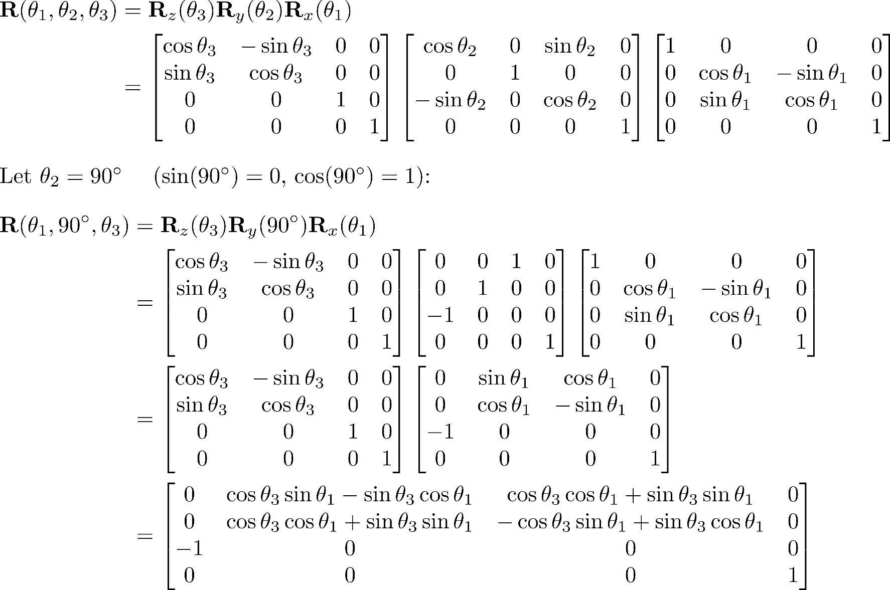
Gimbal Lock
What happens when the middle angle is 90˚?

Slide 8
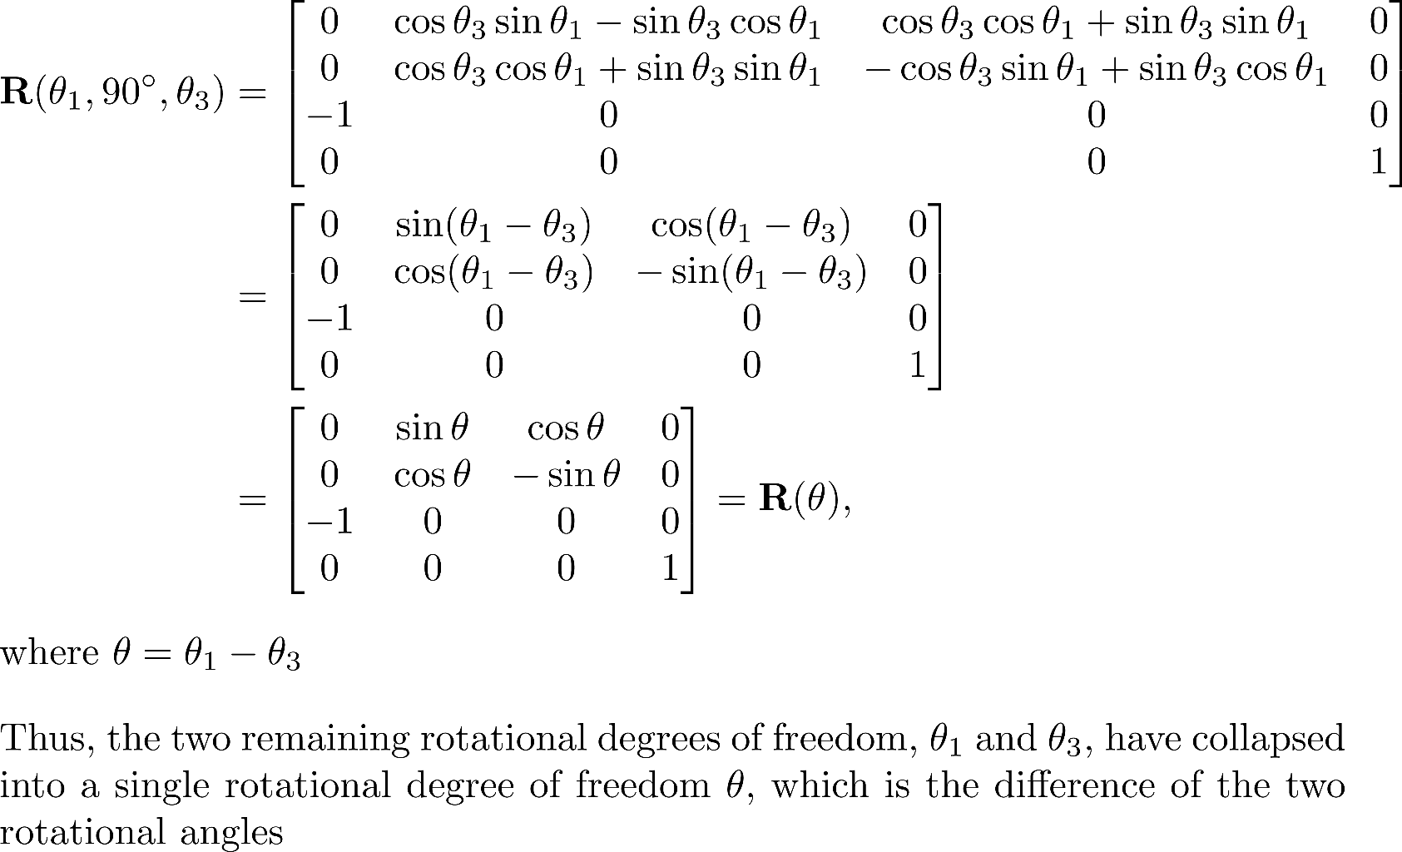
Loss of a Rotational Degree of Freedom

Slide 9
There are Alternatives
It is often convenient to use other representations of 3D rotations that do not suffer from Gimbal Lock
Advanced concepts
Quaternions
Exponential Maps

Slide 10
“LookAt” Matrices

Slide 11
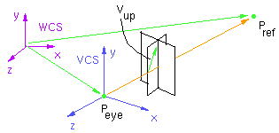
Defining M_{cam}
Given:
Eye point P_{eye} Reference point P_{ref} Up vector v_{up}
To build M_{cam} we need to define a camera coordinate system [i j k O]
(v_{up} is not necessarily orthogonal to z)

Slide 12
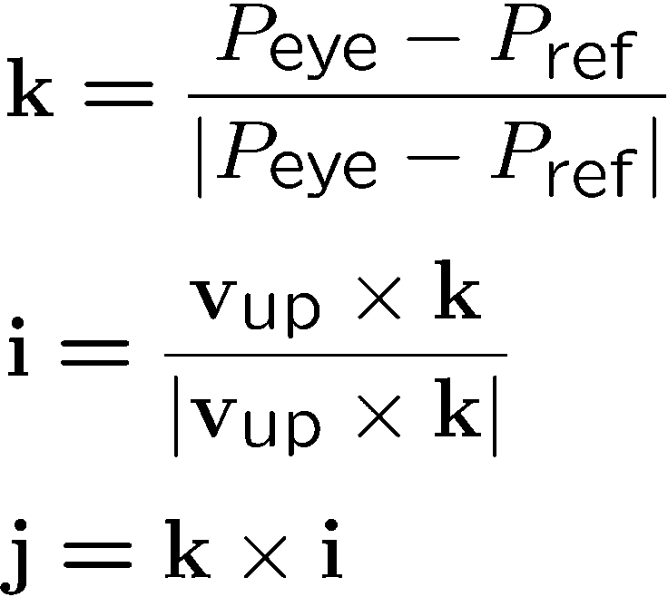
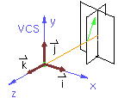
Camera Coordinate System

Slide 13
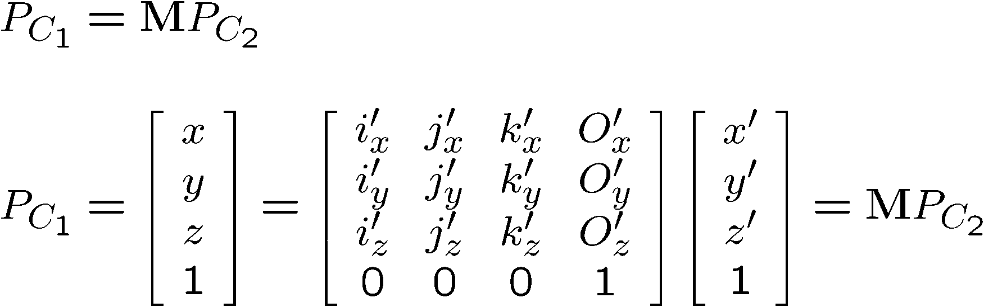
Reminder: Change of Basis
P
j’
C₂
M
i’
j
O’
C₁
k’
O
i
k

Slide 14
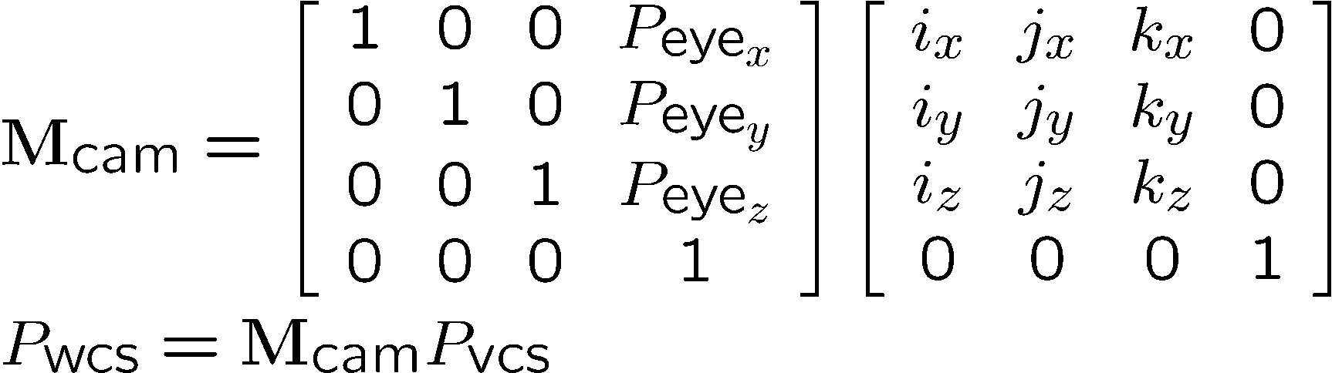
Building M_{cam}
Change of basis
Our reference system is WCS, we know the camera parameters with respect to the world
Align WCS with VCS
WCS
VCS
y
P_{eye}
x
z
Translation
Rotation

Slide 15
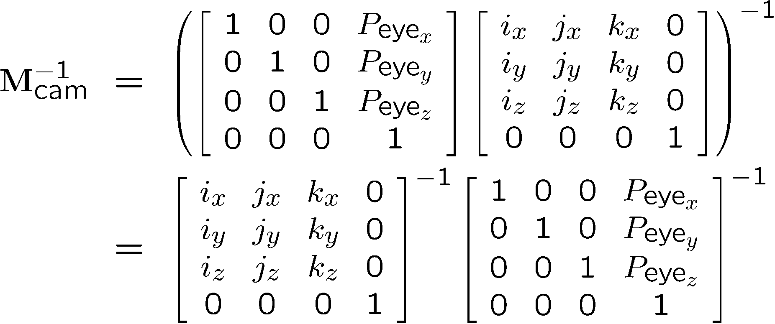
Building M_{cam} Inverse
Invert the smart way

Slide 16
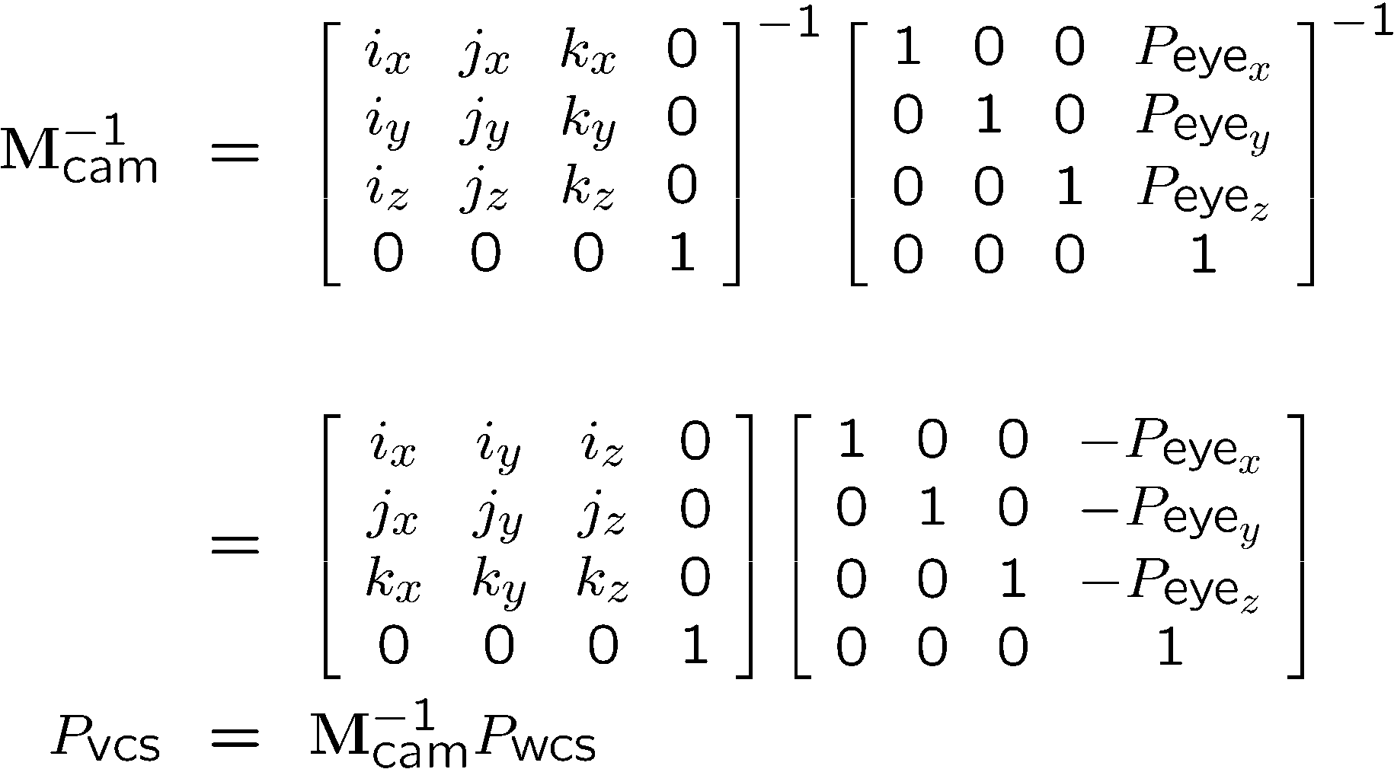
Building M_{cam} Inverse
Invert the smart way
Transpose
Negate

Slide 17
How to call look_at()
// Pass in eye position, at
// position, and up vector.
Mat4.look_at( Vec.of( 0,0,0 ), Vec.of( 0,0,1 ), Vec.of( 0,1,0 ) ) );
// Or:
Mat4.look_at( ...Vec.cast( [0,0,0], [0,0,1], [0,1,0] ) );

Slide 18
Positioning camera without look_at()
Not as easy to point directly at things, but valid.
Generate it using mult()/rotation()/translation()/scale() instead of look_at()
Remember inverse() concepts apply to cameras
Any incremental modifications you make will encounter properties of inverted products (reverse the order and invert each part)

Slide 19
Summary of the Modelview Transformation
An affine transformation composed of elementary affine transformations
The camera transformation is a change of basis
The modelview transformation preserves:
lines and planes
parallelism of lines and planes
affine combinations of points and relative ratios

Slide 20
Normals in Graphics

Slide 21
Normals
Mathematics:
A vector that is perpendicular to the surface at a given point
Point “outward” or “away” from the object
True realism:
Would require calculation of normal/derivative at every point along a continuous shape
Not feasible
Graphics:
We’re only interested in vertex normals
Discrete “approximations” of the normal sampled at points on the imaginary surface

Slide 22
Transforming Normals
Normal vectors are transformed along with vertices and polygons.
How do you transform a normal ?
What about unit magnitude ?

Slide 23

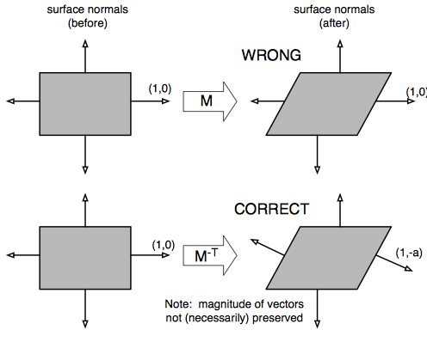
Consider the shear matrix:
The good thing is, this problem does not happen with tangent vectors!!!

Slide 24
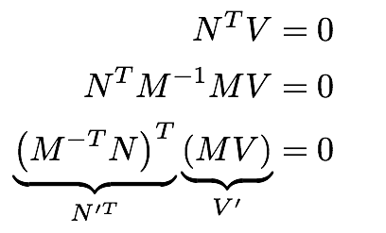
Mathematical Reason for Inverse Transpose:
All we know about the transformed normal is that the dot product with tangent (V) must equal zero:

Slide 25
Polygon Attributes
Per vertex
Position
Texture coordinates
Per vertex or per face (if flat shading)
Color
Normal

Slide 26
Reminder: What are normals for?
Lighting!
The direction of the normal determines how the light will bounce off each surface when modeling light rays.

Slide 27
Our shapes so far have easy normal vectors.
“Z axis” vector is perpendicular to Triangle and Square
For a cube, normals would also just be axis-aligned
For a sphere, we know analytically that the vector pointing away from the center (perpendicular to the formula’s surface) will be the normal.
Just assign normal = position coord.

Slide 28
What do you do when the normals aren’t known?
Hint: Think per-triangle.

Slide 29
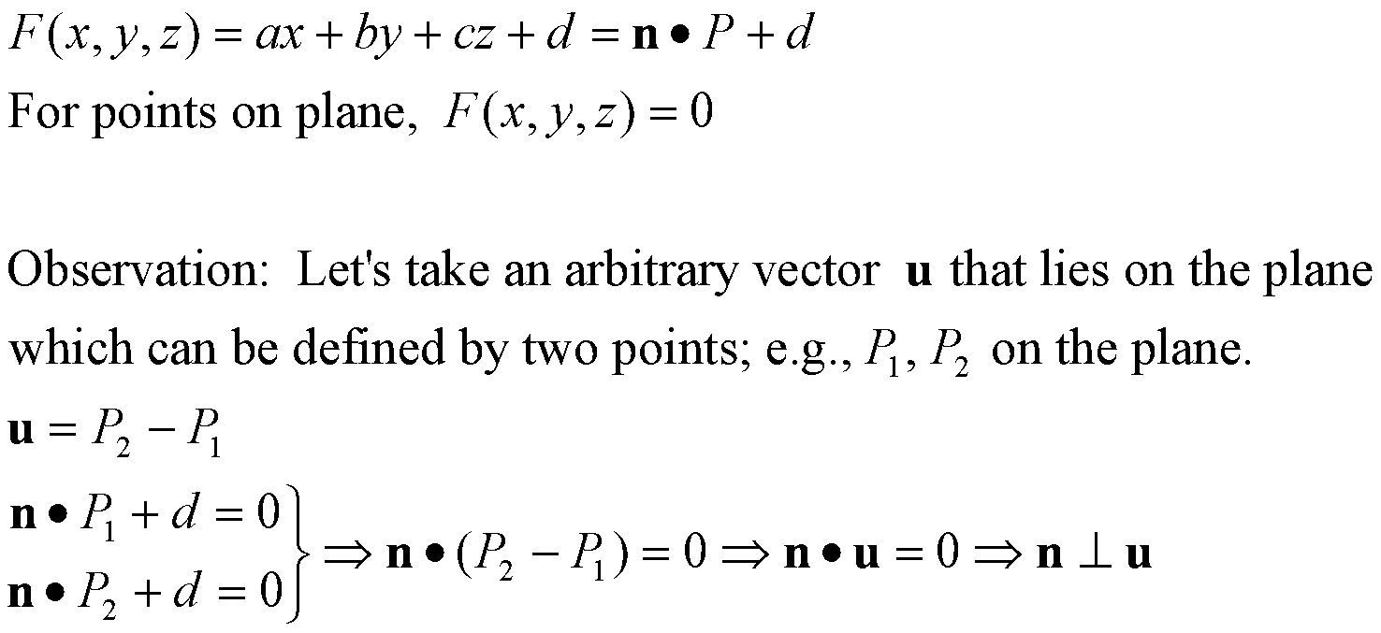
Plane Equation
Normal / point form
n = [a b c]^{T}
P₂
u
P = [x y z]^{T}
P₁

Slide 30
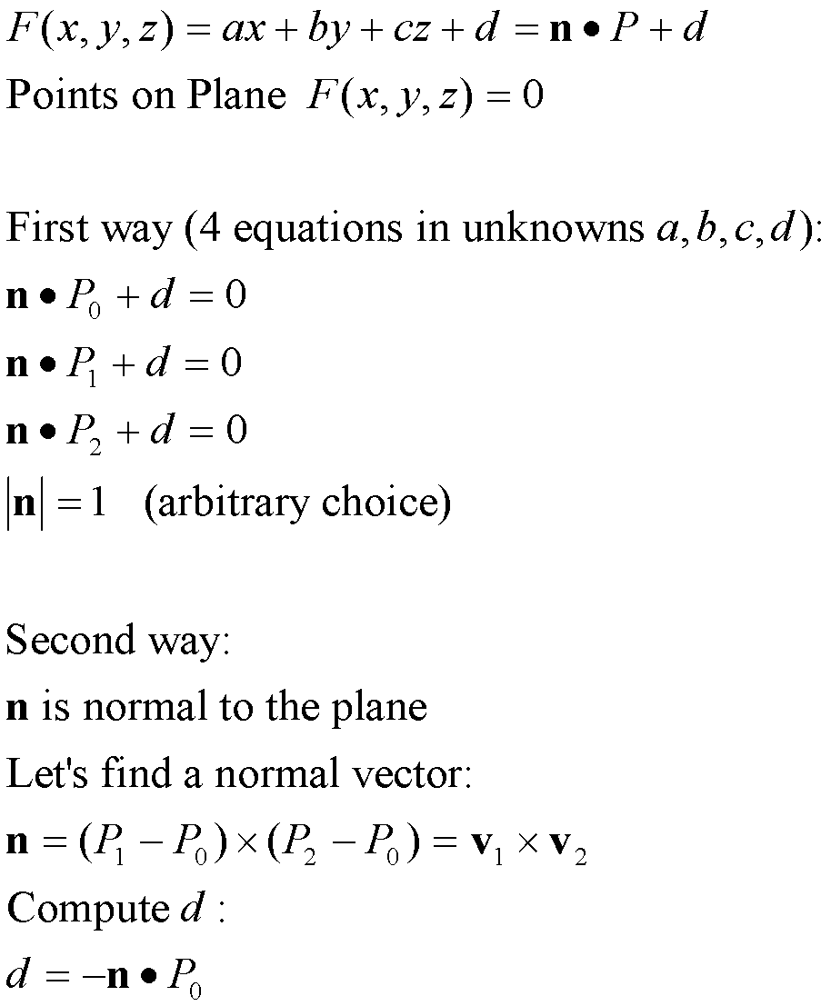
Computing Normal / Point Form From 3 Points
n = [a b c]^{T}
P₂
P = [x y z]^{T}
v₂
P₁
P₀
v₁

Slide 31
When the normals aren’t known:
Using the indices, collect the positions of the three points of the triangle.
Create two vectors out of the triangle.
Use a cross product.

Slide 32
Cross Product Normals
The result might point inside the shape instead of out!
(AxB = -BxA)
Hard to know which edges to make “A” and “B”
How to detect an inward vector? Assume shape is convex and centered at the origin.

