Slide 1
CS174A Lecture 9

Slide 2
Announcements & Reminders
Midterm: Oct 29
Midterm study guide posted in Piazza
Team project proposals due (first draft): Oct 31
Team project proposals due (final version): Nov 5
Project #3 assigned in Piazza/Github

Slide 3
TA Session This Friday
Team project
First draft of proposal due: 10/31/19
What’s expected in the proposal
Still looking for teammates? Resolve this Friday
Project assignment #3
Midterm review
Jonathan’s office hours: Friday 10-11 AM, additional office hours next week before midterm
Yunqi Guo: Office hours Tuesday 9-11 AM

Slide 4
Last Lecture Recap
Spaces:
Model space
Object/world space
Eye/camera space
Screen space
Projections: Orthographic and Perspective
Orthographic and perspective view volumes
Canonical (normalized) view volume
Window-to-Viewport Mapping

Slide 5
Next Up
Backface Culling
Geometric Calculations
MIDTERM REVIEW
Hidden Surface Removal
Flat and Smooth Shading
Lighting

Slide 6
Backface Culling
N = outward normal vector of face
P = a point on face
E = eye vector (from a point on face to eye = E - P)
In World Space: N·E > 0
In Eye/Camera Space: N·P > 0
In Projection Space (after perspective division): N_{z} < 0

Slide 7
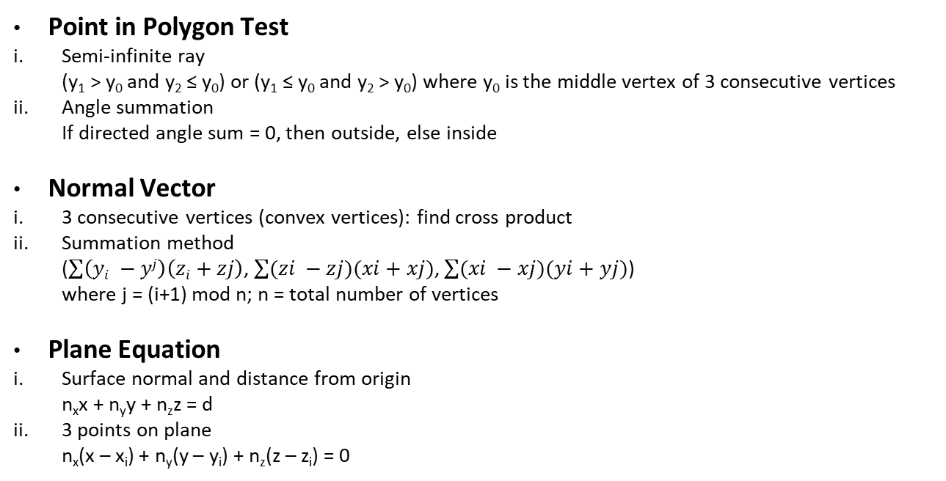
Geometric Calculations
Point in Polygon Test
Semi-infinite ray (y₁ > y₀ and y₂ ≤ y₀) or (y₁ ≤ y₀ and y₂ > y₀) where y₀ is the middle vertex of 3 consecutive vertices
Angle summation If directed angle sum = 0, then outside, else inside
Normal Vector
3 consecutive vertices (convex vertices): find cross product
Summation method ($\sum{\left(yi −yj\right)\left(zi+zj\right)}$, $\sum{(zi −zj)(xi+xj)}$, $\sum{(xi −xj)(yi+yj)}$) where j = (i+1) mod n; n = total number of vertices
Plane Equation
Surface normal and distance from origin n_{x}x + n_{y}y + n_{z}z = d
3 points on plane n_{x}(x – x_{i}) + n_{y}(y – y_{i}) + n_{z}(z – z_{i}) = 0

Slide 8

Geometric Calculations (Contd)
On-Line Test P is on P₁P₂ means $\frac{x −x1}{y −y1}$ = $\frac{x2 −x1}{y2 −y1}$ If T_{1,2}(P) = (x – x₁)(y₂ – y₁) – (x₂ – x₁)(y – y₁) if +ve, P is on the right; if -ve, P is on the left
Edge-Edge Intersection P₁ and P₂ are on opposite sides of line defined by P₃P₄) and P₃ and P₄ are on opposite sides of line defined by P₁P₂ Equivalently, check for intersection: (T_{1,2}(P₃) · T_{1,2}(P₄) < 0) and (T_{3,4}(P₁) · T_{3,4}(P₂) < 0)

Slide 9

Geometric Calculations (Contd)
Collinearity Test t = distance from point P to line P₁P₂ θ = angle between P₁P and P₁P₂ t = |P₁P|sinθ = $\frac{\left|P1P\right||P1P2|sinθ}{|P1P2|}$ = $\frac{|P1P X P1P2|}{|P1P2|}$ if t < ϵ, P is considered to be on P₁P₂

Slide 10
Midterm Review
Only students registered in the course may take this exam
Exam is closed book, closed notes, closed electronics
Unless explicitly specified, you don’t have to multiply matrices
No points are deducted for wrong answers
I will NOT ask anything that I’ve not covered in class
Midterm carries 100 points

Slide 11
Chapter 1: Graphics Systems & Models
What are the 4 elements of computer graphics?
Examples of procedural animation: physics-based, behavioral
Diff between random scan (calligraphic) & raster output devices
Diff between interlaced and non-interlaced devices
Diff between single and double buffering
Memory space needed by a frame buffer
Max time to read pixel from memory at a certain refresh rate
Book Exercises: 1.8 - 1.11

Slide 12
Points and Vectors
Vector operations, properties, inverse, etc.
Find new point based on initial point and direction of vectors
Dot products, special cases
Cross products
Parametric equations of line and plane
What is the diff between affine combinations and convex combination of points?
Find point on an edge based on different values of α₁ and α₂; which is affine, which is convex?

Slide 13
Chapter 2.4.1: Polygons
What is tessellation and triangulation? Difference between them
Provide the full index structure of a simple polyhedron
Two problems with concave polygons: finding outward normals and determining if a point is inside or outside a polygon
Give 3 reasons why triangles are preferred polys in graphics hardware
Book exercises: 2.11-2.14, 2.18-2.19

Slide 14
Chapter 4: Transformations
Properties of affine combinations
Properties of rigid body transformations
Translation, scaling, rotation, shear, mirror matrices
Prove using HMs that 2 consecutive transformations are commutative
How to rotate a point about a random point?
How to rotate about a random vector, using sequence of rotations or changes of basis/frames?

Slide 15
Geometric Calculations
Point in polygon test for convex/concave polys: semi-infinite ray, angle summation
Normal vector calculations: 3 consecutive CCW vertices, summation method
Plane equations: 3 points in a plane, surface normal + distance from origin
On-line test
Edge-edge intersections
Collinearity test

Slide 16
Chapter 5: Viewing & HSR
What params are needed to form eye/camera matrix?
What params are needed to form orth or pers proj matrix?
Transformations from projection matrices to normalized forms
Aspect ratio
Normalized window to viewport mapping
What is back face culling? How do you do this in world space, in eye space and in normalized projection space?

