Slide 1

CARGO TRAFFIC PREDICTOR
Group Name and Member: Javen

Slide 2
TABLE OF CONTENTS
01
04
Problem Statement
Product
02
05
Understanding Problem
Benefits
03
06
Solution
Conclusion
Purpose of project; what my product aims to solve
How to solution looks like
Research on topic
How the product solves the problem statement for the user
Proposed solution to solve the problem statement
Reflection

Slide 3
Problem Statement
AI and Data
How can digital solutions powered by data and AI optimize demand and supply in the logistics ecosystem for a seamless flow of cargo?

Slide 4
What I aim to solve
PREDICTIBILITY
AVAILABILITY
CAPACITY MANAGEMENT
forecasting demand for container shipments
optimizing the availability of containers
Ensuring the infrastructure can handle the expected volume of shipments

Slide 5

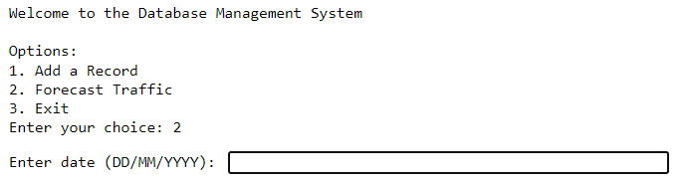
ABOUT THE PROJECT
AI Machine Learning Model that predicts container shipment volume. Knowing how much cargo to expect in advance allows workers to plan ahead to optimize the availability of containers and ensure the infrastructure can handle the expected volume of shipments, allowing for seamless flow of cargo in the logistic ecosystem.

Slide 6
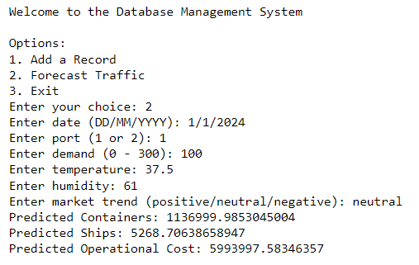

Slide 7
HOW IT WORKS
DATA ENTRY PAST CARGO TRAFFIC INTO A DATABASE
PREDICT CARGO TRAFFIC VOLUME FOR THE DAY
MACHINE LEARNING TO STUDY HISTORICAL CARGO TRAFFIC

Slide 8
Benefits
PREDICT PORT TRAFFIC FOR ANY HOUR OF THE DAY
PLAN AND PREPARE AHEAD OF TIME
NO DISRUPTANCIES ON ACTUAL DAY
1
2
3

Slide 9
CONCLUSION
My digital solution is a machine learning model powered by data to predict the demand for cargo for the day so that the logistics ecosystem can be optimized for a seamless flow of cargo.

Slide 10
THE END
Thank you for your attention!

Slide 11
CREDITS
Presentation template by Slidesgo
Icons by Flaticon
Infographics by Freepik
Images created by Freepik
Author introduction slide photo created by Freepik
Text & Image slide photo created by Freepik

Slide 12


