Slide 1
Routing Architectures and Protocols Lab (LPA)
Master Programme in
Computer Science and Networking
Academic Year 2024-2025

Slide 2

About LPA
Teacher name: Davide Adami
Email: d.adami@iet.unipi.it
Phone: +390502217652
Semester: First
Exam mode: Oral (Project)
Pre-requisites:
Networking fundamentals
Understanding of destination-based, hop-by-hop IP routing in a Classless Inter-Domain Routing (CIDR) environment
Area: Networking

Slide 3
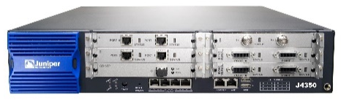

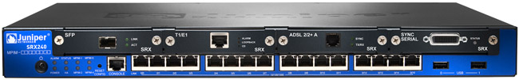
Course Overview
Goal: Basic knowledge and key concepts to understand the functional components required to design and implement routing in Intenet Service Providers networks
Topics: Router configurations and monitoring basics; Routing Policy; Packet Filters; Routing protocols (OSPF, BGP); Class of Service; IPv6.
How: Traditional lectures are coupled with hands-on lectures which provide students with the possibility to work with Juniper routers and GNS3 VM
JNAA Certification
Program
JNCIA-Junos Certification: students may obtain Juniper Certification (RECOMMENDED for future career!!)

Slide 4
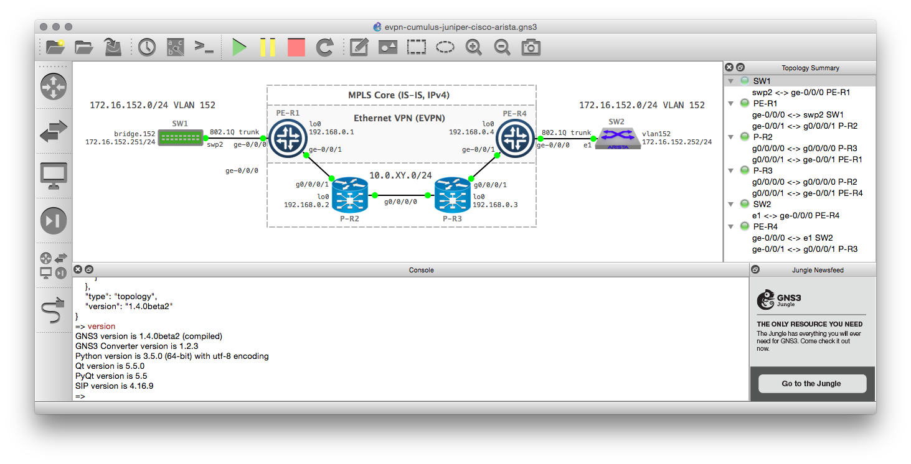
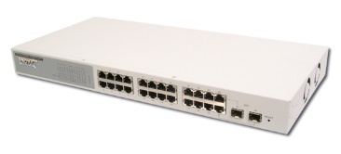
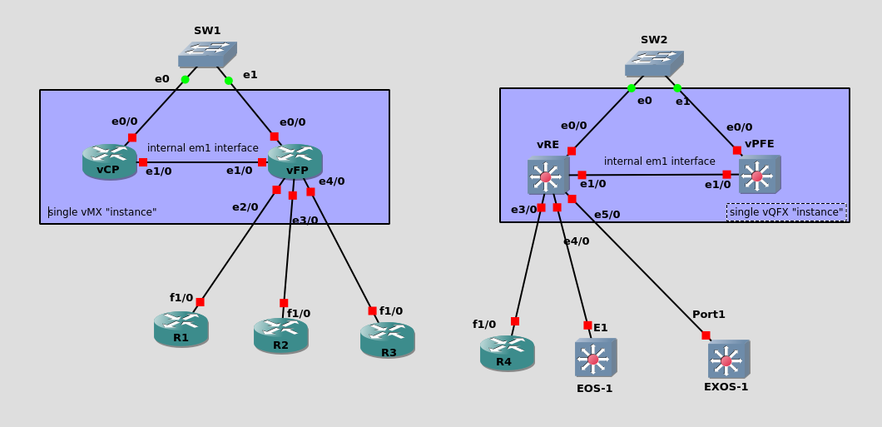
Lab Equipment
@UNIPI
J4350 Router
Juniper and Cisco VM and Appliances for GNS3
@Home
SRX-240 Router
Layer 2 switches

Slide 5
Online Streaming/Recordings/Course Repository
Microsoft TEAMS
CODE: ay1dy84
Timetable Academic Year 2023-2024
Monday (14.00 – 16.00) – Fibonacci I-LAB
Thursday (9.00 – 11.00) – Fibonacci I-LAB

Slide 6
Course material (repository: Teams -> File)
Introduction to the Junos Operating System - Student Guide (LPA_Guide.pdf)
Introduction to the Junos Operating System - Detailed Lab Guide (LPA_Lab_Guide.pdf)
Introduction to the Junos Operating System - Lab Diagrams (LPA_Lab_Diagram.pdf)
Slides
DAY ONE: BEGINNER’S GUIDE TO LEARNING JUNOS

Slide 7
Useful links
Download JunOS for GNS3
https://networkrare.com/free-download-junos-juniper-image-for-gns3-eve-ng-vmware-and-virtual-box/
Introduction to Junos Opearting System On-Demand
https://learningportal.juniper.net/juniper/user_activity_info.aspx?id=EDU-JUN-WBT-OD-IJOS
Library
https://www.juniper.net/documentation/

