Slide 1
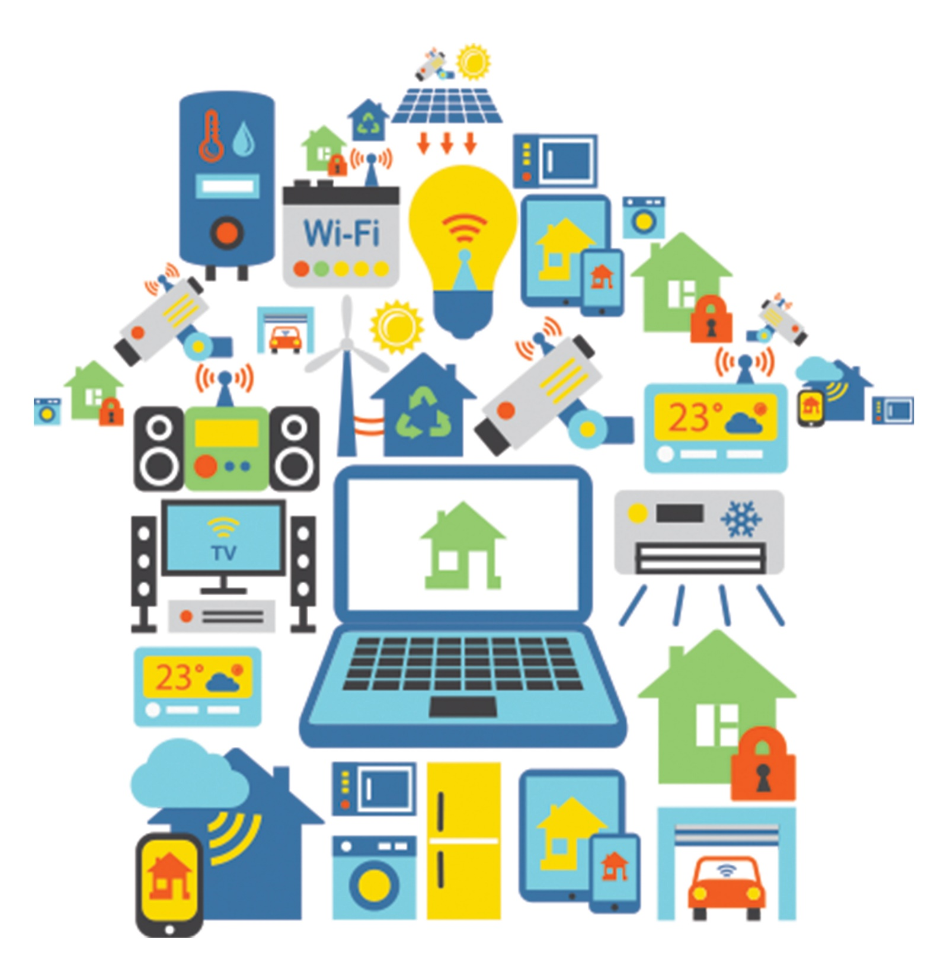
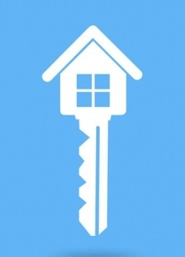
PRODUCT
OVER VIEW
These Smart Home systems are designed to improve human quality of life. It deals with the smart home network controlled directly using the human physiological state. Brain Computer Interface (BCI) systems offer communication and control capabilities to people with severe disabilities and technology lovers. BCI’s use electroencephalographic (EEG) signals recorded from scalp to start or stop different household devices like fan, LED light and to control speed of fan etc.
FEATURES
Thought Controlled
Quick Response
User Friendly
Time Saving
Affordable Price
Free Training
Excellent Service
Best Warranty
Package
EEG SMART
BASED HOMES

