Slide 1
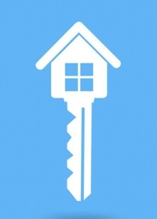
EEG BASED SMART HOMES
SMART HOMES OF FUTURE

Slide 2
EEG BASED SMART HOMES
Smart home control system based on BCI using EEG signals.
User can control devices only by THINKING.
No physical activity is performed.
Every appliance is just a thought away.

Slide 3
SURVEY QUESTIONNARE

Slide 4
LITERATURE SURVEY
BRAIN COMPUTER INTERFACE (BCI)
ELECTROENCEPHALOGRAPHY (EEG)
SMART HOME
BENEFITS
APPLICATIONS

Slide 5
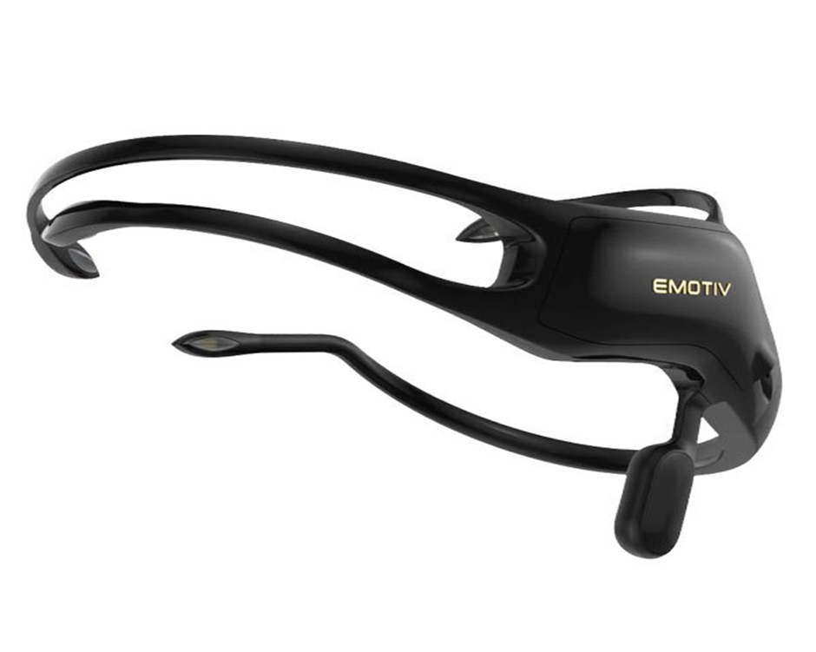
TOOLS
EEG HEADSET
EMOTIV INSIGHT
WORKING
SOFTWARES AND APPS
ARDUINO
ANALOGUE TO DIGITAL CONVERTOR
AMPLIFIER
WORKING

Slide 6
HOME SMART HOME
SERVICES
BUSINESS PLAN
MARKETING STRATERGY
MARKET SHARE
FUTURE

Slide 7
THANKS
ANY QUESTIONS?

