Slide 1
Aitken’s DELTA SQUARED PROCESS
Javeria Riaz 2016-CS-251
Khadija Zahoor 2016-CS-259

Slide 2
Agenda
Derivation
Analytical Analysis
Graphical Analysis
Practical Applications
Comparison with other methods
Case Study

Slide 3
Problem Statement
In mathematics, extrapolation is the process of estimating, beyond the original observation range, the value of a variable on the basis of its relationship with another variable.
In numerical analysis, Aitken's delta-squared process or Aitken Extrapolation is a series acceleration method, used for accelerating the rate of convergence of a sequence.

Slide 4
Methodology
Aitken’s Algorithm
Start with a suitable x1
Take x2 = g(x1)
Take x3 = g(x2)
Take x4 = x3 – (x3-x2)^2/(x3-2x2+x1)
Take x5 = g(x4)
Take x6 = g(x5)
Take x7 = x6 – (x6-x5)^2/(x6-2x5+x4)
Continue this process to the required accuracy

Slide 5
Methodology
Practical Applications
Aitkens Method and Rectification of Circle
Calculating Largest Eigen Values
Numerical Inversion Transforms of Laplace
Accelerating Page Rank Computations
Conjugate Gradient Acceleration for EM Algorithm

Slide 6
Comparison Table
Minimum Polynomial Extrapolation | Shanks Transformation | Quadratic Extrapolation | Steffensen’s Method
The minimal polynomial extrapolation (MPE) is exceptionally viable procedures that have been utilized as a part of quickening the converging of vector arrangements | In Acceleration technique we take a sequence (sn) and an accelerated sequence is produced. It is offer necessary in computational sciences to get a limit sequence of objects vector spaces. | The extrapolation technique is basically estimating beyond the original observation range, the value of a variable on the basis of its Uncertainty and estimations. | The primary preferred standpoint of Steffensen's strategy is that it has quadratic convergence like Newton's technique

Slide 7
Error Analysis
Error of extrapolation only increases quadratically as you move away from average of x values when data is known to be linear
It can be shown that any extrapolation using an interpolating linear function has no statistical significance it is like using a single point to estimate a mean: you cannot say anything about the error associated with your estimator.

Slide 8
Results
Aitkens process is to used to accelerate the convergence greatly
It has a wide variety of applications in CS domain
It is used for rectification of many sequences e.g. circle
It is very efficient than many other methods like quasi newton and EM extrapolation

Slide 9
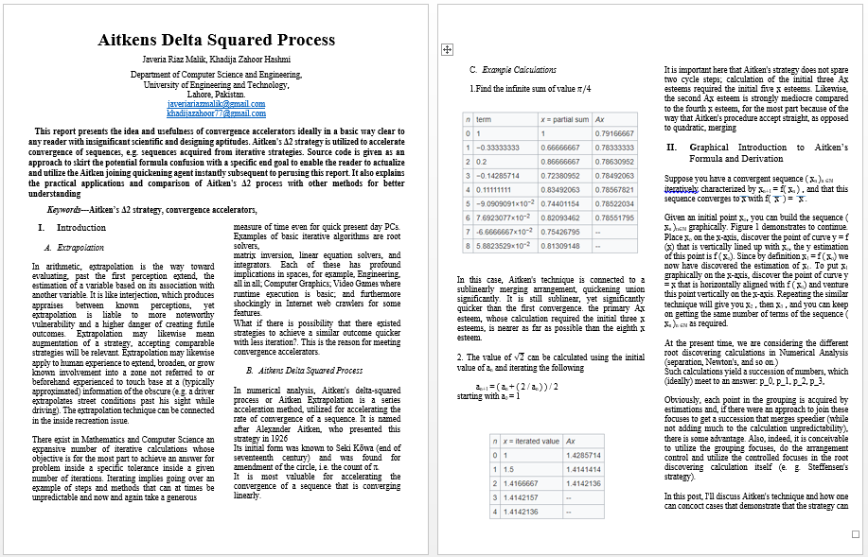
Report Demo

