Slide 1
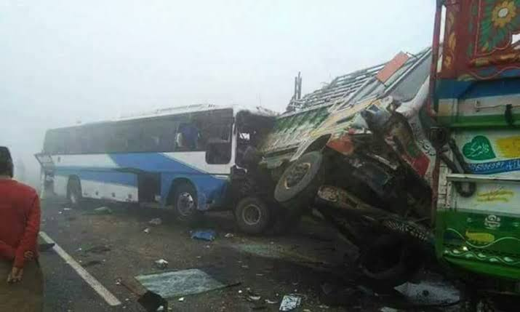
SafarGuard | HIGHWAY INTELLIGENCE
GOOGLE DEEPMIND • GEMMA 4 | DIGITALOCEAN OPEN SOURCE
● PROVINCIAL HIGHWAY SAFETY • CENTRAL PUNJAB
THE WINTER
DEATH TRAP.
Every winter, dense smog paralyzes the M-2, M-11, and GT Road.
Conventional apps treat smog merely as an air quality issue.
Drivers continue cruising at 100 km/h until blinding whiteout glare and a greasy chemical dew slick turn the highway into fatal multi-vehicle pileups.
Presenter: Javeria Farhan • Hacktoberfest Hack Day Lahore 2026

Slide 2
SafarGuard | HIGHWAY INTELLIGENCE
GOOGLE DEEPMIND • GEMMA 4 | DIGITALOCEAN OPEN SOURCE
REAL-TIME ACCIDENT RISK MATRIX — THE GROUND REALITY
Punjab Rescue 1122 Highway Dispatch Benchmarks
+34.8% — Winter Collision Dispatch Surge
Rescue 1122 emergency dispatches surge on M-2 & GT Road (Nov - Feb)
Speed | Dry Asphalt (f=0.70) | Smog Slick (f=0.28)
40 km/h | 26 meters | 48 meters (+84%)
60 km/h | 45 meters | 91 meters (+102%)
80 km/h | 69 meters | 147 meters (+113%)
100 km/h | 98 meters | 216 meters (+120%)
120 km/h | 131 meters | 297 meters (+126%)
0.28 f — Chemical Dew Friction Collapse
Aerosol soot + 90% humidity collapses road friction from 0.70 to 0.28
2.85 s — Driver Perception Delay
Aerosol optical particle scattering expands driver reaction lag by over 80%

Slide 3
SafarGuard | HIGHWAY INTELLIGENCE
GOOGLE DEEPMIND • GEMMA 4 | DIGITALOCEAN OPEN SOURCE
HIGHWAY SAFETY MATHEMATICS — DETERMINISTIC PHYSICS & AI
AASHTO Stopping Sight Distance + Google DeepMind Gemma 4
AASHTO Stopping Sight Distance (SSD):
SSD = (v · tr) + [ v² / (2 · g · f) ]
• v = velocity (m/s) • tr = perception lag (2.85s in smog)
• f = friction coefficient (0.28 on chemical dew)
• Crash Probability Index: CPI = SSD / Visibility (Safe: < 1.0)
Quadratic Safe Speed Solver:
v_safe = [ -b + √(b² + 4ac) ] / 2a
Dynamically calculates the exact speed cap where vehicle stopping distance never exceeds visible road boundary.
GOOGLE DEEPMIND AI ENGINE
Gemma 4 Multimodal Vision
Audits forward dashcam camera frames in real-time:
1. Glare & Backscatter Audit:
Detects blinding high-beam reflection bouncing off aerosol soot.
2. Low-Contrast Obstacle Alert:
Identifies unlit sugarcane tractor-trolleys and broken-down buses.
3. Roman Urdu Audio Beacons:
Synthesizes direct spoken voice warnings tailored for Pakistani drivers.

Slide 4
SafarGuard | HIGHWAY INTELLIGENCE
GOOGLE DEEPMIND • GEMMA 4 | DIGITALOCEAN OPEN SOURCE
MULTI-INTERFACE SYSTEM ARCHITECTURE
"Don't Outdrive What You Can See."
SCREEN 01
Corridor Monitor
Live risk table across 5 Punjab corridors (M-2, M-11, N-5, Ring Road, M-4) with sensor tracking and dynamic safe speed caps.
SCREEN 02
Careem / In-Ride HUD
Dedicated mobile companion for Careem, InDrive, and Uber drivers with live GPS map, hazard pins, and non-distracting audio alerts.
SCREEN 03
Police Command Console
Control room console for Motorway Police (NHMP) and Rescue 1122 with geohash cluster maps and emergency broadcast controls.
SCREEN 04
Night HUD Cockpit
Pitch-black OLED cockpit mode with big contrast speedometer, CPI danger dial, and one-tap Roman Urdu audio beacon.
SCREEN 05
Stopping Simulator
Interactive dynamic road diagram showing real-time collision gaps between reaction time, braking distance, and visibility.
SYSTEM SPEC
Automotive Telematics
Barlow & Fira Code typography, automotive ISO safety colors, 100% WCAG AAA night contrast ratios for zero glare.

Slide 5
SafarGuard | HIGHWAY INTELLIGENCE
GOOGLE DEEPMIND • GEMMA 4 | DIGITALOCEAN OPEN SOURCE
ACOUSTIC SAFETY BEACON
Urgent Roman Urdu Audio Warning
Drivers in zero-visibility fog cannot look down at phone screens.
SafarGuard speaks directly to them in urgent, clear Roman Urdu:
🔊 "Khatra shadeed hai! Motorway par greasy chemical dew ki wajah se break nahi lagegi. Raftaar foran 35 km/h karein!"
[Live Browser Speech Synthesis & Google Gemma 4 Audio Guidance]
Live Web App: http://localhost:5173 | AI & Physics Dashboard: http://localhost:8501

Slide 6
SafarGuard | HIGHWAY INTELLIGENCE
GOOGLE DEEPMIND • GEMMA 4 | DIGITALOCEAN OPEN SOURCE
HACKTOBERFEST HACK DAY LAHORE 2026
Double Prize Track Alignment
GOOGLE DEEPMIND TRACK
Best Use of Gemma 4
• Multimodal dashcam inspection via Gemini API & Gemma 4.
• Real-time detection of low-contrast unlit road hazards (sugarcane trolleys).
• Synthesizes contextual Roman Urdu safety guidance for Pakistani drivers.
✔ Verified Dual-Mode Inference: Cloud Gemini API with local edge fallback.
DIGITALOCEAN TRACK
Best Open-Source AI Project
• 100% Permissive Open-Source MIT License.
• Full Agent Skill Open Standard (SKILL.md) for autonomous AI agents.
• Official Punjab Rescue 1122 and NHMP motorway closure benchmarks included.
✔ Public GitHub Repository Ready for Launch.

