Slide 1
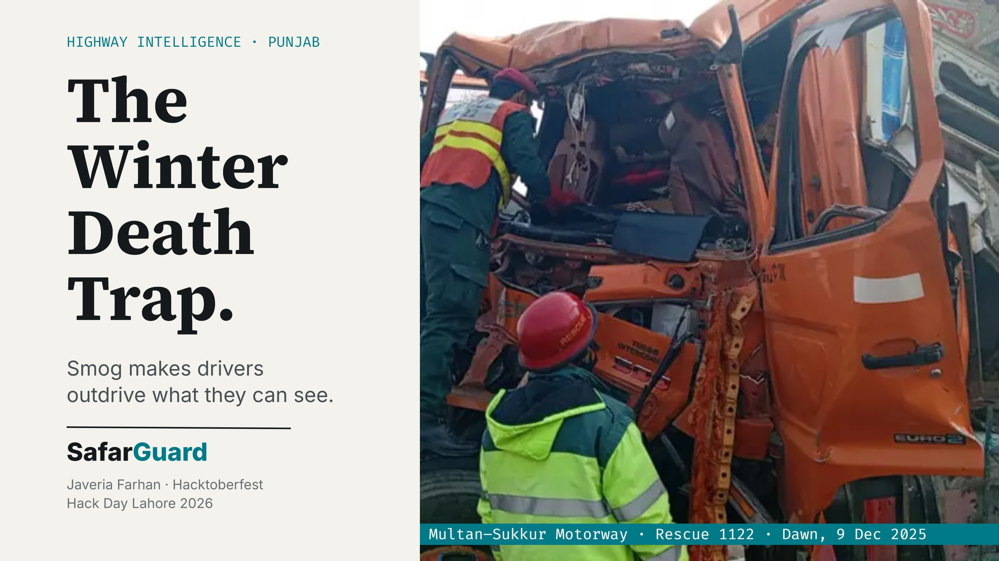
Notes:
Good afternoon judges, I'm Javeria Farhan. This is the Multan-Sukkur Motorway in December 2025: six trailer trucks collided in fog and seven people were injured, according to Rescue 1122. Every winter, drivers cruise at 100 km/h into a whiteout. SafarGuard exists so they stop outdriving what they can see.

Slide 2
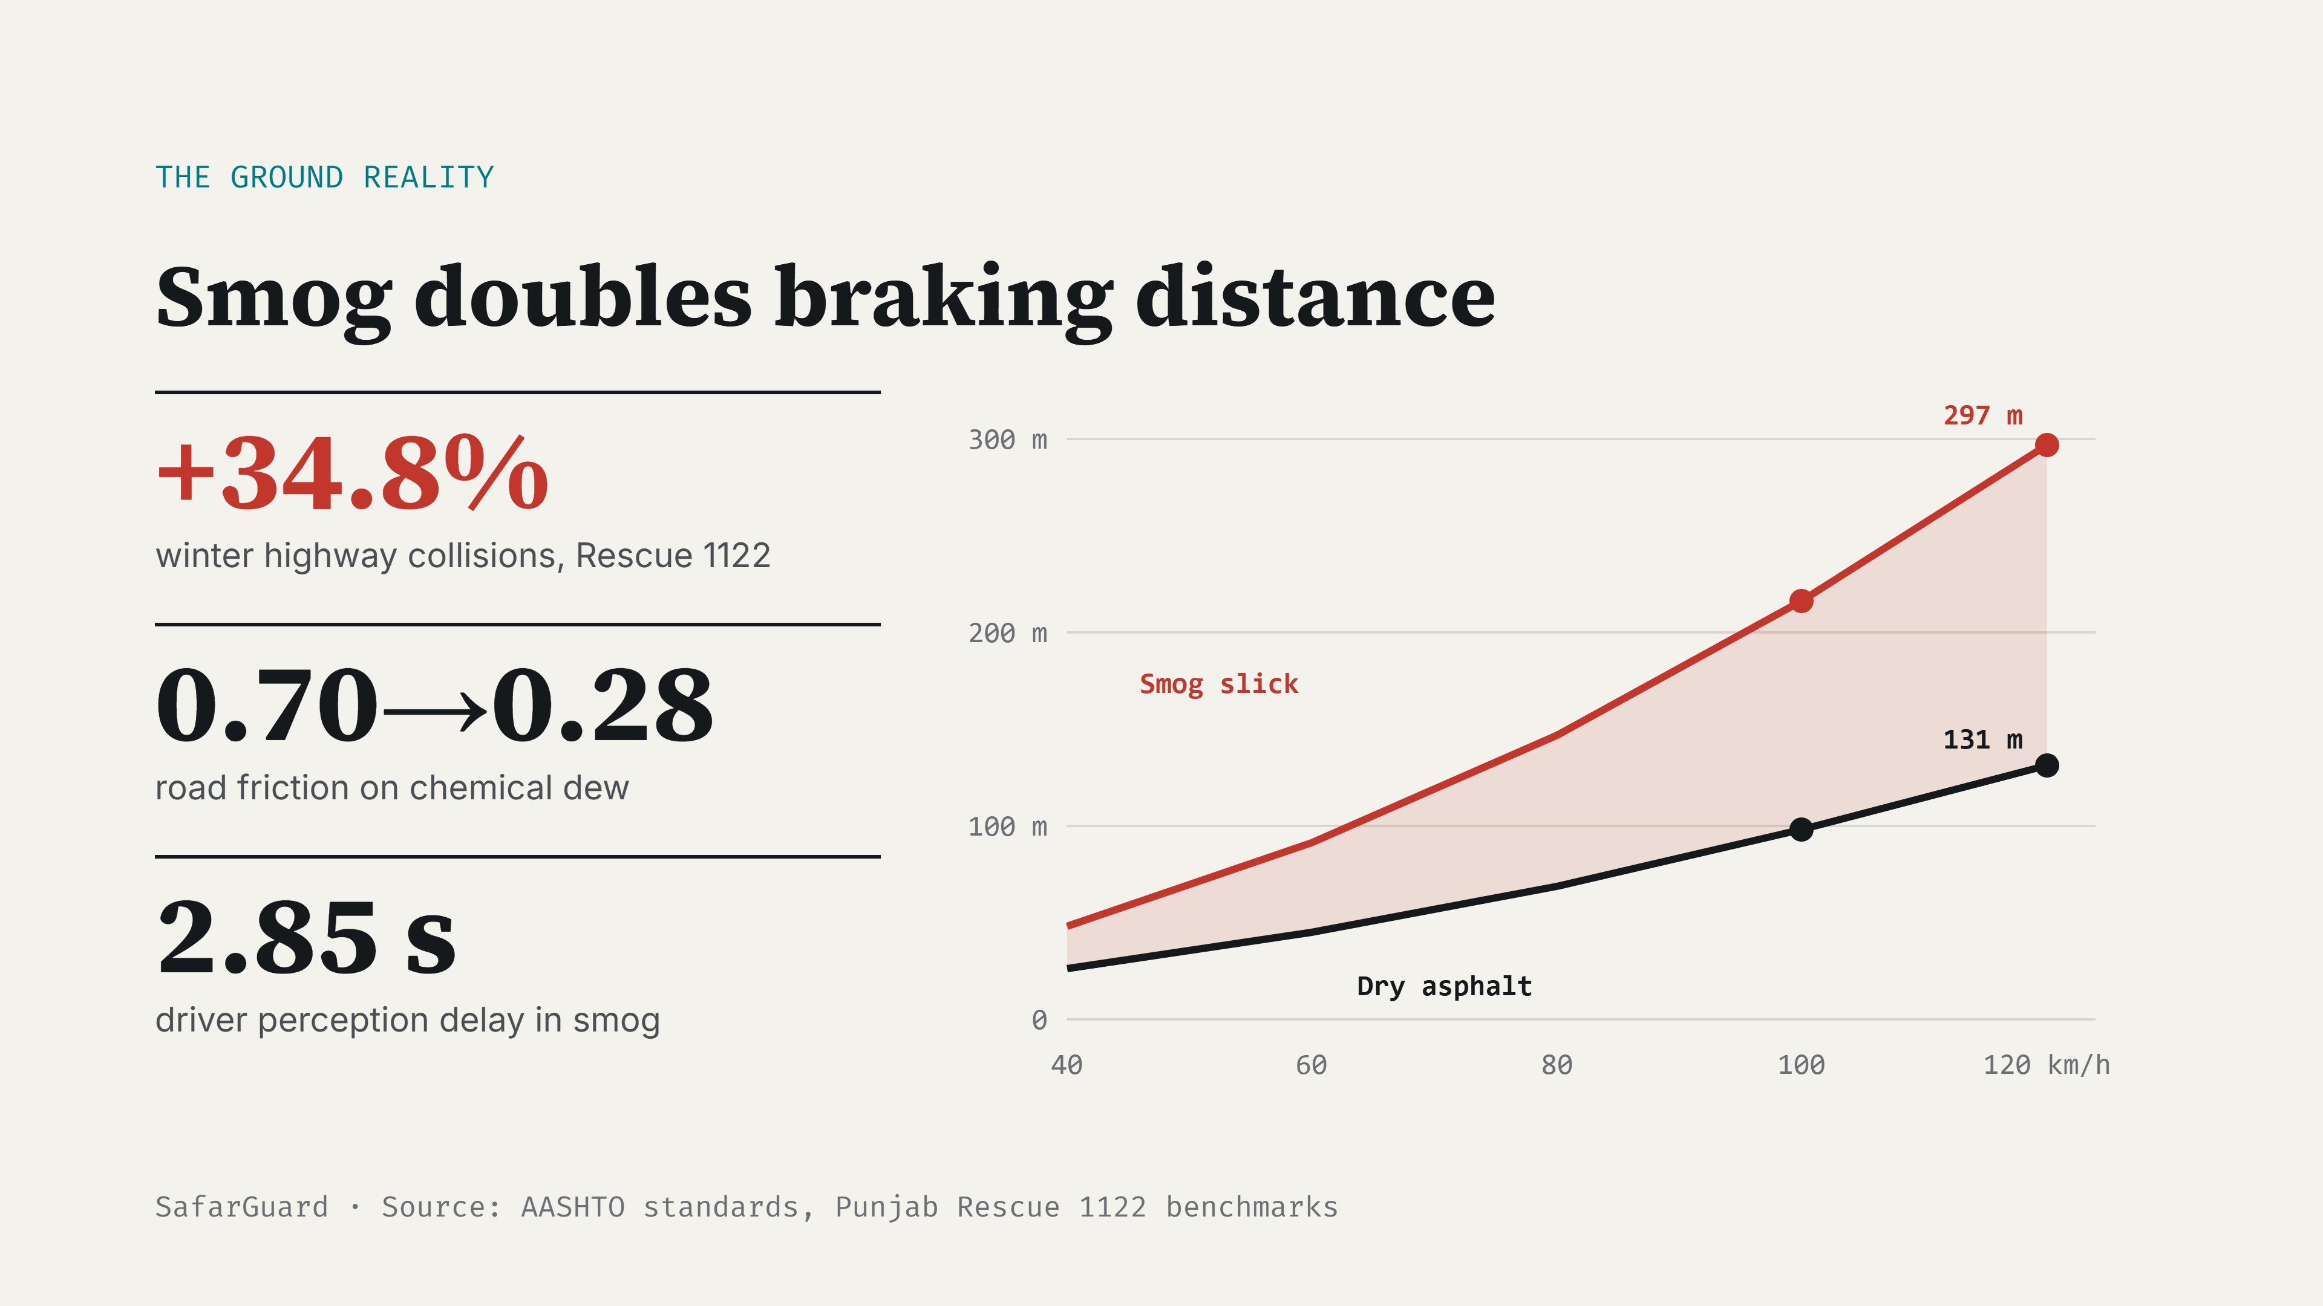
Notes:
Rescue 1122 logs show a 34.8 percent surge in winter collisions. Dew collapses friction from 0.70 to 0.28 and perception lag rises to 2.85 seconds. At 100 km/h, braking distance goes from 98 meters to 216.

Slide 3
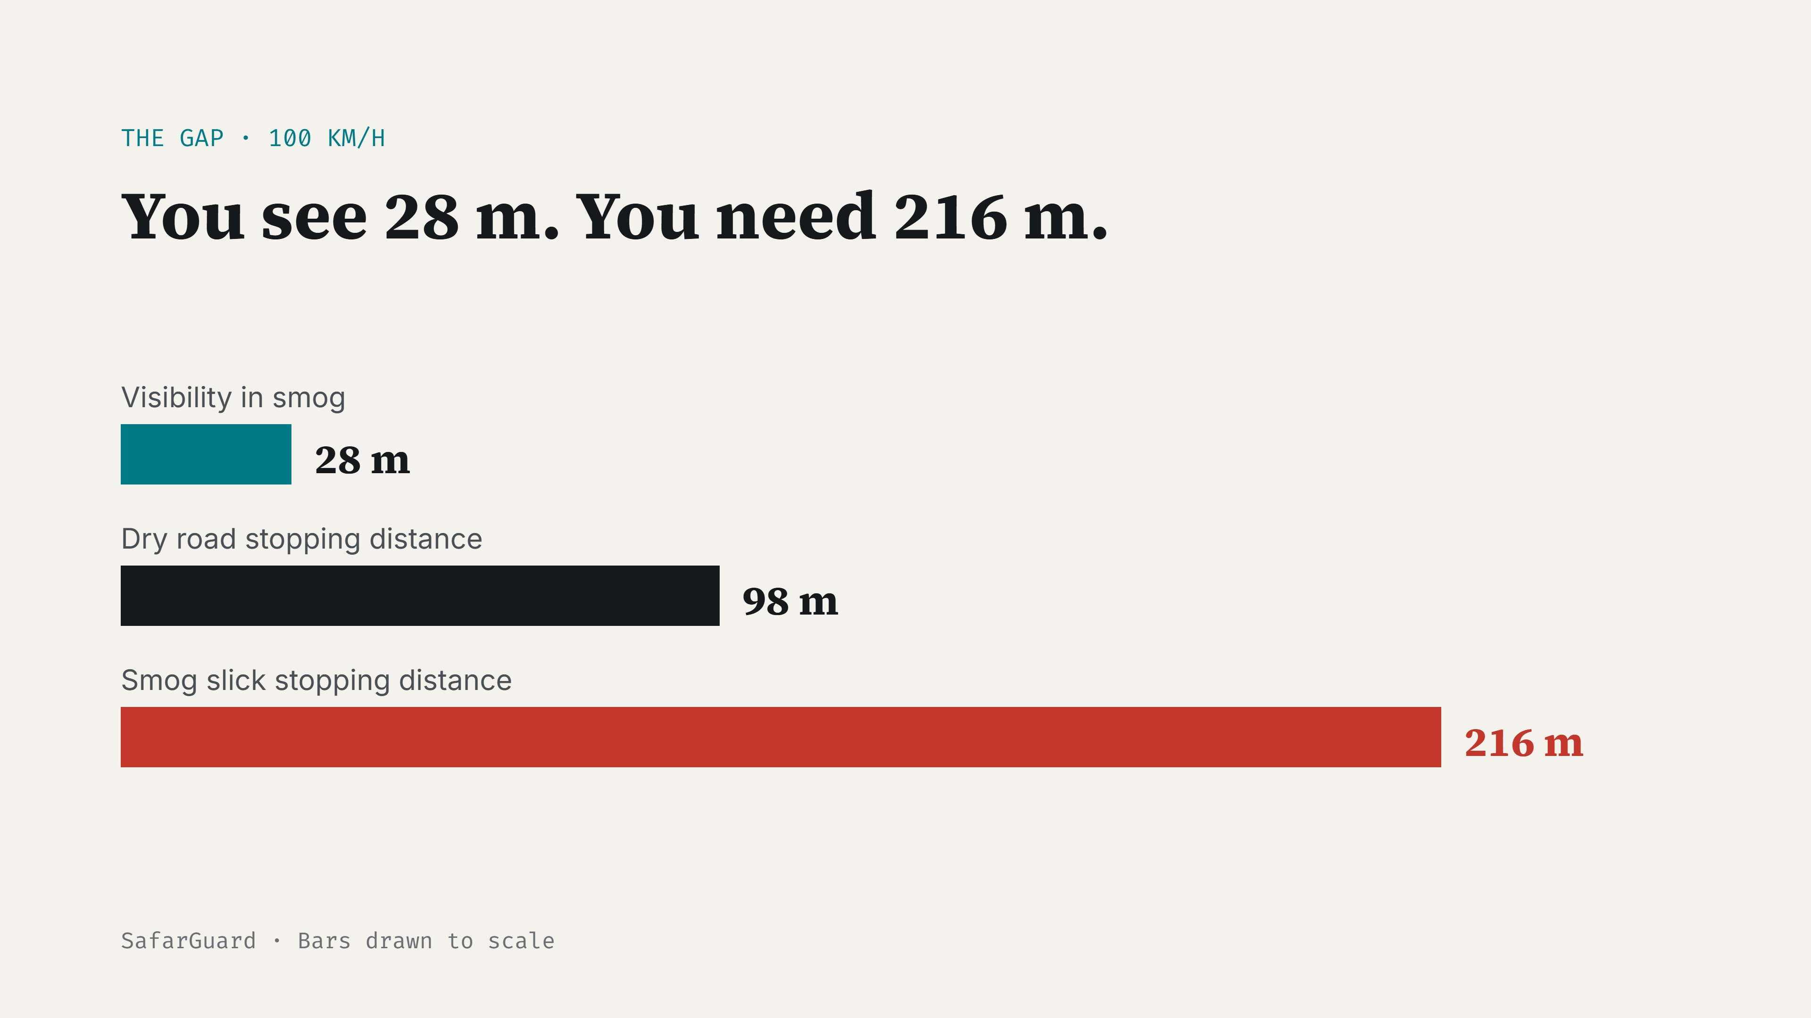
Notes:
Same speed, same car. In smog the driver can see only 28 meters but needs 216 to stop. Collision is guaranteed unless speed is capped.

Slide 4
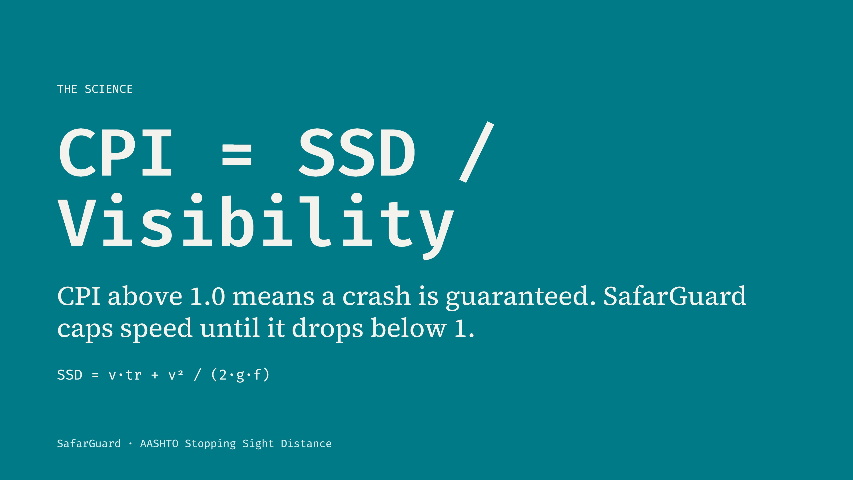
Notes:
Our engine computes AASHTO stopping sight distance, then a quadratic solver finds the maximum safe speed so stopping distance never exceeds visibility.

Slide 5
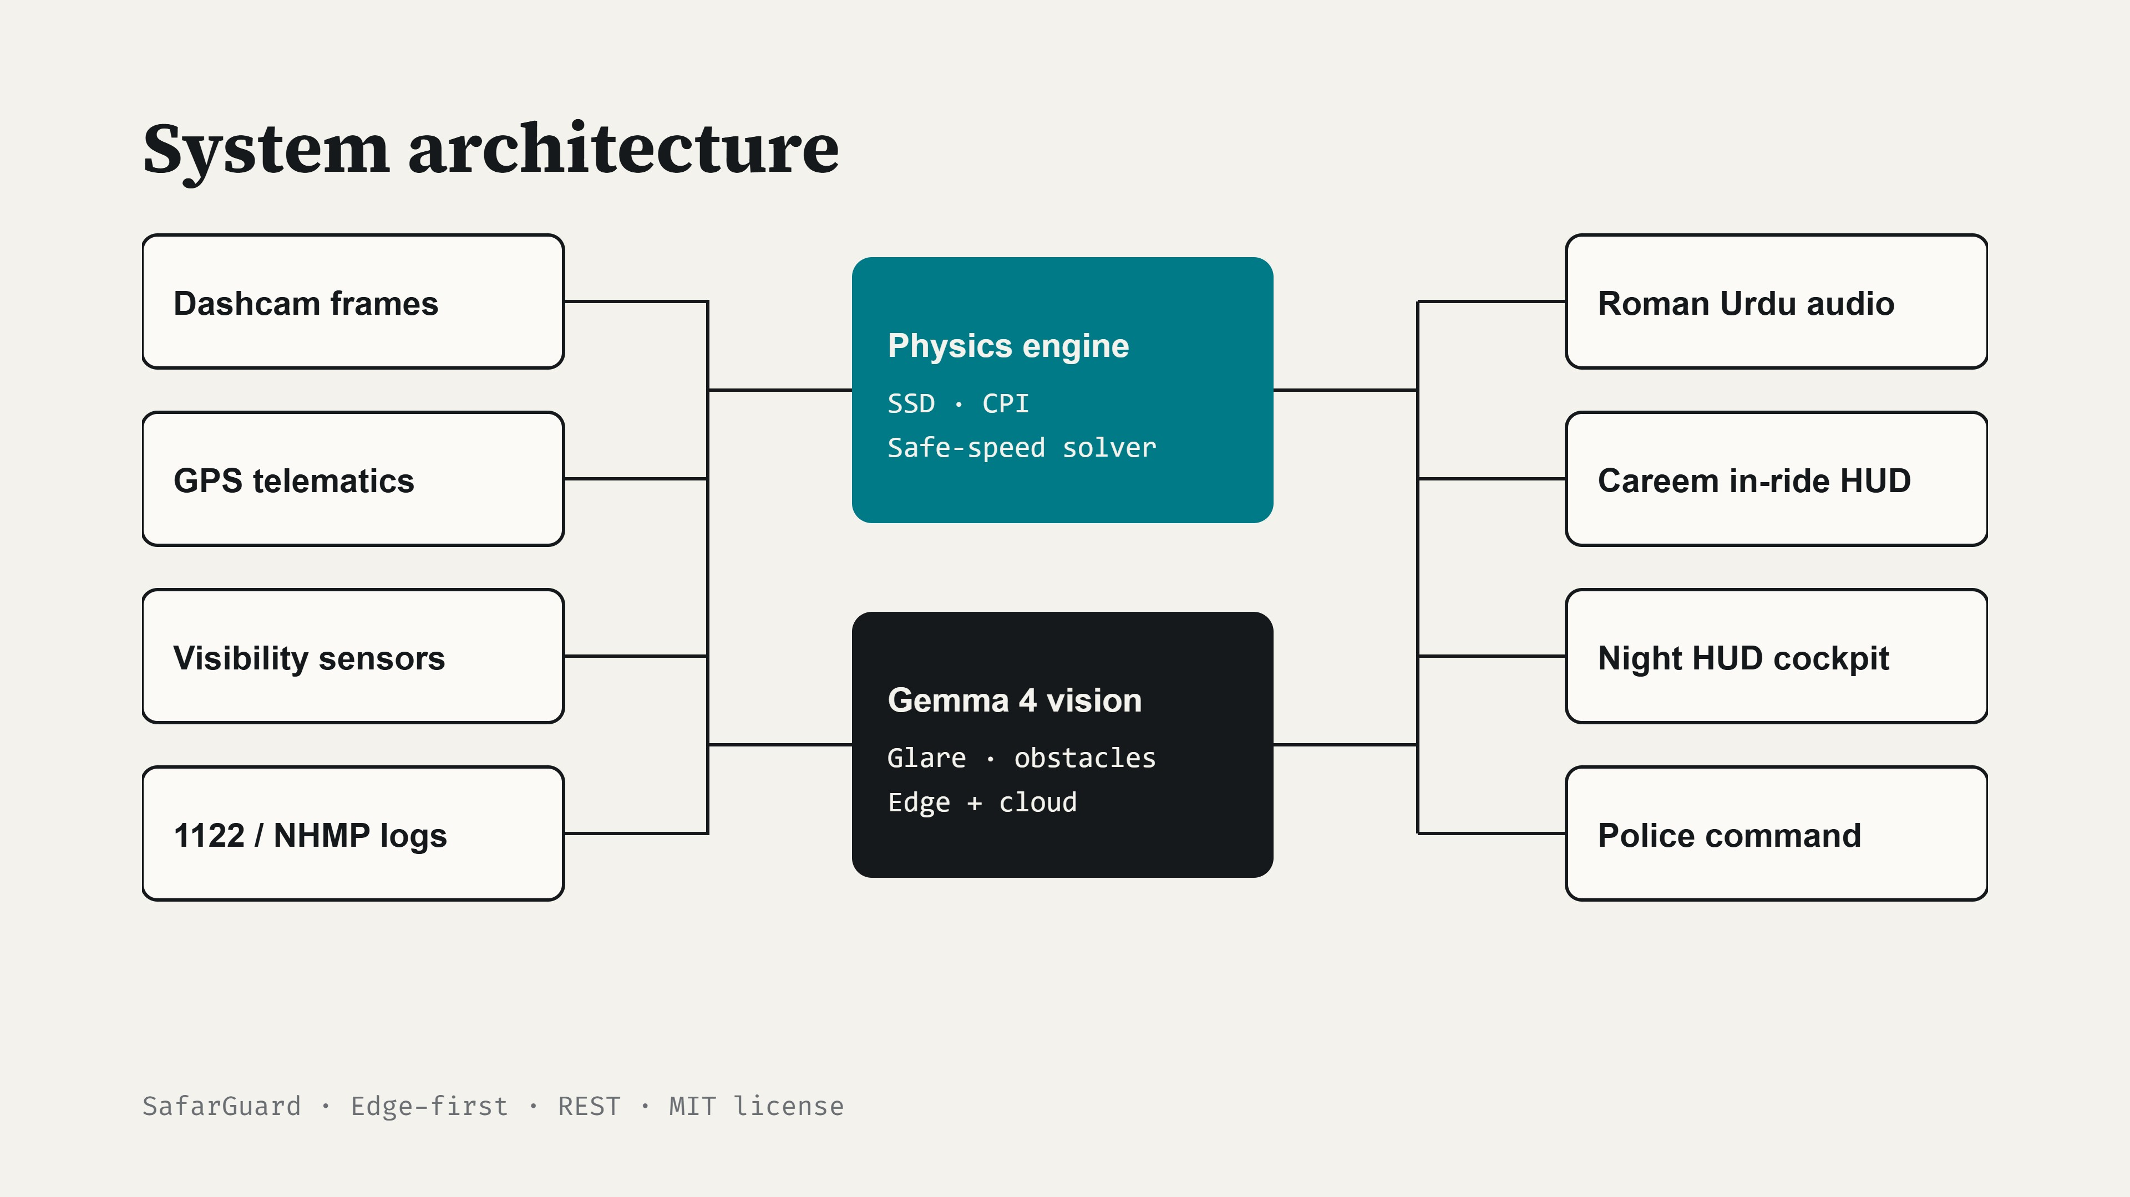
Notes:
Inputs feed two cores: a deterministic physics engine and Gemma 4 vision with edge fallback. Outputs reach drivers, ride-hailing apps, and control rooms.

Slide 6
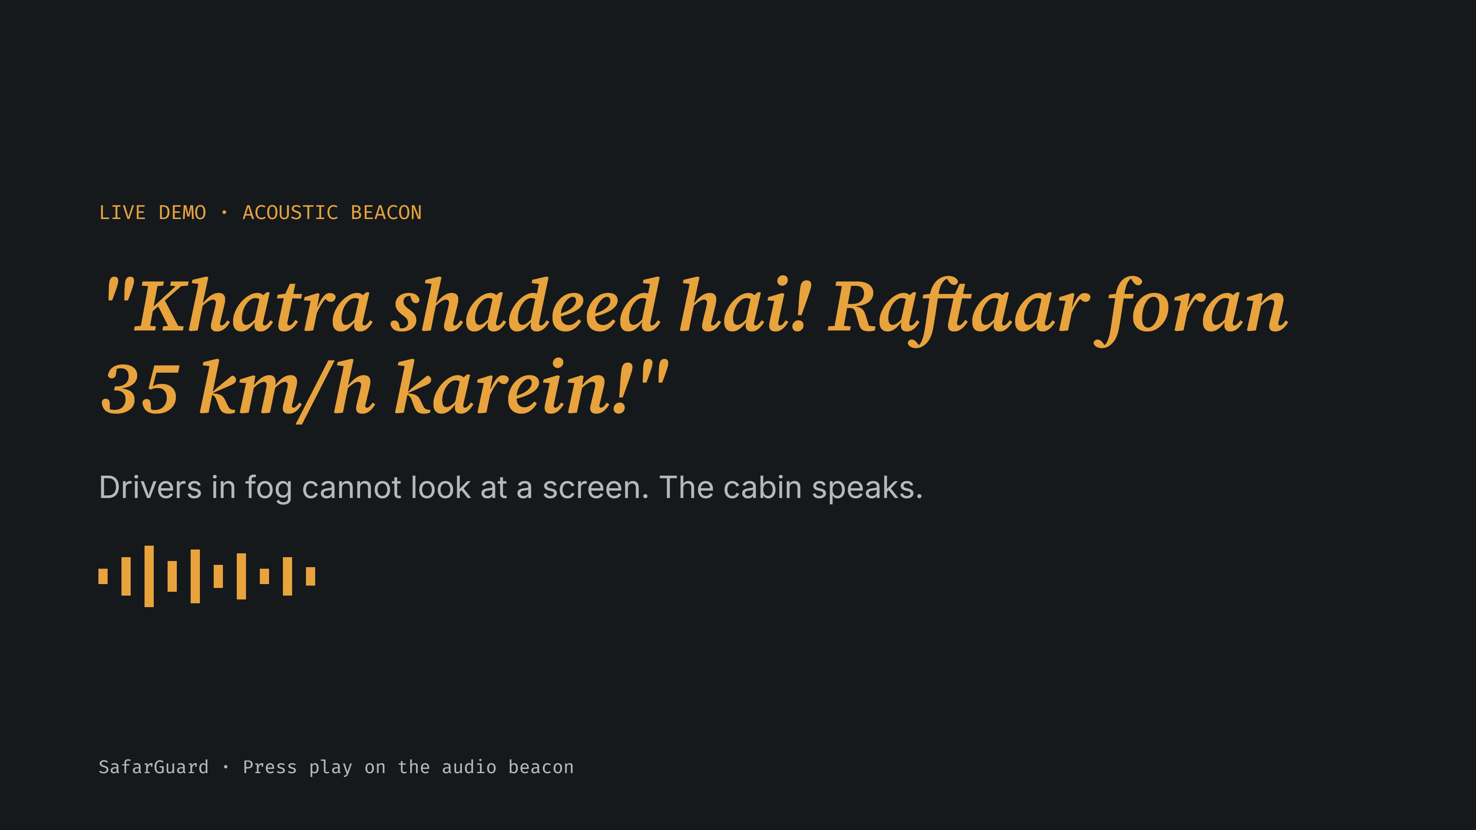
Notes:
Click the Play Audio Beacon button now. Greasy chemical dew means brakes will not hold, slow to 35 km/h immediately.

Slide 7
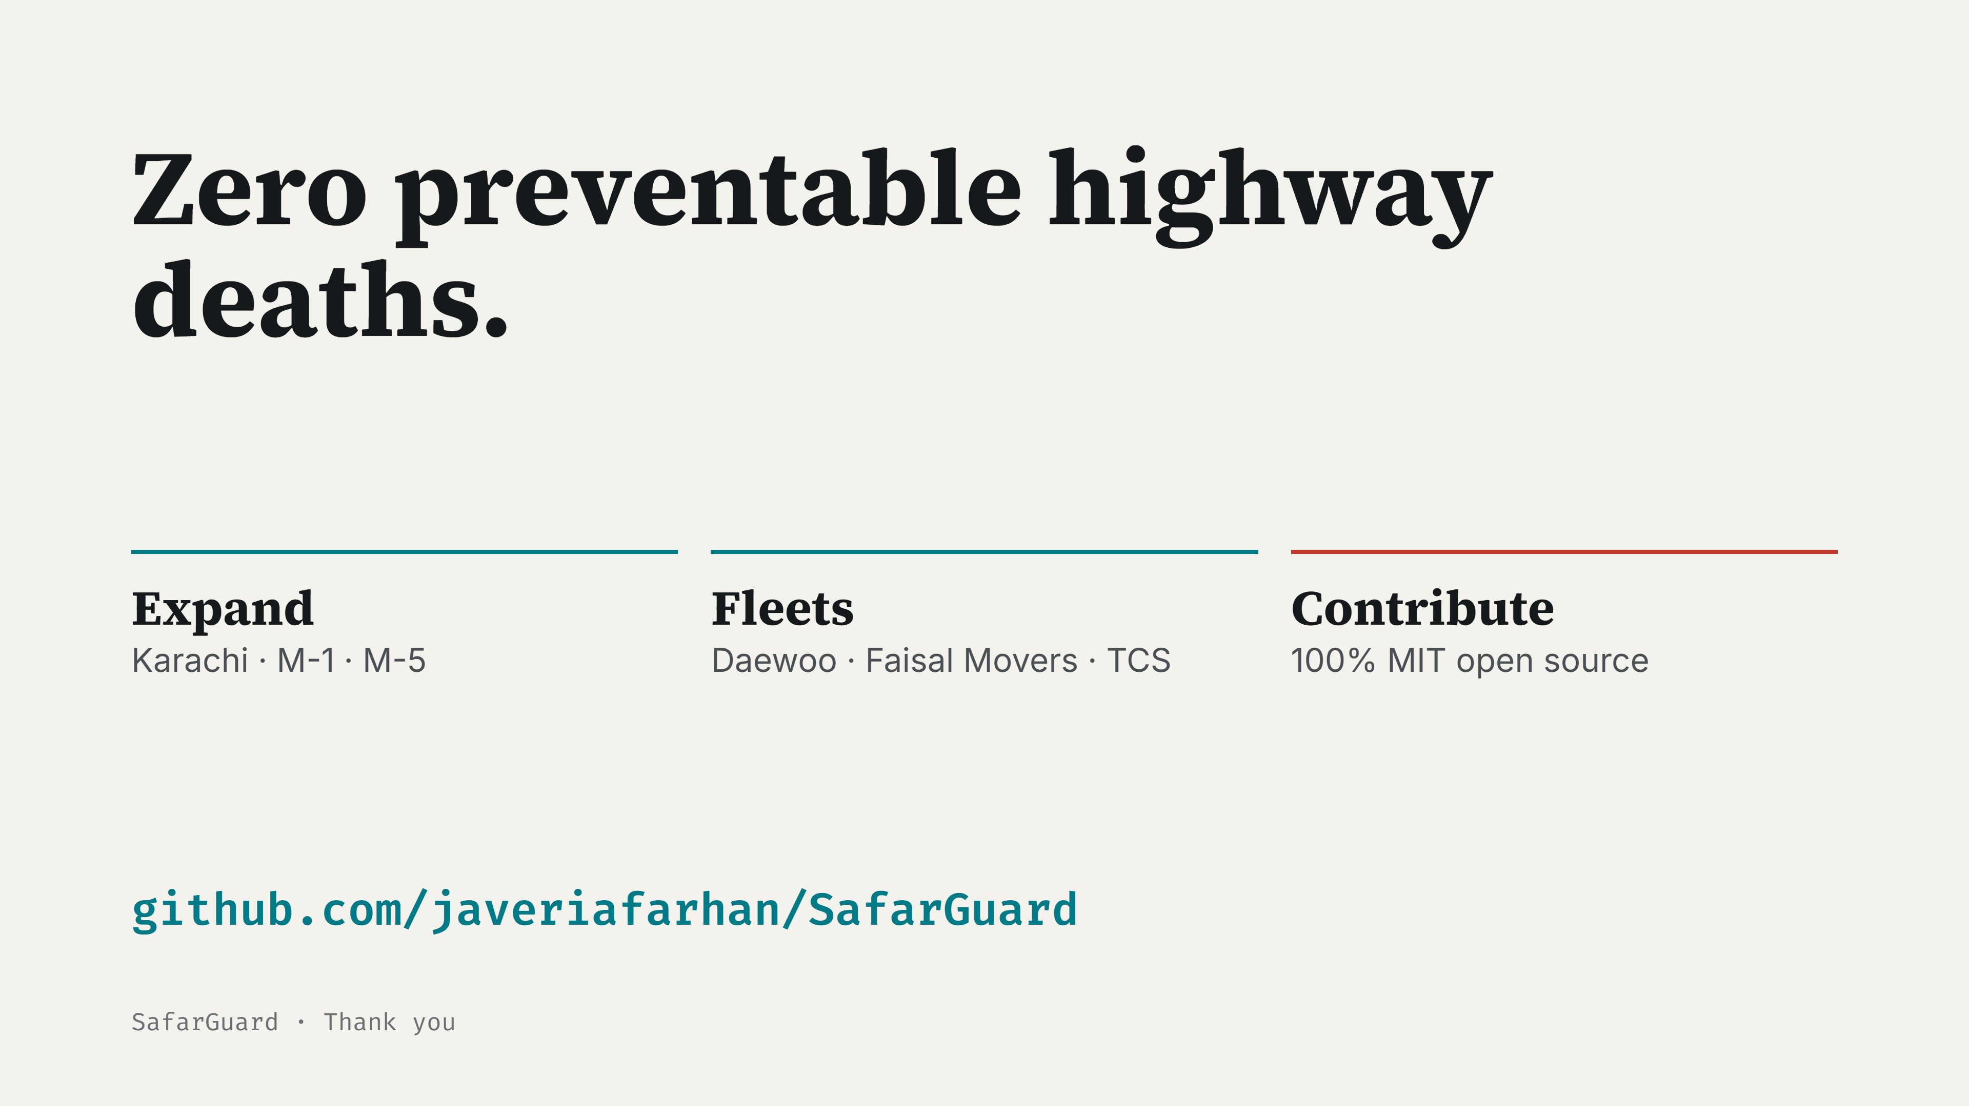
Notes:
Smog does not stop at provincial borders and neither should safety. Star, fork and contribute. Thank you!

