Slide 1
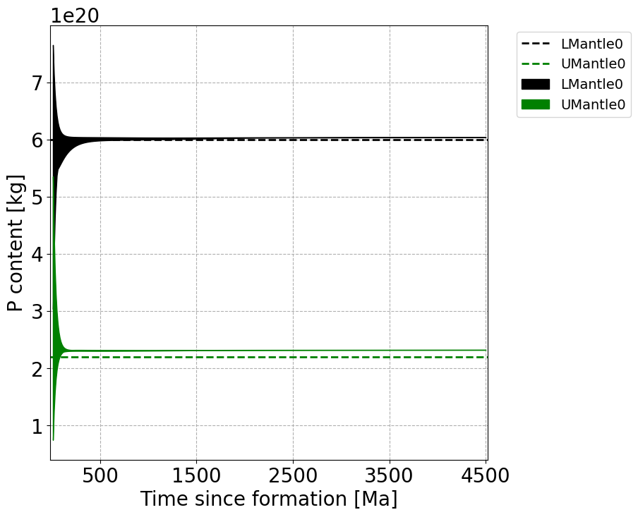
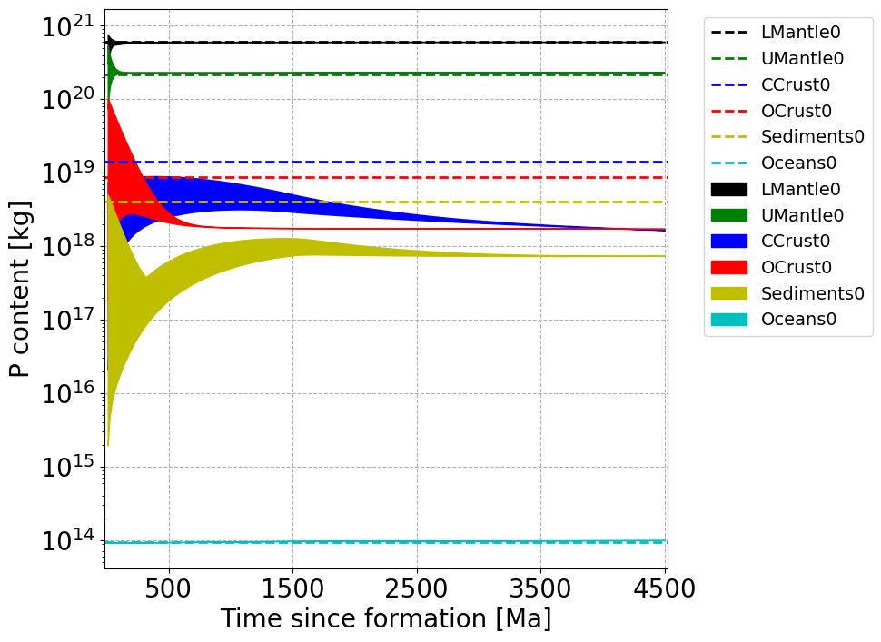
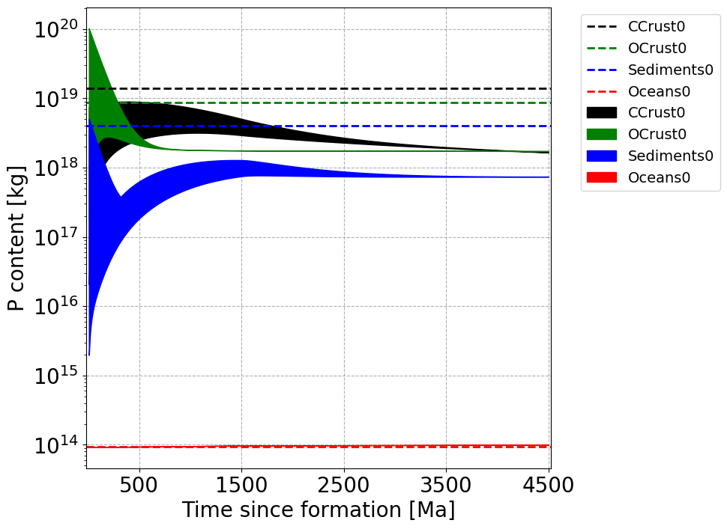
Seedings simulations: P reservoirs

Slide 2
Param. Sensitivity – Erosion and Accretion rates

Slide 3
Param. Sensitivity – Erosion and Subduction rates

Slide 4
Param. Sensitivity – Oceanic Concentration and Subduction rates

Slide 5
Param. Sensitivity – Continental Accretion and Subduction rates

Slide 6
Param. Sensitivity – Mantle-Mixing and Initial Volcanism rates

Slide 7
Param. Sensitivity – Erosion and Initial Volcanism rates

