Slide 1
Python
introduction

Slide 2
Topics
Installation & Setup
Python Syntax
Data Types & Variables
Classes & Functions
Conditionals & Loops
Import & Export
Regular Expression
Error Handling

Slide 3
Installation & Setup

Slide 4
Installation
Locate and install the Miniconda distribution of Python 3.x
https://repo.continuum.io/miniconda/Miniconda3-latest-Windows-x86_64.exe or C:/LocalInstall
Miniconda is a slimmed down version of Anaconda, and comes with several useful packages for data analytics (scipy, matplotlib, pandas, etc.)
Once it’s installed simply type python on the command line to start working
For editing code, VS Code is recommended: https://code.visualstudio.com/
It is possible to download and install Python on its own along with a preferred IDE
Note that there are some syntactical differences between Python 2.x and 3.x

Slide 5
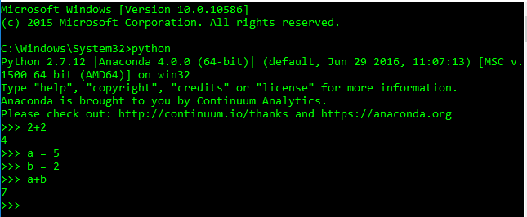
Installation
You can work simply on the command line and even get quite complex
Notes:
Useful for ad hoc data analysis

Slide 6


Installation
You can use notepad++ to create scripts, simply save as a .py file and run on the command prompt!

Slide 7
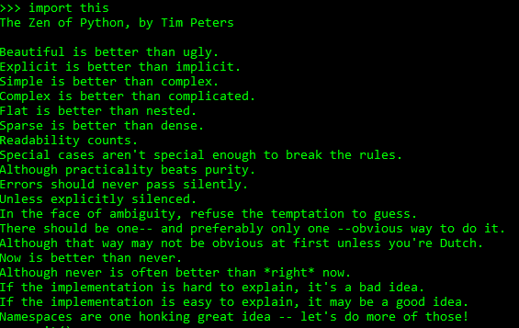
Installation
You could even use an IDE – Anaconda ships with Spyder
There are a number of other integrated development environments for Python available
If you ever want to read the Python mantra, just type import this on the command prompt

Slide 8
Classes
Python has the ability to be object oriented but you also don’t have to follow all of the rigorous rules that many other programming languages enforce
Classes are useful for structuring your code in an object oriented way if that is appropriate
Classes can contain methods and attributes of a particular object
You create instances of classes that will have attributes particular to that instance which can then run methods

Slide 9
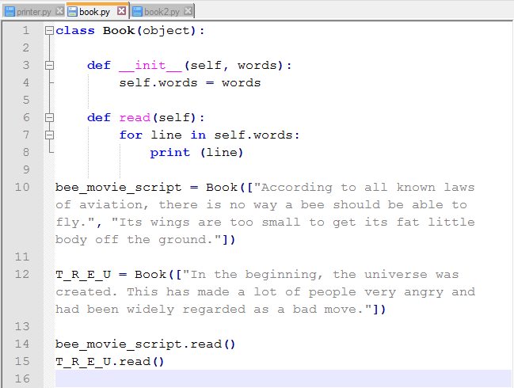
Notes:
All could be in same .py file
Look carefully at the indentation
In Python we arrange code in to blocks using indentation
So print(line) is part of the read function and within the for loop in that

Slide 10
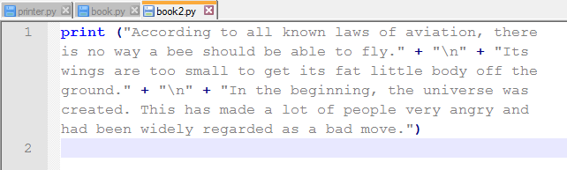
Classes
Alternatively, we can do exactly the same output from one single print statement!
This doesn’t mean the simplest solution is the best – consider what it is you’re trying to do
Classes are often useful once projects get increasingly complex
Notes:
\n means a new line will be added

Slide 11
Identifiers
Class names start with an uppercase letter
All other identifiers start with a lowercase letter
Private Identifiers start with a single leading underscore
Strongly Private Identifiers start with two leading underscores
Notes:
Private – just indicates to others that it is meant to be private, weak internal use
Strongly private – private to that particular class, e.g. __variable would be replaced internally with _classname__variable
Still does not prevent access! The idea is that you’re indicating to others that you’re not supposed to use this class. It is not enforced.

Slide 12
Python Syntax

Slide 13
Identifiers
Identifiers can only be made up of letters (upper and lower case), numbers, and the underscore _
Identifiers may not include spaces or other special characters other than the underscore _
Identifiers may not start with a number
Identifiers must not be keywords
Be descriptive when naming your variables
Don’t over-use abbreviations
Try and make them as human-friendly as possible for readability!

Slide 14
Python Syntax
: → Groups the following selection of indented code
; → Allows multiple statements on a single line
\ → Continues the statement on the following line
‘’ → Surrounds a string (word / sentence / multi-line)
# → Comments out the following text (must be repeated on each line)
''‘ → Multi-line comment
( ) → Surrounds parameters and arguments
. → Accesses a variable’s methods and attributes.
__ → Prefix sets an attribute’s visibility to hidden
__method__() → Special Python functions, do not make up your own like this

Slide 15
Operators
Arithmetic Operators
+ → Addition
- → Subtraction
* → Multiplication
/ → Division
% → Modulus
** → Exponentiation
// → Floor Division (removes decimal after division)
Comparison Operators
== → Equal to
!= or <> → Not equal to
< → Less than
<= → Less than or equal to
> → Greater than
>= → Greater than or equal to

Slide 16
Data Types & Variables

Slide 17
Variables & Methods
Variables
A variable is a container that holds values that we use in the program.
Every variable has a data type and a name associated with it, and eventually, a value.
Methods
A method is a set of code which is referred to by name and can be called at any point in a program by simply utilising the methods name.
Think of a method as a sub-program that acts on data and often returns a value.
Every method has a name and can also have parameters that are variables that you give it that it may need to perform its function.

Slide 18
Sequencing & Statements
Variables
Variables as you know are where we store values
Expressions
Expressions are what we write to compute new values from existing ones
Assignment Statements
Assignment statements are where we store values into variables

Slide 19
Sequencing & Statements
Conditional Statements
Conditional statements are where code will only be run if a specified condition is met
Iteration Statements
Iterative statements are where a block of code is run multiple times until a conditional statement has been satisfied
Transfer & Control Statements
These statements are used to interrupt and stop the normal flow of control.

Slide 20
Variables
Global Variables: Available everywhere
Member Variables: Only available to members of a particular class
Instance Variables: Only available to particular instances of a class
You can assign multiple objects to multiple variables
name, species, cuteness \
= “Brian”, “tamarin”, 2.5

Slide 21
Variable Scope
Whereabouts a variable is accessible from in a program is called its scope
The duration for which the variable exists is its lifetime
Global variables are defined in the main body of the file
Local variables are defined inside a function and are only accessible during and within that function

Slide 22
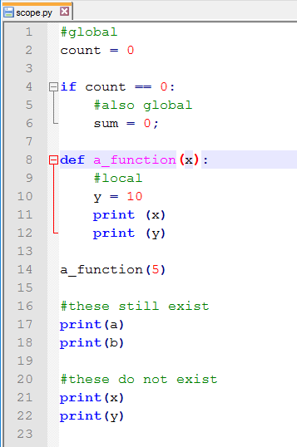
Variable Scope
Notes:
Demonstrating differences between global and local scope accessibility

Slide 23
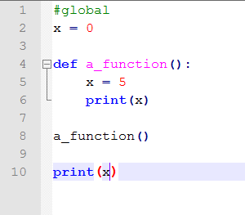
Global vs Local
This outputs a 5 followed by a 0 – why?
We are evidently trying to access the global variable x in the function to change its value
But by default, Python will create a new local variable called x instead!

Slide 24
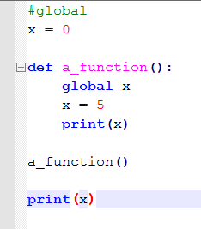
Global vs Local
We can access global variables within functions of course, we just have to specify that’s what we want!
Not that you cannot refer to both a global variable and a local variable by the same name inside the same function
Really, using good naming conventions should help us steer clear of this issue!
It’s generally considered bad practice to access global variables from inside functions

Slide 25
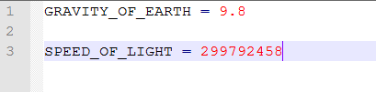
Constants
In many languages there is the ability to create variables that, once their values have been set, they cannot be changed
Python doesn’t allow this constraint, but the convention is to indicate that these values should not change by writing the names in all caps with underscores separating words
Notes:
Good practice to define these rather than just hard code them in
Gives readability
We may need to refer to this number more than once
If we ever need to update code we only need to change it in one place

Slide 26
Data Types
Number (int, float)
Boolean
String
List
Tuple
Dictionary
Pandas
Notes:
Number: int, long, float, complex
String: treated as vector of characters

Slide 27
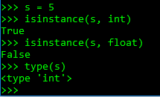
Data Types
You can check the type of a variable using the type() method
You can check if a variable matches a specific type using the isinstance() method

Slide 28
Strings
In Python, strings can be manipulated similarly to vectors
string = “Dev is good at Smash?”
number = 4
print(string)
print(string[3:])
print(string[0:3] * 2)
print(string + " Yes!")
print(string[:-1] + str(number))
Dev is good at Smash?
is good at Smash?
DevDev
Dev is good at Smash? Yes!
Dev is good at Smash4

Slide 29
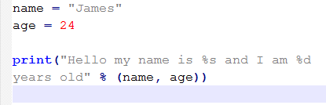
Strings
They can also be formatted to include values that are stored in variables
The variables to be inserted are listed in the same order they appear in the string

Slide 30

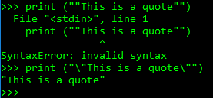
Strings
Sometimes you will need to ‘escape’ special characters so they do not interfere with the program – to do this you must use the backslash \ character
Imagine if we wanted to print a string enclosed in speech marks when it appears on the console…

Slide 31
Lists
A list contains items separated by commas and enclosed within square brackets
Lists can hold multiple variable types
list = [‘Cat’, 100, 10.0]
print(list)
print(list[1])
print(list[:2])
print(list[1:] * 2)
print(list[0:1] + list)
--------------------------------------
[‘Cat’, 100, 10.0]
100
[‘Cat’, 100]
[100, 10.0, 100, 10.0]
['Cat', 'Cat', 100, 10.0]

Slide 32
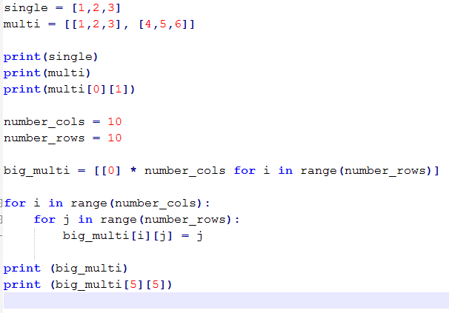
Lists
Since lists can contain a range of data types that means they can also hold other lists!

Slide 33
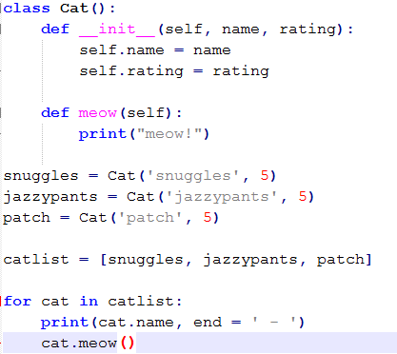

Lists
All data types in Python are ‘objects’
We can create our own objects by creating a class blueprint and instantiating this (covered more later)
So here we create a list of Cats!

Slide 34
Tuples
A tuple is a read-only sequence of items separated by commas and enclosed within parentheses
Tuples cannot be changed once they have been created
tuple = (‘Cat’, 100, 10.0)
list = [‘Cat’, 100, 10.0]
tuple[1] = 1000000
list[1] = 1000000
print(list)
--------------------------------------
['Cat', 1000000, 10.0]

Slide 35
Dictionaries
A dictionary is an array of key-value pairs enclosed within curly brackets
A key can be any Python type
A value can be any Python object
dictionary = {}
dictionary["monkey"] = tamarin.name
dictionary[2] = list
print(dictionary)
print(dictionary["monkey"])
print(dictionary[2])
print(dictionary.keys())
print(dictionary.values())
-------------------------------------------
{2: ['Cat', 1000000, 10.0], 'monkey': 'Brian'}
Brian
['Cat', 1000000, 10.0]
dict_keys([2, 'monkey'])
dict_values([['Cat', 1000000, 10.0], 'Brian'])

Slide 36
Pandas
import pandas
DataSet = [(‘James’,91),(’Joseph’,93),(’Jack’,88),(’Jacob’,89)]
df = pandas.DataFrame(data = DataSet, columns = [‘Names’, ‘BirthYear’])
df
Package that needs to be imported – DataFrames are not a standard data type!
Holds content in a format similar to a table like SQL or Excel
 | Names | BirthYear
0 | James | 91
1 | Joseph | 93
2 | Jack | 88
3 | Jacob | 89

Slide 37
Pandas
Can export and import with .csv files
df.to_csv(‘birthyears1990.csv’,index=‘false’,header=‘false’)
Setting index and header to true will stop them being imported
df = pandas.read_csv(‘C:\Users\training\data\birthdays1990.csv’)
df = pandas.read_csv(‘C:\Users\training\data\birthdays1990.csv’, names=[‘Names’,’BirthYears’])
Includes column headers
Can use to analyse data
Sorted = df.sort_values([‘Births’], ascending=False)
df[‘Births’].max()
df.dtypes tells you what each element is, df.describe() gives us things like the total count and mean for each column

Slide 38
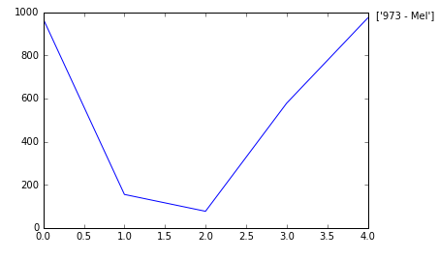
Pandas
Can be used to create plots
df[‘Births’].plot()
MaxValue = df[‘Births’].max()
MaxName = df[‘Names’][df[‘Births’] ==
df[‘Births’].max()].values
Text = str(MaxValue) + “ – “ + MaxName
plt.annotate(Text, xy=(1, MacValue), xytext=(8,0), xycoords(‘axes fraction’, ‘data’), textcoords=‘offset points’)

Slide 39
Data Type Conversion
Simply use the type name as a function
X = 5
float(X)

Slide 40
Conditionals & Loops

Slide 41
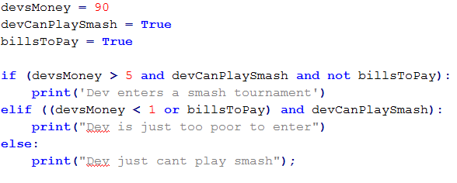
If/Else
If statements will run if the condition is true, if the statement is false then the code in the else or elif (else if) block will run
You can chain if/else statements to make complex conditional statements
Notes:
Dev is just too poor to enter
Will be printed
Here we have also used the and/or/and not statements

Slide 42
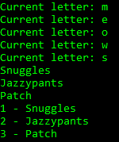
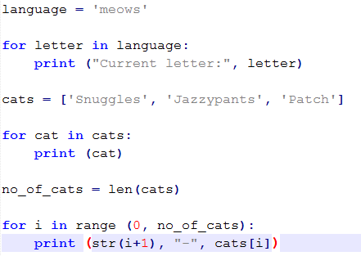
For
It is often the case that we want to ‘loop’ over a set of values and we can do this in a number of ways

Slide 43
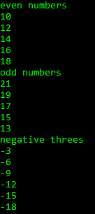
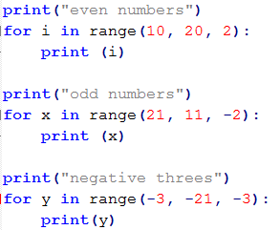
For
Range loops are very versatile, you can specify and additional parameter at the end called the ‘step’, which is how much you jump by each time

Slide 44
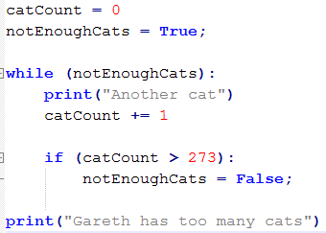
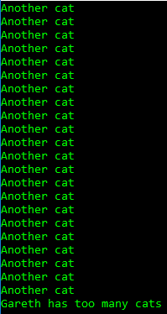
While
While loops check to see if a condition has been met and will run the code if not, checking the condition before each run

Slide 45
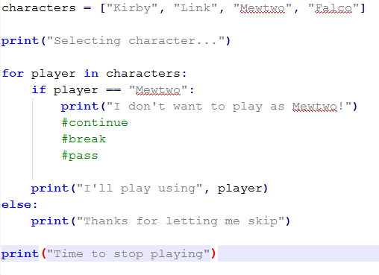
Transfer and control
Continue, break, and pass are keywords we can use for flow control in Python
Depending on which one we use in this scenario will change what is printed to the console
Notes:
Can be used in while loops as well

Slide 46
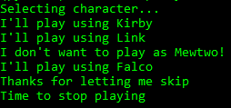
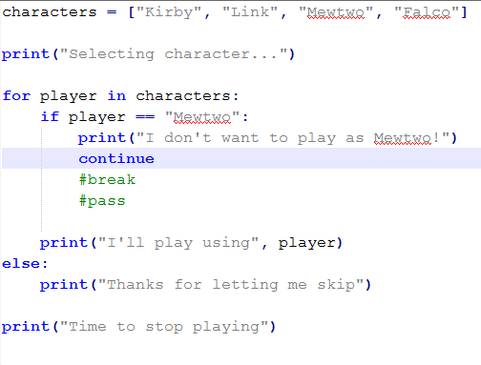
Transfer and control

Slide 47

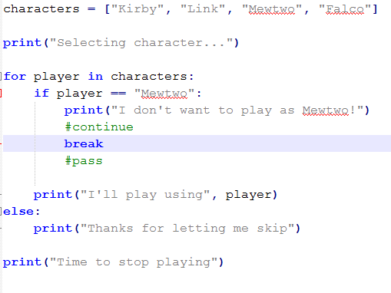
Transfer and control

Slide 48
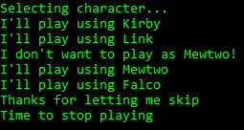
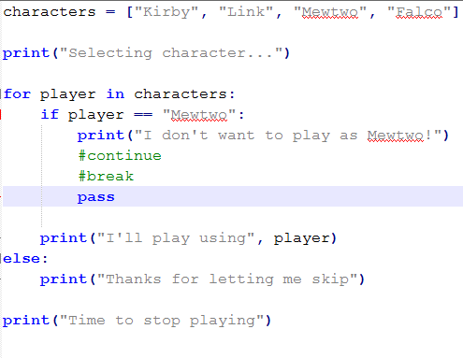
Transfer and control
Notes:
Pass is the same as not putting anything there at all
Pass can be used as a placeholder when you need to write some code in an area
Good for readability

Slide 49
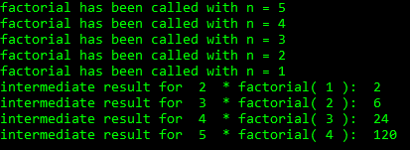
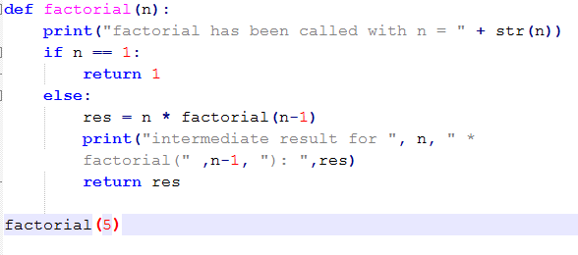
Functions
A function can even call itself recursively
Notes:
Factorial is just n * (n-1) * (n-9) n – m reaches 1

Slide 50
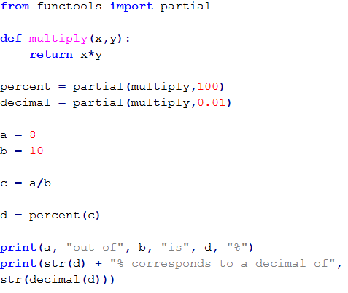

Partial Functions
Partial functions let us take a function, then create a new one from it where we have set a certain number of the parameters as fixed

Slide 51
Loops
In Python 3, setting the end parameter alters the separators between each print function
By default it is a new line
class Loops(object):
def forLoop(self):
for i in range(1,6):
print (i, end = ' ')
def whileLoop(self):
a = 1
while a < 6:
print(a, end = ' ')
a += 1
loop = Loops()
loop.forLoop()
print()
loop.whileLoop()
-----------------------------------------------------
1 2 3 4 5
1 2 3 4 5

Slide 52
Working With Classes

Slide 53
Classes
Python is not an object oriented language alone, so it doesn’t have to operate exactly like other OO programming languages, but it can
We have already seen we can perform simple commands ad-hoc on the command line, but if we want to start storing things in a file – how should we structure this?

Slide 54
Structure
Python .py files are called modules
You don’t need to have a separate module per class or method, but the idea is you would group together things that are related, then other modules can access and use them as necessary
You would store all of these in a package which is basically just a directory containing all of your python files and a .py initialisation file

Slide 55
Comparison
Python
Java
class Animal ():
def __init__ (self, name, species, ambition):
self.name = name
self.species = species
self.ambition = ambition
def printInfo (self):
print (self.name, “the”, self.species, “wants to”, self.ambition)
squirrel = Animal (“Jeff”, “black squirrel”, “throw a great party”)
tamarin = Animal (“Brian”, “tamarin monkey”, “resolve an argument he had with a friend”)
squirrel.printInfo ()
tamarin.printInfo ()
public class Animal {
private String name;
private String species;
private String ambition;
public Animal (String name, String species,
String ambition) {
this.name = name;
this.species = species;
this.ambition = ambition;
}
public void printInfo () { } System.out.println (this.name + “ the ” + self.species + “ wants to ” + self.ambition)
public static void main (String args []) {
squirrel = new Animal (“Jeff”, “black squirrel”, “throw a great party);
squirrel = new Animal (“Brian”, “tamarin monkey”, “resolve an argument he had with a friend”);
squirrel.printInfo ();
tamarin.printInfo ();
}
Notes:
__init__ method initialises our new object with the parameters we pass to the instance

Slide 56
self
You may have noticed the self parameter
We don’t have to pass this parameter when running methods as the object itself is automatically passed in as the first parameter
This means we can access the object’s properties from within the object’s methods

Slide 57
Attributes
getattr(object, name) → Access an attribute of object
hasattr(object, name) → Check whether or not an attribute exists
setattr(object, name, value) → Set an existing attribute or create one if it do not already exist
delattr(obj, name) → Delete an attribute

Slide 58

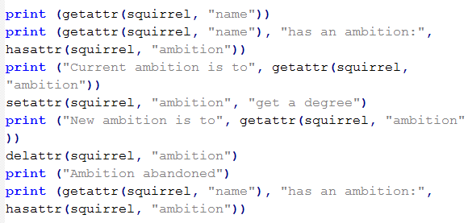
Attributes

Slide 59
Attributes
We can create new attributes outside of the __init__ method in other methods within the class, however this is considered bad practice
If you create a new attribute outside of the __init__ method you run the risk of trying to use it before it has been initialised
You can even make these __init__ attributes empty values, at leas then they’re there
Generally all attributes should be initialised in the __init__ method but it is very common for other methods to update/change these attributes

Slide 60
Input/Output Functions
The input([prompt]) function reads one line from standard input and returns it as a string
Using eval(input([prompt])) instead assumes the input is a valid Python expression and returns the evaluated result
class InputOutput(object):
def getInput(self):
string = input("Type something: ")
print(string)
def evaluateInput(self):
string = input("Type an expression to evaluate: ")
print(eval(string))
inputOutput = InputOutput()
inputOutput.getInput()
inputOutput.evaluateInput()

Slide 61
Object Oriented Programming

Slide 62
Concepts
Inheritance
Child class ‘inherits’ attributes and behaviours from its parent
Encapsulation
Controlling what manipulates methods and attributes
Abstraction
Taking away the complexity when you don’t need to know it
Polymorphism
Something being able to have many forms depending on the situation

Slide 63
Inheritance
State the arguments you want to pass on instantiation and include any additional methods or attributes in the __init__() method
Methods will be evaluated in reverse order so redefining a method in the child class will override the parent method
def printInfo():
print(sparrow.name,
“wants to be the best”,
sparrow.species,
“he can be!”)
sparrow = Sparrow("Bellami",
"be a caring friend")
sparrow.printInfo()
print(sparrow.name, "can fly:", sparrow.canFly)
------------------------------------------
Bellami wants to be the best sparrow he can be!
Bellami can fly: True
class Animal(object):
def __init__(self, name, species, ambition = "unknown"):
self.name = name
self.species = species
self.ambition = ambition
class Sparrow (Animal):
def __init__(self, name, ambition):
Animal.__init__(self, name, "sparrow", ambition)
self.canFly = True
Notes:
Hiding implementation in methods is abstraction

Slide 64
Inheritance
Animal
In Python, you can inherit from as many classes as you like without restriction (be wary this is not the case in other languages)
You can inherit from an existing class
You can inherit from an abstract class (which will be covered shortly…)
Mammal
Fish
Cat
Tuna
A Cat IS A Mammal which IS An Animal

Slide 65
Menu
Garage
Vehicle
Car
Motorbike
Notes:
We have a menu item where we create our Garage and the initial vehicles within it
The menu acts as the way of the user interacting with the program
Garage holds vehicles and performs methods in order to expose what it contains
Vehicle is an abstract class
Car and Motorbike inherit from it
Vehicle should not be instantiated on its own

Slide 66

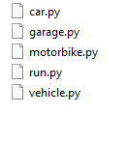
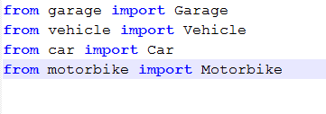
File structure
Top level you need the folder(s) that contain your code and a __init__.py file
Then within your folder(s) you can have your .py files that execute the code
__init__.py file contains what you need to import from different files

Slide 67
Inheritance & Abstract Classes
In many cases of inheritance there is an obvious ‘base’ class that many other classes inherit from but that we never want that base class itself to be able to be created on its own
In the Garage example – would we want to be able to have just a mystery Vehicle floating around or should we enforce that it must be one of the types of vehicle we set up?
If that is the case, then why do we bother creating inherited classes at all?
It reduces code duplication!

Slide 68
Inheritance & Abstract Classes
To enforce that Vehicle shouldn’t be initialised itself we create it as an abstract class
Abstract classes can contain fully written code
They can also contain abstract methods which must be implemented by any class that inherits from them

Slide 69
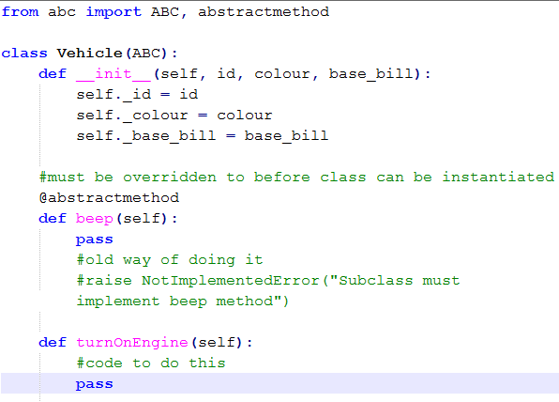
Notes:
Top line is importing packages we will need for abstract class
class Vehicle declares our class and the (ABC) means we are making this an abstract class through inheriting this package
By default, all classes inherit from the ‘object’ class
We then create our __init__ method where we instantiate any attributes we know all vehicles will have, in this case, id, colour, and base_bill
Also note we have made all of these attributes softly private
The next method beep() is an abstract method. We denote this through the decorate @abstractmethod. This means this method must be overridden before the class can be instantiated.
The final method turnOnEngine() is an example of a method that perhaps every Vehicle does the same way so we’ve created it in Vehicle and haven’t specified that it must be overridden. It could be overridden though if the subclass instantiated it.

Slide 70
Self
A quick recap on the self keyword
You can technically call this variable whatever you want
Calling it ‘self’ is best practice though and makes sense when you understand what it is
The first parameter that is passed to a method of a class is the object itself
This is so it can access its attributes and other methods

Slide 71
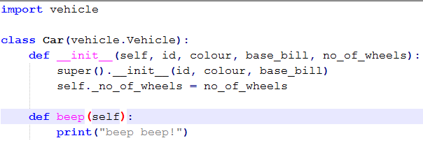
Inheritance & Abstract Classes
First we must import the file we are going to get our inherited class from
Then when we create the Car class we have it inherit from file.class (vehicle.Vehicle) in this case
We then also need to override any abstract methods

Slide 72
Inheritance & Abstract Classes
Notice we still have an __init__ method, as initialising a car is going to be different from a motorbike
In our __init__ method we also call the super() __init__ method, which is our abstract classes method
Since the functionality is already partially there we may as well use it!

Slide 73
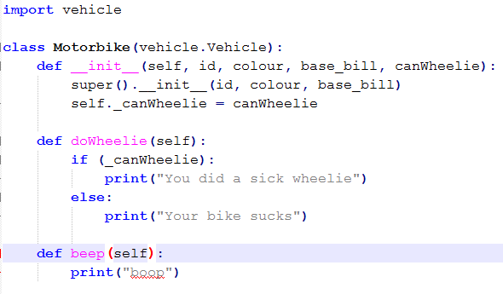
Inheritance & Abstract Classes
In motorbike we add a whole new method that is unique to it as well as an attribute

Slide 74
Polymorphism & Abstract Classes
Another key concept we’re implementing here is polymorphism
This is that we have our abstract method beep() which comes in many different forms depending on the class that has inherited from Vehicle
Note that Python does not have method overloading capability!
A simple example of polymorphism is using the addition symbol +
If you use it on 2 integers it will sum them 1+2 = 3
If you use it on 2 strings it will concatenate them “hello “ + “world” = “hello world”
Depending on the parameters given it will act differently

Slide 75
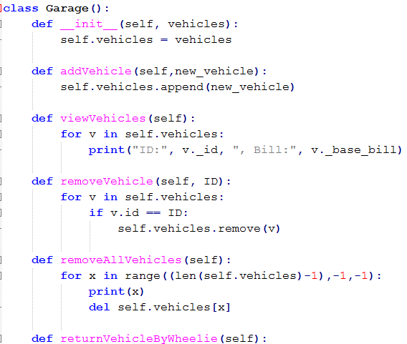
Notes:
Goes on for longer
But essentially right now our garage is just a list of vehicles
And methods to interact with that list of vehicles

Slide 76
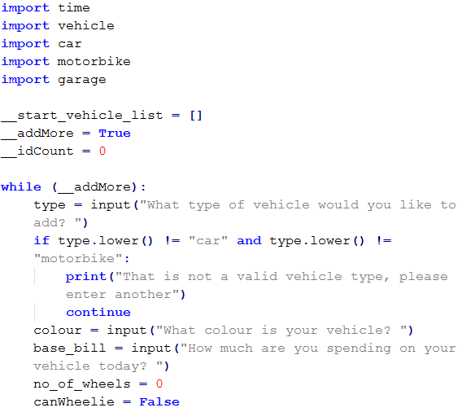
Object Oriented Programming
We’ll now start looking at our run.py file – a kind of menu that the user will interact with
Note that we do not create this as a class – to properly follow OOP we could make a menu class and then instantiate that in order to start the program
Here we import the necessary packages
We also instantiate a few variables we will need
Notes:
Note the variables are strongly private, meaning they shouldn’t be accessed outside the file, but they still could be
Start_vehicle_list is a list that will hold all initial vehicles for the garage
addMore is a boolean that we will use to track if the user wants to add more initial vehicles to the garage
idCount will be an int to auto create ids for the vehicles

Slide 77
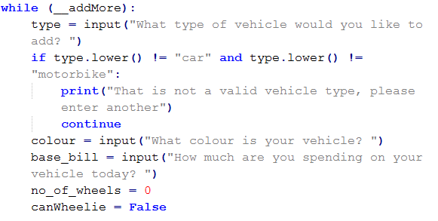
Object Oriented Programming
We then start a while loop to say “while addMore is true, do this”
At the end of the loop it will ask the user if they want to add more, and if not it will become False and break out of the loop
We then ask the user what type of vehicle they would like to add and do a quick sanity check
Notes:
We then start a while loop where we are saying “while addMore is true, do this loop”. It starts True so we go in to the loop. It will check if the user wants to add more vehicles at the end of the loop, and break out if they don’t want to. But we are enforcing that the garage should have at least one vehicle upon initialisation.
To start, we ask the user what kind of vehicle they want to add
We then do a check to see if they’ve entered something valid, and if it isn’t we ask them to try again
We then do this for a couple of other variables (note we don’t check if base_bill can be converted to an int which would be a good check to implement!)
We also set up a couple of variables we will use in a moment

Slide 78
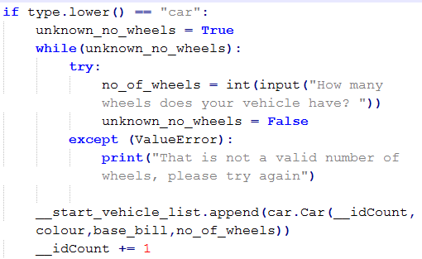
Object Oriented Programming
Now we do some specific checks if it’s a car – remember only the Car vehicle has the attribute of no_of_wheels
We also do a check here to make sure a user can’t enter a no_of_wheels that isn’t an int e.g. “hello” or 4.5
This is a try except statement that will catch errors for us
We then create our Car!
Notes:
Note we use the append() method to add new variables to our list and add a new car
We also increase the idCount so it’s new for the next Vehicle

Slide 79
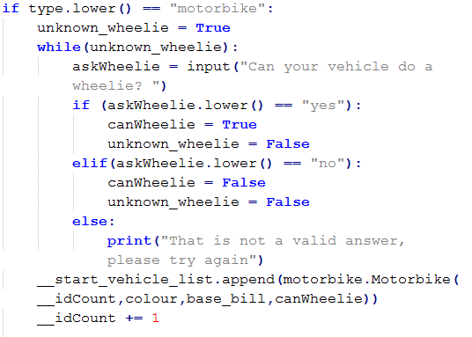
Object Oriented Programming
We then do a similar thing for motorbike with slightly different error checking

Slide 80
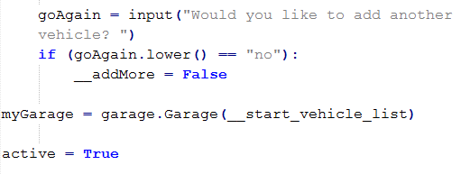
Object Oriented Programming
At the end of our while loop we then ask the user if they want to add another vehicle
If they answer anything except ‘no’ they will go through the loop again
Otherwise, we set the __addMore variable to False which means the loop will end
We then create our Garage with the initial vehicles and create a variable for the menu loop…

Slide 81
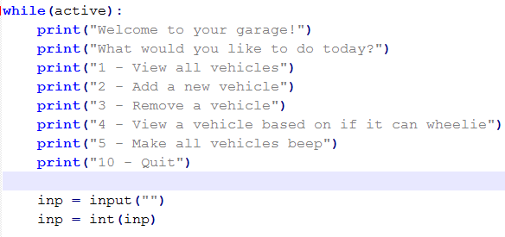
Object Oriented Programming
We then create a new while loop for while the user is interacting with the menu and print out what they need to see
We then take their input and convert it to an int
Notes:
A good addition here would be error checking to the int conversion

Slide 82
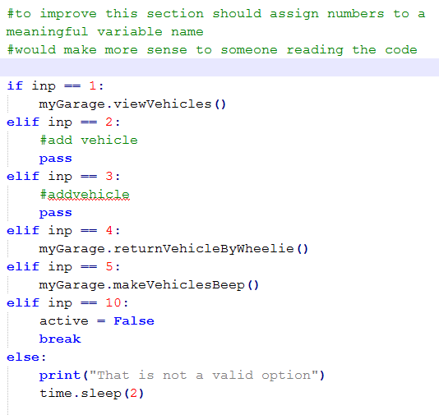
OOP
We then perform actions based on what the user has said they want to do and keep looping until they pick the Quit option (no. 10)
Note that this could be improved from a readability standpoint

Slide 83
Working with files

Slide 84
Open & Close Functions
The first step in interacting with a file is to open it and assign the file to a file object
accessMode refers to functions such as read, write, append, etc.
file = open(“file.txt”, “w+”)
print(file.name, "closed:", file.closed) print(“Access mode:”, file.mode)
file.close()
print(file.name, "closed:", file.closed)
----------------------------------------------
file.txt closed: False
Access mode: w+
file.txt closed: True
Notes:
If buffering is set to 0 then no buffering will take place

Slide 85
Reading & Writing Methods
The write() method creates a new file with a given name and writes some given input to it
The read() method reads a string from an open file
file = open(“file.txt", “w")
file.write(“This is some test text”)
file.close()
file = open(“file.txt", “r")
lines = file.read()
print(lines)

Slide 86

Reading & Writing Methods
You can also append to a file by using the ‘a’ keyword
You can also open files in a slightly different way that means you don’t have to remember to close them later

Slide 87
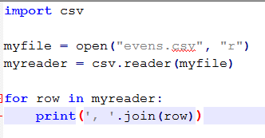
csv files
It’s handy to be able to read csv files for analysis
We’ve already seen we can read these in to the panda data type bit you can also read them in other ways depending on what you needs

Slide 88
Paths & Directories
The os module provides functions for working with files and directories
Be sure to import os first
os.getcwd() → Return current working directory
os.path.abspath(‘bromeliad.txt') → Return absolute path
os.path.exists(‘bromeliad.txt') → Check whether a path exists
os.path.isdir(‘C:/Big Data') → Check whether a path is a directory

Slide 89
Regular Expressions

Slide 90
Match & Search
re.match (pattern, string, flags=0) searches for regular expression pattern within a string and returns a match object
.group(number) returns an entire match or specific subgroup number
.groups() returns all matching subgroups in a tuple
re.search() searches for the first occurrence of regular expression pattern within a string and returns a match object
Notes:
Match checks for a match only at the beginning of the string
Search checks for a match anywhere in the string

Slide 91
Match & Search
search checks for a match anywhere in the string
match checks for a match only at the beginning of the string
r tells Python to treat the following string as raw code
import re
line = "Cats are better than dogs";
matchObj = re.match( r'dogs', line, re.M|re.I)
searchObj = re.search( r'dogs', line, re.M|re.I)
if matchObj:
print("matchObj.group() : ", matchObj.group()
else:
print("Nothing found!“)
if searchObj:
print("searchObj.group() : ", searchObj.group())
else:
print("Nothing found!“)
---------------------------------------------------------------
Nothing found!
searchObj.group() : dogs

Slide 92
Match & Search
\w → searches for any word character
\s → searches for any whitespace character
\d → searches for any digit
Capitalising any of these will make it search for the opposite
E.g. \W → searches for any non-word character

Slide 93
Match & Search
\w+ → searches for one or more word characters
\w* → searches for any amount of word characters
\w? → searches for one or zero word characters
[A-Z] → searches for any character between A and Z, capitals only
. → the wildcard character, use carefully as it will accept anything

Slide 94
Regular Expressions
Regular Expression | String (matched in bold)
Marvel | I wish Marvel had 9 movies in 2016.
\d | I wish Marvel had 9 movies in 2016.
\d{4} | I wish Marvel had 9 movies in 2016.
\d\s\w+ | I wish Marvel had 9 movies in 2016.
\w{5,9} | I wish Marvel had 9 movies in 2016.
.?\\. | I wish Marvel had 9 movies in 2016.
.*\\. | I wish Marvel had 9 movies in 2016.

Slide 95
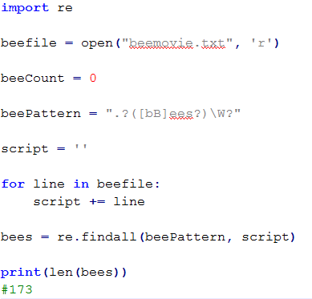
Match & Search
findall() will find all instances of an occurrence within some text
This returns a list of these occurrences

Slide 96
Assertions & Exceptions

Slide 97
Overview
Assertion: A means of testing a program
The assert statement will raise an AssertionError if the expression does not evaluate to true
Exception: A Python object representing an event which disrupts the normal flow of a program's instructions
When a Python script raises an exception, unless it can handle it immediately, it terminates and quits

Slide 98
Examples
assert bees < rats
try:
if number < 0:
print (number, "is less than zero")
elif number > 0:
print (number, "is greater than zero")
except NameError:
print("NameError: number is not defined.")
------------------------------------------------------------------------------------------------
assert bees < rats
AssertionError
NameError: number is not defined.

Slide 99
Assertions
Method | Checks
assertEqual(a, b) | a == b
assertNotEqual(a, b) | a != b
assertTrue(x) | Boolean x is True
assertFalse(x) | Boolean x is False
assertIs(a, b) | a is b
assertIsNot(a, b) | a is not b
assertIsNone(x) | x is None
assertIsNotNone(x) | x is not None
assertIn(a, b) | a in b
assertNotIn(a, b) | a not in b
assertIsInstance(a, b) | isinstance(a, b)
assertNotIsInstance(a, b) | not isinstance(a, b)
This is a list of some common assertions you can use with the TestCase class that we will cover shortly
Be aware there are others
All of these can have an optional message argument that can be used as a error message on failure

Slide 100
Method | Checks
assertAlmostEqual(a, b, places=x) | round(a-b, x) == 0 Essentially, a minus b, rounded to x number of decimal places
assertAlmostEqual(a, b, delta=x) | abs(a-b) <= x Difference between a and b must be less than delta (x)
assertGreater(a, b) | a > b
assertGreaterEqual(a, b) | a >= b
assertLess(a, b) | a < b
assertLessEqual(a, b) | a <= b
assertRegex(string, regex) | regex.search(string)
assertNotRegex(string, regex) | not regex.search(string)
assertCountEqual(a, b) | a and b have the same elements in the same number, regardless of order
Notes:
These are some slightly more specific/complicated assertions but are also useful
abs() function is absolute, means it will return the positive version of a value which is good in this case
There is also the assertNotAlmostEqual()
You can’t specify both places and delta

Slide 101
Test Driven Development

Slide 102
Unit testing
In order to use unit testing in Python we must first import the unittest package
This adds some useful functionality such as creating test case classes which should represent a unit of testing, as well as test suites which are collections of test cases
When you run a .py file of unit tests it will also pop up to let you know what has passed/failed, allowing you to work in a TDD fashion

Slide 103

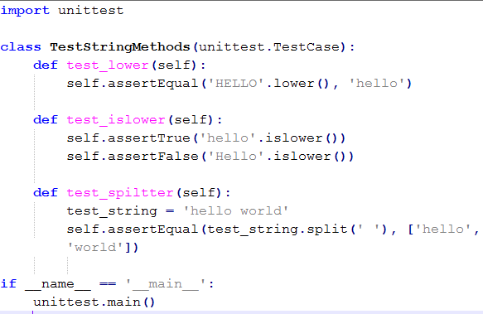
Unit testing
Notes:
First import unittest package
Then we can create a Test Case class, notice it inherits from the TestCase class from the unittest package
We then create methods to test various string methods
If you do exactly this it will run 3 tests and they will all pass
Try changing the separator (‘ ‘) in the test_string.split method to read (‘/’) instead – that method will now fail!

Slide 104
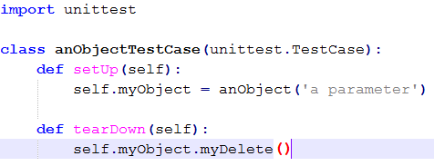
Unit testing
Sometimes we need to perform some code before or after tests
For example, setting something up that the test will need - for this we can use the setUp() and tearDown() methods
If setUp() runs successfully, tearDown() will always run, regardless of whether other test methods were successful

Slide 105
Productivity

Slide 106
Comparison
Python - Dynamically Typed
Variables do not need to be declared
“An assignment statement binds a name to an object, which can be of any type and can be changed to an object of a different type later”
Container objects can hold objects of any type
No casting is required when retrieving an object from a container
Java - Statically Typed
All variables must be explicitly declared
Container objects (e.g. ArrayList) cannot hold primitives (e.g. int), meaning these must be converted into the appropriate form
Upon retrieving an object from a container, its type is forgotten and must be cast to the desired type

Slide 107
Comparison
Python
Concise
Multiple classes can be defined in a single file
Compact
Exceptions will automatically propagate upwards
Java
Verbose
Each class must be defined in its own individual file
Not Compact
Exceptions must be caught or thrown by every method in which they could appear

Slide 108
Comparison
Python - Concise
Java - Verbose
print (“Cats are the best animals in the world!”)
public class Cats {
public static void main (String args []) {
System.out.println (“Cats are the best animals in the world!”);
}

Slide 109
Constructor Methods
Suppose you want to create an Animal class with multiple arguments, but you want to account for unknown variables when defining your constructor
In Java, you would need to write multiple constructors to handle the different input combinations when creating instances
In Python, you define a single constructor with default values for any optional arguments
When you create an instance of Animal, you always know its name and species, but finding out the animal’s ambition is more of a challenge and requires extra time and attention

Slide 110
Constructor Methods
Python
Java
class Animal ():
def __init__ (self, name, species, ambition = “<unknown>”):
self.name = name
self.species = species
self.ambition = ambition
def printInfo (self):
print (self.name, “the”, self.species,
“wants to”, self.ambition, “!”)
tamarin = Animal (“Brian", “tamarin monkey”, “resolve an argument he had with his friend)
squirrel = Animal (“Jeff", “black squirrel”)
tamarin.printInfo ()
squirrel.printInfo ()
public class Animal {
private String name;
private String species;
private String ambition = “<unknown>”;
public Animal (String name) {
this.name = name;
}
public void printInfo () { System.out.println (this.name + “ the ” + self.species + “ wants to ” + self.ambition + “!”)
}
public static void main (String args []) {
squirrel = new Animal (“Jeff”, “black squirrel”);
squirrel = new Animal (“Brian”, “tamarin monkey”, “resolve an argument he had with a friend”);
squirrel.printInfo ();
tamarin.printInfo ();
}

Slide 111
PyMySQL

Slide 112
Connecting to MySQL
First install the pymysql package
On the command line: conda install pymysql
In code: import pymysql
To connect: conn = pmysql.connect(host, port, user, password, database)

Slide 113
PyMySQL
import pymysql
db = pymysql.connect(“localhost”, “root”, “password”, “movielens”)
cursor = db.cursor
sql = “SELECT * FROM genres”
cursor.execute(sql)
results = cursor.fetchall()
for row in results:
genreid = row[0]
genrename = row[1]
print(genreid, “ “, genrename)
cursor.close()
db.close()
First import
Then connect to a database
Create a cursor object to interact with your database
Then you can start running queries

Slide 114
Inserting
Similar to any other query
Do a db.commit() followed by a db.rollback() in case of issues

Slide 115
CRUD
#all importing and connecting from earlier
cursor.execute(“DROP TABLE IF EXISTS employee”)
sqlC = “CREATE TABLE employee(fname CHAR(20), lname CHAR(20), age INT, salary FLOAT)”
cursor.execute(sqlC)
sqlU = “UPDATE expmloyee SET AGE = AGE + 1 WHERE lname = ‘Jackson’”
sqlD = “DELETE FROM employee WHERE age > 65”
try:
#execute SQL command
db.commit()
except:
db.rollback()
Other CRUD commands work very similarly

Slide 116
MongoDB

Slide 117
Connecting to MongoDB
First install the pymongo package
On the command line: conda install pymongo
In code: import pymongo
from pymongo import MongoClient
To connect: conn = MongoClient(“url:port”)
If you do not specify any arguments to MongoClient it will default to the instance running on locahost with the port 97017 (MongoDB’s default)

Slide 118
Connecting
First import
Then connect to a MongoDB instance
Then select your database
Then access collections
from pymongo import MongoClient
conn = MongoClient()
db = conn.MovieLens
# db = conn[‘MovieLens’]
collection = db.movies
CollectionU = db[‘users’]

Slide 119
Inserting
#all inserts and connections as before
#we are working with the restaurants data
result = db.restaurants.insert_one(
{
“address”: {
“steet”: “9 Avenue”
“zipcode”: “87619”
“borough” : “place”
“cuisine” : “Swiss”
“grades”: [
{
......
#returns ID it was inserted with
result.inserted_id
First import
Then connect to a MongoDB instance
Then select your database
Then access collections

Slide 120
Finding
We can run queries similar to how you would do so on the command line
#all inserts and connections as before
#we are working with the restaurants data
cursor = db.restaurants.find()
for document in cursor:
print(document)
cursor = db.restaurants.find({“borough”:”Manhattan”})
cursor = db.restaurants.find({“address.zipcode”:”20165”})

Slide 121
Updating
Use the $set as normal
You can then used the matched_count and modified_count attributes to access information on the update commands
#all inserts and connections as before
#we are working with the restaurants data
cursor = db.restaurants.update_one(
{“restaurant_id”:”41156888”},
{“$set”: {“address.street”: “East 31st Street”}})
result = db.restaurants.update_many

Slide 122
Libraries
As you have seen, there are a number of different Python libraries available for you to use and you can use them in programs using the import <name> function
You may need to install them on your machine first

Slide 123
scipy
Mathematics, science, engineering
Includes many core libraries for scientific computing
Numpy
Matplotlib
Scipy library
Sympy
Ipython
pandas

Slide 124
numpy
Scientific computing module
Includes:
Numpy homogeneous multi-dimensional arrays
Random number capabilities
Statistical capabilities
Notes:
Regular python array can only be one dimensional

Slide 125
matplotlib
2D plotting library
Range of graphs (histograms, bar charts, scatter plots) created easily
Lots of control over how the graph looks letting you create what you need, aiming for publication worth visuals

Slide 126
Thank you
QA hopes you enjoyed your course,
as much as we enjoyed teaching you.

