Slide 1
Python Flask
Introduction

Slide 2
What is Flask?
Flask is a Python driven Micro-Framework:
The “micro” in micro-framework means Flask aims to keep the core simple but extensible.
Framework means a structure for supporting or enclosing something else, especially a skeletal support used as the basis for something being constructed. In short, it is a set of methodologies and design considerations one should follow to achieve a web-conforming application.
It differs from a full-stack application as it aims to keep all of the differing layers of an application in a single technology, allowing easy communication and interaction between the layers.

Slide 3
WSGI and PEP3333
When Python first made it’s appearance in 1990, due to it’s incredible flexibility and ease of use, web app frameworks were popping up in quick succession. Due to the quick influx of frameworks, standards had to be agreed upon:
PEP 3333
This document specifies a proposed standard interface between web servers and python web applications or frameworks, to promote web application portability across a variety of web servers.

Slide 4
WSGI and PEP3333
WSGI – Web Server Gateway Interface
Is a specification that describes how a web server communicates with web applications and how web applications can be chained together to process one request, described in the PEP 3333.
Werkzeug is a comprehensive WSGI web application library. Flask wraps Werkzeug, using it to handle the details of WSGI while providing more structure and patterns for defining powerful applications.

Slide 5
What Makes Flask Great?
Flask does not include a database layer – at first this might seem like a downside, but it allows the developer the flexibility to integrate whatever back end technology that they require.
It is highly extensible. Libraries already exist for all aspects of a web application, such as database integration, form validation, upload and download handling, user authentication, to name a few.
Installation, setup and deployment are straight forward.

Slide 6
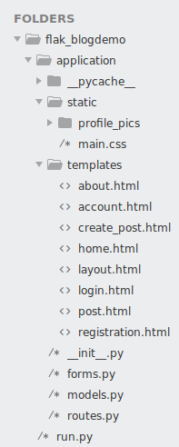
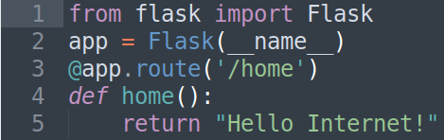
What Makes Flask Great?
Installation, setup and deployment are straight forward.
A Flask made web application can be as simple as 5 lines of code (below), or a fully structured, enterprise project (right).

Slide 7
Thank you for listening.
Any questions?

