Slide 1
Python Flask
Installation and structure

Slide 2
Installation and Configuration
Installation of flask requires a few dependencies:
sudo apt-get install python3
sudo apt-get install python3-pip
sudo apt-get install python3-venv
Once all dependencies are downloaded, configure your system variable, to allow Flask to find your application:
export FLASK_APP=app.py
export FLASK_ENV=development

Slide 3
Projects and Environments
All projects should follow a sensible structure in terms of file and directory layout. Web templates in a ‘templates’ directory, images in an ‘images’ folder, and so on.
An environment is a way of segregating projects from one another, when they are deployed to the same machine. For this purpose python3 has a virtual environment called ‘venv’.
With venv, the developer may toggle between environments, and thus projects, from the same command line interface.

Slide 4
Creating a Project & Environment
Begin with a simple directory as the root of a project:
mkdir flasklectures
cd ./flasklectures
And create a virtual environment:
sudo python3 -m venv venv

Slide 5
Starting an Environment and pip
Start an environment using Python:
sudo python3 -m venv venv
Enter the environment:
. venv/bin/activate
The same way that Linux is able to download and update programs and packages from a repository, Python can too. Python’s dependency/package management system is called pip. Once inside an environment, download the required Flask library:
sudo pip3 install flask

Slide 6
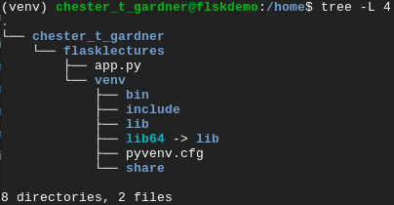
Creating the app.py
Before developing the web application, the ‘app.py’ file needs to be made:
touch app.py
Project structure should now look like this:

Slide 7
Build a Basic Project Structure
Directions
10 minutes
Create a basic project structure as previously outline
Debrief
Discuss any hurdles and issues occurred
<number>

Slide 8
app.py – import and app
Inside the ‘app.py’ import the library ready to use, taking note of the case used:
Next there needs to be an actual application object that needs to be able to be manipulated:
This command passes the name of the file that is executing this command to the Flask library, and store this application in the variable named ‘app’
Due to app.py being ran from a command line, not imported & called from another script, __name__ is presently set to ‘__main__’.

Slide 9
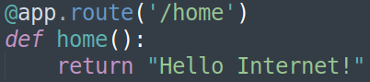
app.py - Routes
Routes are a way of directing traffic to different parts of you application. You can direct traffic to a home page with flask in a couple of lines:
You can even direct multiple routes to the same end point:

Slide 10
Running the Application
Run the application from the command line with:
flask run
As the environment was configured to be the development environment (export FLASK_ENV=), a Debugger PIN is show. More on this later.

Slide 11
Checking and Updating the Application
Navigate to ‘localhost:5000/’ or ‘127.0.0.1:5000/’ to see the application.
Modify the code and refresh the page to see live changes without redeployment:

Slide 12
Build a Basic Project Structure
Directions
10 minutes
Create some basic pages conforming to basic <html> standards, for the following routes:
/home
/about
Note: You may need to rerun your application with ‘flask run’ after making changes, if you’ve saved with errors in your code.
Debrief
Discuss what you had to change in order for the routes to work correctly, and what duplication you have.
<number>

Slide 13
Thank you for listening.
Any questions?

