Slide 1
Python Flask
JINJA2 and templating

Slide 2
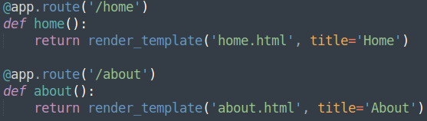
app.py - Jinja2
A common tern of phrase in programming is ‘Don’t Repeat Yourself’. As shown in the solution, there is repeated HTML code. This can be avoided by using the HTML templating library that accompanies Flask – Jinja2.
The templating library can be accessed by importing ‘render_template’:
And return a render template .html page (one has not been created yet).

Slide 3
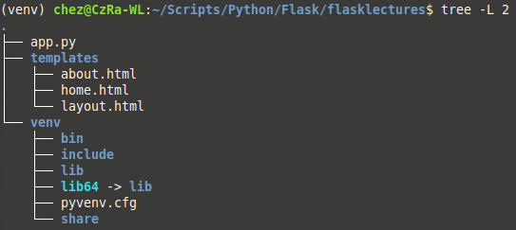
Creating Pages
Following good project structure, make a directory at root level strictly called ‘templates’, which will store the web application’s pages. Also create three files, ‘home.html’, ‘about.html’ and ‘layout.html’ within that new templates folder:

Slide 4
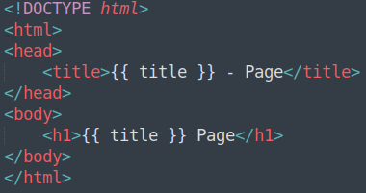
layout.html – Jinja Templating
Inside layout.html, write code as you would normally expect, but including Jinja syntax:
The Jinja2 syntax is wrapped in double curly braces ‘{{‘ and ‘}}’ - everything inside is variable substitution.
In this instance, the variable ‘title’ is being accessed. This variable we passed through, during the render template execution:

Slide 5
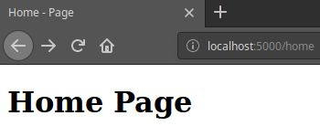
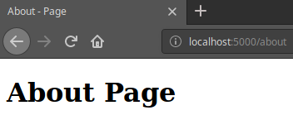
home.html & about.html
Inside the remaining pages, home and about, the following code will support the use of the layout.html page as a template:
Navigate to the respective routes and check for functionality.

Slide 6
layout.html – Block Contents
Changing layout.html’s body to the following code, will allow us to customise our individual pages (home, about):
Notice the different Jinja syntax this time. Before, double opening and closing curly braces were used, but only for variable substitution. This new syntax of curly brace with an accompanying percent symbol denotes that there is code to be executed, within the code block.
{% <code to be executed> %}
‘block’ states that a content block is going to be created, of the name ‘body_content’

Slide 7
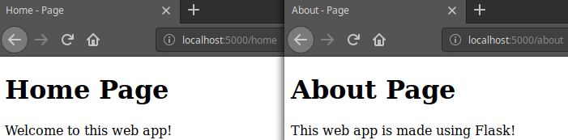
home.html & about.html
With the layout updated to allow for code blocks, applying the same syntax to the home and about page will render the content provided:

Slide 8
Building Template Structures
Directions
20 minutes
Update your application to conform to the Jinja templating system.
Create additional pages for the following routes:
/login
/register
Bonus – Create some links between your pages if you know how. Are you utilise the template to make this task easier?
Debrief
Discuss how this setup is beneficial
<number>

Slide 9
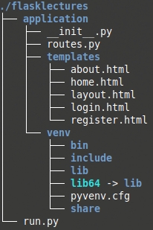
Better Structure
Having defined directories for project assets is important, and increases it’s maintainability.
Create a new folder within the root of the project called ‘application’, and move everything inside of it.
Rename ‘app.py’ to ‘__init__.py’.
Create a new file within the ‘application’ folder called ‘routes.py’.
In the root of the project, create a file called ‘run.py’.
Finally, export the FLASK_APP variable to reflect new naming:
export FLASK_APP=run.py

Slide 10
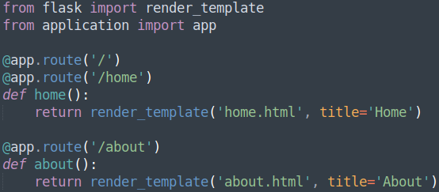
routes.py - Moving Code
Now that the structure is complete, code can be moved to their allocated homes. ‘__init__.py’ currently holds all of the routes. These will need moving to the new ‘routes.py’ file.
This includes moving over the import statement, but a further import statement is needed to make this application functional; from application import app:

Slide 11
__init__.py – References
For ‘__init__.py’ to be able to access the routes, the routes will need importing from the application folder. This must be done after the instance has been created.
This is due to a reference issue that occurs, as ‘routes.py’ needs to access the ‘app’ object. If ‘routes.py’ is imported before the app instance is made, ‘routes.py’ will not be able to see the ‘app’ object and the application will fail.

Slide 12
run.py – The Root of The Application
This file contains some special code, that was briefly mentioned earlier, as well as importing the ‘app’ from application once more:
The interesting thing now, is the application can be executed from command line, as well as invoking the flask program with the run argument, as long as the correct name is set for the FLASK_APP system variable:
flask run
Python3 run.py

Slide 13
Building Better Structure
Directions
30 minutes
Update your application to conform the better project structure
Debrief
Discuss how this setup is beneficial
<number>

Slide 14
Thank you for listening.
Any questions?

