Slide 1
Python Flask
Creating links

Slide 2
Creating Links
During the ‘Build A Template Structure’ activity it was tasked, if time allowed, to create links between the pages created. This may have caused some issues, with responses like:
Not Found - The requested URL was not found on the server. If you entered the URL manually please check your spelling and try again.
The address wasn't understood
This is due to the way the Flask application directs links – as the routes set up are for a specific path, and the IP address may change dependent on the environment – the application must have a way to handle the links internally, irrespective of IP address.

Slide 3
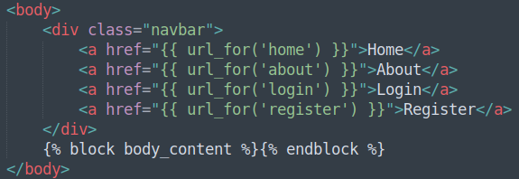
layout.html - url_for
The way that Flask handles links is with the ‘url_for()’ function. This function allows the browser to navigate to a template, held within the project structure.
To access this function, the Jinja2 code syntax comes in to play. Editing ‘layout.html’ to include the following code, will allow our navigation links to persist across all pages:

Slide 4
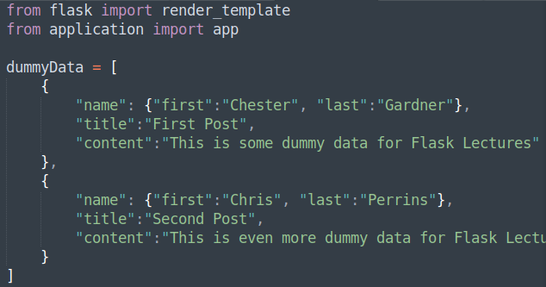
routes.py – Dummy Data
Creating some dummy data will allow the testing of Jinja’s implementation of Pythons for loop.

Slide 5
routes.py – Updating the Route
Updating the return statement to include the new dummy data will allow it to be accessed from within the ‘home.html’ template.

Slide 6
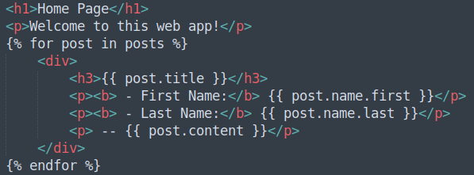
home.html – Looping Through the Posts
Inside the ‘content_body’ block within ‘home.html’, the following code will allow Jinja/Flask the ability to loop through all of the posts sent to the template, from the return statement within ‘routes.py’.

Slide 7
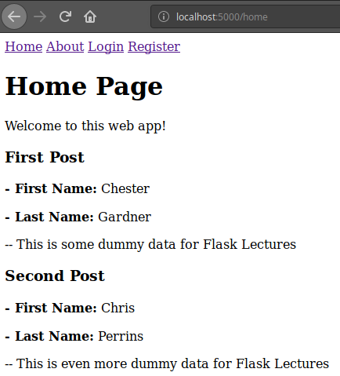
The Home Page
Refreshing the web application’s home page should display:

Slide 8
Creating Links and Dummy Data
Directions
30 minutes
Update your project to include a Navigation Bar between your pages
Add some dummy data and display it within the ‘home.html’ template
Debrief
Discuss how this ability to loop is beneficial
<number>

Slide 9
Thank you for listening.
Any questions?

