Slide 1
Python Flask
Data-layer

Slide 2
Persistent Data
The use of dummy data was great for establishing how to present the information to the user of the web application. Although this was useful, it is not a long term solution, as none of the content can be changed, once the application is up and running.
To avoid this, the data must persist within a database. For this end, SQLite will be used, as it is pre-packaged with python.
A useful tool to accompany this endeavour is called ‘DB Browser for SQLite’, and can be downloaded, and subsequently opened from the command line, with:
sudo apt-get install sqlitebrowser
sqlitebrowser

Slide 3
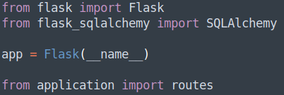
__init__.py – SQLAlchemy
As with the rest of this project, it is a good idea to segregate functions from one another. Again, this shall be done for the database tables.
The database layer will be handled by a library called Flask_SQLAlchemy, a library designed specifically for Flask and SQLite.
As Flask-SQLAlchemy’s Python 3 implementation is still in development, use of the 2.x version is required. Therefore, the ‘pip’ command will be used instead of ‘pip3’.
sudo pip install Flask-SQLAlchemy
Within ‘__init__.py’, the new library must be imported:

Slide 4
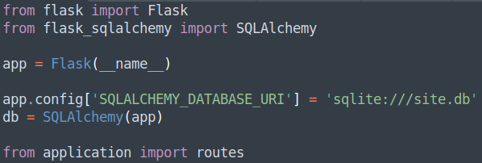
__init__.py – SQLAlchemy Cont.
With the import statement done, an instance of the SQLAlchemy must be made, in order to manipulate the SQLite tables.
This is achieved by creating a URI for where our database will live within our project directory:
And then creating an instance, by passing in the ‘app’ to SQLAlchemy:

Slide 5
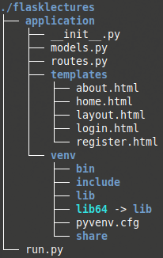
models.py – Project Structure
Again, conforming to good project structure, the tables that we will create with Python & SQLAlchemy, should once more, be in it’s own file. This file will be called ‘models.py’, and will live in the ‘application’ directory:

Slide 6
models.py – Creating a Table
Within ‘models.py’, you will need to import the ‘db’ instance that was just made:
Then create a class called ‘Posts’ - this will be the name of the first table – passing in the ‘db.Model’ object:
Within this class is where the fields will be declared, as well as any logic required for validation. More on this later.

Slide 7
The ‘Posts’ Table
This first field created will be the primary key called ‘id’, and will be of type integer.
The second field created will be ‘first_name’, will be of type String, length 30, and will not be allowed to be null. The same restrictions will be applied to the ‘second_name’ field.
The fourth field created will be ‘Title’, will be of type String, length 100, will not be nullable, and must be unique to prevent duplicate post titles.
The final field will be ‘content’, of type String, length 10,000, will not be nullable, and finally, must also be unique to prevent duplicate post content.

Slide 8
models.py – __repr__(self)
Next, a special Pythonic method needs to be created, called ‘__repr__’, which has the argument ‘self’ passed in.
__repr__ - a hidden method that returns a printable representation of an object
self – Python reserved key word used to identify itself. In this instance, self is the object of the class ‘Posts’, which in turn is a ‘db.Model’
Therefore, this special method is a way of identifying, and subsequently creating a legible representation of the table model.
Finally, the return statement needs to represent the data created:

Slide 9
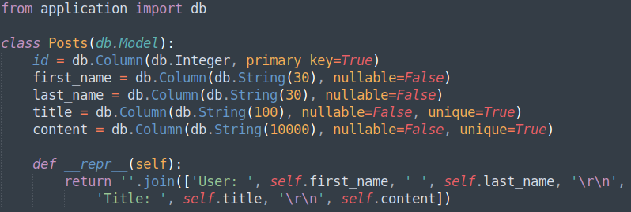
models.py – Overview
The full code should now appear like:

Slide 10
Creating the Actual Database
Even though models were created from within the ‘models.py’ file, a database has yet to be constructed. This cannot (without a lot of issues) and should not be done from within the application start-up. Any data that was posted to the table will be lost every time the web application restarts (for whatever reason).
Therefore, the database must be created separately, and can be achieved from the command line. From the command line, stop the web server with ‘Control + C’ keys, and enter the following:
python
from application import db

Slide 11
Creating the Actual Database Cont.
If that was successful, something similar to the following should be outputted:
Now that the ‘db’ object has been imported, all tables for that database can be made:
db.create_all()

Slide 12
Adding Data to the Table
With the table created, importing the Posts model, will allow data to be inserted in to the table.
from application.models import Posts
Still within the command line, some test data should be added to ensure that the table has been created as expected:
post1 = Posts(first_name=’Chester’, last_name=’Gardner’, title=’First Post’, content=’This is some test data, to validate table creation’)
db.session.add(post1)
db.session.commit()

Slide 13
Checking Data in the Table
Last, the following commands should return data, if all has been added successfully:
Posts.query.all()
Posts.query.first()
Posts.query.filter_by(first_name=’Chester’).all()
.first() would work here too
Displayed below is the command line output of the ‘Posts’ table. This is rendered in the same way as the return statement that was used for the class Posts:

Slide 14
routes.py - Displaying the Table Data
Now that persistent data has been established, there is no need for the ‘dummyData’ object created.
There also needs to be the same import statement in here, as was seen when testing the table:
Finally, the last thing to do is get the post that are stored within the table, and pass this data to the ‘home.html’ template, via the ‘posts’ variable:

Slide 15
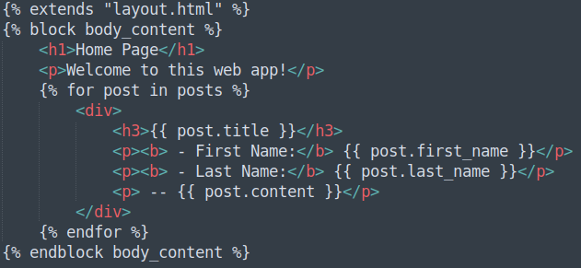
home.html - Displaying the Table Data
‘home.html’ template needs to be modified to reflect the new data: post.name.first → post.first_name post.name.last → post.last_name

Slide 16
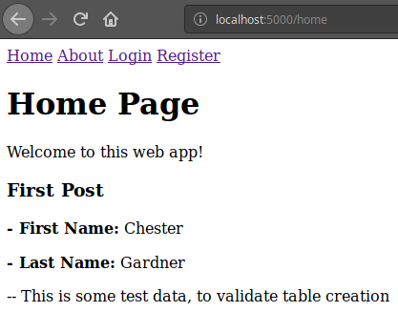
Checking the Application
Saving all edited scripts, and restarting the web server with:
flask run
Navigating to the ‘home’ page should display similarly to the image shown left

Slide 17
Creating a Database to Persist Data
Directions
1 hour
Update your project to include the SQLAlchemy library, and implement a table that has the following table and fields, with a few lines of data inserted in to it:
Posts
id, first_name, last_name, title, content
Debrief
Discuss how the structure is now more important than ever, and further discuss why the database must not be created at application start up.
<number>

Slide 18
Thank you for listening.
Any questions?

