Slide 1
Iowa house price prediction

Slide 2

Index
Introduction
Initial Plan
Issues
Changes
The Process
Demo
Further work

Slide 3
Introduction
 | Reasons For Not Selecting Alternatives
Keep the current system in place | Unnecessary expenditure of funds for increased staffing levels Continued occurrence of a high number of data errors Poor and untimely reporting Lack of automation
Implement a software already built for estate agents | Vendor’s lack of familiarity with our internal requirements
Strain on workforce
Broad/inaccurate estimates

Slide 4
Initial Plan
Knn
MySQL
Shiny
Cloud

Slide 5
Issues
KNN Underperforming Accuarcy
GCP Complexity
Changes in user stories

Slide 6
Changes
KNN Algorithm
User Stories

Slide 7
The Process

Slide 8
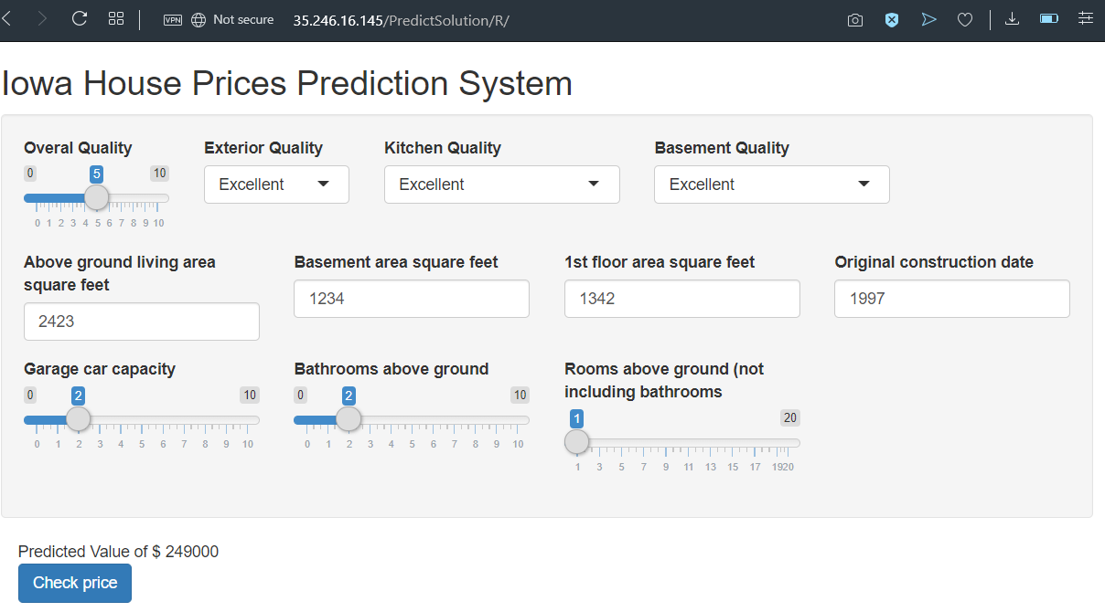
Demo
http://35.246.16.145
https://github.com/JaviAZ/IowaPrediction

Slide 9
Further work
Better GUI
More functionality

Slide 10
Questions?

