Slide 1
Big Data Administration
including ambari

Slide 2
Topics
Problems with traditional large-scale computing systems
Motivation for Big Data technologies
Fundamental Hadoop conceptsCore components of Hadoop
HDFS
MapReduce
YARN
Hadoop Ecosystem
Ambari
Hive, Impala

Slide 3
Big Data

Slide 4
Big Data
Velocity
Variety
Volume
Speed of new data arriving
Types of data
Amount of data

Slide 5
Big Data
Velocity
Variety
Volume
Veracity
Value
Speed of new data arriving
Is the data worth keeping?
Types of data
Is the data trustworthy, secure and compliant?
Amount of data
Notes:
For an alternate 5 V’s, see: http://davebeulke.com/big-data-impacts-data-management-the-five-vs-of-big-data/

Slide 6
Volume
Google processes over 24 petabytes of data a day
There are over 86 million WordPress websites
More than 1.5 billion shares are traded on the New York Stock Exchange every day
Facebook users create 2.7 billion comments and likes every day

Slide 7
Velocity
Processes are increasingly autonomous
Systems are increasingly interconnected
People are increasingly interacting online

Slide 8
Variety
Different kinds of data
Social network connections
Log files
Electronic records
Images
Audio
Video
Ratings and reviews
Email
Text
Not necessarily well structured

Slide 9
Veracity
Can the source be verified?
Was the data added by a known source?
Has it survived intact (integrity)?
Typically, data is implicitly trusted, provided the source and collect method(s) are appropriate

Slide 10
Value
Is the data worth its storage space?
Can you justify keeping it?
Is there another piece of data that could be stored instead?
Useless data doesn’t just waste storage space, it wastes time determining that it is useless!
Ultimately, what is valuable will depend on the business, the data gathered and the way the data is mined

Slide 11
Traditional large-scale computation
Bigger computers
More memory
Faster processor
High cost
Limited scalability
Moore’s law
Kryder’s law
Disk capacity
Disk read time
Year | Capacity (GB) | Cost per GB
1997 | 2.1 | $157
2004 | 200 | $1.05
2014 | 3000 | $0.036
Year | Capacity (GB) | Transfer Rate (MB/s) | Disk Read Time (minutes)
1997 | 2.1 | 16.6 | 2
2004 | 200 | 56.5 | 59
2014 | 3000 | 210 | 238

Slide 12
Scalability
Consider both storing the data and analyzing it
However all of this data is valuable!
Marketing analysis
Product recommendations
Demand forecasting
Fraud detection
If we don’t analyse all of it we risk missing some key information

Slide 13
Distributed systems
Typical processing pattern:
Copy input data from storage to compute node
Perform necessary processing
Copy output data back to storage
However this only really works for small amounts of data where the second step dominates the overall time taken
With larger amounts of data we risk spending more time copying it than processing it!

Slide 14
Distributed systems complexity
Availability
Data consistency
Event synchronization
Bandwidth
Failures
Scalability
Independent running jobs
Complex code

Slide 15

The Hadoop solution
Inspired by Google’s MapReduce and GFS architecture
Hadoop aims to solve the problems addressed in the previous slides
Nodes talk to each other as little as possible
Bring the computation to the data!
Data replication
Inexpensive hardware
Intelligent job scheduling

Slide 16
Data access bottleneck - solved
Store and process data on the same machine
Data locality
Bring the computation to the data
Conserves bandwidth

Slide 17
Disk performance - solved
Use multiple disks in parallel
One disk might have a transfer rate of 210 MB/s
4 hours to read 3TB of data
1000 of those disks can transfer 210 GB/s
15 seconds to read 3TB of data
Collate the storage and processing

Slide 18
Scalability - solved
Simple add more nodes to the cluster to increase scale as needed
We’ll see how to add nodes in future lectures
Inexpensive hardware makes this less costly
Increasing the workload only results in a graceful decline in performance, not immediate failure

Slide 19
Fault tolerance - solved
With Hadoop we accept that failure is inevitable
Instead of minimizing the possibility of failure, aim to minimize the effect of failure
Data replication across nodes so that if one node fails, the data can be re-replicated from one of the other copies
Data processing is broken into small tasks so many tasks run in parallel
If one node fails during processing, the small task can be rescheduled elsewhere
Nodes that recover can rejoin the system automatically

Slide 20
Hadoop core components
Hadoop Distributed File System (HDFS)
Yet Another Resource Negotiator (YARN)
MapReduce
Notes:
Task 1 and 2

Slide 21
Apache Ambari

Slide 22
Ambari Server
The collection point for data from across the cluster
Relies on a database that maintains cluster topology, configuration information, and user and group information
Cluster nodes have Ambari Agent enabling the server to monitor and control
Web UI at <server_host_ip>:8080

Slide 23
Users and groups
Ambari vs Hadoop
Ambari user privileges set up in web portal with log ins, stored in database
Hadoop users can be stored in database or Linux /etc/passwd file
Different parts of Hadoop may have different permissions
Hadoop services are run under the ownership of a particular Linux account

Slide 24
Ambari users and groups
Permission type | Privileges
No permissions (default) | Log in permitted, but no access to info
Read only | Log in, can view services and configurations but cannot modify
Operator | Log in, may start, restart, stop, and add new services, can modify or revert configurations
Admin | Log in, full permissions for services and configurations, can manage user and group accounts and change permissions
You can also create Ambari Views, a custom tool to provide a certain view of the cluster, to which certain users or groups may be assigned access

Slide 25
Ambari admin
Select ‘Manage Ambari’ on the admin drop down menu to manage users, groups, and permissions
Users
Active/Inactive means whether they can log in
Groups
Add users to groups on the group page
Permissions page to assign permissions to users and groups
Permissions are additive, that is, a user assigned read only permission who belongs to an operator group will have operator privileges
Notes:
TASK 3

Slide 26
Hadoop Configuration Files
core-site.xml – core configuration used by a variety of components
hdfs-site.xml – HDFS configuration mostly used by NameNodes/DataNodes
yarn-site.xml – YARN configuration used by resource management
mapred-site.xml – MapReduce configuration
hadoop-env.sh – bash script file of environment variables used by various scripts and programs
log4j.properties – Java system log file configuration
hadoop-metrics2.properties – Java metrics publishing configuration
Notes:
http://www.cs.colostate.edu/helpdocs/vi.html to edit these files

Slide 27
Hadoop Configuration Files
There are default files of each
You can have different ones across a cluster for different groups which you can manage via Ambari
Users can override settings when submitting a job
yarn jar –D property=value…

Slide 28
Hadoop Configuration Files
If you don’t want a user to be able to override a property you can mark it as final
Via the configuration file itself or Ambari
In Ambari simply click the lock button next to a value
In the file itself…
<property>
<name>dfs.datanode.data.dir</name>
<value>/hadoop/hdfs/data</value>
<final>true</final>
</property>

Slide 29
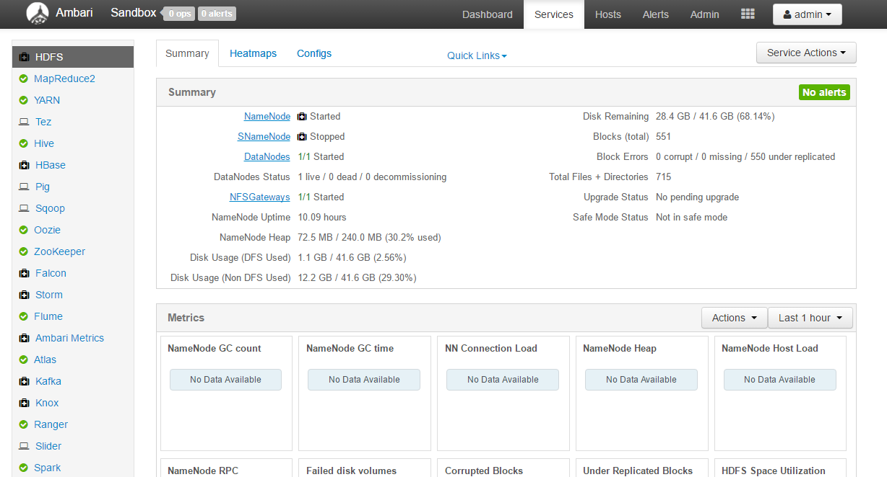
Notes:
Installed services on the left panel
Click any service to see information in the Summary tab
Heatmaps shows similar information on a node by node basis

Slide 30
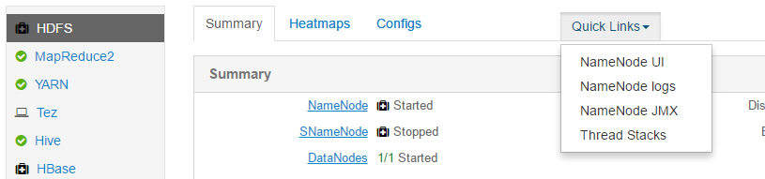
Many Hadoop services have their own Web UI. It’s worth remembering some of the ports you access frequently, but you can also use the quick links on the services summary page
The Web UIs tend to include information on how the service is running

Slide 31
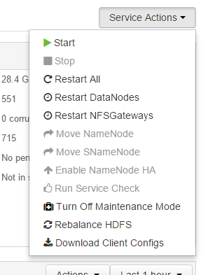
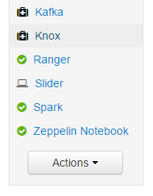
Actions
Service Actions will be different for each service you look at, allowing you to start or stop particular components of a service, or the entire thing
Actions are used for starting or stopping the entire cluster or installing new services

Slide 32
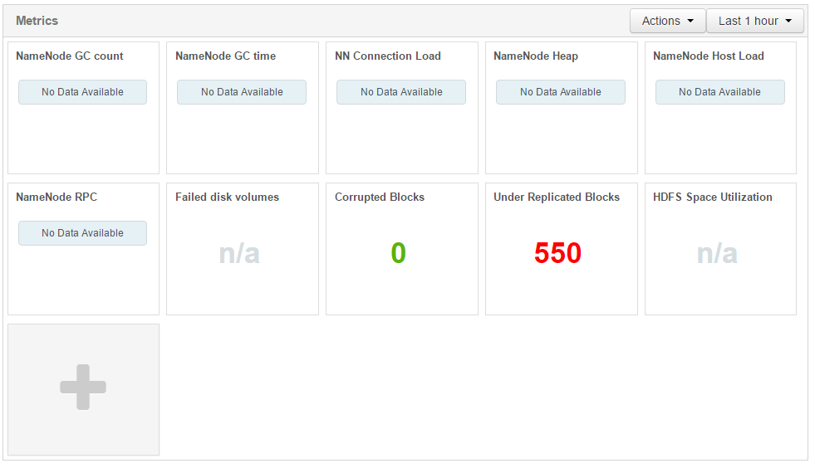
Notes:
Service specific metrics let’s us track interesting things about particular services. For example here we can see we have lots of under replicated blocks, so we should probably find the source of why we can’t re-replicate these (the answer is we’re working with the Hortonworks sandbox on only a single machine!)

Slide 33
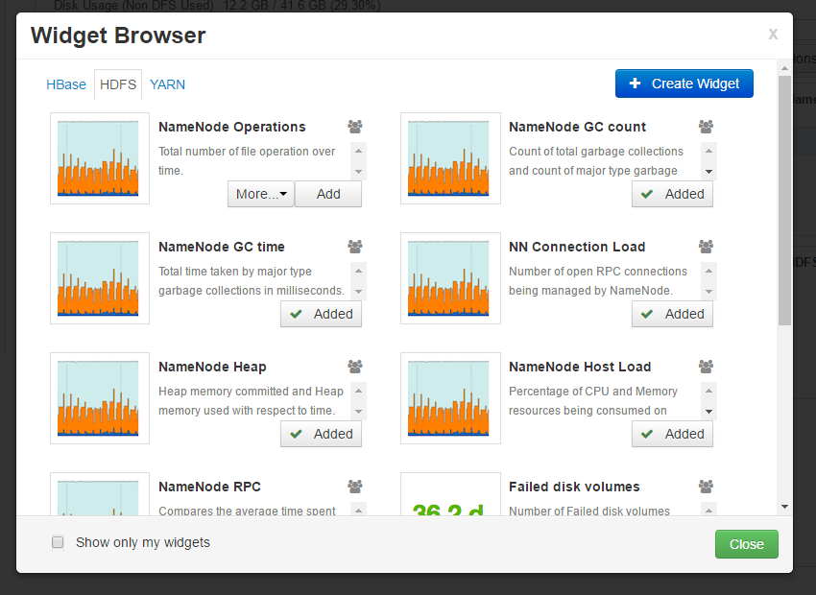
Notes:
You can add additional widgets for important things you need to know

Slide 34
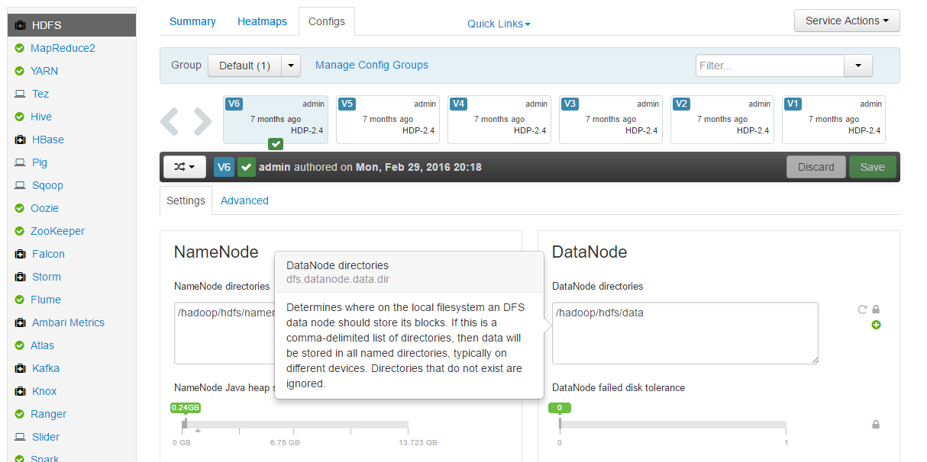
Notes:
In configs tab we can start looking at a range of configurations we can set
This can be done via sliders or typing in a value
The lock button will set to final
You can hover over any setting to find out more
You can revert
You can set to recommended value

Slide 35
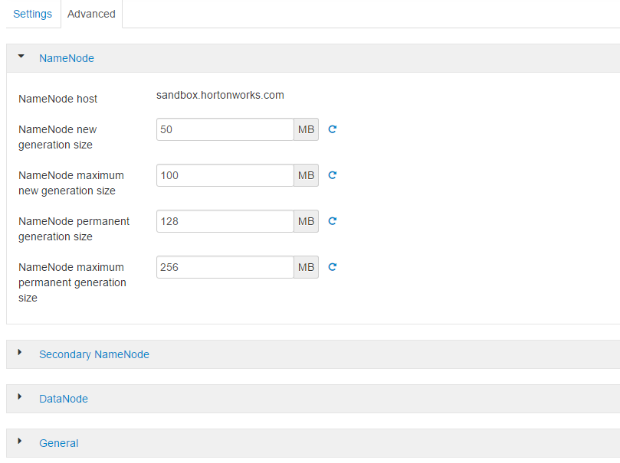
Notes:
There are lots more properties stored under ‘Advanced’
These tend to be grouped together somehow
The groups may not necessarily all change something in the same configuration file, just relating to the same daemon usually

Slide 36
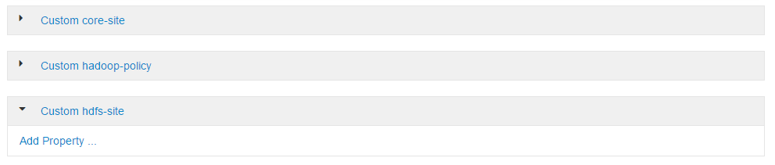
Notes:
Most services include custom sections for specific files where you can add more properties

Slide 37
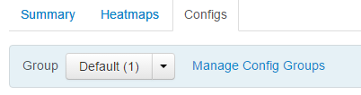
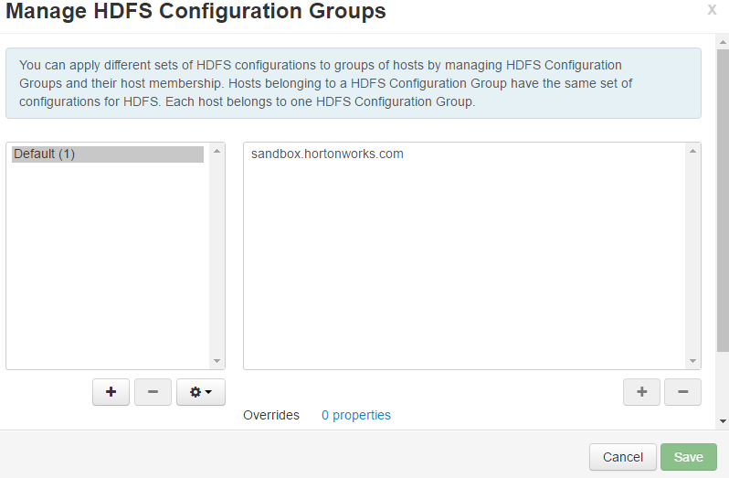
Configuration Groups
If the hardware is different in your cluster you may need to change your configuration dependent per machine

Slide 38
Client Configuration
Ambari can install client-side software and sort out client configuration files
Alternatively if software is manually installed then Ambari can download the client configuration files to it
An Ambari agent is not required just to download the configuration files but it is for the software

Slide 39
Manual Administration
Not compatible with Ambari
Can be slow and error prone but improved with scripting
Locate the configuration file and property that needs to be changed
Update the property
Distribute the changed file to all necessary nodes
Restart the service/service components/dependent services to make the changes effective via command line (most commands along the lines of sudo service <name> restart)

Slide 40
Manual Administration
Knox
ZooKeeper
HDFS
YARN
HBase
Hive Metastore
HiveServer2
WebHCat
Oozie
Storm
Kafka
If manually starting it must be done in this order via the necessary command via the command line
If manually stopping it must be done in this order via the necessary command via the command line
Knox
Oozie
WebHCat
HiveServer2
Hive Metastore
HBase
YARN
HDFS
ZooKeeper
Storm
Kafka
Notes:
Task 3

Slide 41
HDFS

Slide 42
HDFS
Inexpensive and reliable storage for large amounts of data
Optimised for sequential access to relatively small number of large files, not random reads
Similarities with a UNIX filesystem
Hierarchical
File ownership and permissions
Some deviations from UNIX
No concept of a ‘current’ directory
Can’t modify files once written
Must use Hadoop-specific utilities or custom code to access HDFS

Slide 43
Accessing HDFS via the command line
Typically access HDFS using the hadoop fs OR hdfs dfs command
Example: Display the content of the /user/james/times.txt file
Example: Create a directory (below the root) called general
$ hadoop fs –cat /user/james/times.txt
$ hdfs dfs –mkdir /general
Notes:
The complete list: http://hadoop.apache.org/docs/current/hadoop-project-dist/hadoop-common/FileSystemShell.html#chgrp

Slide 44
Further common command line prompts
Example: Copy input.txt from local disk to the user’s directory in HDFS
Example: Get a directory listing of the HDFS root directory
Example: Delete the file /reports/timesheets.txt
$ hadoop fs –put input.txt input.txt
$ hadoop fs –ls /
$ hadoop fs –rm /reports/timesheets.txt

Slide 45
Copying data
Remember:
Use hadoop fs –put to copy local files to HDFS
Use hadoop fs –get to copy HDFS files to the local disk
Can also access HDFS within Java and some ecosystem projects

Slide 46
HDFS daemons
HDFS master daemon: NameNode
Manages namespace and metadata
Monitors slave nodes
HDFS slave daemon: DataNode
Reads and writes data

Slide 47
How files are stored
Data files are split into blocks (the size can be set, the default is 64MB, Cloudera recommends 128MB) and distributed
Each block is replicated on multiple data nodes (the number of replications can be set, the default is 3)
DataNodes communicate with the NameNode
The NameNode stores the metadata
Filenames
File locations in HDFS
File ownership and permissions
Block locations
Changes to the metadata are made in RAM and written to a log file on disk called edits
Metadata filename is called fsimage

Slide 48
Block Replication
First copy of the block is placed on the same node as the client
If the client is not part of the cluster it is random
It will try to find one that is not too busy
Second copy is placed on a node residing on a different rack
Third copy is placed on a different node in the same rack as the second copy
If there is no rack topology
The first copy is still placed on the same node as the client
The other two copies will be placed on different nodes

Slide 49
How files are stored
Name Node:
Metadata
Data Node
Block 1
Very Large Data File
Block 1
Block 3
Data Node
Block 1
Block 2
Block 2
Data Node
Block 2
Block 3
Data Node
Block 3
Block 2
Data Node
Block 1
Block 3

Slide 50
HDFS NameNode
The NameNode must always be running otherwise the cluster becomes inaccessible, making it a single point of failure
High Availability mode solves this
Two NameNodes – Active and Standby
Classically, there could be two NameNodes, but the second was the Secondary NameNode and was used for bookkeeping, not backup like the Active/Standby setup
Data never travels via the NameNode – it is not a bottleneck

Slide 51
NameNode
All metadata is held in RAM for fast response
Each item consumes 150-200 bytes of RAM
Filenames
Permissions
Block information
Consider why HDFS prefers fewer, larger files:
1 x 1 GB file
Name: 1 item
Blocks: 8 items
Total: 9 items
1000 x 1 MB files
Name: 1000 items
Blocks: 1000 items
Total: 2000 items

Slide 52
Secondary NameNode
NameNode keeps metadata and writes changes to the edits file
Secondary NameNode then performs memory-intensive admin for the NameNode
Combines a prior snapshot of the metadata and edit log into a new snapshot
This new snapshot is then transferred back to the NameNode
Secondary NameNode should typically run on a separate machine as it requires just as much RAM as the NameNode

Slide 53
High Availability
Eliminates Single Point of Failure (SPOF) with the NameNode
Standby NameNode takes over when the Active NameNode fails
Standby NameNode also acts as Secondary NameNode as it does checkpointing as well

Slide 54
Reading a File
Client connects to the NameNode
NameNode returns the name and locations of the first few blocks of the file
Block locations are returned closest first
Client connects to the first of the DataNodes and reads the block
If the DataNode fails during the read, the client will simply connect to the next one in the list to read the block

Slide 55
Writing a File
Client connects to the NameNode
NameNode places an entry for the file in the metadata then returns the block name and list of DataNodes to the client
Client connects to the first DataNode and starts sending data
As data is received by the first DataNode, it connects to the second and starts sending data
Similarly, the second DataNode connects to the third
ack packets from the pipeline are sent back to the client
Client reports to the NameNode when the block is written

Slide 56
Writing a File
If a DataNode in the pipeline fails:
The pipeline is closed
A new pipeline is opened with two good nodes
The data continues to be written to the two good nodes in the pipeline
The NameNode will realise the block is under-replicated and re-replicate the block to another DataNode
As data is written, the client calculates a checksum for each block
Sent to the DataNode with the data
Written with each data block
Used to ensure the integrity of the data

Slide 57
Dealing with Data Corruption
‘Live’ checksum is compared to the initial checksum from when the block was created
If they differ the client will read from the next DataNode
The NameNode is informed that a corrupted version of the block has been found
The NameNode will re-replicate the block somewhere else
The DataNode will verify the checksums regularly (every three weeks is the default)

Slide 58
Data Reliability and Recovery
DataNodes sends ‘heartbeats’ to the NameNode every 3 seconds
After a period without any heartbeats the DataNode is assumed to be lost
The NameNode will then determine what blocks it held
The NameNode will find other DataNodes with these blocks
The NameNode then instructs these DataNodes to copy the blocks elsewhere to avoid under-replication
A DataNode can rejoin a cluster after being down
The NameNode will ensure the blocks are not over-replicated by instructing DataNodes to remove excess copies
Not all blocks will necessarily be removed from the DataNode that was temporarily down

Slide 59
MapReduce

Slide 60
MapReduce nodes
Similar Master/Slave architecture as with HDFS
Master node distributes data and work that is performed by the slave nodes
A daemon is a program running on the node

Slide 61
Versions
MapReduce v1 (MRv1 or Classic MapReduce)
JobTracker/TaskTracker architecture
One JobTracker per cluster (limit 4000 nodes)
Slots on slave nodes designed for Map or Reduce tasks
MapReduce v2 (MRv2)
Built on top of YARN (Yet Another Resource Negotiator)
ResourceManager/NodeManager architecture
Increases scalability
Node resources can be used for any type of task
Improves cluster utilization
Support for non-MR jobs

Slide 62
MRv2 daemons
NodeManager
ResourceManager (Active & Standby
NodeManager
NodeManager ApplicationMaster
Job History Server

Slide 63
Nodes and daemons
Don’t confuse the previous slides with the HDFS nodes and daemons
HDFS provides distributed data
MRv1/MRv2 & YARN provides distributed processing
NodeManager / DataNode
ResourceManager (Active & Standby
NodeManager / DataNode
NameNode(s)
NodeManager / DataNode
Job History Server
NodeManager / DataNode

Slide 64
Running an application in YARN
Containers
Allocated by the ResourceManager
Requires a certain amount of resources (memory, CPU)
Applications run in one or more containers
ApplicationMaster
One per application
Framework specific (MRAppMaster for MapReduce)
Runs in a container
Requests more containers to run application tasks
NodeManager
1 GB
1 core
3 GB
1 core
NodeManager
Application Master

Slide 65
Terminology
Job / application
A Mapper, a Reducer and a list of inputs
Task
An individual unit of work
A job is broken down into tasks
Each task is either a Map or Reduce task
Runs in a container on a slave node
Client
The program that submits the job to the ResourceManager

Slide 66
NodeManager / DataNode
HDFS: mydata
Client
Block1
NodeManager / DataNode
ResourceManager (Active & Standby)
Block2
NameNode(s)
NodeManager / DataNode
Job History Server
NodeManager / DataNode

Slide 67
$ hadoop jar MyMR.jar MyDriver mydata outdir
NodeManager / DataNode
Block1
Client
NodeManager / DataNode
ResourceManager (Active & Standby)
Block2
NameNode(s)
NodeManager / DataNode
MapReduce Application Master
Job History Server
NodeManager / DataNode
Notes:
Job submission

Slide 68
$ hadoop jar MyMR.jar MyDriver mydata outdir
NodeManager / DataNode
Block1
Client
NodeManager / DataNode
ResourceManager (Active & Standby)
Block2
NameNode(s)
NodeManager / DataNode
MapReduce Application Master
Job History Server
NodeManager / DataNode
Notes:
Map task resource request

Slide 69
NodeManager / DataNode
Map Task 1
Block1
Client
NodeManager / DataNode
ResourceManager (Active & Standby)
Map Task 2
Block2
NameNode(s)
NodeManager / DataNode
MapReduce Application Master
Job History Server
NodeManager / DataNode
Notes:
Map task launch

Slide 70
NodeManager / DataNode
Map Task 1
Int. data
Block1
Client
NodeManager / DataNode
ResourceManager (Active & Standby)
Map Task 2
Int. data
Block2
NameNode(s)
NodeManager / DataNode
MapReduce Application Master
Job History Server
NodeManager / DataNode
Notes:
Intermediate data

Slide 71
NodeManager / DataNode
Int. data
Block1
Client
NodeManager / DataNode
ResourceManager (Active & Standby)
Int. data
Block2
NameNode(s)
NodeManager / DataNode
MapReduce Application Master
Job History Server
NodeManager / DataNode
Notes:
Reduce task resource request

Slide 72
NodeManager / DataNode
Int. data
Block1
Client
NodeManager / DataNode
ResourceManager (Active & Standby)
Reduce Task 1
Int. data
Block2
NameNode(s)
NodeManager / DataNode
MapReduce Application Master
Job History Server
NodeManager / DataNode
Reduce Task 2
Notes:
Reduce task launch

Slide 73
NodeManager / DataNode
Int. data
Block1
Client
NodeManager / DataNode
ResourceManager (Active & Standby)
Reduce Task 1
Int. data
Block2
NameNode(s)
NodeManager / DataNode
MapReduce Application Master
Job History Server
NodeManager / DataNode
Reduce Task 2
Notes:
Shuffle & Sort

Slide 74
NodeManager / DataNode
Block1
Client
NodeManager / DataNode
ResourceManager (Active & Standby)
Reduce Task 1
part-00000
Block2
NameNode(s)
NodeManager / DataNode
MapReduce Application Master
Job History Server
HDFS: outdir
NodeManager / DataNode
Reduce Task 2
part-00001
Notes:
Job output

Slide 75
NodeManager / DataNode
Block1
Client
NodeManager / DataNode
ResourceManager (Active & Standby)
part-00000
Block2
NameNode(s)
NodeManager / DataNode
MapReduce Application Master
Job History Server
NodeManager / DataNode
part-00001
Notes:
Job history

Slide 76
NodeManager / DataNode
Block1
Client
NodeManager / DataNode
ResourceManager (Active & Standby)
part-00000
Block2
NameNode(s)
NodeManager / DataNode
MapReduce Application Master
Job History Server
NodeManager / DataNode
part-00001
Notes:
Job completion

Slide 77
NodeManager / DataNode
Block1
Client
NodeManager / DataNode
ResourceManager (Active & Standby)
part-00000
Block2
NameNode(s)
NodeManager / DataNode
Job History Server
NodeManager / DataNode
part-00001
Notes:
Resources released

Slide 78
ResourceManager
Manages nodes
Tracks heartbeats from NodeManagers
Runs a scheduler
Determines how resources are allocated
Manages containers
Handles ApplicationMasters’ requests for resources
De-allocates containers when they expire or the application completes
Manages ApplicationMasters
Creates a container for ApplicationMasters and tracks heartbeats
Manages cluster-level security

Slide 79
NodeManager
Communicates with the ResourceManager
Registers and provides info on node resources
Sends heartbeats and container status
Manages processes in containers
Launches ApplicationMasters on request from ResourceManager
Launches application processes on request from ApplicationMasters
Monitors resource usage by containers and kills runaway processes
Provides logging services to applications
Aggregates logs for an application and saves them to HDFS
Runs auxiliary services
Maintains node-level security

Slide 80
Cluster resource allocation
ApplicationMaster
Negotiates with the ResourceManager to obtain containers for the job
Presents containers to NodeManagers
ResourceManager
Grants containers
Performs cluster scheduling
NodeManager
Manages life-cycle of containers
Launches Map and Reduce tasks in containers
Monitors resource consumption

Slide 81
Cluster resource allocation
The ResourceManager Scheduler allocates a container for the ApplicationMaster
The ResourceManager asks a NodeManager to launch the ApplicationMaster
The ApplicationMaster determines the number of Map tasks based on the Input Splits
The ApplicationMaster asks the ResourceManager to assign containers for each Map task
The ResourceManager Scheduler decides where to run the Map tasks based on memory requirements and data locality
The ApplicationMaster asks the assigned NodeManagers to run the Map tasks

Slide 82
Fault Tolerance
When something fails…
Task (Containers)
ApplicationMaster reattempts tasks that complete with exceptions or stop responding (default 4 times)
Applications with too many failed tasks are considered failed
ApplicationMaster
If an application fails or if the ApplicationMaster stops sending heartbeats then the ResourceManager will reattempt the whole application (default 2 times)
Job recovery
If false, all tasks will re-run
If true, ApplicationMaster retrieves state of tasks when it restarts; only incomplete tasks will be rerun

Slide 83
Fault Tolerance
When something fails…
NodeManager
If the NodeManager stops sending heartbeats to the ResourceManager, it is removed from the list of active nodes
Tasks on the node will be treated as failed by the ApplicationMaster
If the ApplicationMaster node fails, it will be treated as a failed application
ResourceManager
No applications or tasks can be launched if the ResourceManager is unavailable
Can be configured with high availability

Slide 84
Log aggregation
Debugging distributed processes can be difficult
Logs are saved locally on nodes
YARN provides application log aggregation services
NodeManagers move local log to HDFS
Aggregated by job
Can be accessed from HDFS client, command line or Web UI

Slide 85
MapReduce
Programming model
Record-oriented data processing (key-value pairs)
Facilitates task distribution across multiple nodes
Each node processes data stored on that node where possible
Automatic parallelization and distribution
Easy abstraction for programmers
Keeps ‘housekeeping’ out of the way

Slide 86
MapReduce
Consists of two developer-created phases
Map
Always runs first
Usually used to filter, transform or parse data
Works on an individual record at a time
The number of Map tasks is determined by the amount of input data
For each input record, a Map task will emit zero or more records as output

Slide 87
MapReduce
Consists of two developer-created phases
Reduce
Optional
Summarises data from the map function (aggregation)
In between these there is the shuffle and sort
Automatically sorts and merges the map tasks

Slide 88
Example : Word Count
Aim: Input – text file with sentences
Output – file with a list of words that appear in the text and how many times they appear
Output Data
antelope 1
Cat 1
Ma 1
On 2
Sat 2
Seat 1
The 4
Input Data
the cat sat on the mat
the antelope sat on the seat

Slide 89
Example : Word Count
The 1
Cat 1
Sat 1
On 1
The 1
Mat 1
Input Data
the cat sat on the mat
the antelope sat on the seat
Mapper
Record Reader
The 1
Antelope 1
Sat 1
On 1
The 1
Seat 1
0
the cat sat on the mat
23
the antelope sat on the seat
Mapper
52
…

Slide 90
Example : Word Count
Many Mappers can run in parallel. Say our input file was even larger, other Mappers may run on another node.
The 1
Cat 1
Sat 1
…
Node 1
the cat sat on the mat
the antelope sat on the seat
Map
The 1
Antelope 1
Sat 1
…
Input Data
the cat sat on the mat
the antelope sat on the seat
the person drove the vehicle to get the package
Node 2
the person drove the vehicle to get the package
Map
The 1
Person 1
Drove 1
…

Slide 91
Example : Word Count
The 1
Cat 1
Sat 1
On 1
The 1
Mat 1
antelope 1
cat 1
mat 1
on 1,1
sat 1,1
seat 1
the 1,1,1,1
Shuffle & Sort
Node 1
the 1
antelope 1
sat 1
on 1
the 1
seat 1

Slide 92
Example : Word Count
The 1
Person 1
Drove 1
The 1
Vehicle 1
To 1
Get 1
The 1
Package 1
Drove 1
Vehicle 1
Get 1
package 1
Person 1
The 1,1,1
To 1
Shuffle & Sort
Node 2

Slide 93
Example : Word Count
Antelope 1
Cat 1
Mat 1
Drove 1
On 1,1
Antelope 1
Cat 1
Mat 1
On 1,1
Sat 1,1
Seat 1
The 1,1,1,1
Shuffle & Sort
Vehicle 1
Sat 1,1
Person 1
Seat 1
Drove 1
Vehicle 1
Get 1
Package 1
Person 1
The 1,1,1
To 1
Get 1
Package 1
The 1,1,1,1,1,1,1
To 1

Slide 94
Example : Word Count
part-r-00000
Antelope 1
Cat 1
Mat 1
Drove 1
On 2
Antelope 1
Cat 1
Mat 1
Drove 1
On 1,1
Reduce
part-r-00001
Vehicle 1
Sat 2
Person 1
Seat 1
Vehicle 1
Sat 1,1
Person 1
Seat 1
Reduce
part-r-00002
Get 1
Package 1
The 1,1,1,1,1,1,1
To 1
Get 1
Package 1
The 7
To 1
Reduce

Slide 95
Example : Word Count
reduce ()
part-r-00002
Get 1
Package 1
The 1,1,1,1,1,1,1
To 1
reduce ()
Get 1
Package 1
The 7
To 1
reduce ()
reduce ()

Slide 96
Example : Word Count
Word counting is challenging over massive amounts of data
Using a single node would take too long
The number of unique words could exceed memory
Statistics are simply aggregate functions
Easy to make in MapReduce
MapReduce breaks down the complex tasks to run in parallel making it quicker and more efficient
Many tasks have commonality with counting words such as log file analysis

Slide 97
Potential bottleneck – Shuffle & Sort
At first it may appear that the Shuffle & Sort is a bottleneck
The reduce() method in the Reducers can’t start until all Mappers have finished
However, Hadoop will start to transfer data from the Mappers to the Reducers as soon as Mappers complete work
This avoids large amounts of data transferring as soon as the last Mapper finishes
The reduce() method still doesn’t start until all intermediate data has been transferred and sorted

Slide 98
Potential bottleneck – Slow Mappers
What if one Mapper runs much slower than others, perhaps due to faulty hardware
The reduce() method cannot start until all Mappers have completed
Hadoop uses speculative execution to mitigate this
If a Mapper appears to be running significantly slower than others, a new instance of the Mapper will be started on another machine, operating on the same data, a new task attempt
The result of the first Mapper to finish will be used
Hadoop will kill off the Mapper still running

Slide 99
Ecosystem

Slide 100
Ecosystem components
Data analysis
Database integration
Workflow management
Built on HDFS and/or MapReduce
Designed to integrate with or support Hadoop

Slide 101
Apache Pig
High-level data processing as opposed to low-level MapReduce code
Especially good at joining and transforming data
Pig interpreter runs on the client machine, turns Pig Latin scripts into MapReduce jobs and submits them to the cluster

Slide 102
Apache Hive
Like Pig, it is an abstraction on top of MapReduce
Uses an SQL-like language called HiveQL
Hive interpreter runs on the client machine and turns HiveQL queries into MapReduce jobs, then submits those to the cluster

Slide 103
Impala
High-performance SQL engine for large amounts of data
Similar query language to HiveQL
10 to 50+ times faster than Hive, Pig or MapReduce
Runs on Hadoop clusters using data stored in HDFS but not MapReduce

Slide 104
Apache Sqoop – SQL to Hadoop
Transfers data between RDBMSs and HDFS
Does this via a Map-only MapReduce job
Supports JDBC, ODBC and other databases
Can import all tables, a single table, or table portions into HDFS
Results in a directory in HDFS containing comma-delimited text files
Can also export data from HDFS back to the database
Can incrementally append new records and update current ones

Slide 105
Apache Flume
Imports data into HDFS as it is being generated contrasted against batch-processing it later
E.g. log files

Slide 106
Apache Oozie
Workflow engine for MapReduce jobs
Oozie server submits jobs to the server in a set sequence
Supports actions such as:
MapReduce jobs
Pig or Hive scripts
Java or shell programs
Manipulating data via HDFS commands
Running remote commands with SSH
Sending emails

Slide 107
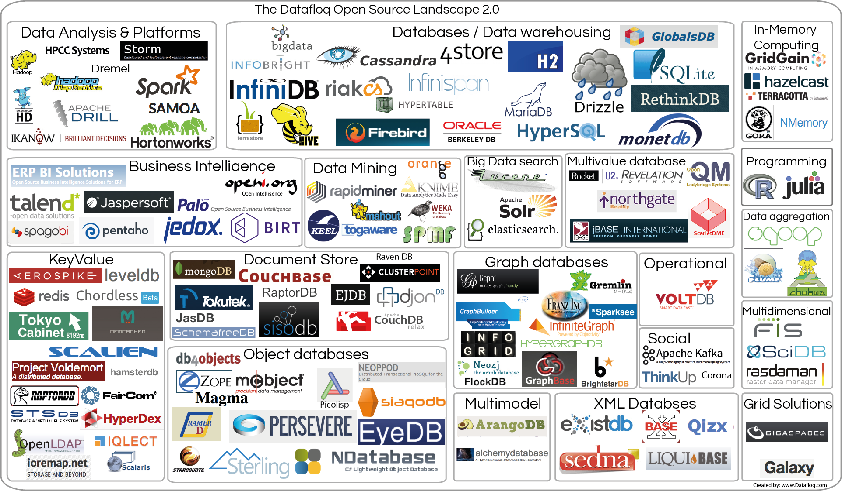

Slide 108
Admin

Slide 109
Topics
Hadoop Administration
Ports
Racks
Security
Hive, Impala and Pig
Clients
Advanced configuration
High Availability
Jobs

Slide 110
Hadoop Ports
Hadoop daemons each provide a web-based user interface
Useful for both users and system administrators
Expose information on a variety of ports, the numbers are configurable though most have defaults
Some ports used for communication between components of the system

Slide 111
Common Web UI Ports for Users
HDFS
NameNode – 50070 – dfs.namenode.http-address
DataNode – 50075 – dfs.datanode.http.address
Secondary NameNode – 50090 – dfs.namenode.secondary.http-address
YARN
ResourceManager – 8088 – yarn.resourcemanager.webapp.address
NodeManager – 8042 – yarn.nodemanager.webapp.address
JobHistoryServer – 19888 – mapreduce.jobhistory.webapp.address

Slide 112
Rack Topology Awareness
HDFS is ‘rack aware’
Distributes blocks based on host location
Administrator supplies a script which tells Hadoop which rack a node is in
Should return a ‘rack ID’ such ash /datacenter1/rack20
Can use a flat file, database etc.
Script name is specified in net.topologu.script.file.name in core-site.xml
If this is blank Hadoop will return /default-rack for all nodes

Slide 113
Rack Topology Script
Give host name and find it in a list of hosts, return the rack
Example rack file
Host1 /datacenter1/rack1
Host2 /datacenter1/rack1
Host3 /datacenter1/rack1
Host4 /datacenter1/rack1
Host5 /datacenter1/rack2
Host6 /datacenter1/rack2
Host7 /datacenter1/rack2

Slide 114
Hadoop Security
HDFS file ownership and permissions
User/group authentication is easily subverted
Mainly intended to guard against accidental deletions/overwrites
Kerberos
Strong authentication
Wraps Hadoop API calls in an SSL handshake
Encrypted HDFA data transfers
Encrypted HTTP traffic
Hadoop Web UIs
Intermediate data transferred during shuffle & sort
Does not provide encryption for data stored on disk
Security enhanced by isolation

Slide 115
Kerberos
Client
Desires access to a service e.g. the hadoop fs command
Server providing desired network service
Service daemon e.g. NameNode or JobTracker
The Kerberos Key Distribution Center (KDC)
Not provided or part of Hadoop
Most Linux distributions come with the MIT Kerberos KDC
Authenticates and authorizes a client

Slide 116
Hive

Slide 117
Hive
Open source Apache project originally developed at Facebook
Many data analysts are familiar with SQL but less so with Java
Hive lets us query data in HDFS using a SQL-like language
SELECT * from movies m
JOIN scores s
ON (m.id = s.movie_id)
WHERE m.year > 1995
ORDER BY m.name DESC
LIMIT 50;

Slide 118
Hive
A table in Hive represents an HDFS directory
Hive interprets the files in the directory as contents of the table
Stores delimitation information in the Hive Metastore
The Metastore, by default, is on the user’s local machine
If multiple users will be running Hive, the Administrator should configure a shared Metastore, a database in an RDBMS such as MySQL

Slide 119
The Hive Metastore Service
Optional but recommended when using a shared Metastore
Use the Thrift API to make calls to the Hive Metastore service
The Hive Metastore service connects to the Metastore database using JDBC
Cloudera Impala also accesses the shared Metastore by calling this service

Slide 120
Hive – Installation and Configuration
Hive runs on the user’s machine so it needs no Administrator input
sudo [package manager] install hive
Configure the client so Hive can access the Hadoop cluster
Hive can use core-site.xml, yarn-site.xml, mapred-site.xml if they are already configured to access the cluster
Else, configure fs.defaultFS and yarn.resourcemanager.address in /etc/hive/conf/hive-site.xml

Slide 121
Shared Metastore
Create a database in your RDBMS - CREATE DATABASE metastore;
Create a database user with appropriate privileges - USE metastore; CREATE USER ‘hiveuser@’%’ IDENTIFIED BY ‘password’; REVOKE ALL PRIVILEGES, GRANT OPTION FROM ‘hiveuser@’%’; GRANT SELECT, INSERT, UPDATE, DELETE, LOCK TABLES, EXECUTE, CREATE, ALTER ON metastore.* TO ‘hiveuser@’%’;

Slide 122
Shared Metastore
Run the schematool utility to import the Hive metastore schema into the database - sudo /usr/lib/hive/bin/schematool –dbType mysql –initSchema
Revoke the ALTER and CREATE privileges from the database user - REVOKE ALTER, CREATE ON metastore.* FROM ‘hiveuser@’%’;
Install and start the Hive Metastore service - sudo yum install hive-metastore - sudo service hive-metastore start
Modify hive-site.xml on client systems to refer to the shared Metastore

Slide 123
ZooKeeper
HiveServer2 uses ZooKeeper to support concurrency
Install the ZooKeeper server on an odd number of hosts
sudo yum install zookeeper-server
Initialise a data directory on each host that will run a ZooKeeper server
sudo service zookeeper-server init –myid n
Creates a file named myid in the ZooKeeper data directory that has a single number identifier
Create a ZooKeeper configuration file on each host in /etc/zookeeper/conf/zoo.cfg
Start the ZooKeeper server
sudo service zookeeper-server start

Slide 124
zoo.cfg
tickTime=2000
clientPort=2181
initLimit=10
syncLimit=2
dataDir=/var/lib/zookeeper
server.1.elephant.example.com:2888:3888
server.2.tiger.example.com:2888:3888
server.3.horse.example.com:2888:3888
Server ID matches the number in the --myid argument shown on the previous slide

Slide 125
Installing and Configuring HiveServer2
sudo yum install hive-server2
Set HADOOP_MAPRED_HOME in /etc/default/hive-server2
Configure the HiveServer2 Table Lock Manager in hive-site.xml
sudo service hive-server2 start
Property | Sample value
hive.support.concurrency | true
hive.zookeeper.quorum | elephant,tiger,horse

Slide 126
Impala

Slide 127
Impala
Querying data in HDFS using HiveQL
Uses the same shared Metastore as Hive
Does not turn queries into MapReduce jobs
Impala queries run on their own set of daemons on the Hadoop cluster
Impala Servers should reside on each DataNode host and can coexist with NodeManagers if you are also running MapReduce
One Impala State Store and one Impala Catalog Server per cluster – very lightweight and can co-locate with NameNode or Secondary NameNode
Significantly faster than Hive

Slide 128
Installing, Configuring and Starting Impala
Install the Impala software
Configure HDFS for performance
Restart all DataNodes
If necessary, configure hive-site.xml for the shared Hive Metastore
Copy hive-site.xml, core-site.xml, hdfs-site.xml and log4j.properties to /etc/impala/conf on all hosts that will run Impala Servers
Configure startup options in /etc/default/impala on all hosts that will run the Impala State Store Server or Impala Catalog Server
Start the Impala Servers, the Impala State Store Server and the Impala Catalog Server

Slide 129
Installing Impala
Install the Impala Server on all hosts running DataNodes
sudo yum install impala-server
Install the Impala State Store Server on a single host
sudo yum install impala-state-store
Install the Impala Catalog Server on the same host as above
sudo yum install impala-catalog
Install the Impala shell on clients
sudo yum install impala-shell

Slide 130
Impala HDFS Configuration
dfs.client.read.shortcircuit (hdfs-site.xml) | Allows daemons to read directly off their host’s disks. Required value: true
dfs.domain.socket.path (hdfs-site.xml) | Short-circuit reads use a UNIX domain socket which required a path. Recommended value: /var/run/hadoop-hdfs/dn._PORT
dfs.client.file-block-storage-locations.timeout.millis (hdfs-site.xml) | Timeout on a call to get the locations of required blocks. Recommended value: 10000
dfs.datanode.hdfs-blocks-metadata.enabled (hdfs-site.xml) | Expose the disk on a datanode on which a block resides. Recommended value: true

Slide 131
etc/default/impala – startup options
IMPALA_STATE_STORE_HOST | The host running the Impala State Store Server. Default value: 127.0.0.1 Required value: Host name or IP address of the host running this server
IMPALA_CATALOG_SERVICE_HOST | The host running the Impala Catalog Server. Default value: 127.0.0.1 Required value: Host name or IP address of the host running this server
-mem_limit argument in export IMPALA_SERVER_ARGS statement | The amount of system memory available to Impala. Default: 100% Set as needed based on system activity

Slide 132
Starting Impala
Impala Servers
sudo service impala-server start
Impala State Store Server
sudo service impala-state-store start
Impala Catalog Server
sudo service impala-catalog start
impala-shell client
impala-shell

Slide 133
Client Interaction

Slide 134
Pig
High-level abstraction on top of MapReduce
Open source originally created at Yahoo
Scripting language known as Pig Latin
Operations that are applied to the input data to produce output
Easy to write complex tasks such as joins of multiple databases
Converted to MapReduce jobs
Client-side application
sudo yum install pig
Configuration properties in core-site.xml, yarn-site.xml and mapred-site.xml

Slide 135
Hadoop Clients
Accesses functionality within a Hadoop cluster using Hadoop APIs
Command-line clients
The hadoop shell
The Pig shell
The Sqoop command-line interface
Server daemons
Flume agent
Centralised Sqoop and Hive server
Oozie
Mapper and Reducer tasks

Slide 136
Client Installation and Hadoop APIs
Install with sudo yum install name
hive
pig
sqoop
flume-ng-agent
Client installers automatically include any required Hadoop APIs as dependencies if they aren’t already there

Slide 137
Client Configuration
Need to be configured to identify the Hadoop cluster, include NameNode and ResourceManager locations
Can copy the configuration files to clients
Some will require client-specific configuration
hive-site.xml
pig.properties
flume-conf.properties
Cloudera Manager can handle client configuration

Slide 138
Hue
Access Hue applications via a web browser
sudo yum install hue
Set an arbitrary value for secret_key in the [desktop] section of hue.ini
Start the Hue server – sudo service hue start
Access Hue from a browser – http://<hue_server>:8888
Configure the Hue applications by modifying /etc/hue/conf/hue.ini then restart the Hue server

Slide 139
Further Configuration

Slide 140
Trash
fs.trash.interval (core-site.xml) | When a file is deleted, it is placed in a .Trash directory in the user’s home directory, rather than being immediately deleted. It is purged from HDFS after the number of minutes specified. Default: 0 (disabled). Recommended: 1440 (one day)

Slide 141
Resource Allocation and Process Size
Be sure to adjust both the Java heap size properties and the resource allocation properties
The resource allocation properties do not determine the heap size for the ApplicationMaster, Mappers and Reducers
Example
yarn.nodemanager.resource.memory-mb = 8192
mapreduce.map.memory.mb = 4096
mapreduce.map.java.opts is left as default
Then the heap size for Mappers would be 200MB from mapreduce.map.java.opts = 200m

Slide 142
File Compression
io.compression.codecs (core-site.xml) | List of compression codecs that Hadoop can use for file compression. Used by clients and all nodes running Hadoop daemons. If you are using another codec, add it here. Default: org.apache.hadoop.io.compress.DefaultCodec, org.apache.hadoop.io.compress.GzipCodec, org.apache.hadoop.io.compress.BZip2Codec, org.apache.hadoop.io.compress.DeflateCodec, org.apache.hadoop.io.compress.SnappyCodec
mapreduce.map.output.compress (mapred-site.xml) | Determines whether intermediate data from Mappers should be compressed before transfer across the network. Default: false. Recommendation: true

Slide 143
File Compression
mapreduce.map.output. compress.codec (mapred-site.xml) | The compression codec used to compress intermediate data from Mappers. Default: org.apache.hadoop.io.compress.DefaultCodec Recommended: org.apache.hadoop.io.compress.SnappyCodec

Slide 144
Speculative Execution
If a task is running significantly slower than the average speed of the tasks for that job, speculative execution may occur
Another attempt to run the task is instantiated on a different node
The results from the first completed task is used
The slower task is killed
mapred.map.speculative (mapred-site.xml) | Whether to allow speculative execution for Map tasks. Default: true. Recommended: true
mapred.reduce.speculative (mapred-site.xml) | Whether to allow speculative execution for Reduce tasks. Default: true. Recommended: false

Slide 145
High Availability

Slide 146
HDFS High Availability
In non-HA, a single NameNode runs and is a single point of failure
Either an unexpected crash or planned NameNode maintenance causes HDFS downtime
HDFS High Availability eliminates this and is available in CDH4 and onwards

Slide 147
HDFS High availability
Uses a pair of NameNodes
One is Active and one Standby
Clients only contact the Active NameNode
DataNodes heartbeat to both NameNodes
Active NameNode writes the metadata to a quorum of JournalNodes
Standby NameNode reads from the JournalNodes to remain in sync with the Active NameNode

Slide 148
HDFS High Availability
Active NameNode writes edits to the JournalNodes
Uses software called the Quorum Journal Managger (QJM)
Waits for a success acknowledgment from the majority of JournalNodes
Majority commit means a single crashed or lagging JournalNode will not impact NameNode latency
Uses the Paxos algorithm to ensure reliability even if edits are being written as a JournalNode failes
Note that there is no Secondary NameNode when implementing HDFS High Availability
The Standby NameNode periodically performs checkpointing

Slide 149
Failover
Only one NameNode must be active at any given time while the other is in standby mode
The Standby maintains a copy of the active NameNode’s state so it can take over when it goes down
Two types of failover
Manual – detected and initiated by a user
Automatic – detected and initiated by HDFS

Slide 150
Automatic Failover
ZooKeeper Failover Controller (ZKFC) runs on each NameNode machine
Needs a quorum of nodes
Typically 3 or 5 nodes
Low resource usage

Slide 151
Fencing
Only one NameNode must be active at a time otherwise there is a possibility of ‘split-brain syndrome’
The Quorum Journal Manager ensures that a previously-active NameNode cannot corrupt the NameNode metadata
Could possibly report ‘stale’ data to a client
Therefore you should ‘fence’ the NameNode to isolate and shut it down
When configuring HDFS HA you must specify one or more fencing methods
Shell Scripts
SSH

Slide 152
HDFS HA Deployment
Modify the Hadoop configuration
Install and start the JournalNodes
Configure and start a ZooKeeper ensemble
Initialise the shared edits directory if converting from a non-HA setup
Install, bootstrap, and start the Standby NameNode
Install, format, and start the ZooKeeper failover controllers
Restart DataNodes and the YARN and MapReduce daemons

Slide 153
JournalNodes
Install the JournalNode – sudo yum install hadoop-hdfs-journalnode
Create the shared edits directory on the JournalNode
Location specified by dfs.journalnode.edits.dir
Owned by the hdfs user
Start the JournalNode – sudo service hadoop-hdfs-journalnode start

Slide 154
Shared Edits Directory
This section is only required if you are converting an existing non-HA deployment to an HA setup
Run sudo –u hdfs hdfs namenode –initializeSharedEdits
After these are initialized you can restart the existing NameNode
Run the hdfs haadmin –getServiceState command to verify the existing NameNode is not active yet

Slide 155
The Standby NameNode
Install the second NameNode
Bootstrap it with sudo –u hdfs hdfs namenode –bootstrapStandby
Start the NameNode
Run hdfs haadmin –getServiceState to ensure the existing NameNode is not active yet

Slide 156
ZooKeeper Failover Controller
Automatic failover only
Install the ZooKeeper Failover Controllers on the same hosts as the NameNodes with sudo yum install –assumeyes hadoop-hdfs-zkfc
Initialise the current NameNode state in ZooKeeper with sudo –u hdfs hdfs zkfc –formatZK
Start the ZooKeeper Failover Controllers with sudo service start hadoop-hdfs-zkfc
Restart the DataNodes and the YARN and MapReduce daemons
Restart the Active NameNode and check the service state

Slide 157
core-site.xml for HDFS HA
fs.defaultFS | Change from <host>:<port> to a logical URI to the HDFS file system that specifies a NameService ID defined in hdfs-site.xml. This URI defines a virtual NameNode and transparently resolves to the Active NameNode. E.g. hdfs://mycluster
ha.zookeeper.quorum | Comma-delimited list of all ZooKeeper nodes in the quorum. Specify fully qualified host names (FQHNs) and port numbers. Example: elephant.example.com:2181, tiger.example.com:2181, horse.example.com:2181 Used by ZooKeeper Failover Controllers. Required for automatic failover only.

Slide 158
hdfs-site.xml for HDFS HA
dfs.nameservices | A unique NameService ID. Example: mycluster
dfs.ha.namenodes.<NSID> For example: dfs.ha.namenodes.mycluster (<NSID> = NameService ID) | A comma-separated list of two NameNodes in the cluster. Example: nn1,nn2
dfs.namenode.rpc-address.<NSID>.<NNID> For example: dfs.namenode.rpc-address.mycluster.nn1 dfs.namenode.rpc-address. mycluster.nn2 (<NNID> = NameNode ID) | The RPC address of a NameNode in the cluster. Two entries required – one for each NameNode. Specify FQHN and port number. Example: elephant.example.com:8020
dfs.namenode.http-address.<NSID>.<NNID> For example: dfs.namenode.http-address.mycluster.nn1 dfs.namenode.http-address.mycluster.nn2 | The HTTP address of a NameNode in the cluster. Two entries required – one for each NameNode. Specify FQHN and port number. Example: elephant.example.com:50070

Slide 159
hdfs-site.xml for HDFS HA
dfs.namenode.shared.edits.dir | A semicolon-delimited list of the JournalNodes. Specifies the location written by the Active NameNode and read by the Standby NameNode in order to keep them synchronized. Example:qjournal://elephant:8485;tiger:8485;horse:8485/mycluster
dfs.journalnode.edits.dir | The location on JournalNodes where edits and other state information should be stored. Example: /disk1/dfs/jn
dfs.client.failover.proxy.provider.<NSID> For example: dfs.client.failover.proxy. provider.mycluster | The name of the Java class used to contact the currently active NameNode. Currently, only one class is supported in CDH. Example: org.apache.hadoop.hdfs.server. namenode.ha.ConfiguredFailoverProxyProvider

Slide 160
Jobs

Slide 161
Displaying Jobs
To view all jobs currently running on the cluster including the application ID run yarn application –list
To include completed jobs run yarn application –list all
To display the status of an individual job run yarn application –status <application_ID>
You can also use the ResourceManager Web UI, Hue or Cloudera Manager to display jobs

Slide 162
Killing Jobs
Once a job has been submitted you cannot just stop it by hitting ctrl-c on the terminal
This just stops the job output appearing on the user’s console
To kill a job run yarn application –kill <application_ID>
You can also kill jobs from Cloudera Manager

Slide 163
Job Scheduling in YARN
ResourceManager’s scheduling component assigns available resources
Administrators define a scheduling policy
The poly established rules for resource sharing
The Fair Scheduler
Fine-grained resource allocation for Memory (default) and CPU (optional
Should allow short, interactive jobs to coexist with longer ones
Should allow resources to be controlled proportionally
Should ensure the cluster is efficiently utilised

Slide 164
The Fair Scheduler
Promotes fairness
Awards resources to pools that have the fewest resources allocated
Each job is assigned to a pool (or a queue)
Physical resources are not bound to any specific pool
Pools can be predefined or defined dynamically by specifying a pool name when submitting a job
Pools and subpools defined in fair-scheduler.xml

Slide 165
The Fair Scheduler
The default pool for a job is root.username
You can drop root when referring to a pool
For example, you can refer to root.Bob simply as Bob
Jobs can be assigned to arbitrarily-named pools
-D mapreduce.job.queuename
Policies defined in fair-scheduler.xml
Uses three techniques for prioritizing jobs within pools:
Single resource fairness
Dominant resource fairness
First In First Out
Can also be configured to delay assignment of resources

Slide 166
Single Resource Fairness
Default
Schedules jobs using memory
Example:
Two pools: Alice has 15GB allocated, Bob has 5GB
Both pools request a 10GB container of memory
Bob has less resources and will be granted the next 10GB that becomes available
Adding pools redistributes resources
The user Charlie now submits a job to a new pool
Resource allocations are adjusted
Each pool receives a fair share of resources – 10GB each

Slide 167
Minimum Resources
A pool with minimum resources defined will receive priority
Example:
First, fill up the Production pool to the minimum guarantee
Then distribute remaining resources evenly
Total: 30GB
20GB
5GB
5GB
Production
Demand: 100GB
minResources: 20GB
Alice
Demand: 30GB
Bob
Demand: 25GB

Slide 168
Minimum Resources
Production has no demand so no resources are allocated to it
Total: 30GB
15GB
15GB
Production
Demand: 0GB
minResources: 20GB
Alice
Demand: 30GB
Bob
Demand: 25GB

Slide 169
Minimum Resources
Combined minResources of Production and Research exceed capacity
Minimum resources are assigned proportionally based on defined minResources until available resources are exhausted
Total: 30GB
20GB
10GB
Production
Demand: 100GB
minResources: 50GB
Research
Demand: 30GB
minResources: 25GB
Bob
Demand: 25GB

Slide 170
Minimum Resources
Production is filled to minResources, remaining 25GB is distributed evenly across all pools
Total: 30GB
10GB
10GB
10GB
Production
Demand: 100GB
minResources: 5GB
Alice
Demand: 30GB
Bob
Demand: 25GB

Slide 171
Pools with weights
Pools can be assigned a weight
Pools with higher weights receive more resources during allocation
‘Even water glass height’ analogy
Think of the weight as controlling the width of the glass

Slide 172
Pools with weights
Production is filled to minResources
Remaining 23GB distributed across pools
Bob pool receives twice the amount as the weight is double
Total: 28GB
7GB
7GB
14GB
Production
Demand: 100GB
minResources: 5GB
Alice
Demand: 30GB
Bob
Demand: 25GB
Weight: 2

Slide 173
Dominant Resource Fairness
Fair scheduler can be configured to schedule with both memory and CPU using dominant resource fairness
Scenario
Alice has 6GB and 3 cores, Bob has 4GB and 2 cores
Bob receives the next container because it has less memory and CPU cores than Alice
Cluster has 10GB of memory, 20 cores
Alice has 4GB and 5 cores, Bob has 1GB and 10 cores
Alice receives the next container because its 40% dominant share of memory is less than Bob’s 50% dominant share of CPU

Slide 174
Resource Allocation for Pools and Users
Configure Fair Scheduler pools in /etc/hadoop/conf/fair-scheduler.xml
The Fair Scheduler reads this file every 10 seconds
ResourceManager restart is not required when this file changes
The fair-scheduler.xml file must contain an <allocations> element
Uses the <queue> element to configure resource allocation for a pool
Use the <user> element to configure resource allocation for a user across multiple pools
Within <user> or <queue>
<minResources> - x mb, y vcores
<maxResources> – x mb, y vcores

Slide 175
Resource Allocation for Pools and Users
Further subelements of <queue> or <user>
<maxRunningApps> - maximum applications in the pool that can be run concurrently
<weight> - non-proportionate sharing, default 1
<minSharePreemptionTimeout> – time to wait before pre-empting tasks
<schedulingPolicy> - srf for single resource fairness (default), drf for dominant resource fairness, fifo for first in, first out

Slide 176
fair-scheduler.xml
<?xml version =“1.0”?>
<allocations>
<userMaxAppsDefault>3</userMaxAppsDefault>
<user name=“bob”>
<maxRunningApps>6</maxRunningApps>
</user>
</allocations>
Allows users to run 3 jobs but Bob can run 6 jobs

Slide 177
Checking HDFS status
Run hdfs fsck to check for missing or corrupt data blocks, will not attempt to repair errors
Can add additional parameters for things like listing all files, blocks for each file, block locations and racks
hdfs fsck / -file –blocks –locations –racks
Good idea to run this as a regular job that emails the results to admins
-move option moves corrupted files to /lost+found
-delete option removes corrupted files

Slide 178
dfsadmin
The hdfs dfsadmin command provides various admin features
hdfs dfsadmin –report lists information about HDFS on a per-datanode basis
hdfs dfsadmin –refreshNodes re-reads the dfs.hosts and dfs.hosts.exclude files
hdfs dfsadmin –safemode enter / hdfs dfsadmin –safemode leave
Starts in safe mode
Read-only, no changes to the metadata
Does not replicate or delete blocks
hdfs dfsadmin –saveNamespace saves the metadata to disk and resets the edit logs
hdfs dfsadmin –allowSnapshot <directory_name> allows an HDFS directory to be snapshotted

Slide 179
Backing up
Backing up data should be done frequently in case of disaster
However, remember we are working with huge amounts of data
distcp copies data within or between clusters
Turns the copy procedure into a MapReduce job
Copies files or directories
Files previously copied will be skipped (checked against file name, size and checksum)
Generally, many organisations do not copy data between clusters
Instead they will write data to two clusters as it is being imported

Slide 180
Adding cluster nodes
Add the names of the nodes to the ‘include’ file(s) if need be
Update the rack awareness script
Update the NameNode – hdfs dsfadmin –refreshNodes
Update the ResourceManager – yarn rmadmin –refreshNodes
Start the new DataNodes and NodeManagers
Check that the new nodes appear in the Web UI
A NameNode will not ‘favour’ a new node
If all new blocks were written to the new node, this would impact data locality

Slide 181
Removing cluster nodes
Add the names of the nodes to the ‘exclude’ file(s)
Update the ResourceManager – yarn rmadmin –refreshNodes
Update the NameNode – hdfs dfsadmin –refreshNodes
Shut down decommissioned nodes
Remove the nodes from the ‘include’ and ‘exclude’ files and update the NameNode

Slide 182
Cluster rebalancing
A cluster can become imbalanced – e.g. some nodes have much more data than others, perhaps a new node has just been added, therefore it will have far less data than others and will therefore use much more network bandwidth as it retrieves data from other nodes
Clusters can be rebalanced with hdfs balancer

Slide 183
hdfs balancer
Reviews block data placement and adjusts blocks to ensure all nodes are within x% utilization of each other
Utilization is the amount of data storage used while x is the threshold
A node is under-utilized if the utilization is less than the average utilization minus the threshold
Similarly, a node is over-utilized if the utilization is more than the average utilization plus the threshold
Does not consider block placement on individual disks on a node, only the utilization as a whole

Slide 184
hdfs balancer
hdfs balancer –threshold x
Threshold is optional, defaults to 10
Rebalancing can be cancelled at any time with ctrl-c
Bandwidth usage can be controller by setting dfs.datanode.balance.bandwidthPerSec in hdfs-site.xml
Rebalance immediately after adding new nodes and during non-peak usage times
It doesn’t interfere with existing MapReduce jobs but does use bandwidth

Slide 185
Troubleshooting

Slide 186
Log File Growth
Large task logs impact disk usage
The log files are originally written to local disk, not HDFS, on the slave nodes
With log aggregation these move to HDFS
Ensure you have enough room for task logs
Monitor local disk and HDFS to ensure there isn’t excessive logging
You can configure several properties to control task log growth
yarn.nodemanager.log-retain-seconds
Retention of local log files without log aggregation
yarn.log-aggregation.retain-seconds
Retention of HDFS log files with log aggregation
yarn.nodemanager.log-aggregation.compression-type
Type of compression for log files with log aggregation

Slide 187
Troubleshooting – Common Sources
Misconfiguration
Hardware failure
Resource exhaustion
Disks
RAM
Network Bandwidth
Inability to reach hosts on the network
Naming issues
Network hardware
Network delays

Slide 188
Troubleshooting – Gathering Information
Environment issues
Dependency components
Look for predictability – same job, same NodeManager?
Check your resources
Check the logs
Google is your friend! As is the CDH documentation

Slide 189
HBase

Slide 190
Data Warehousing
Hadoop is just one storage and processing system
It can link with many more!
There are tools specifically to do this, for example, Sqoop transports data from a SQL database to Hadoop
Sometimes you want to keep data in one place then transfer it to another before/after processing
This section particularly focuses on HBase

Slide 191
HBase Overview
NoSQL
Runs on a Hadoop cluster
Provides a low latency, updateable record store
Enables random, realtime read/write access to Big Data
Hosts very large tables (billions of rows and millions of columns)
HDFS provides fault tolerance
Integrates with YARN
Can analyse using Hive/Pig/Spark etc
Best suited for OLAP but adds some OLTP support
Notes:
Table insert/updates/deletes
HDFS automatically replicates data in HBase
Modelled after Google BigTable

Slide 192
Features
Linear and modular scalability
Consistent read/writes
Automatic and configurable table sharing
Automatic failover support

Slide 193
Data storage
Contains maps of key/value pairs
Keys are made up of multiple components
(column family name, rowID, column qualifier, timestamp) -> value

Slide 194
Data storage
Column families determines how it is stored
Compression
Number of versions
Time-to-live for deleted data
All data in the same column family is stored together on disk
Configured by the user when a table is created

Slide 195
Data storage
RowIDs are used to access the data and divide the data into regions
A region consists of a sorted range of rowIDs
Clients can retrieve a single value for a single key OR all values for a key between a given range
Regions are maintained on RegionServer nodes that sit on top of YARN

Slide 196
Data storage
The column qualifier is the column name
Helps identify a specific piece of information in a row
Actually just part of the key, less like traditional row/columnar database format
In any row, one or more columns may or may not exist
Does not have a rigid structure

Slide 197
Data storage
Timestamp means each value in each row is versioned
Allows versioning of data and data updates
Writes are atomic so the reader will always read the last written value
Readers can request any version of the data

Slide 198
Components
HMaster
Coordinates databases metadata changes
Monitors RegionServer nodes
Orchestrates load balancing across RegionServer nodes
Orchestrates recovery from failed RegionServer nodes
If HMaster fails, the tables are still readable and writeable
Cannot split regions and new clients can’t find region information
Can be configured for High Availability
Notes:
HA comes from setting up a standby HMaster, zookeeper tracks which is the active
Zookeeper cluster handles all confi management like finding the regionserver that has the data the client wants to read

Slide 199
Components
HFile – underlying file format to store cells for a table
Cells are written in an order – increasing row key, then increasing column names, then finally by the timestamp

Slide 200
Regions
HBase table
Region
Store
StoreFile
Block
Regions – availability and distribution of tables
A range of consecutive rows, a table subset
Region comprised of Stores for each column family
Have a unique name made up of a table name, start key, regionID, and an encoded name
Also contains an end key, whether the region is split, and whether the region is offline

Slide 201
Services
Two key services
HMaster
Coordinates cluster
Master node for controlling
RegionServer
Subset of table data
Horizontally scalable
Worker node for completing tasks and storing

Slide 202
Hadoop Integration
RegionServers should be co-located with DataNodes for optimization
HDFS also provides the fault tolerance
DataNode should write the first copy of the data from the RegionServer to its own disk, meaning that the RegionServer has local access to the data it is in charge of

Slide 203
High Availability
Two different types – HMaster or HBase read
Remember high availability means if the core master service goes down, we can still access the cluster the same way we would normally

Slide 204
HMaster High Availability
Uses ZooKeeper for leader election
Others are stand by nodes
On failure, a stand by will assume the primary role
When an HMaster node starts, it queries the ZooKeeper and if no other HMasters are running it will become the master, else it will be a stand by

Slide 205
HBase Read High Availability
Data is held in a primary Region and one or more replicas
Any of these can server reads, but writes only go to the primary
Replicas then receive updates (this means that data in replicas can be stale)
However the client decides whether they need strict consistency or if they will accept stale data (all results indicate if they are the latest or stale)
Notes:
Leads to eventual consistency

Slide 206
Operations
HBase allows you to interact with your data
Put – add data to a table
Get – retrieve data from a table using key(s)
Delete – remove data from a table
Scan – retrieve data where key(s) are unknown
Does not support SQL*

Slide 207
Operations
Writes
First written to an in memory store called a ‘memstore’
Then written to a log file called a Write Ahead Log (WAL) for durability
Once the memstore reaches a configured size, data is flushed to a ‘storefile’ on disk
Storefiles are then merged together as new ones are made – this is called ‘compaction’ of which different types exist

Slide 208
Operations
Get
Retrieves a single cell, all cells with a matching row key, or all cells with a matching row key in the same column family
get ‘users’, ‘1’
It returns a single row, essentially
Delete
Actually a version of put
deleteall ‘users’, ‘9’
Delete all cells as per the specifications

Slide 209
Operations
Put
Inserts a new version of a cell
Scan
The whole table, or section of (starting and ending at given keys), row by row
scan ‘users’
Expensive

Slide 210
Command Line Interface
HBase has a CLI you can use to interact with it
Range of commands available
General
Table management
Data manipulation
Surgery tools
Cluster replication tools
Security tools
./bin/hbase shell

Slide 211
General
status - Shows status of coprocessor
hbase> status ‘summary’
version – shows HBase version
hbase> version
whoami – shows current user
hbase> whoami

Slide 212
Apache Phoenix
Alternative way to use Hbase
Forgoes MapReduce for an SQL interface
SQL statements are converted into native API calls
Began as a Salesforce project – open sources in 2014
Yet another reason why MapReduce has fallen out of favour

Slide 213
Thank you
QA hopes you enjoyed your course,
as much as we enjoyed teaching you.

