Slide 1
Python Flask
master

Slide 2
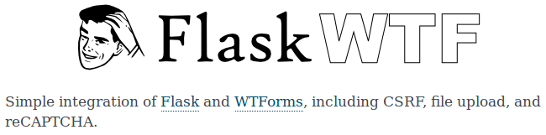
Flask WTForms
Now there is an established persistence layer, the web application must allow users to post data to the website, and thus, to the database. To achieve this, another library that is pre-packaged with Flask, called ‘Flask WTForms’ is used.
This library allows the creation of form layouts, along with data validators, to prevent the user from inputting data that is not compliant with the database structure.

Slide 3
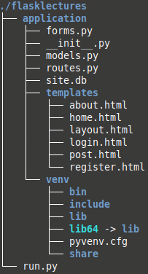
Conforming to the Structure
First, create a new file within the ‘application’ directory, called ‘forms.py’.
Next, create a new file within the ‘templates’ directory, called ‘post.html’.

Slide 4
forms.py – Setup
Inside of ‘forms.py’ the ‘FlaskForm’ object must be imported from the Flask/WTForms library, ‘flask_wtf’:
The database only holds String values (not including the auto generated, primary key ‘id’), therefore, ‘StringField’ must be imported from ‘wtforms’ directly. From the same library, ‘SubmitField’ is required, so that a submission button may be created:
Next, just as was shown in ‘models.py’, a class will be created for each form, passing in the ‘FlaskForm’ object previously imported.

Slide 5
forms.py – The Form Fields
The data held for Posts, within the database, consists of four fields, all of which are string. The same data structure needs to be represented in a form class, so the data may be handled by the Flask application.
Creating the fields of the form can be as simple as creating a ‘StringField’ object, with the label ‘First Name’:
But this isn’t as robust as it should be. There are data requirements that need to be conformed to, so that the data may persist successfully. To this end, validators will be used.

Slide 6
forms.py – Validators
There are many validators that can be used, but at this moment, the only validators required are ‘DataRequired()’ and ‘Length()’, which need to be imported.
‘DataRequired()’ forces the submission of the field, to hold at least a piece of information
‘Length()’ forces the submitted field to conform to a max-min length.
The following code will then force the data submitted to conform to being: not nullable, and between 4 & 30 characters long.

Slide 7
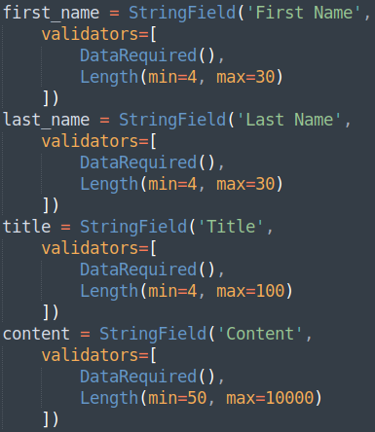
forms.py – More Fields
Now repeating the same syntax as before, for the remaining fields of ‘last_name’, ‘title’ and ‘content’, ensuring that the validators conform to the original database structure (left):
The last line of code for the form, is the ‘SubmitField’ - the button that allows the data to be presented to the web application server, once clicked/tapped.

Slide 8
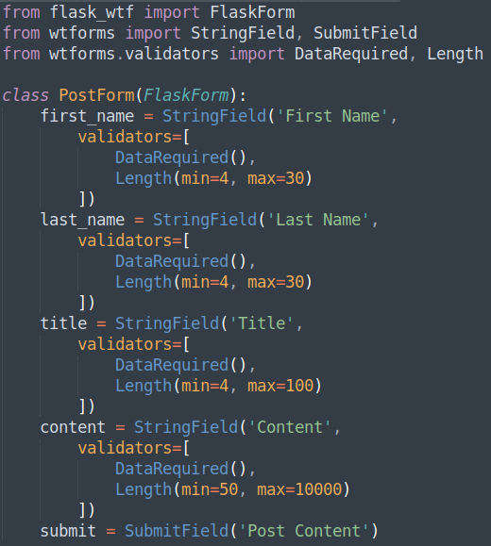
forms.py – Overview
The full code should now appear like:

Slide 9
routes.py – Adding a New Route
First, the new form ‘PostForm’ needs to be imported from ‘application.forms’:
Next, a new route must be added to ‘routes.py’ to include a route for ‘GET’ and ‘POST’. All routes have a ‘GET’ method by default, but this method is going to both serve and receive data, and so, a ‘POST’ method is required:
A data object must be created to store the form fields and their validations:

Slide 10
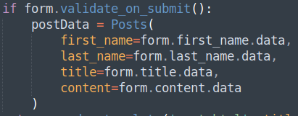
routes.py – validate_on_submit()
All forms build through ‘FlaskWTF’ has a build in method called ‘validate_on_submit()’, which evaluates to either ‘True’ or ‘False’.
It can be utilised to check if the data within the fields of the submitted form, do in fact conform to the data requirements set out in the validators of ‘forms.py’.
If the validation has been passed, the data should be sent to the database. Just as was done within the command line python environment, a data object should be created for the post, from the imported ‘Posts’ object:

Slide 11
routes.py – Persist & Redirecting
Next, the ‘Post’ data object ‘postData’, should be added to the database, again, as seen before:
Therefore, the ‘db’ object must be imported from ‘application’, at the top of this script:
If the form has been validated, and the data has been persisted, it would be a good idea to redirect the user to the ‘home’ template, where the content just posted will be displayed. This requires a new import, as well as another command previously seen from within a Jinja template - ‘redirect’ and ‘url_for’, respectively:

Slide 12
routes.py – redirect() and url_for()
‘redirect()’ is Flasks internal method of changing the page that is currently displayed on the end-user’s browser, upon an action – in this instance, it is once a user posts a valid post.
‘url_for()’ is Flasks internal method of translating a template in to a link, and so displays the page to the end-user.
With both of these commands in combination, if the data is valid and has become persisted, the user can be directed to the ‘home’ template:
Finally, if the route was accessed without posting data (via the ‘GET’ method, not the ‘POST’ method that is invoked by the form’s ‘SubmitField’), the user should be shown the ‘PostForm’ form that should live within the ‘post.html’ template:

Slide 13
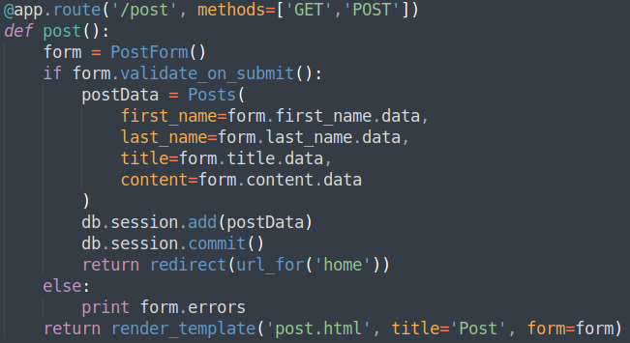
routes.py – Overview
The complete import block and new route should now look like:

Slide 14
post.html – Basic Structure
Now it is finally time to build the ‘post.html’ template. Just as other templates, it needs to extend layout, and all new material must be built within the block ‘content_body’:
Create a simple <div> and <form> block, and include ‘{{ form.hidden_tag() }}’. This is the built in, anti cross-site-script attack function.
As this function is being invoked, a secret will be needed within ‘__init__.py’

Slide 15
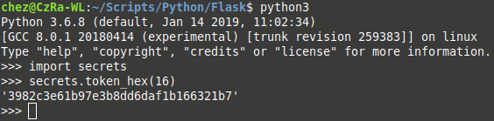
__init__.py – Adding a Secret
The following line will add a ‘SECRET_KEY’ to the application, adding a layer of security to prevent unwanted attacks against the web server:
The long string can be achieved from within Python. From a command line:
import secrets
secrets.token_hex(16)

Slide 16
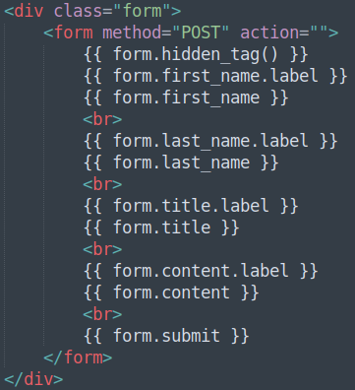
post.html – The Form Fields
Now, implement the form’s fields, within ‘post.html’ template:

Slide 17
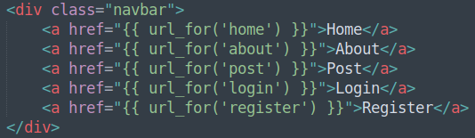
layout.html – Adding the Post Link
Last activity before testing the new additions is to add a link to the ‘post.html’ template, within the ‘layout.html’ template:

Slide 18
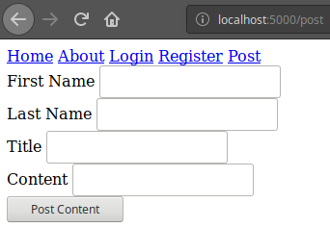
Checking the Application
Navigating to the ‘post.html’ page, either via the new link within the nav-bar, or via the direct path should now display:

Slide 19
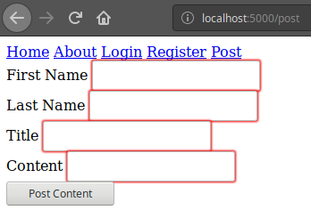
Checking the Application Cont.
Inputting and submitting data that is known to be rejected from the validation, or no data at all if the ‘DataRequired()’ validator is used, should result a failed post. This will be indicated by the form highlighting it’s edges with red for every field invalid, as well as a helpful hint:

Slide 20
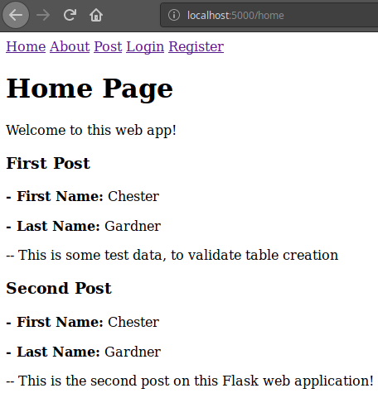
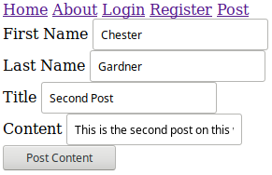
Checking the Application Cont.
Inputting and submitting valid data should result in a redirect to the home page, with the new data present:

Slide 21
Creating a Form and Template
Directions
60 – 90 minutes
Update your project to have a ‘PostForm’ form for submitting Posts. This form should be passed to a newly created ‘post.html’ template, along with suitable validation.
Debrief
Discuss how maintaining all these big changes need to be tracked, and backed up. What tools can/do you use?
<number>

Slide 22
Thank you for listening.
Any questions?

