Slide 1
Python Flask
More jinja logic

Slide 2
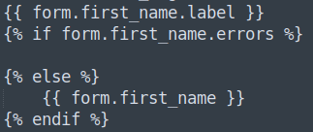
post.html – Jinja if Statements
So far the user is able to navigate between pages, and post a new post to the home page. During the post submission, if something doesn’t pass a validation check, the feedback is minimal, and does not aid in resolving the underlying problem.
To fix this, feedback presented to the user would be a good idea. This can be achieved by editing the ‘post.html’ template to handle the errors, with the Jinja code block, and ‘if’ syntax:
Whether there is an issue or not, the label should always be displayed. If the page is being called from a ‘GET’ method (first time loading the page), there will be no errors, and therefore, display the field.

Slide 3
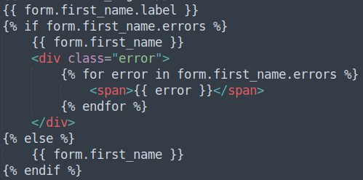
post.html – Jinja for Loops
If there is more than one error, it should be displayed. Again, with a Jinja syntax code block, but this time with a for loop:

Slide 4
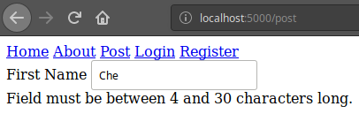
Checking the Application Feedback
This should create a separate <div> block, with a <span> block that will display an error, for each error being found within the validation check:
This activity should then be repeated for all fields within the form, except the ‘SubmitField’ field.

Slide 5
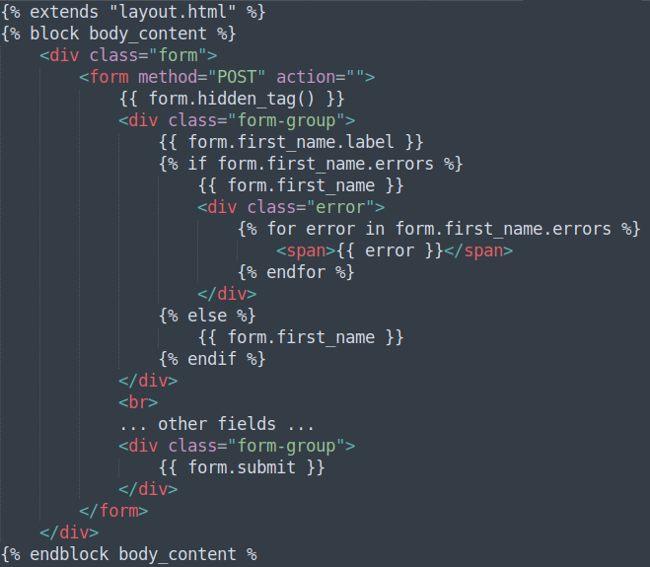
post.html – Overview
The code should look similar to (left):

Slide 6
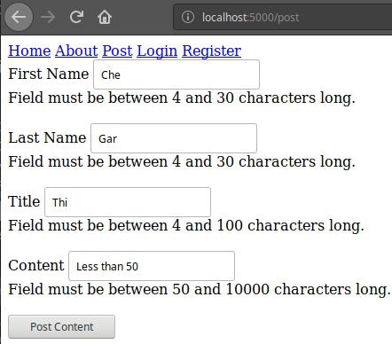
Checking the Application
Submitting not enough characters for each field, should yield a valid error for each field:

Slide 7
Creating Feedback
Directions
20 minutes
Update your project to display relevant error messages, for incorrect form submission.
Debrief
Discuss why this method only works for some validation errors and not others. Try submitting the form with no data, and compare the types of feedback.
<number>

Slide 8
Thank you for listening.
Any questions?

