Slide 1
$${\dot{q}}_{3SolAbs}$$
$${\dot{q}}_{56,conv}$$
$${\dot{q}}_{34,rad}$$
$${\dot{q}}_{34,conv}$$
$${\dot{q}}_{57,rad}$$
$${\dot{q}}_{5SolAbs}$$
$${\dot{q}}_{23,cond}$$
$${\dot{q}}_{12,conv}$$
$${\dot{q}}_{45,cond}$$
HTF
Tube receiver
Glass envelope

Slide 2
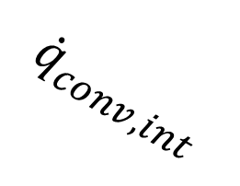











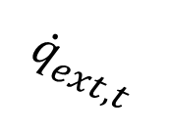
$${\dot{q}}_{conv,amb}$$
$${\dot{q}}_{Sol,t}$$
$$T_{g}$$
$${\dot{q}}_{rad, int}$$
$${\dot{q}}_{conv, int}$$
$${\dot{q}}_{rad,amb}$$
$${\dot{q}}_{Sol,g}$$
$$T_{t}$$
$${\dot{q}}_{ext,t}$$
$${\dot{q}}_{ext,g}$$
$${\dot{q}}_{int,t}$$
$${\dot{q}}_{conv,fl}$$
$${\dot{q}}_{int,g}$$
HTF
Absorber tube
Glass envelope

