Slide 1
Problem 1 (15 pts)
CS526 Homework Assignment 3
Write a program to determine if a given string is a palindrome
Input: you will be given an input file with one string per line
Output: for each line output if the string is a palindrome
Output: the total number of palindromes
E.g.
Input:
Output:
geek
asleelsa
thisisatesttsetasisiht
false
true
true
2

Slide 2
Problem 2 (20 pts)
CS526 Homework Assignment 3
Using Recursion
Create a function that prints and counts the unique set of sub-strings of a given string
Input: abcab
Output: bca, bc, abc, cab, c, b, a, abca, ca, ab, abcab, bcab -> 12

Slide 3
Problem 3 (20 pts)
CS526 Homework Assignment 3
Using Recursion
Write a function that reverses a stack implemented as an array
Write a function that reverses a stack implemented as a Linked-list
Write a function that reverses a stack implemented as a doubly linked-list
Input: 1, 2, 3, 4, 5, 6, 7, 8, 9, 10
Output: 10, 9, 8, 7, 6, 5, 4, 3, 2, 1

Slide 4
Problem 4 (45 pts)
CS526 Homework Assignment 3
A group of n Ghostbusters is battling n ghosts. Each Ghostbuster carries a proton pack which shoots a steam at a ghost destroying it. A stream goes in a straight line in both directions and continues when it hits the ghost. The Ghostbusters decide upon the following strategy:
They will pair off with the ghosts, forming n Ghostbuster-ghost pairs and then simultaneously each Ghostbuster will shoot a stream at their chosen ghost. The streams are not allowed to cross so each Ghostbuster must choose a paring for which no streams will cross.
You can assume that there are an equal number Ghostbusters and ghosts.
Create a solution which will determine if all of the Ghosts can be eliminated in a single shot of the Ghostbusters by returning the string “All Ghosts: “ <were|were not> “ eliminated”
Partial credit will be given for the design and algorithm and full credit will be given for a correct working solution.
I will provide a set test cases in the format:
Line 1 will contain the number of Ghostbusters
Lines 2-n will contain a ghostbuster, ghost paring represented as a series of letters and numbers space separated with a B indicating the position of a Ghostbuster, a G indicating the position of a ghost. The information following either a B or a G will be the X Y coordinate of either the ghostbuster or the ghost.

Slide 5
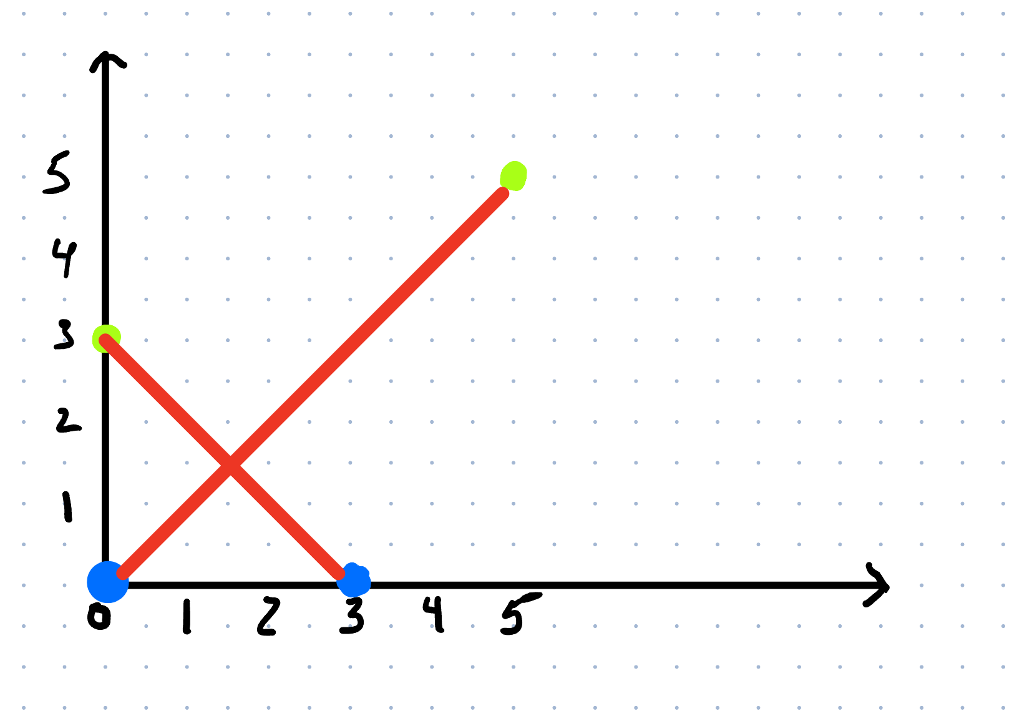
Problem 4 (con’t)
CS526 Homework Assignment 3
A sample input file might look like:
2
B 0 0 G 5 5
B 3 0 G 0 3

