Slide 1
Google’s AI can see through your eyes what doctors can’t

Slide 2
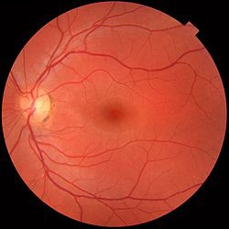
Can you tell from this photo if the patient is male or female?

Slide 3
Obviously you can, because you have 50-50 chance of getting it right or wrong.

Slide 4

You have the same possibilities to get right than an ophthalmologist.

Slide 5
97!

Slide 6

How is it possible?
We don’t know it yet

Slide 7


Slide 8
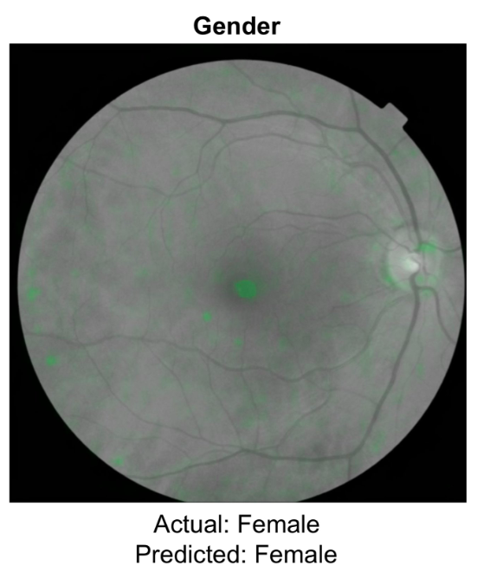

Slide 9
They found that…
71% of the heat maps highlighted vessels
78% of the maps highlighted the optic disc
50% of the maps also highlighted non-specific features.
In other words, the neural network was looking at a bit of everything but nothing in particular…

Slide 10

So, finally… Can it be useful?

Slide 11

Yes, it can!!

Slide 12
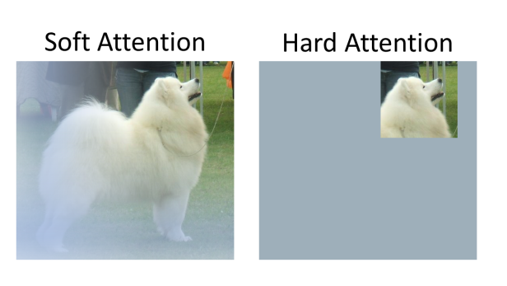
Soft attention vs Hard attention

