Slide 1
Designing Accessible Systems
Dyslexia & UI Research
Alfred Acosta, Javier Coyoc, Ervin Lin

Slide 2

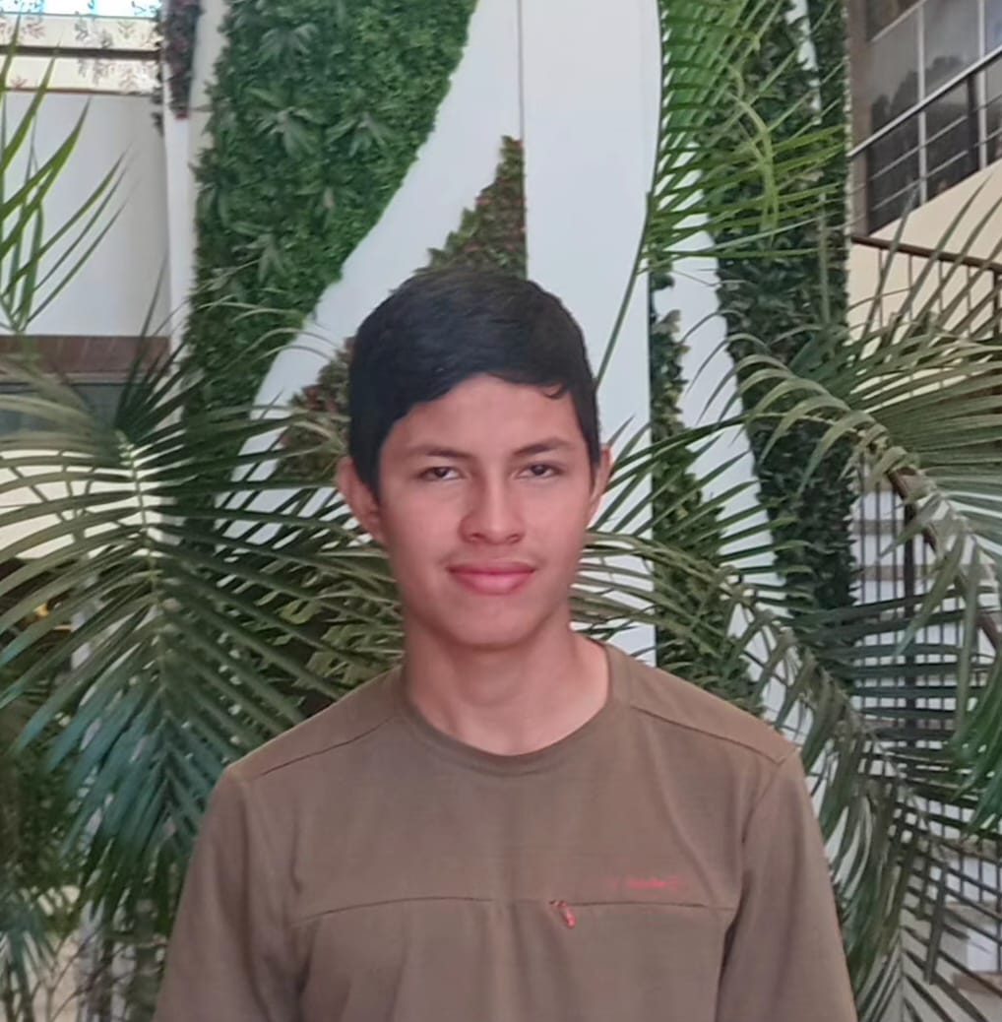

The Team
Alfred Acosta
Javier Coyoc
Ervin Lin

Slide 3
Introduction
This project explores how HCI principles can make digital tools accessible for people with dyslexia. Standard web apps use cramped layouts and poor typography that trigger visual fatigue. Through user interviews, we are gathering insights to guide our design choices. Our goal is to use spacious layouts, strong contrast, and clear visual cues to remove reading barriers.

Slide 4
Needfinding
Methodologies
. . .

Slide 5


The Interviewee
Principal of Belize Christian Academy
Chosen and recruited because of his experience as a principal as well as a teacher.
Interviewed at BCA by Alfred
Former teacher from Belmopan Comprehensive School
Chosen and recruited because of her experience as a teacher.
Interviewed at home by Javier.
Mr. Acosta
Ms. Coyoc

Slide 6


The Interviewee
Student of Belize Christian Academy
Chosen and recruited because of their experience with dyslexia.
Interviewed at BCA by Alfred
Student of Belize Christian Academy
Chosen and recruited because of their experience with dyslexia.
Interviewed at BCA by Alfred
Student 1
Student 2

Slide 7
Questions Asked (Teachers):
Describe an experience where a student with dyslexia struggled to navigate or understand a complex course gradebook or syllabus layout.
How different is it when you are teaching a student with dyslexia compared to others without dyslexia? What methods do you have to use to ensure they learn effectively?
Share a time when providing visual progress elements (like progress bars or clear category cards) noticeably helped dyslexic students track their coursework.

Slide 8
Questions Asked (Students):
Describe an experience of how dyslexia impacted your learning or daily life, whether that be in the classroom or using a website.
What device (phone, laptop, tablet) do you usually use when checking course materials, and what issues have you faced using that device for school apps?
Describe a situation where a visual layout (such as low contrast text, distracting backgrounds, or inconsistent fonts) made a web page hard to read.
Describe a time when using a website with clear visual cues (like bold headings, colored badges, or distinct borders) helped you process information much faster.

Slide 9
Interview
Results
. . .

Slide 10
Describe an experience where a student with dyslexia struggled to navigate or understand a complex course gradebook or syllabus layout.
1
My student with dyslexia struggled with our dense course layout, getting confused by scattered tracking and weighted grades. They lost track of completed work and syllabus details. To support them, I chunked content into smaller sections with clear headings, consistent formatting, and verbal explanations.
Mr. Acosta

Slide 11
How different is it when you are teaching a student with dyslexia compared to others without dyslexia? What methods do you have to use to ensure they learn effectively?
2
It's not that hard to teach a student that doesn't have dyslexia but when teacher teach students with dyslexia they have to go slower with the topics and have to listen and be patient with these types of students.
Ms. Coyoc

Slide 12
Describe an experience of how dyslexia impacted your learning or daily life, whether that be in the classroom or using a website.
1
Having dyslexia causes severe short-term memory issues and slows down my learning process. When doing online research, I almost always forget what I am searching for or why I started.
Student 1

Slide 13
Describe a time when using a website with clear visual cues (like bold headings, colored badges, or distinct borders) helped you process information much faster.
2
When I was in a rush checking a website, the bold headings significantly helped me locate where I was supposed to be.
Student 2

Slide 14
Analysis
. . .

Slide 15
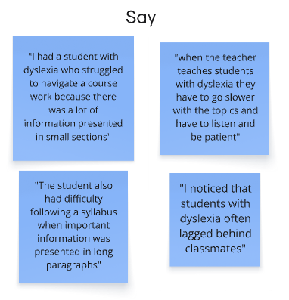
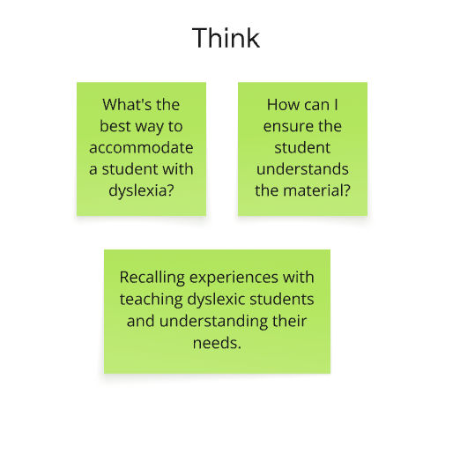
Empathy chart

Slide 16
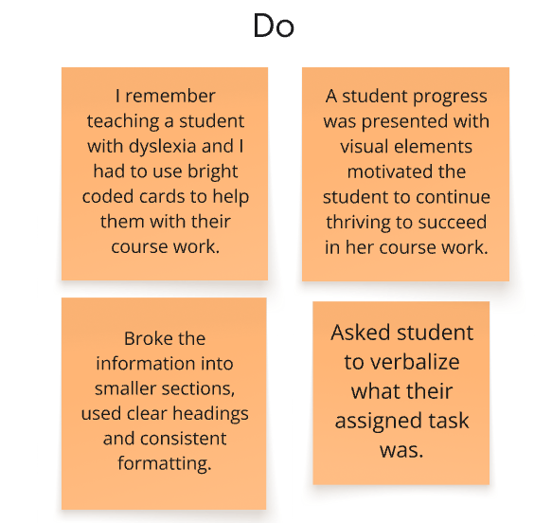
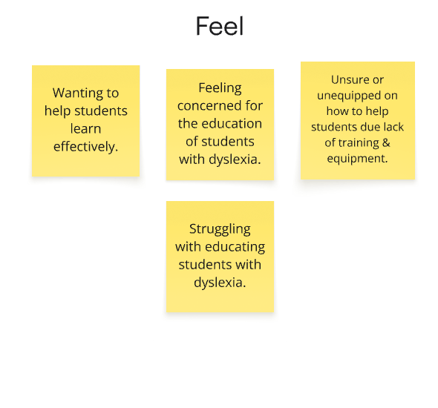
Empathy chart

Slide 17
Insights and
Needs
. . .

Slide 18
"To support them, I broke the information into smaller sections, used clear headings and consistent formatting..."
Mr. Acosta
Insight:
Complex layouts force teachers to manually simplify course content.
Need:
Automated systems that chunk data and highlight key tasks.

Slide 19
"When teachers teach students with dyslexia, they have to go slower with the topics and have to listen and be patient."
Ms. Coyoc
Insight:
Standard digital layouts present data too quickly and densely for dyslexic students to process smoothly.
Need:
Simplified, digestible interface elements that let students absorb information at their own pace.

Slide 20
"Almost 99% of the time I be forgetting why or what am I researching for..."
Student 1
Insight:
Dyslexia impairs short-term memory during multi-step tasks.
Need:
Clear navigation anchors and visible progress trackers.

Slide 21
"The bold headings significantly helped me locate where I was supposed to be."
Student 2
Insight:
Dense text causes rapid visual fatigue and reading confusion.
Need:
Spacious layouts with bold headings and visual cues.

Slide 22
Questions About the Results
How can digital tools make studying feel less exhausting for students with dyslexia?
Is there a simple way to keep students from getting lost when switching between tasks?
What interface elements give dyslexic students the most confidence while navigating school sites?

Slide 23
Summary
4 interviews were conducted, two with teachers who have had experience teaching students with dyslexia and two with students who have dyslexia
Learned about different methods that teachers used to teach students with dyslexia
Gained an understanding on the website features that students with dyslexia like and dislike

Slide 24
Thank
you!

