Slide 1
ClearType
SSP4
Alfred Acosta
Javier Coyoc
Ervin Lin

Slide 2
ClearType: Making web content readable for every mind
Standard digital learning materials and web pages use dense layouts, harsh contrast, and rigid typography that cause rapid visual fatigue for dyslexic readers. ClearType is an interactive web platform that lets students and teachers preview, test, and toggle dyslexia-friendly formatting in real time through instant visual overlays and live controls.

Slide 3
TASKS
Simple Task (Customizing Reading View): Adjust line spacing, font style, and background tint on a web page to reduce eye strain and visual clutter while reading.
Moderate Task (Toggling Shared Notes): Toggle dense, unformatted study notes or peer slides into a clean, dyslexia-friendly view with a single click.
Complex Task (Educator Readability Preview): Test digital lesson plans using real-time side-by-side previews and readability feedback before publishing them to a class.

Slide 4
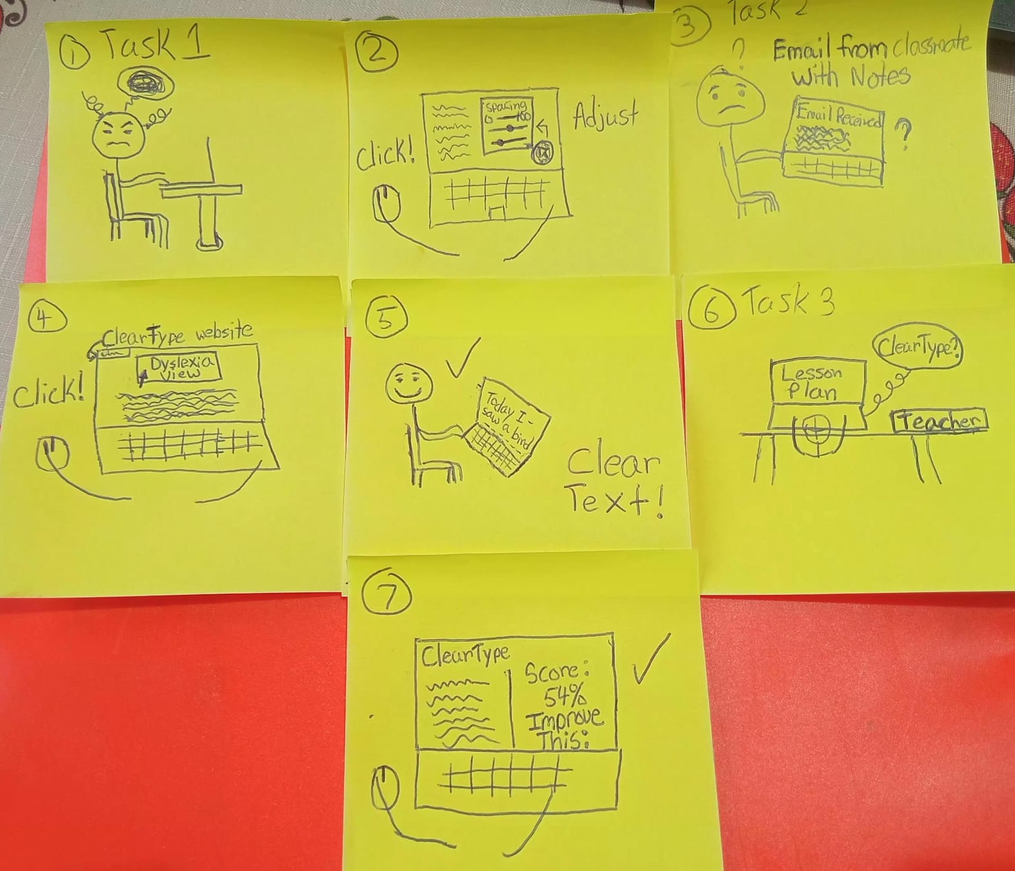
STORYBOARDS

Slide 5
VIDEO LINKS
https://youtu.be/J4uMKkXnO1Y

Slide 6
AI Video Critique
The AI video worked well in giving us a means to be able to structure and give our ideas a visual mockup
The AI we were using gave us a choice between two models and their generated video per prompt, allowed for comparison between videos
The AI fell short in terms of us having to use multiple accounts between us due to limited posting amounts
There were also some inconsistencies when creating certain clips, that the character or something in the scene would change from the previous clips
AI video tools are effective for design communication in professional environments to an extent that it is used for rough prototypes and to brainstorm but not for the final polished tool.
Notes:
Also important that you explain in great detail what it is you are trying to create to the AI, AI is not perfect

