Slide 1




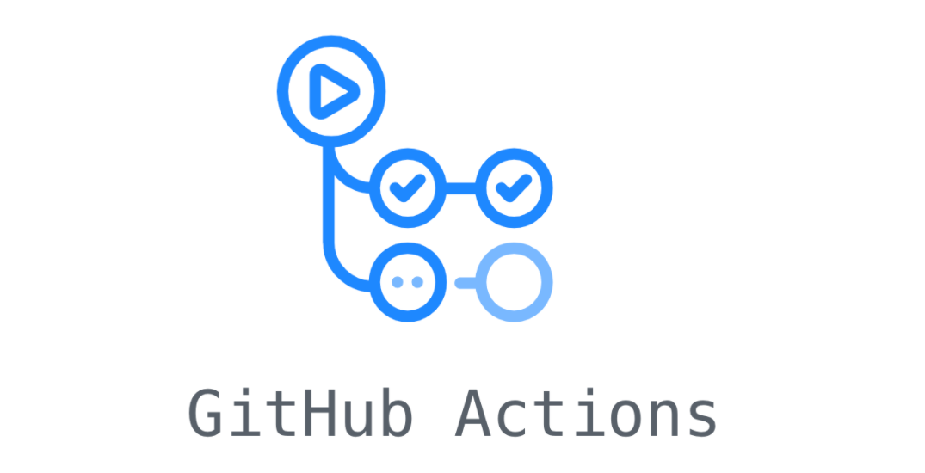



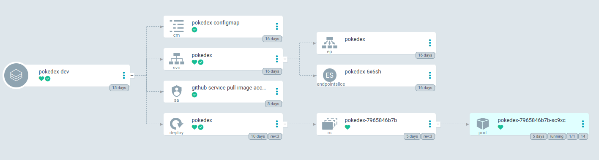


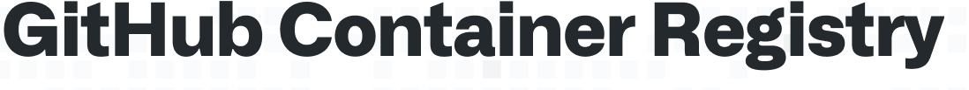




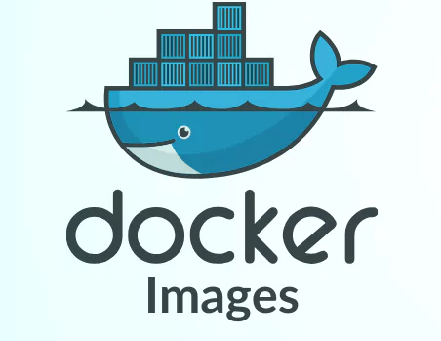

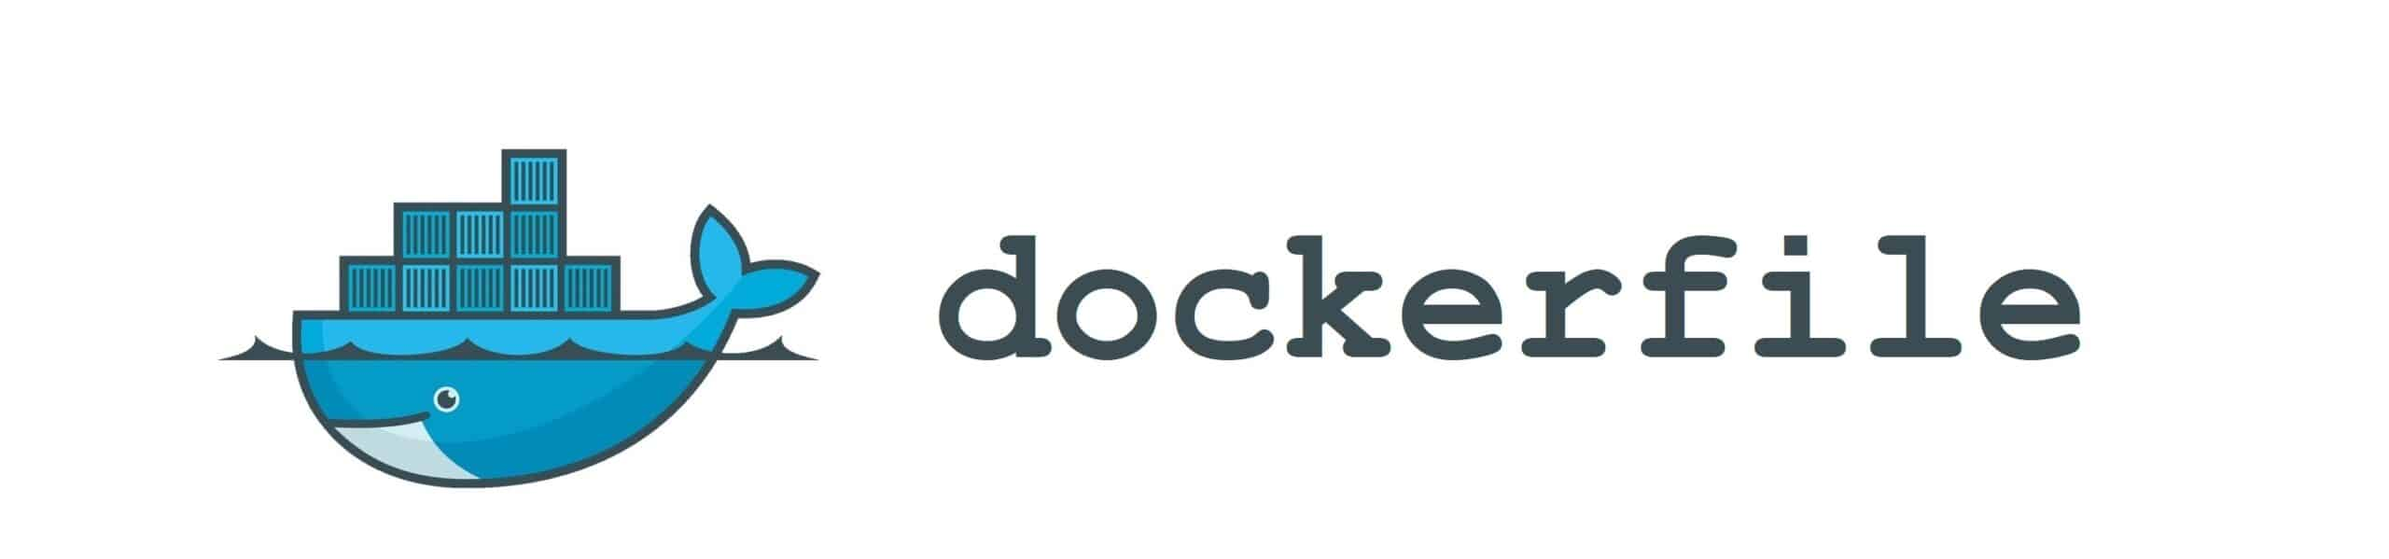
Deployment/GitOps repository
.github
workflows
generate-manifests-from-kcl.yaml
update-image-tag-in-pokedex-dev.yaml
apps
1
2
deployments
Listen to event:
dagger-pipeline-trigger
4
2
pokedex
3
base
PLATFORM ENGINEERS
dev
1
5
manifests
kubernetes-manifests.yaml
ghcr.io/javier-godon/ddd-hexagonal-vertical-slice-cqrs-reactive-kubernetes:a6fb75c...
konfig
argocd
3
managed
apps
pokedex
pokedex-dev.yaml
3
infrastructure-crossplane
Code repository
.github
workflows
run-dagger-ci-pipeline.yaml
trigger-dagger-ci-pipeline.yaml
2
Build and push image to registry
pokedex
Fires event:
dagger-pipeline-trigger
dagger_python
SOFTWARE ENGINEERS
Commit sha: a6fb75c...
1
src
ghcr.io/javier-godon/ddd-hexagonal-vertical-slice-cqrs-reactive-kubernetes:a6fb75c...

