Slide 1
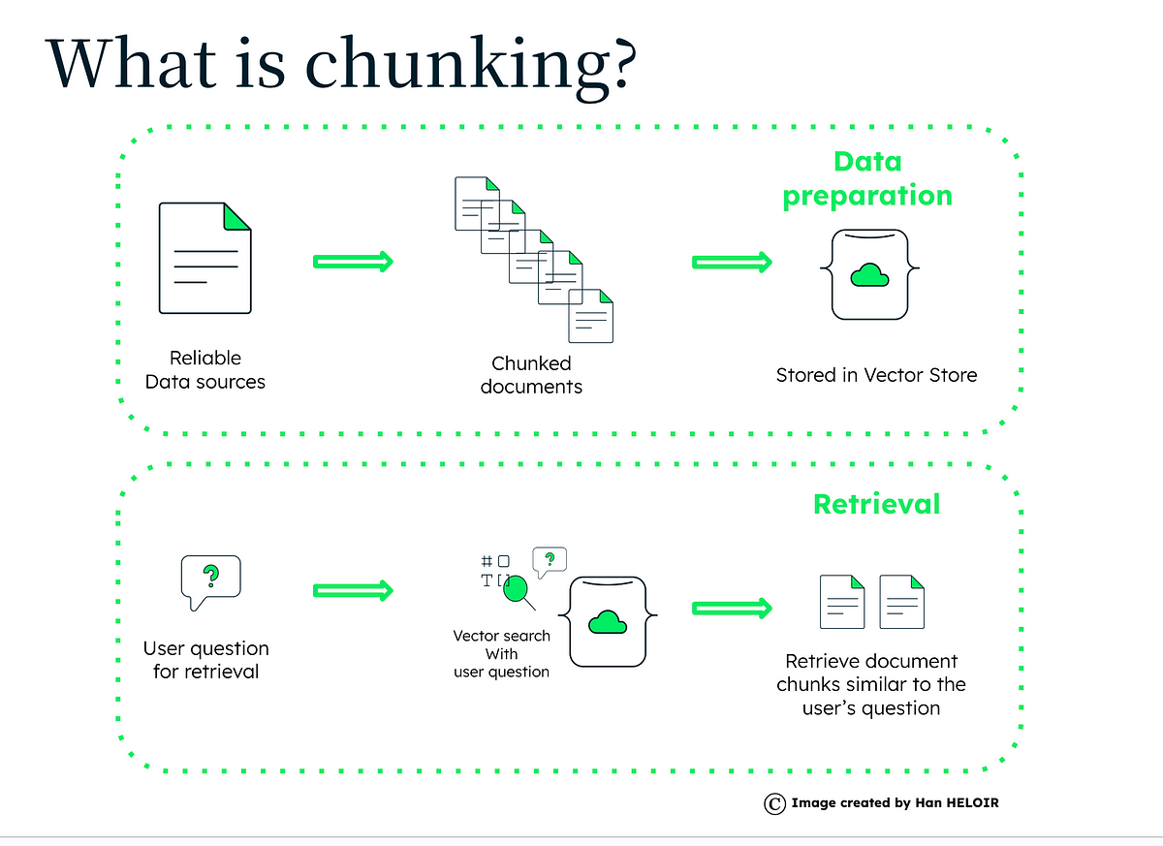


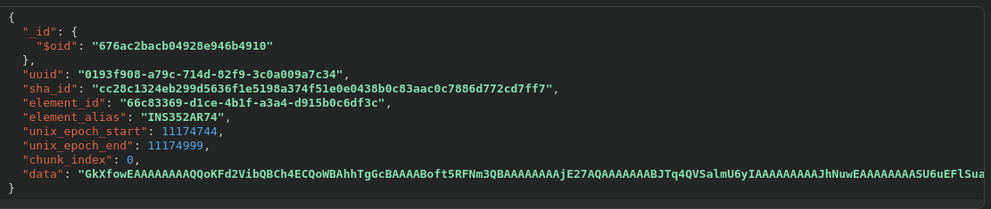
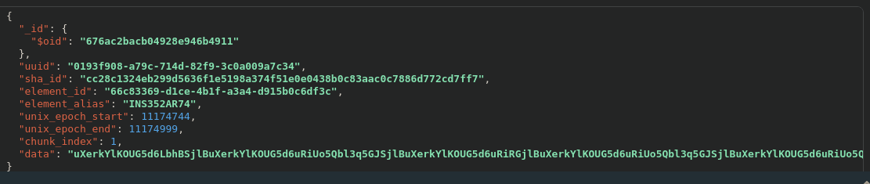

kafka-video-server-python
kafka-video-consumer-mongodb-python
video-collector-mongodb-python

