Slide 1
IA

Slide 2
What is artificial intelligence?
“System’s ability to correctly interpret external data, to learn from such data, and to use those learnings to achieve specific goals and tasks through flexible adaptation”

Slide 3
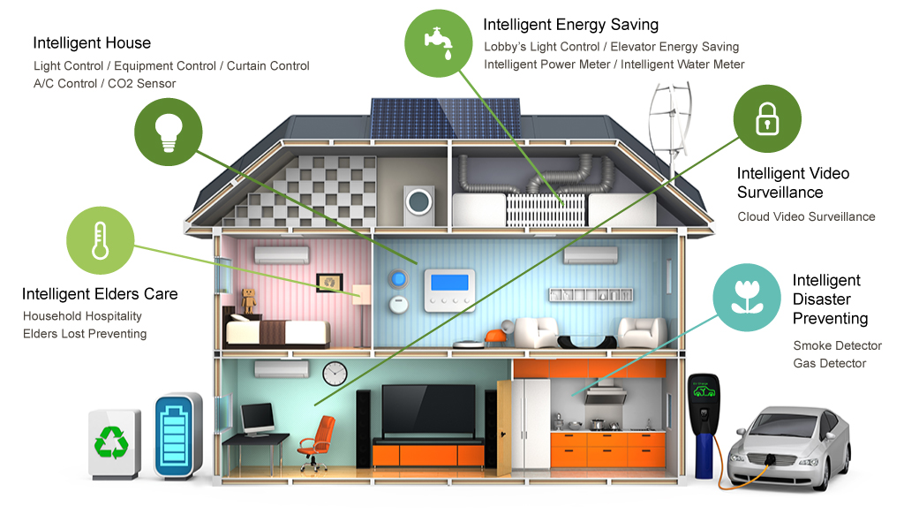
Smart House
IoT

Slide 4

Siri
AI

Slide 5
AI process
Use those learnings to achieve specific goals and tasks
Interpret external data
Learn from such data

Slide 6
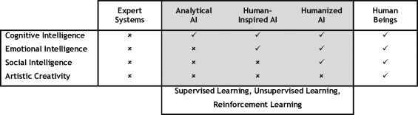
AI characteristics
Cognitive intelligence (competencies related to pattern recognition and systematic thinking).
Emotional intelligence (adaptability, self-confidence, emotional self-awareness, achievement orientation)
Social intelligence (empathy, teamwork, inspirational leadership).

Slide 7
AI classifications
Analytical AI has only characteristics consistent with cognitive intelligence.
Human-Inspired AI has elements from cognitive as well as emotional intelligence.
Humanized AI shows characteristics of all types of competencies (cognitive, emotional, and social intelligence).

Slide 8
IA examples
Driverless car
Siri, Alexa, Bixby
Amazon warehouse robots

