Slide 1
Hotel Matching
Challenges:
Very high accuracy
Complex Data Manipulation
Unintuitive Similarity Score
Very few “labeled” datapoints
Computational Expensive
Expected Results:
Accuracy = 99%
Coverage = 98%

Slide 2
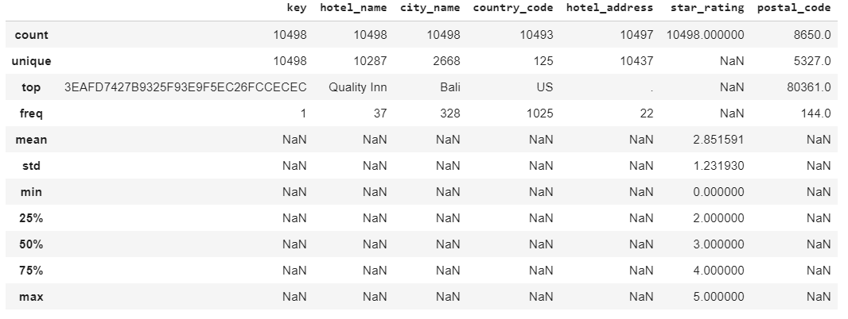
Quick look at the data

Slide 3
Intuition: features to look at
Name
Country
City
Address
Stars
Postal Code
Yes, there’s information
Yes, only same country matchings
Maybe, may confuse models
Yes, there’s information
No, too different and noisy
No, very unreliable

Slide 4
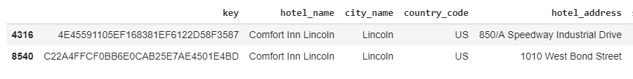
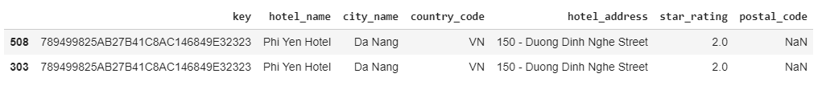
Pre Processing and Exploration
Join partner 1 with example 1
Join partner 2 with example 2
Deal with duplicates
Deal with missing data

Slide 5
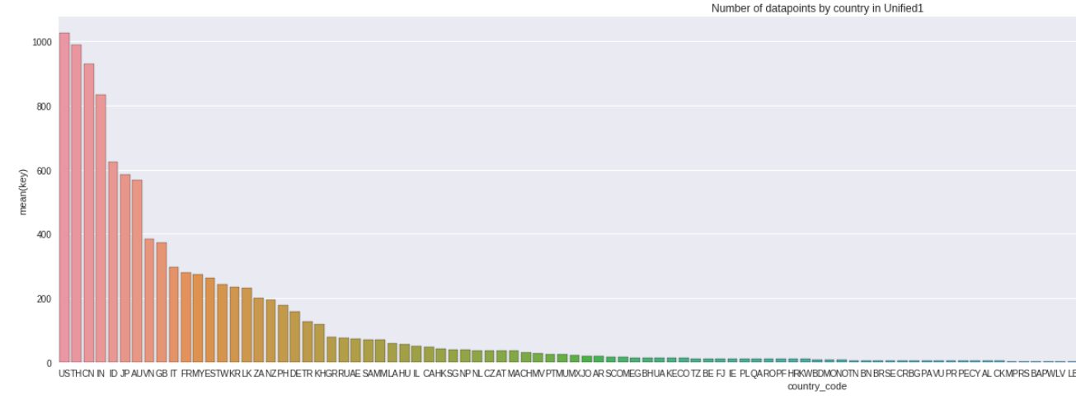
Countries distribution
US, TH, CN, IN, ID, JP, AU, VN, GB, IT, FR, MY, ES, TW, KR, LK, ZA, NZ, PH

Slide 6
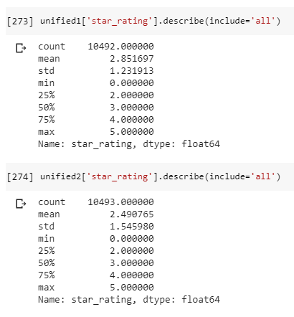
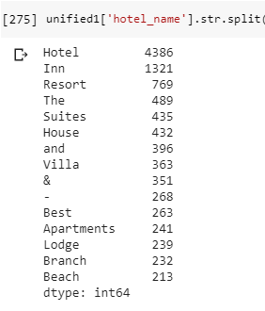
Words in Hotel Names
Stars

Slide 7
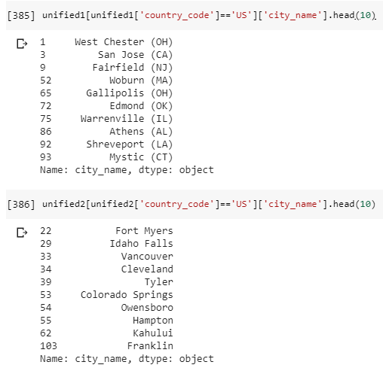
Cities (USA example)

Slide 8
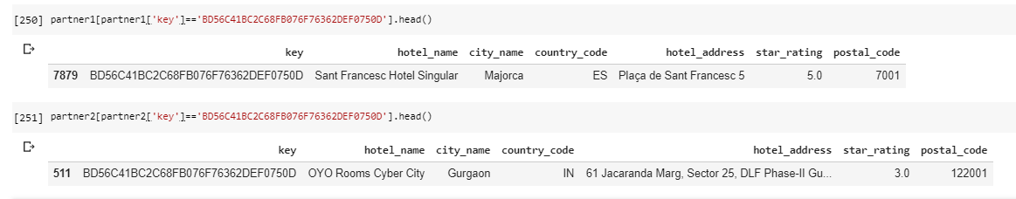
Watch out for the key

Slide 9
Start with the Obvious
Same Hotel Name
Same City
Same Country
Same Hotel
3045 out of 10500
in lowercase
129 out of 500

Slide 10
Now what? Defining similarity
Now that we filtered the perfect matching hotels, how can we generate similarity scores that will help us differentiate between a good match and a bad match?
Ratio
Partial Ratio
Token Sort Ratio
Token Set Ratio
FuzzyWuzzy
0 to 100 – Not Symmetric

Slide 11
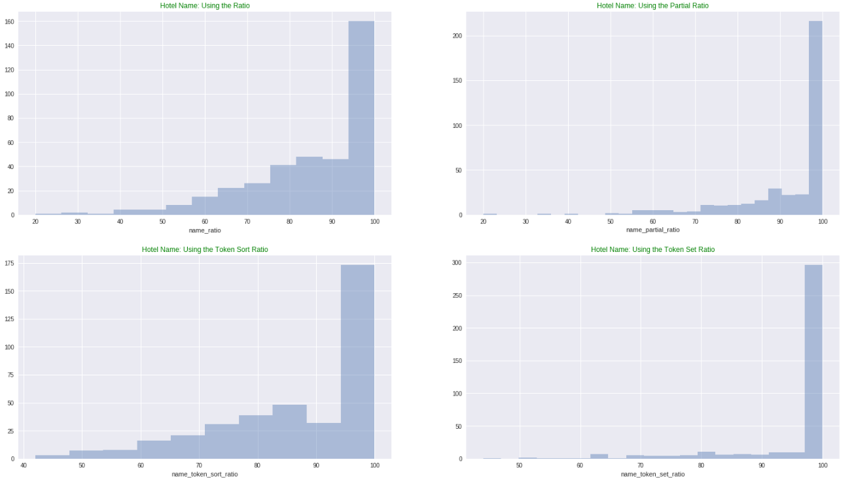
380 Matching Hotels: NAME

Slide 12
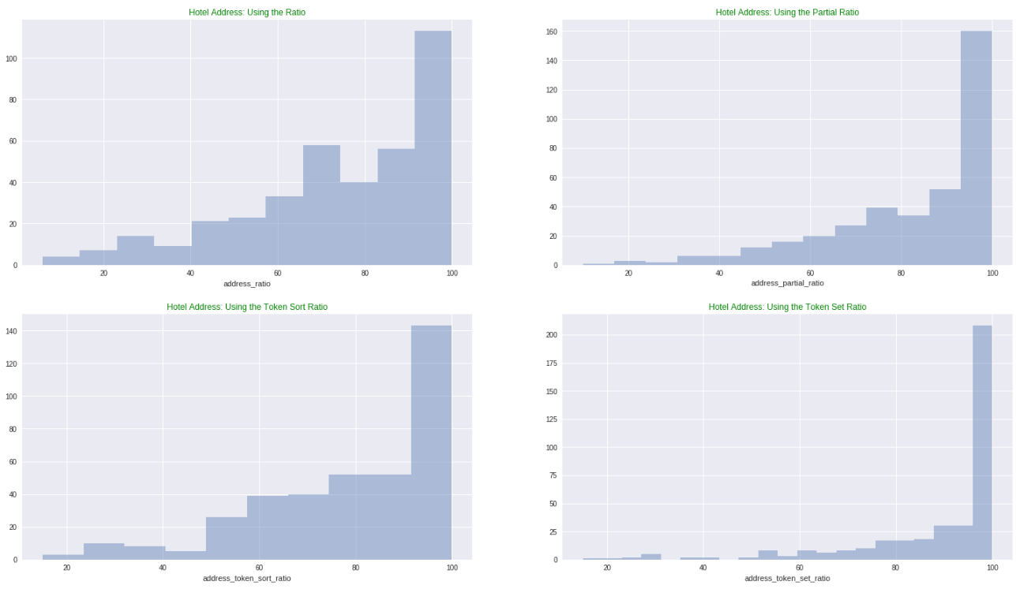
380 Matching Hotels: ADDRESS

Slide 13
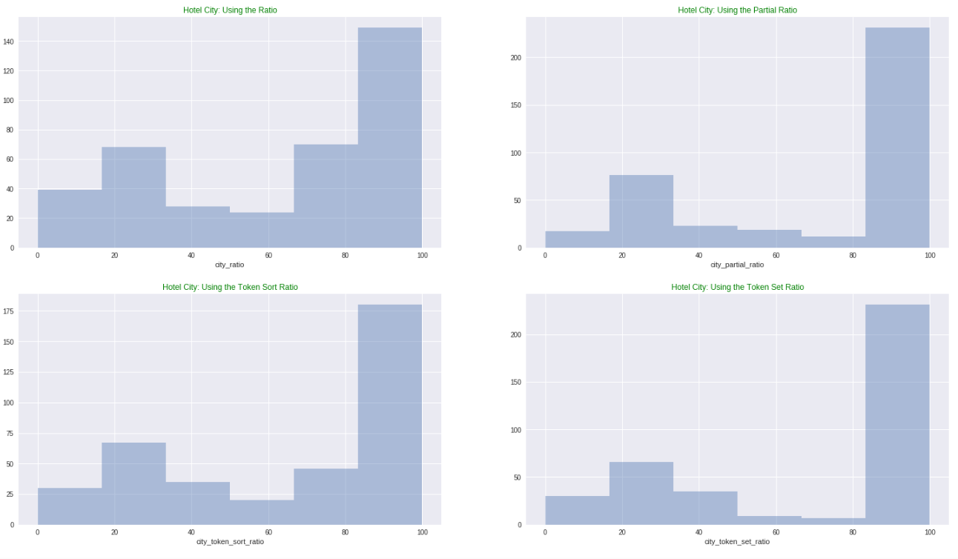
380 Matching Hotels: CITY

Slide 14
1) Take Partner2 unmatched dataset (7600)
2) Take Examples2 unmatched dataset (380)
3) Find and drop all points on Partner2 dataset that belong to Examples2 dataset. We call it Partner2_B (7420)
4) Take all datapoints from Example1 unmatched dataset (380). By design there are NO matching pairs between Example1 and Partner2_B.
5) For every datapoint in Example1, find all datapoints on Partner2_B that are from the same country and calculate the 4 scores.
6) Unify all the scores of all the combinations. About 180.000. This are scores of datapoints that are NOT a match, FOR SURE.
7) Compare the NO-match scores with the YES-match scores. Do this again for the names and for the addresses.
We can calculate the score for the matching (labeled) data, but what about the not matching data?

Slide 15
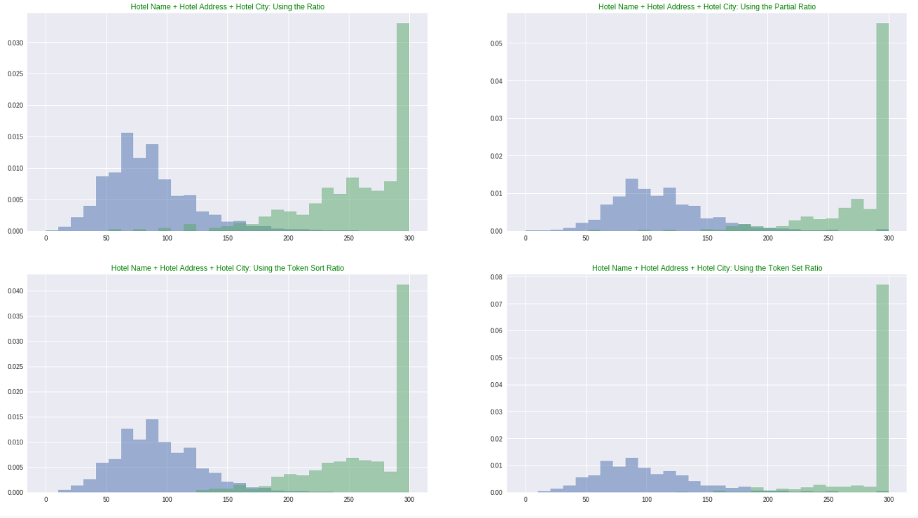
Match VS Not Match (NAME)

Slide 16
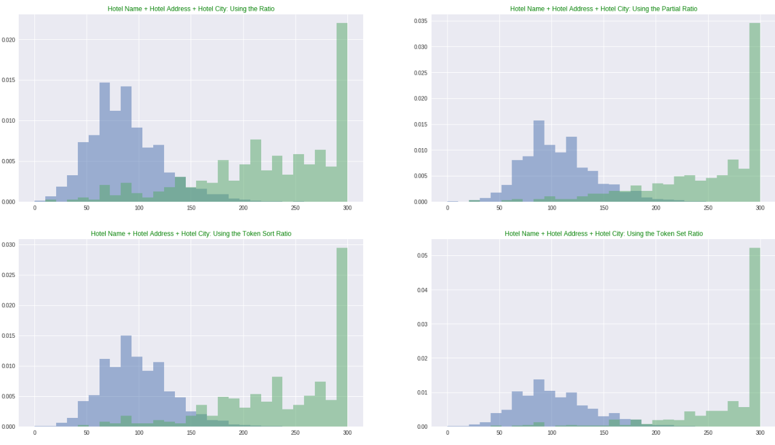
Match VS Not Match (ADDRESS)

Slide 17
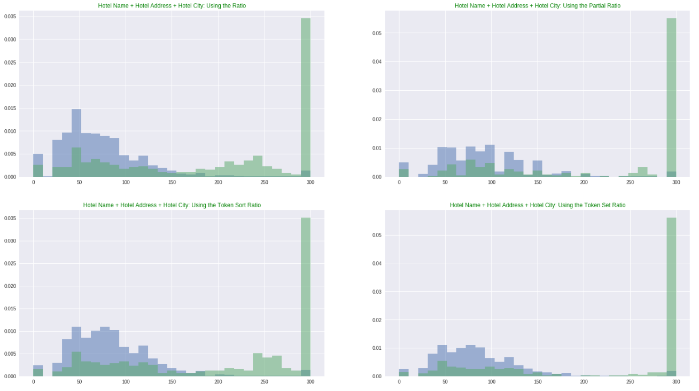
Match VS Not Match (CITY)

Slide 18
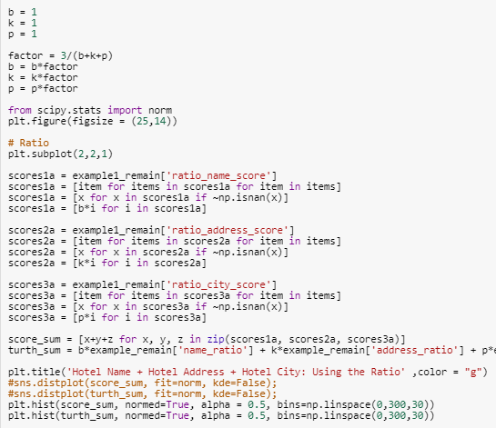
b*NAME + k*ADDRESS + p*CITY
We can make a cool visualization script to visualize this

Slide 19
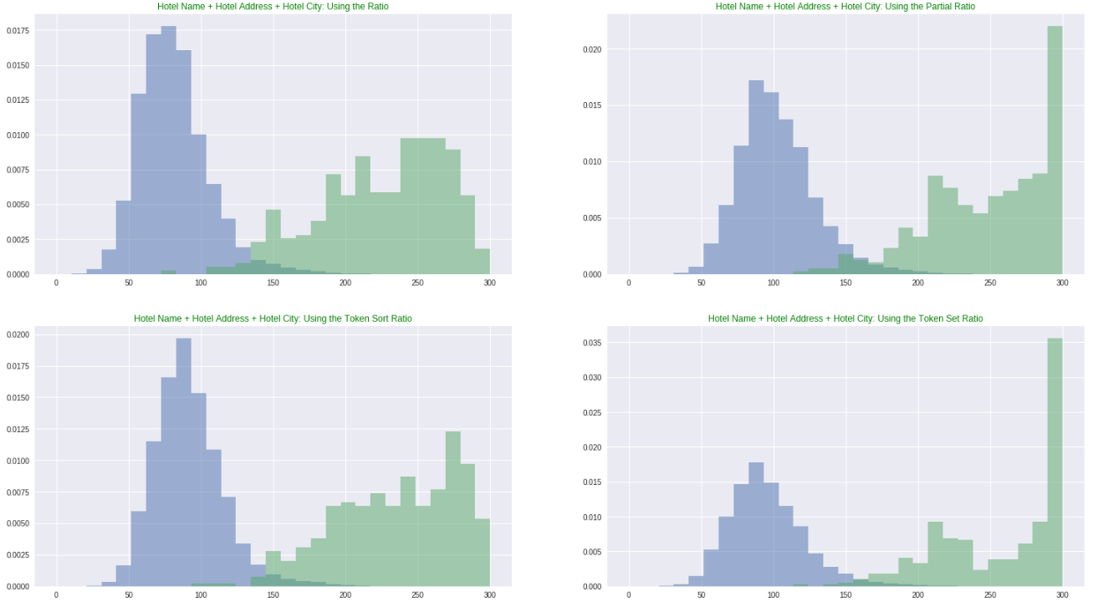
b*NAME + k*ADDRESS + p*CITY
B =1, K = 1, P = 1

Slide 20
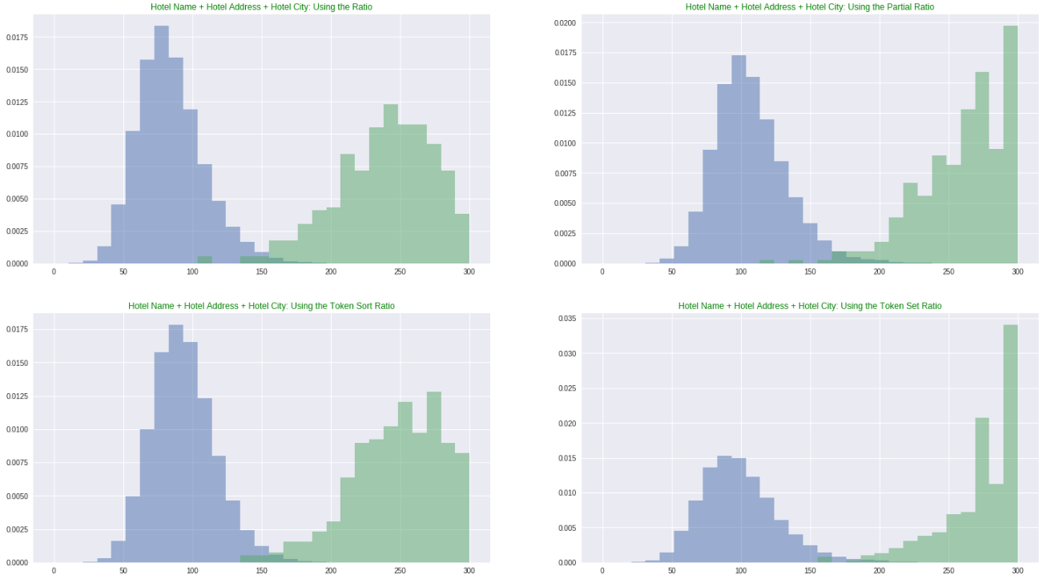
b*NAME + k*ADDRESS + p*CITY
B =1, K = 0.7, P = 0.2

Slide 21
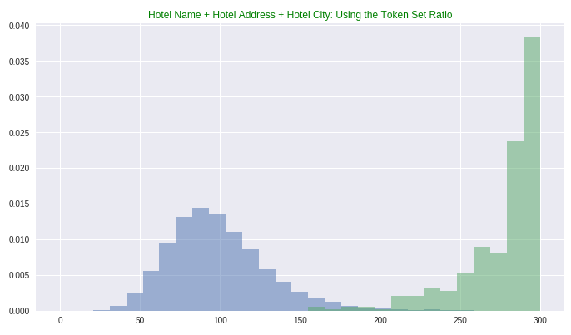
(b*, k*, p*) that maximized class separation
We get maximum separation when using token_set_ratio for parameters (1,0.35,0.1).
We separate ~70% of the population with NO false alarms
Class Separation Criterion: # of elements of class 1 that has a larger score than 10 + the largest score from class 0
Th = 280
7600 out of 10500
365 out of 500

Slide 22
- Try to explore how this scoring methods behave for different countries. - Use all of the scoring methods (ratio, partial, sort, set) and all of the variables (name, city, address) as features of a 12 dimensional boosted decision tree.
What now?

Slide 23
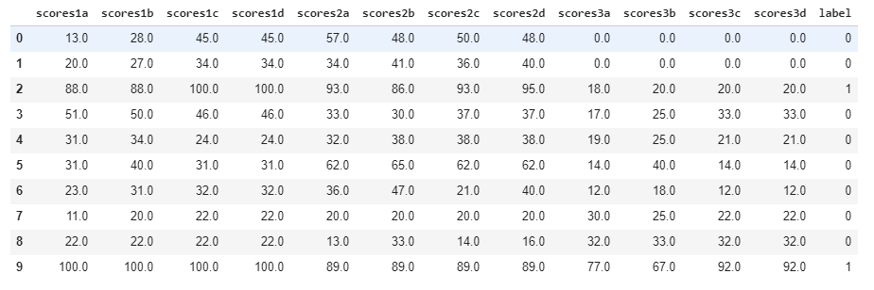
Our new data

Slide 24
- Binary classification problem - Highly correlated features - Highly unbalanced classes (35.000 of class 0 and 140 of class 1)
How does our problem look like?
What can we do?
Logistic Regression
Decision Tree
kNN
XGBoost
Sampling from “No Match” class
Feature Selection
Class Weights

Slide 25



If I drop those with 2+ matches
P(false positive & false negative) = $\frac{b}{c+d}$ * $\frac{c}{c+d}$
No Match
a
b
Accuracy = 1 - $\frac{b}{c+d}$ * $\frac{c}{c+d}$
TRUTH
Coverage = $\frac{d}{c+d}$ - $\frac{b}{c+d} ∗\frac{d}{c+d}+\frac{b}{c+d} ∗\frac{c}{c+d}$
Match
c
d
No Match
Match
We could have go as far as 93% accuracy given that we are dealing with 28% of the data.
I chose acc = 98% and coverage = 80%
PREDICTED

Slide 26
Sort_Ratio > 280
Unique
Non duplicates
Partner1
Perfect Match
Partner1_remain
Partner1_remain
Partner2
Partner2_remain
Partner2_remain
10000
500
7450
369
2770
137
12d Logistic
Regression
Acc = 100%
Cov = 0%
Acc = 100%
Cov = 29%
Acc = 100%
Cov = 72%
Partner1_remain
Partner2_remain
394
21
Acc = >99.5%
Cov = 96%

Slide 27
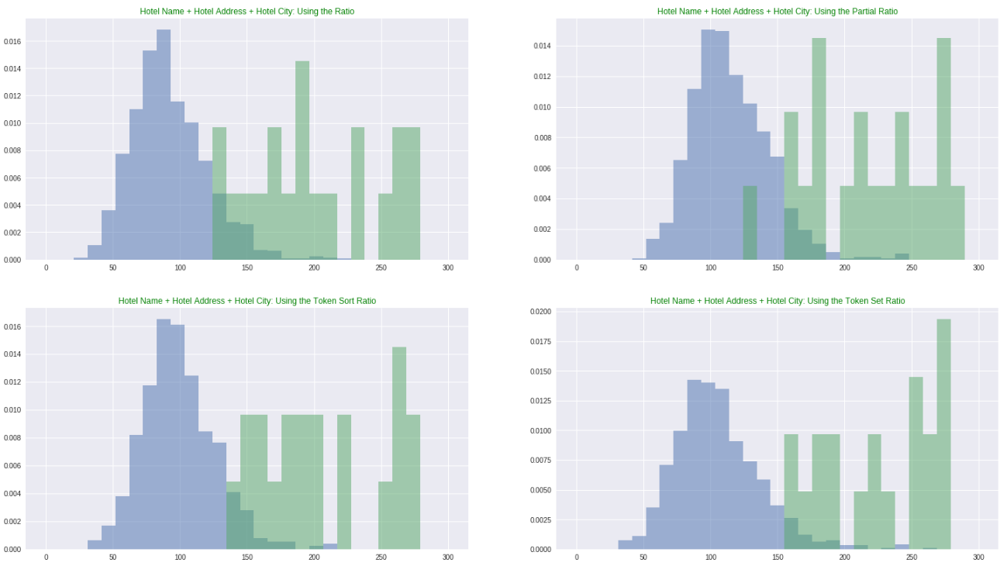
What is left

Slide 28
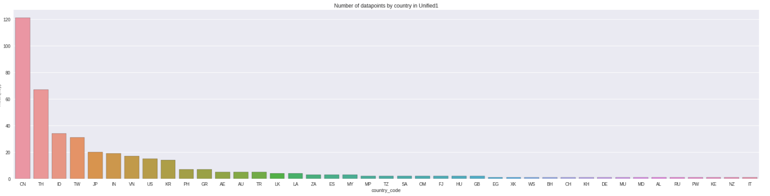
394

Slide 29
Partner1
Perfect Match
Partner1_remain
Sort_Ratio > 280
Partner1_remain
Partner2
Partner2_remain
Partner2_remain
10000
500
7450
369
2770
137
12d Logistic
Regression
Acc = 100%
Cov = 0%
Acc = 100%
Cov = 29%
Acc = 100%
Cov = 72%
Partner1_remain
Final Matches
Partner1_remain
Partner2_remain
Partner2_remain
394
21
204
12
Acc = 99%
Cov = 98%
Acc = >99.5%
Cov = 96%
Acc = 99%
Cov = 98%

Slide 30
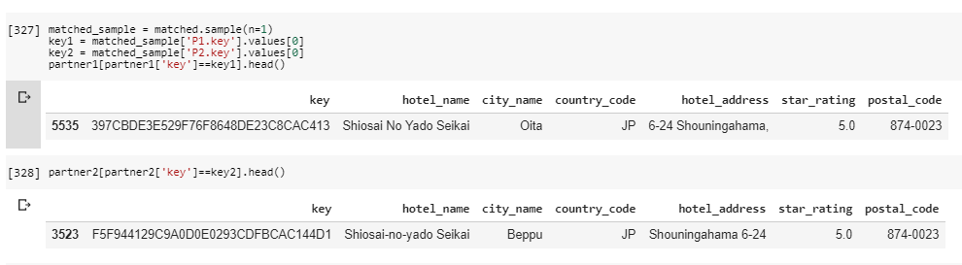
Sanity Check

Slide 31
Improvements
Better data pre-processing (B&B = Bed & Breakfast = Bed and Breakfast)
Customized string similarity scoring function
Better model tuning and ensembles
More data

