Slide 1


WP 3.2 Application
Alessandro Maccarini
Researcher
Aalborg University - Department of the Built Environment
amac@build.aau.dk

Slide 2
Objective of WP3.2
To demonstrate capabilities enabled by the use of Modelica for building and district energy systems design and operation
Outcome
Collection of application case studies aiming at:
disseminating best practices to the simulation community,
illustrating the possibilities that Modelica offers for the design, modeling and analysis of building and district energy system, and
identifying research needs for Task 1 and Task 2 of IBPSA Project 1
Notes:
The goal of this work package is to demonstrate capabilities enabled by the use of Modelica for building and district energy systems.
This is accomplished by collecting a number of case studies that facilitates a systematic comparison and illustrates key findings from different applications. The aim is to:
-share best practices to the simulation community
-illustrating the possibilities that Modelica offers for the design, modeling and analysis of building and district energy system and,
-identifying research needs for Task 1 and Task 2

Slide 3
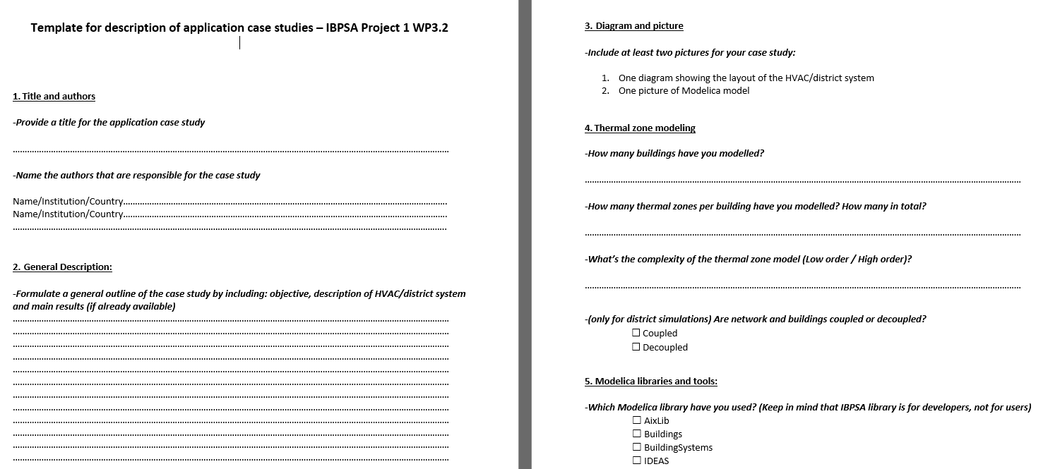
How are the case studies being collected?
Participants fill in a “case study template” available at https://github.com/ibpsa/project1/tree/master/wp_3_2_app
Notes:
The case studies are collected using a “case study template” that is available on the github page of IBPSA Project 1.
The template asks for information such as objective of the case study, layout of the HVAC/district energy system, thermal zone modeling, Modelica libraries used, computation time etc…

Slide 4
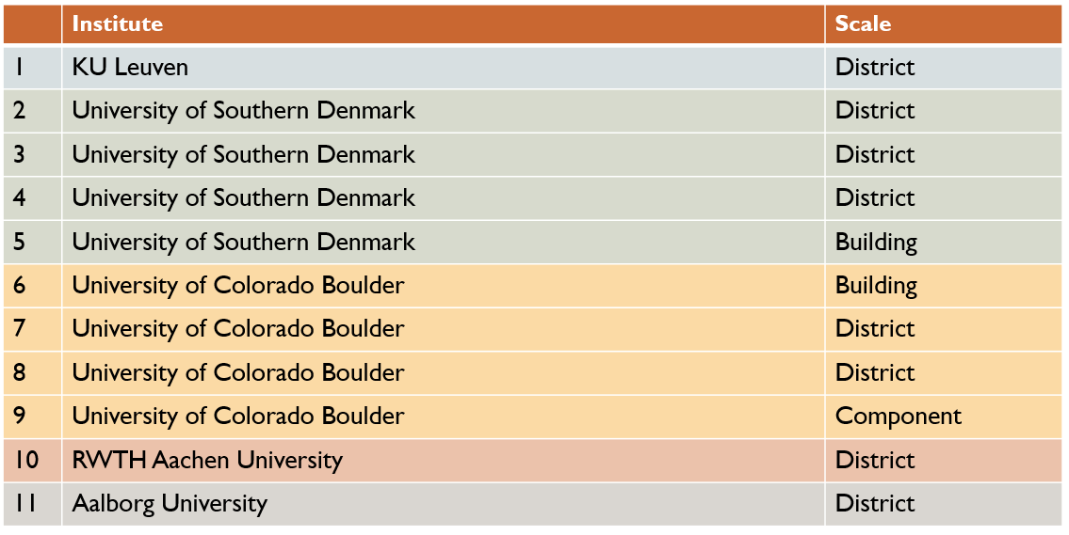
Current case studies
So far 11 case studies have been collected
New case study from LBNL coming soon!
Notes:
So far, 11 case studies from 5 different institutes have been collected. Applications range from hydronic heating loops and cooling systems in data centers to district heating networks and multi-infrastructure smart community systems.
In terms of application scale, the majority of case studies deal with applications at district level. This highlights that the use of Modelica for simulation of district energy systems has grown rapidly in the recent few years.
A new case study from LBNL will be included soon.

Slide 5
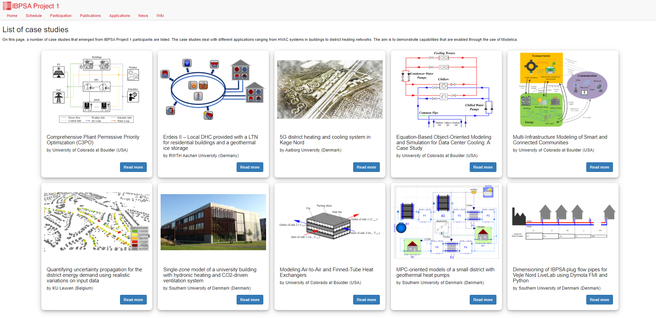
Uploading case studies on IBPSA Project 1 website
The case studies have been recently uploaded on the Project 1 website at https://ibpsa.github.io/project1/applications
Notes:
The information gathered through the templates have been recently uploaded to the project website in order to increase the visibity of the works and show the different applications of Modelica to a larger audience.
Message to participants of WP3.2: Please check that the information shown in your case study webpage are correct. If you want to make any change/addition, just drop me an email.

Slide 6
Next steps
Continuing the collection and coordination of new case studies (if you have a new case study to be included in the IBPSA Project 1 please drop me an email at amac@build.aau.dk
New potential activities will be discussed in the coming months. Possible ideas are:
Making publicly available the Modelica models of the case studies
Developing python-based scripts in collaboration with Task 2 for accelerating the generation of Modelica models
Notes:
The collection of case studies will be continued. Participants interested in including their case studies to the IBPSA Project 1 can fill in the template and send it to me.
Ideas for new potential activities within this WP will be discussed in the coming months (e.g. Making publicly available the Modelica models of the case studies and/or developing python-based script for accelerating the generation of Modelica models)

