Slide 1
The adjoint method for differentiating complex computations … with example applications in engineering design.
Dr. Zin Lin, MIT Applied Mathematics
guest lecture for 18.335 at MIT, Spring 2021 with Prof. Steven Johnson
see also notes: https://math.mit.edu/~stevenj/18.336/adjoint.pdf

Slide 2

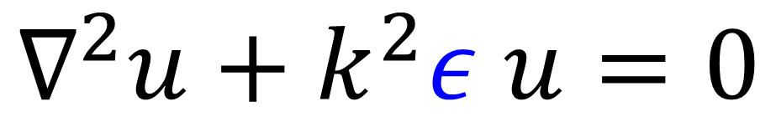
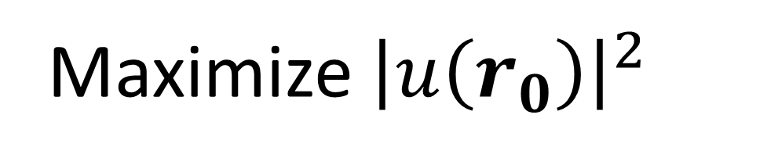
Example: optimizing every pixel of design…
$$ε=?$$
Maximize ${\left|u\left(r_{0}\right)\right|}^{2}$
$$∇^{2}u+k^{2}ε u=0$$
Notes:
Last week, Steven talked about large-scale optimization where you have to handle thousands to even billions of parameters.
Today, I would like to continue that thread of discussion and talk about the key technique that allows you to do such kinds of optimization.
So, one very important class of large-scale optimization is the so-called structural optimization or topology optimization.
Here you want to tweak every pixel in your design until you get whatever performance you want.
For example, we can look at a very simple problem. Let’s say you want to make a structure that focuses waves; it can be light waves, sound waves, water waves, or whatsoever.
But in any case, your waves have to obey some sort of wave equation like the Helmholtz equation.
The problem you want to solve is to figure out the epsilon in the wave equation, which corresponds to the design you want to make, that will focus the incident waves.

Slide 3
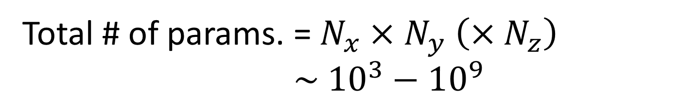
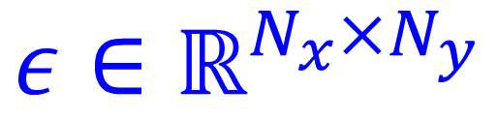
Optimizing every pixel of your design …
$$ε∈ℝ^{N_{x}×N_{y}}$$
Maximize ${\left|u\left(r_{0}\right)\right|}^{2}$
$$∇^{2}u+k^{2}ε u=0$$
Total # of params. = $N_{x}×N_{y} \left(×N_{z}\right)$
$$\sim {10}^{3}−{10}^{9}$$
Notes:
So you discretize your epsilon into a grid.
And you quickly realize that you have to optimize over a lot of parameters.
Even if you only have 100 pixels in x direction and 10 pixels in y direction, you have to optimize an epsilon array with a thousand elements.
In practical applications, you need even larger designs and also 3D so very often you have to optimize hundreds thousands to even billions of parameters.
You clearly can’t do a brute-force search in such a big design space nor can you use an algorithm like genetic or particle swarm, either, which are only good for at most a hundred or so parameters.
You have to do gradient-based optimization.

Slide 4
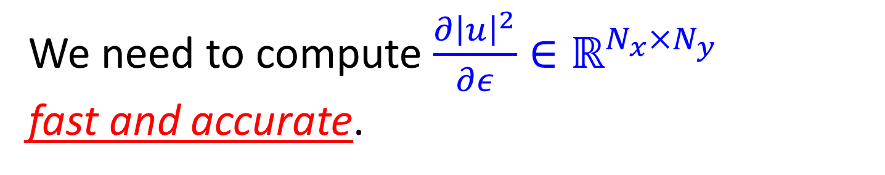
Optimizing every pixel of your design …
$$ε∈ℝ^{N_{x}×N_{y}}$$
Maximize ${\left|u\left(r_{0}\right)\right|}^{2}$
$$∇^{2}u+k^{2}ε u=0$$
We need to compute $\frac{∂{\left|u\right|}^{2}}{∂ε}∈ℝ^{N_{x}×N_{y}}$
fast and accurate.
Notes:
So, we need to compute fast and accurate the derivative with respect to all the parameters, which is itself a big array like the epsilon.
The key word here is fast and accurate.
Another way to put it is we want the gradient field in a form that is analytically exact but also computationally very fast.

Slide 5
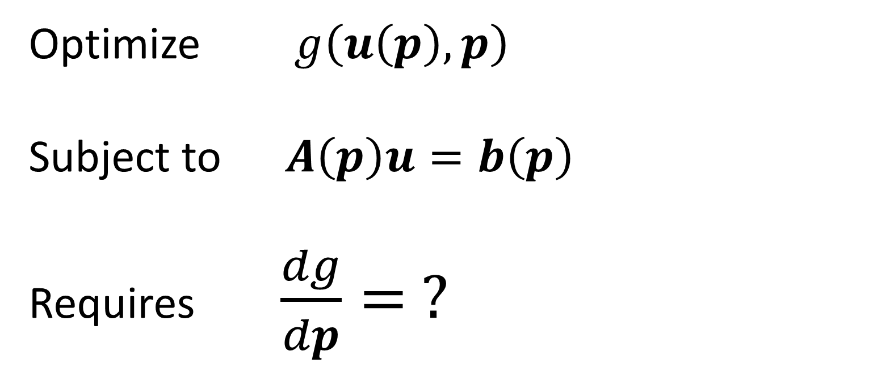
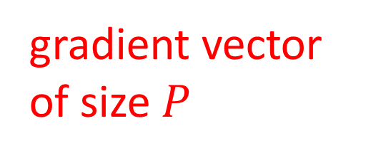

Adjoint method (~ Back prop, Backward differentiation, etc)
$g$ is a scalar-valued function $∈ℝ$.
$u$ is a “physics” vector of size $N.$ (electric, displacement, pressure, temperature, etc.)
$p$ is a param. vector of size $P$.
(dielectric, mass density, conductivity, etc.)
$A$ is an $N×N$ matrix.
(PDE: Maxwell, elastodynamics, heat equation, etc.)
Optimize $g\left(u\left(p\right),p\right)$
Subject to $A\left(p\right)u=b\left(p\right)$
Requires $\frac{dg}{dp}= ?$
gradient vector of size $P$
Notes:
A nice approach to do that is called adjoint method.
If you happen to be in the field of machine learning or neural networks, you might come across names like back propagation, backward differentiation ,etc.
They are all techniques of the same flavor.
…
…
An important thing to note here is that the linear equations A u = b embodies the physics of your device so it is typically the most expensive part of the computation to solve it.
If you have to solve it, you want to solve it only as often as absolutely necessary.
…
…

Slide 6
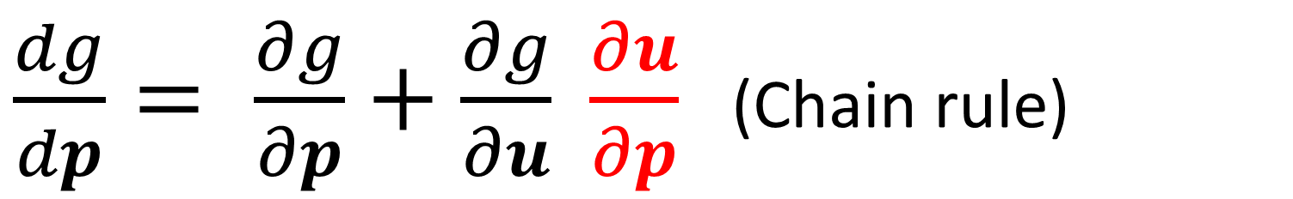
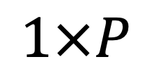
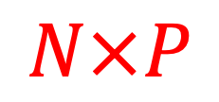
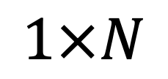
Adjoint method (Linear equations)
$\frac{dg}{dp}= \frac{∂g}{∂p}+\frac{∂g}{∂u} \frac{∂u}{∂p}$ (Chain rule)
$$1×N$$
$$1×P$$
$$N×P$$
Notes:
Since you always have an explicit form of g, you can do the first two derivatives easily.
The last derivative du/dp requires a bit more digging.

Slide 7
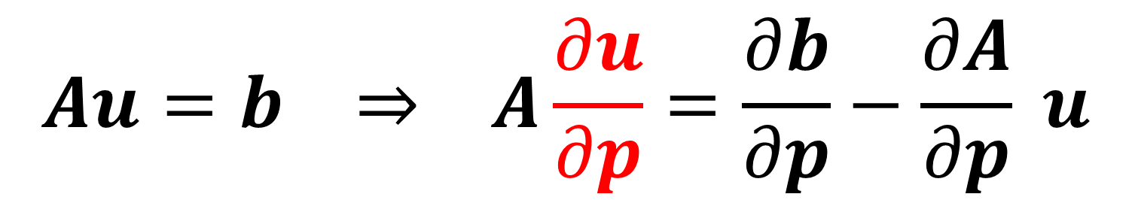
Adjoint method (Linear equations)
$\frac{dg}{dp}= \frac{∂g}{∂p}+\frac{∂g}{∂u} \frac{∂u}{∂p}$ (Chain rule)
$$Au=b ⇒ A\frac{∂u}{∂p}=\frac{∂b}{∂p}−\frac{∂A}{∂p} u$$
Notes:
Now you remember that u depends on p thru the linear equations. So …

Slide 8

Adjoint method (Linear equations)
$\frac{dg}{dp}= \frac{∂g}{∂p}+\frac{∂g}{∂u} \frac{∂u}{∂p}$ (Chain rule)
$$Au=b ⇒ A\frac{∂u}{∂p}=\frac{∂b}{∂p}−\frac{∂A}{∂p} u$$
$$\frac{dg}{dp}= \frac{∂g}{∂p}+\frac{∂g}{∂u} \left[A^{−1}\left(\frac{∂b}{∂p}−\frac{∂A}{∂p} u\right)\right]$$

Slide 9
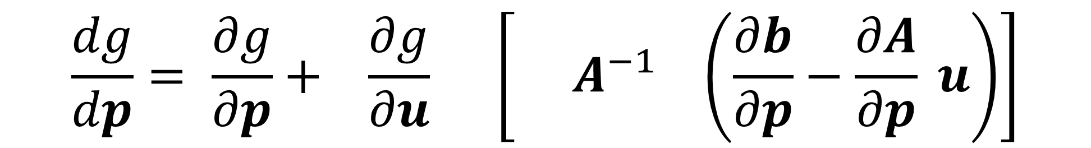

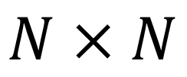
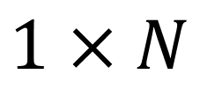
Adjoint method (Linear equations)
$$1×N$$
$$N×N$$
$$N×P$$
$$\frac{dg}{dp}= \frac{∂g}{∂p}+ \frac{∂g}{∂u} \left[{ A}^{−1} \left(\frac{∂b}{∂p}−\frac{∂A}{∂p} u\right)\right]$$
Notes:
Here we have a more or less explicit formula for the gradient.
So let’s stop for a moment and try to process what it really means.
First, let’s make sure we get the dimensions correct.

Slide 10
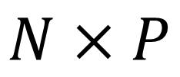
Adjoint method (Linear equations)
$$1×N$$
$$N×N$$
$$N×P$$
$$\frac{dg}{dp}= \frac{∂g}{∂p}+ \frac{∂g}{∂u} \left[{ A}^{−1} \left(\frac{∂b}{∂p}−\frac{∂A}{∂p} u\right)\right]$$
$$N×P$$
You have to solve $A{\left[…\right]}_{i}= \frac{∂b}{∂p_{i}}−\frac{∂A}{∂p_{i}}u$ for every $p_{i}, i=1,…,P$ !!!
Notes:
Now the troublesome quantity here is this bracketed quantity which is an N by P matrix.
To get this matrix, you have to apply A inverse not to a vector by to another matrix.
In other words, you have to get each column of this bracketed matrix by solving the system equations with a different right hand side corresponding to different p_i, repeatedly for P times in total.

Slide 11
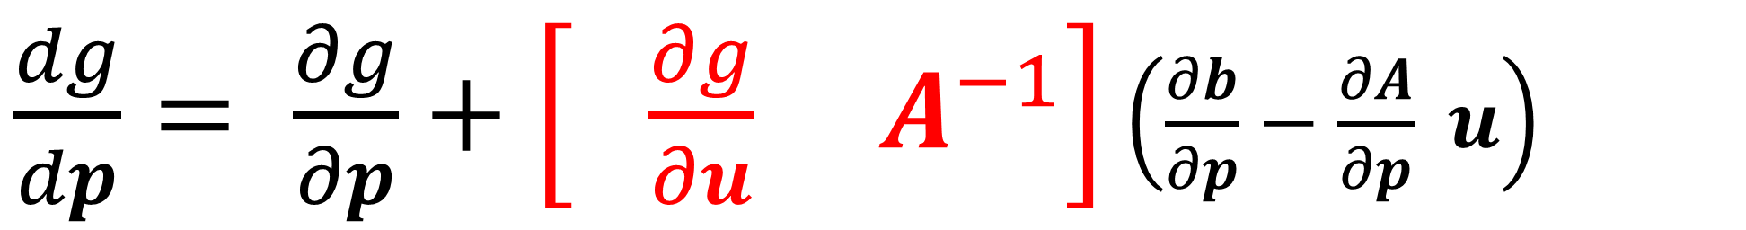
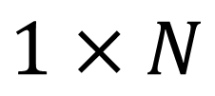

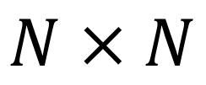
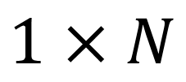
Adjoint method (Linear equations)
$$1×N$$
$$N×N$$
$$N×P$$
$\frac{dg}{dp}= \frac{∂g}{∂p}+\left[ \frac{∂g}{∂u}{ A}^{−1}\right]$ $\left(\frac{∂b}{∂p}−\frac{∂A}{∂p} u\right)$
*********
KEY Trick:
switch the bracket
*********
$$1×N$$

Slide 12
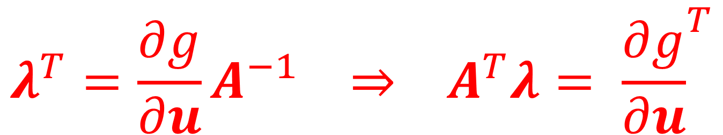
Adjoint method (Linear equations)
$$1×N$$
$$N×N$$
$$N×P$$
$\frac{dg}{dp}= \frac{∂g}{∂p}+\left[ \frac{∂g}{∂u}{ A}^{−1}\right]$ $\left(\frac{∂b}{∂p}−\frac{∂A}{∂p} u\right)$
$$1×N$$
$$λ^{T}=\frac{∂g}{∂u}A^{−1} ⇒ A^{T}λ= {\frac{∂g}{∂u}}^{T}$$

Slide 13
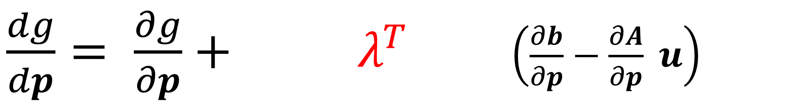
Adjoint method (Linear equations)
$$N×P$$
$\frac{dg}{dp}= \frac{∂g}{∂p}+{ λ}^{T}$ $\left(\frac{∂b}{∂p}−\frac{∂A}{∂p} u\right)$
$$1×N$$
$$λ^{T}=\frac{∂g}{∂u}A^{−1} ⇒ A^{T}λ= {\frac{∂g}{∂u}}^{T}$$

Slide 14
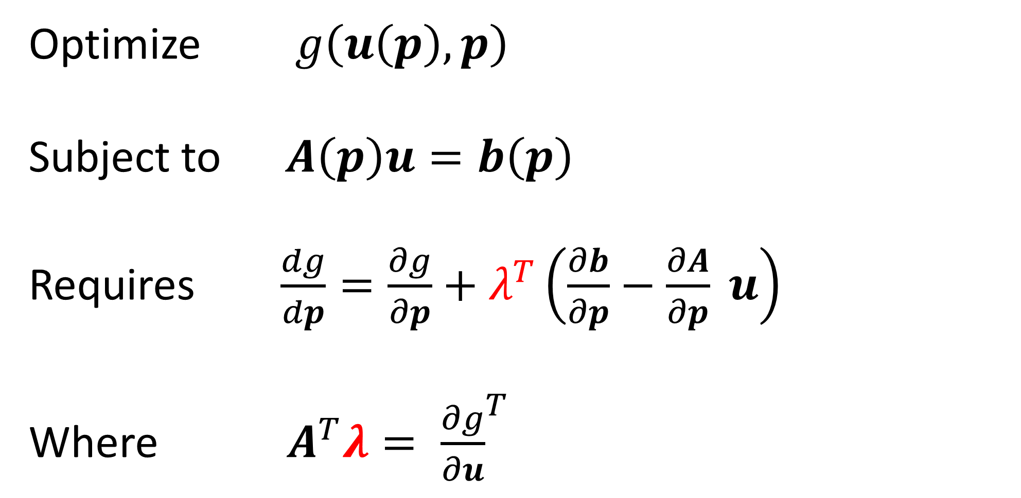
Adjoint method (Linear equations)
Optimize $g\left(u\left(p\right),p\right)$
Subject to $A\left(p\right)u=b\left(p\right)$
Requires $\frac{dg}{dp}=\frac{∂g}{∂p}+λ^{T}\left(\frac{∂b}{∂p}−\frac{∂A}{∂p} u\right)$
Where $A^{T}λ= {\frac{∂g}{∂u}}^{T}$
Takeaway: you can obtain the entire gradient by solving the linear equations just one more time.

Slide 15
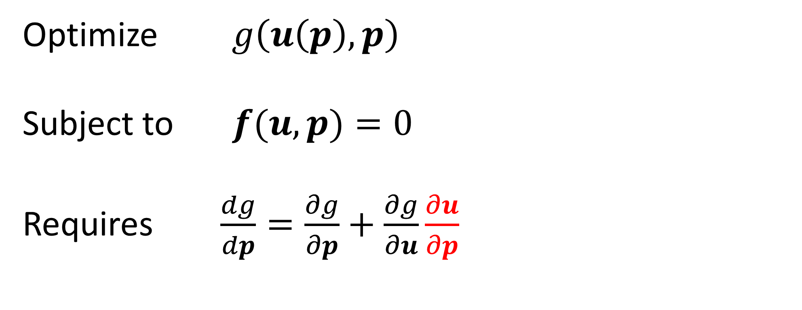

Adjoint method (Nonlinear equations)
Optimize $g\left(u\left(p\right),p\right)$
Subject to $f(u,p)=0$
Requires $\frac{dg}{dp}=\frac{∂g}{∂p}+\frac{∂g}{∂u}\frac{∂u}{∂p}$
$f$ is a vector-valued function of size $N.$ (nonlinear Maxwell equations, Navier-Stokes equations, etc.)

Slide 16
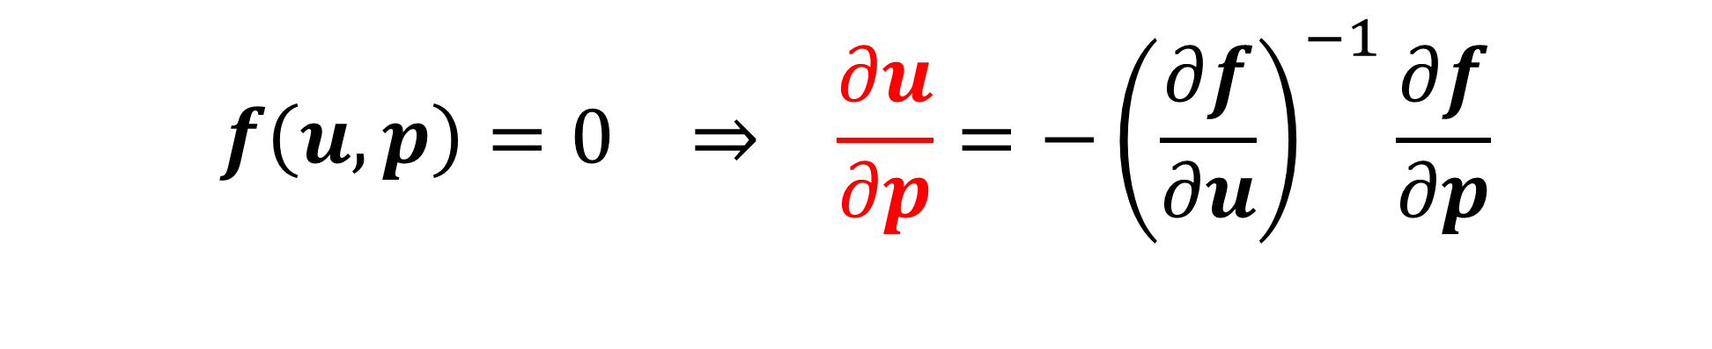
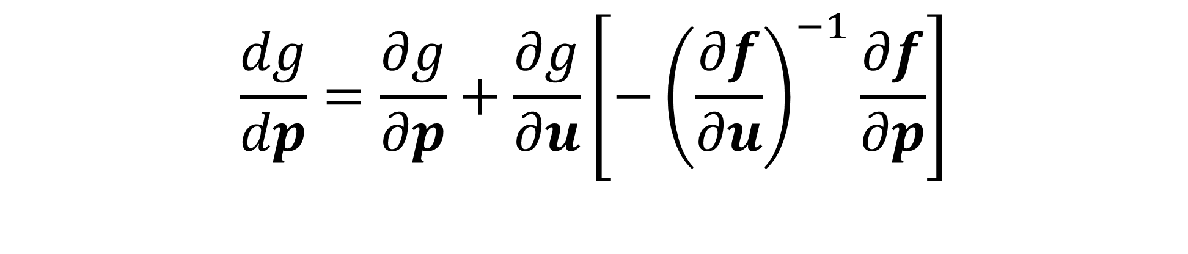


Adjoint method (Nonlinear equations)
$$f\left(u,p\right)=0 ⇒ \frac{∂u}{∂p}=−{\left(\frac{∂f}{∂u}\right)}^{−1}\frac{∂f}{∂p}$$
$$N×N$$
$$N×P$$
$$\frac{dg}{dp}=\frac{∂g}{∂p}+\frac{∂g}{∂u}\left[−{\left(\frac{∂f}{∂u}\right)}^{−1}\frac{∂f}{∂p}\right]$$

Slide 17

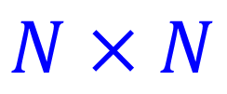

Adjoint method (Nonlinear equations)
Again, switch the bracket
$$\frac{dg}{dp}=\frac{∂g}{∂p}−\left[\frac{∂g}{∂u}{ \left(\frac{∂f}{∂u}\right)}^{−1}\right]\frac{∂f}{∂p}$$
$$=\frac{∂g}{∂p}−λ^{T}\frac{∂f}{∂p}, {\frac{∂f}{∂u}}^{T}λ={\frac{∂g}{∂u}}^{T}$$
$$N×N$$
Note: the adjoint problem is a linear problem (of lesser complexity than the forward nonlinear problem).

Slide 18
Example applications
Engineering optimization (structural “topology” optimization):
Find the physical structure that optimizes some objective (e.g. focusing light, minimizing drag, supporting weight, …).
Adjoint methods are key! “Forward” model is a huge simulation, but gradient requires only one additional simulation.

Slide 19
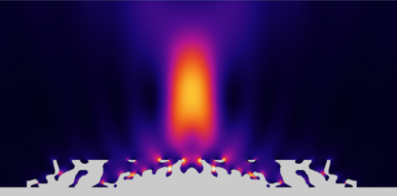

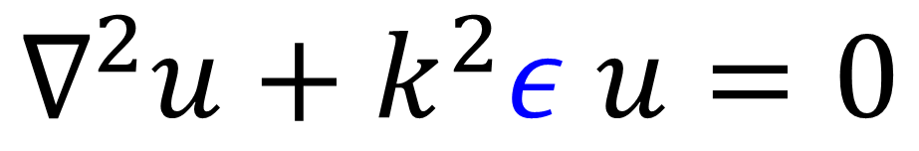

Topology-optimized nanophotonic lens
Max. ${\left|u\left(r_{0}\right)\right|}^{2}$
$$ε$$
$$∇^{2}u+k^{2}ε u=0$$
Christiansen, Rasmus E., and Ole Sigmund. "Inverse design in photonics by topology optimization: tutorial." JOSA B 38.2 (2021): 496-509.

Slide 20
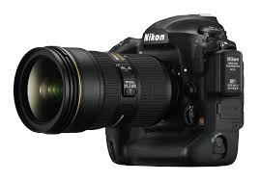
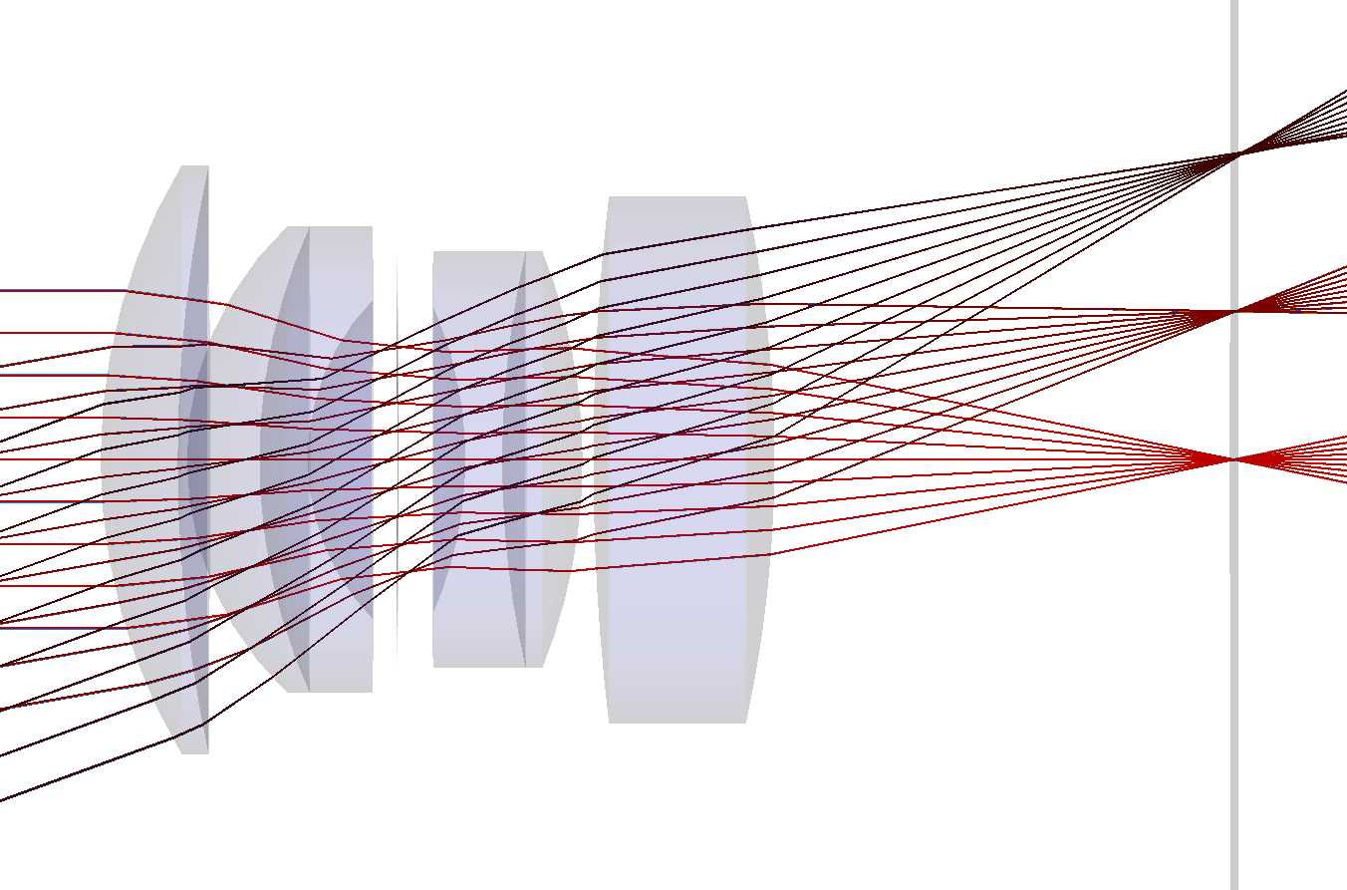
A squished camera lens?
centimeters

Slide 21
A squished camera lens?
centimeters

Slide 22
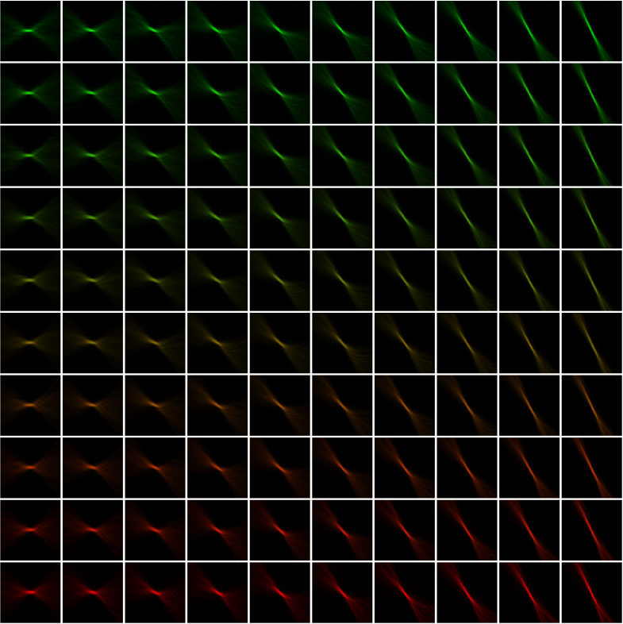
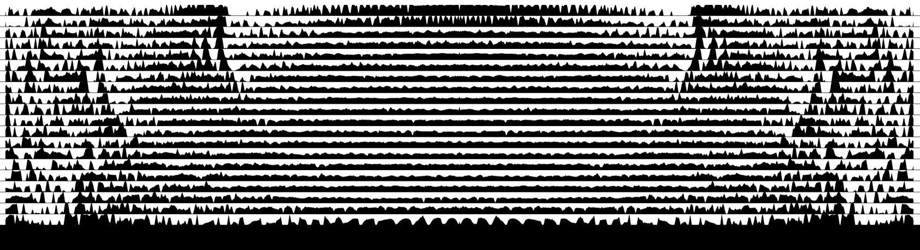
A squished camera lens?
micrometers
centimeters

Slide 23
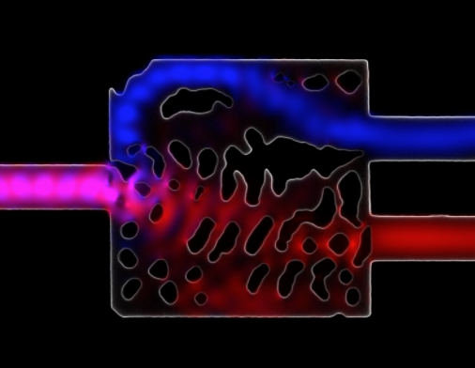
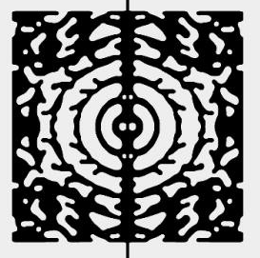
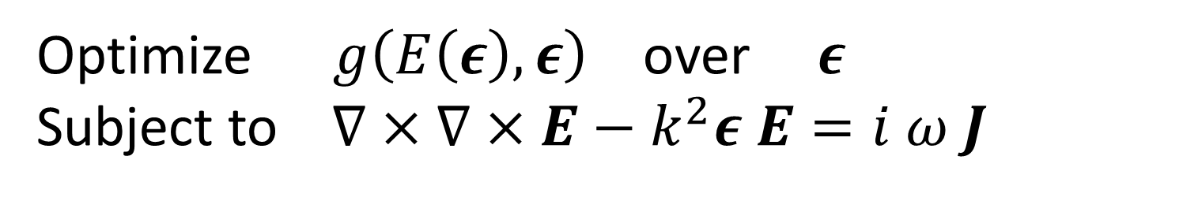
Many more applications in optics and photonics …
Splitting wavelengths into different channels
Piggott et al, Nature Photonics (2016)
Trapping light in a very small volume
Wang et al, APL (2018)
Optimize $g\left(E\left(ε\right),ε\right)$ over $ε$
Subject to $∇×∇×E−k^{2}ε E=i ω J$

Slide 24
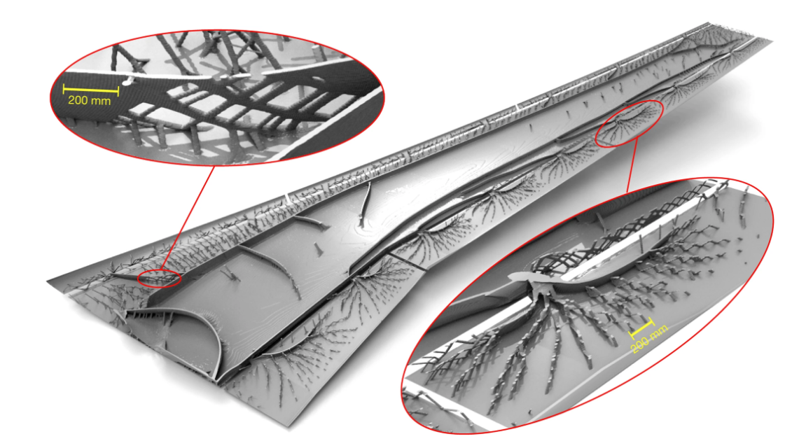
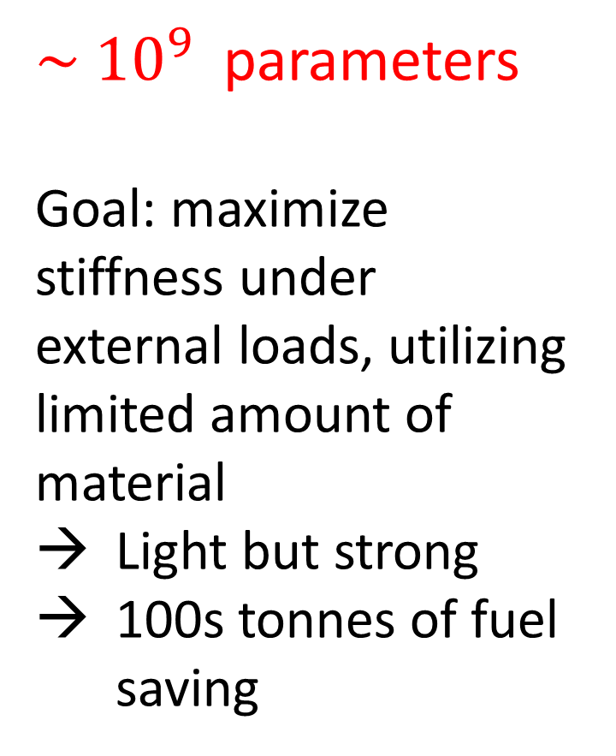
Topology-optimized aircraft wing
$\sim {10}^{9}$ parameters
Goal: maximize stiffness under external loads, utilizing limited amount of material
Light but strong
100s tonnes of fuel saving
Aage, Niels, et al. "Giga-voxel computational morphogenesis for structural design." Nature 550.7674 (2017): 84-86.

Slide 25
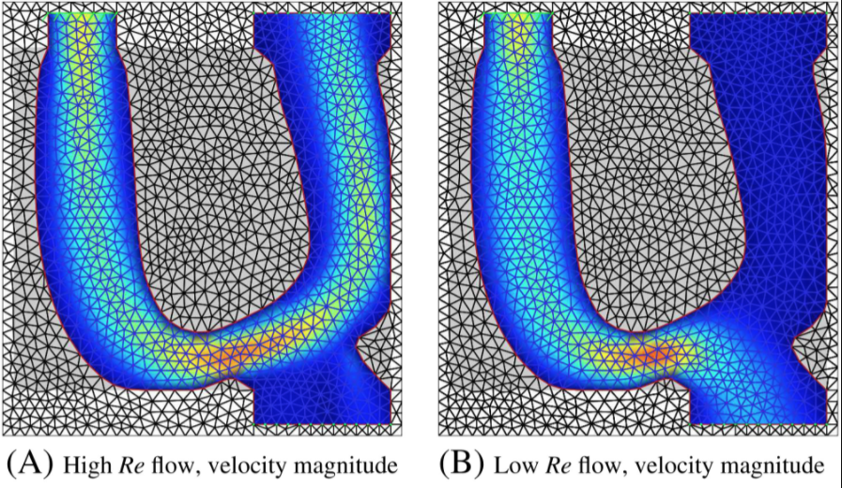
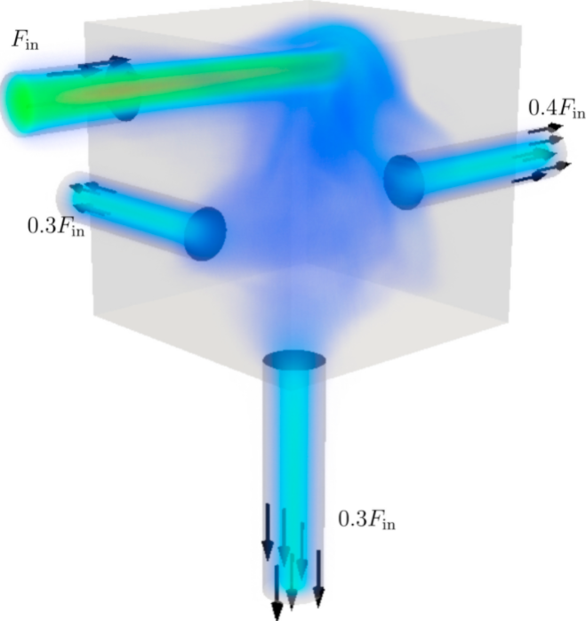
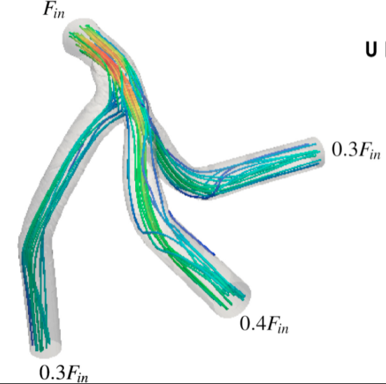
Topology optimization with fluid dynamics
Minimize the power dissipation due to turbulent flow for a given set of inlets and outlets.
Switching flow channels for high vs. low viscosity
Zhou, Mingdong, et al. "Shape morphing and topology optimization of fluid channels by explicit boundary tracking." International Journal for Numerical Methods in Fluids 88.6 (2018): 296-313.
Dilgen, Cetin B., et al. "Topology optimization of turbulent flows." Computer Methods in Applied Mechanics and Engineering 331 (2018): 363-393.

Slide 26
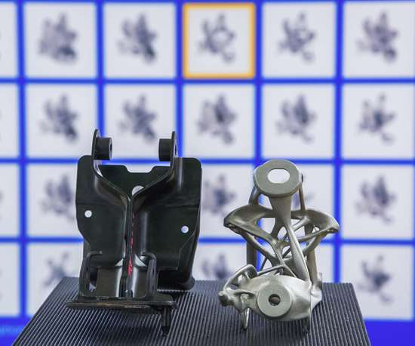
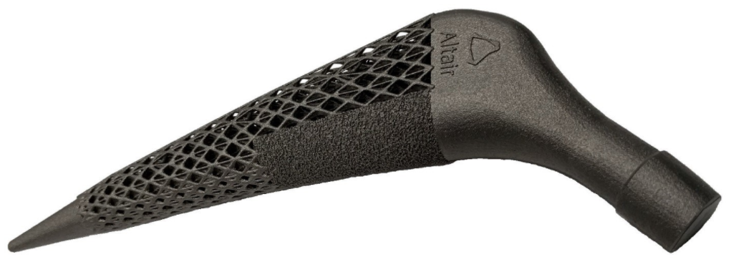
Some industrial applications
Topology-optimized 3D-printed hip replacement (Altair)
Topology-optimized 3D-printed seat bracket (General Motors)
And many others …

Slide 27
Not just for physical problems!
Key point is that if you have any complicated calculation with lots of parameters, you can compute gradient (sensitivity) of a scalar output g(u) with respect to every parameter with roughly one additional calculation.
Enabling factor for large-scale optimization in machine learning [g = loss function, u = network outputs, p = network weights & other parameters], statistics, finance, and many other fields.
Central trick is to evaluate chain rule from “left-to-right”, i.e. “back-propagating” in “reverse” order from “outputs to inputs”, i.e. using left-to-right “vector–Jacobian products”.

