Slide 1
A Brief Overview of Optimization Problems
Steven G. Johnson
MIT course 18.335, Spring 2021

Slide 2
Why optimization?
In some sense, all engineering design is optimization: choosing design parameters to improve some objective
Much of data analysis is also optimization: extracting some model parameters from data while minimizing some error measure (e.g. fitting)
Machine learning (e.g. deep neural nets) is based on optimizing a “loss” function over many model (NN) parameters
Most business decisions = optimization: varying some decision parameters to maximize profit (e.g. investment portfolios, supply chains, etc.)

Slide 3
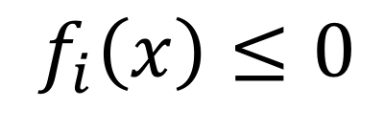
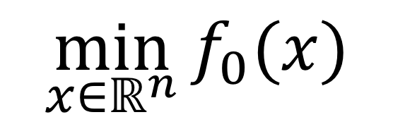
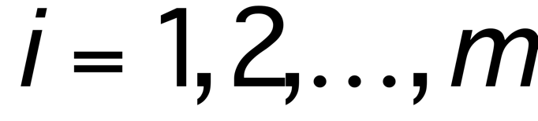
A general optimization problem
minimize an objective function f₀
with respect to n design parameters x
(also called decision parameters, optimization variables, etc.)
$$\min_{x∈ℝ^{n}}{f_{0}(x)}$$
— note that maximizing g(x)
corresponds to f₀ (x) = –g(x)
subject to m constraints
$$f_{i}\left(x\right)≤0$$
note that an equality constraint
h(x) = 0
yields two inequality constraints
f_{i}(x) = h(x) and f_{i+1}(x) = –h(x)
(although, in practical algorithms, equality constraints typically require special handling)
x is a feasible point if it
satisfies all the constraints
feasible region = set of all feasible x

Slide 4
Important considerations
Global versus local optimization
Convex vs. non-convex optimization
Unconstrained or box-constrained optimization, and other special-case constraints
Special classes of functions (linear, etc.)
Differentiable vs. non-differentiable functions
Gradient-based vs. derivative-free algorithms
…
Zillions of different algorithms, usually restricted to various special cases, each with strengths/weaknesses

Slide 5
Global vs. Local Optimization
For general nonlinear functions, most algorithms only guarantee a local optimum
that is, a feasible x_{o} such that f₀(x_{o}) ≤ f₀(x) for all feasible x within some neighborhood ||x–x_{o}|| < R (for some small R)
A much harder problem is to find a global optimum: the minimum of f₀ for all feasible x
exponentially increasing difficulty with increasing n, practically impossible to guarantee that you have found global minimum without knowing some special property of f₀
many available algorithms, problem-dependent efficiencies
not just genetic algorithms or simulated annealing (which are popular, easy to implement, and thought-provoking, but usually very slow!)
for example, non-random systematic search algorithms (e.g. DIRECT), partially randomized searches (e.g. CRS2), repeated local searches from different starting points (“multistart” algorithms, e.g. MLSL), …

Slide 6
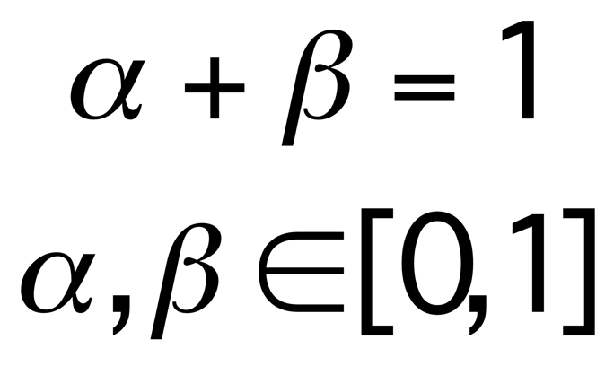

Convex Optimization
[ good reference: Convex Optimization by Boyd and Vandenberghe,
free online at www.stanford.edu/~boyd/cvxbook ]
All the functions f_{i} (i=0…m) are convex:
where
convex:
f(x)
not convex:
f(x)
αf(x) + βf(y)
f(αx+βy)
x
y
x
y
For a convex problem (convex objective & constraints)
any local optimum must be a global optimum
⇒ efficient, robust solution methods available

Slide 7
Important Convex Problems
LP (linear programming): the objective and constraints are affine: f_{i}(x) = a_{i}^{T}x + α_{i}
QP (quadratic programming): affine constraints + convexquadratic objective x^{T}Ax+b^{T}x
SOCP (second-order cone program): LP + cone constraints ||Ax+b||₂ ≤ a^{T}x + α
SDP (semidefinite programming): constraints are that ΣA_{k}x_{k} is positive-semidefinite
all of these have very efficient, specialized solution methods

Slide 8
Non-convex local optimization: a typical generic outline
[ many, many variations in details !!! ]
1
At current x, construct approximate model of f_{i}
—e.g. affine, quadratic, … often convex
2
Optimize the model problem ⇒ new x
— use a trust region to prevent large steps
3
Evaluate new x:
— if “acceptable,” go to 1
— if bad step (or bad model), update
trust region / model and go to 2

Slide 9
Important special constraints
Simplest case is the unconstrained optimization problem: m=0
e.g., line-search methods like steepest-descent, nonlinear conjugate gradients, Newton methods …
Next-simplest are box constraints (also called bound constraints): x_{k}^{min} ≤ x_{k} ≤ x_{k}^{max}
easily incorporated into line-search methods and many other algorithms
many algorithms/software only handle box constraints
…
Linear equality constraints Ax=b
for example, can be explicitly eliminated from the problem by writing x=Ny+ξ, where ξ is a solution to Aξ=b and N is a basis for the nullspace of A

Slide 10
Derivatives of f_{i}
Most-efficient algorithms typically require user to supply the gradients ∇_{x}f_{i} of objective/constraints
you should always compute these analytically
rather than use finite-difference approximations, better to just use a derivative-free optimization algorithm
in principle, one can always compute ∇_{x}f_{i} with about the same cost as f_{i}, using adjoint methods, or equivalently “reverse-mode” automatic differentiation (AD)
gradient-based algorithms can find (local) optima of problems with millions of design parameters!
Derivative-free methods: only require f_{i} values
easier to use, can work with complicated “black-box” functions where computing gradients is inconvenient
may be only possibility for nondifferentiable problems
need > n function evaluations, bad for large n

Slide 11
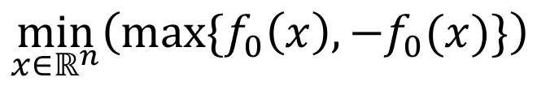
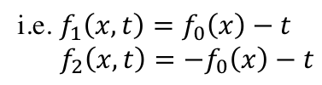
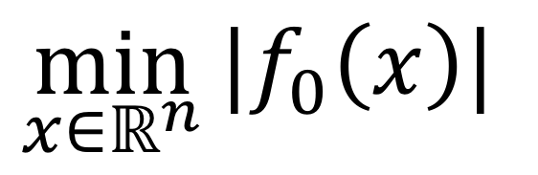


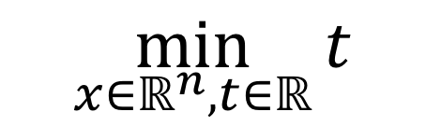
Removable non-differentiability
consider the non-differentiable unconstrained problem:
$$\min_{x∈ℝ^{n}}{|f_{0}\left(x\right)|}$$
f₀(x)
–f₀(x)
optimum
equivalent to minimax problem:
x
$$\min_{x∈ℝ^{n}}\left(\max{\{f_{0}\left(x\right),−f_{0}(x)\}}\right)$$
…still nondifferentiable…
…equivalent to constrained problem with a “temporary” variable t:
$$\min_{x∈ℝ^{n},t∈ℝ}{t}$$
$$t≥f_{0}(x)$$
differentiable!
subject to:
i.e. $f_{1}\left(x,t\right)=f_{0}\left(x\right)−t$
$f_{2}\left(x,t\right)=−f_{0}\left(x\right)−t$
$$t≥−f_{0}(x)$$
(also called “epigraph” reformulation)

Slide 12
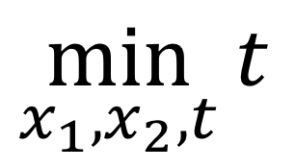
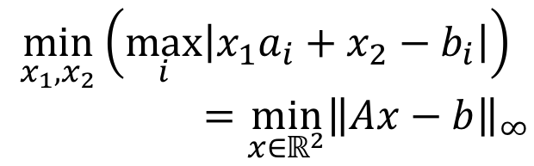



Example: Chebyshev linear fitting
fit line
ax₁+x₂
b
find the fit that minimizes
the maximum error:
$$\min_{x_{1},x_{2}}\left(\max_{i}\left|x_{1}a_{i}+x_{2}−b_{i}\right|\right)$$
$$=\min_{x∈ℝ^{2}}{{\left\|Ax−b\right\|}_{∞}}$$
N points
(a_{i},b_{i})
… nondifferentiable minimax problem
a
equivalent to a linear programming problem (LP):
subject to 2N constraints:
$$\min_{x_{1},x_{2},t}{t}$$
equivalently:
$$t≥x_{1}a_{i}+x_{2}−b_{i}$$
$$t≥\left|x_{1}a_{i}+x_{2}−b_{i}\right|$$
$$t≥{−x}_{1}a_{i}−x_{2}+b_{i}$$
(also called “epigraph” reformulation)

Slide 13
Relaxations of Integer Programming
If x is integer-valued rather than real-valued (e.g. x ∈ {0,1}^{n}),
the resulting integer programming or combinatorial optimization
problem becomes much harder in general.
However, useful results can often be obtained by a continuous
relaxation of the problem — e.g., going from x ∈ {0,1}^{n} to x ∈ [0,1]^{n}
… at the very least, this gives an lower bound on the optimum f₀
“Penalty terms” or “projection filters” (SIMP, RAMP, etc.) can be used to obtain x that ≈ 0 or ≈ 1 almost everywhere.
[ See e.g. Sigmund & Maute, “Topology optimization approaches,” Struct. Multidisc. Opt. 48, pp. 1031–1055 (2013). ]

Slide 14

Example: Topology Optimization
design a structure to do something, made of material A or B…
let every pixel of discretized structure vary continuously from A to B
[ + tricks to impose minimum feature size and mostly “binary” A/B ]
density of each pixel
varies continuously from 0 (air) to max
force
ex: design a cantilever
to support maximum weight
with a fixed amount of material
optimized structure,
deformed under load
[ Buhl et al, Struct. Multidisc. Optim. 19, 93–104 (2000) ]

Slide 15
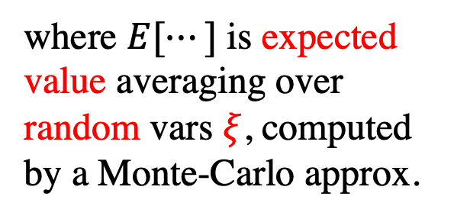
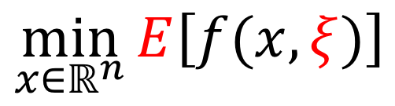
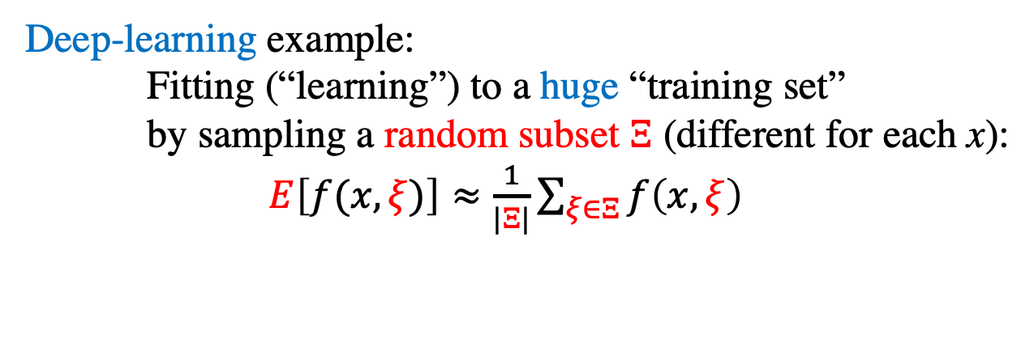
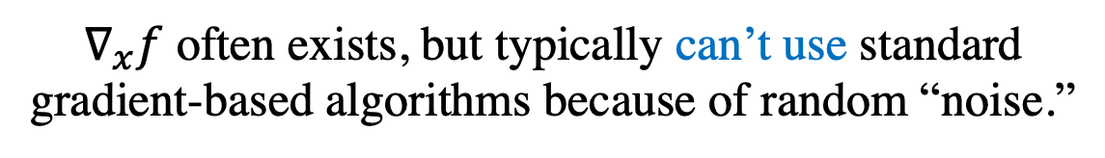
Stochastic Optimization
where $E[⋯]$ is expected value averaging over random vars $ξ$, computed by a Monte-Carlo approx.
$$\min_{x∈ℝ^{n}}{E\left[f(x,ξ)\right]}$$
Deep-learning example:
Fitting (“learning”) to a huge “training set”
by sampling a random subset $Ξ$ (different for each x):
$E\left[f(x,ξ)\right]≈\frac{1}{|Ξ|}\sum_{ξ∈Ξ}{f\left(x,ξ\right)}$
$∇_{x}f$ often exists, but typically can’t use standard gradient-based algorithms because of random “noise.”
A popular algorithm: Adam [Kingma & Ba, 2014]
“stochastic gradient descent”

Slide 16
Some Sources of Software
• NLopt: implements many nonlinear optimization algorithms
callable from many languages (C, Python, R, Matlab, …)
(global/local, constrained/unconstrained, derivative/no-derivative)
http://github.com/stevengj/nlopt
• Python: scipy.optimize, pyOpt, …; Julia: JuMP, Optim,…
• Decision tree for optimization software:
http://plato.asu.edu/guide.html
— lists many (somewhat older) packages for many problems
• CVX: general convex-optimization package http://cvxr.com
… also Python CVXOPT, R CVXR, Julia Convex

