Slide 1



Javier Conde Pascual | 14th April 2022
Course 2: Final Assignment Jupyter Presentation
Javier Conde Pascual | 11th July 2022

Slide 2
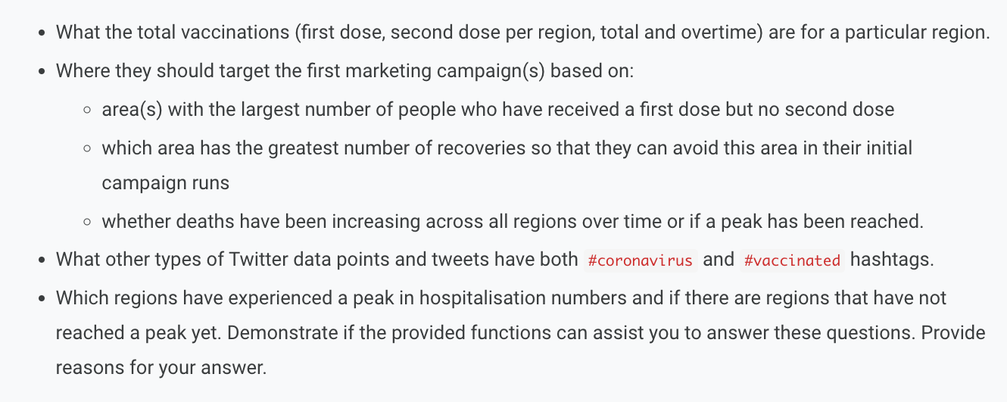
1. Background/context
Figure 1.1: Background, project goal and questions to answer
Source: LSE (2022)
ROLE: assuming the role of data analyst working with the UK government to analyse COVID-19 data (from January 2020 to October 2021)
PROJECT GOAL: identify trends and patterns in the data that could inform a series of marketing campaigns to promote the vaccine. The ultimate target is increasing the number of fully vaccinated individuals (people who have received a first and second dose of the vaccine) through these campaigns
QUESTIONS TO BE ANSWERED:
Javier Conde | 11th July 2022

Slide 3
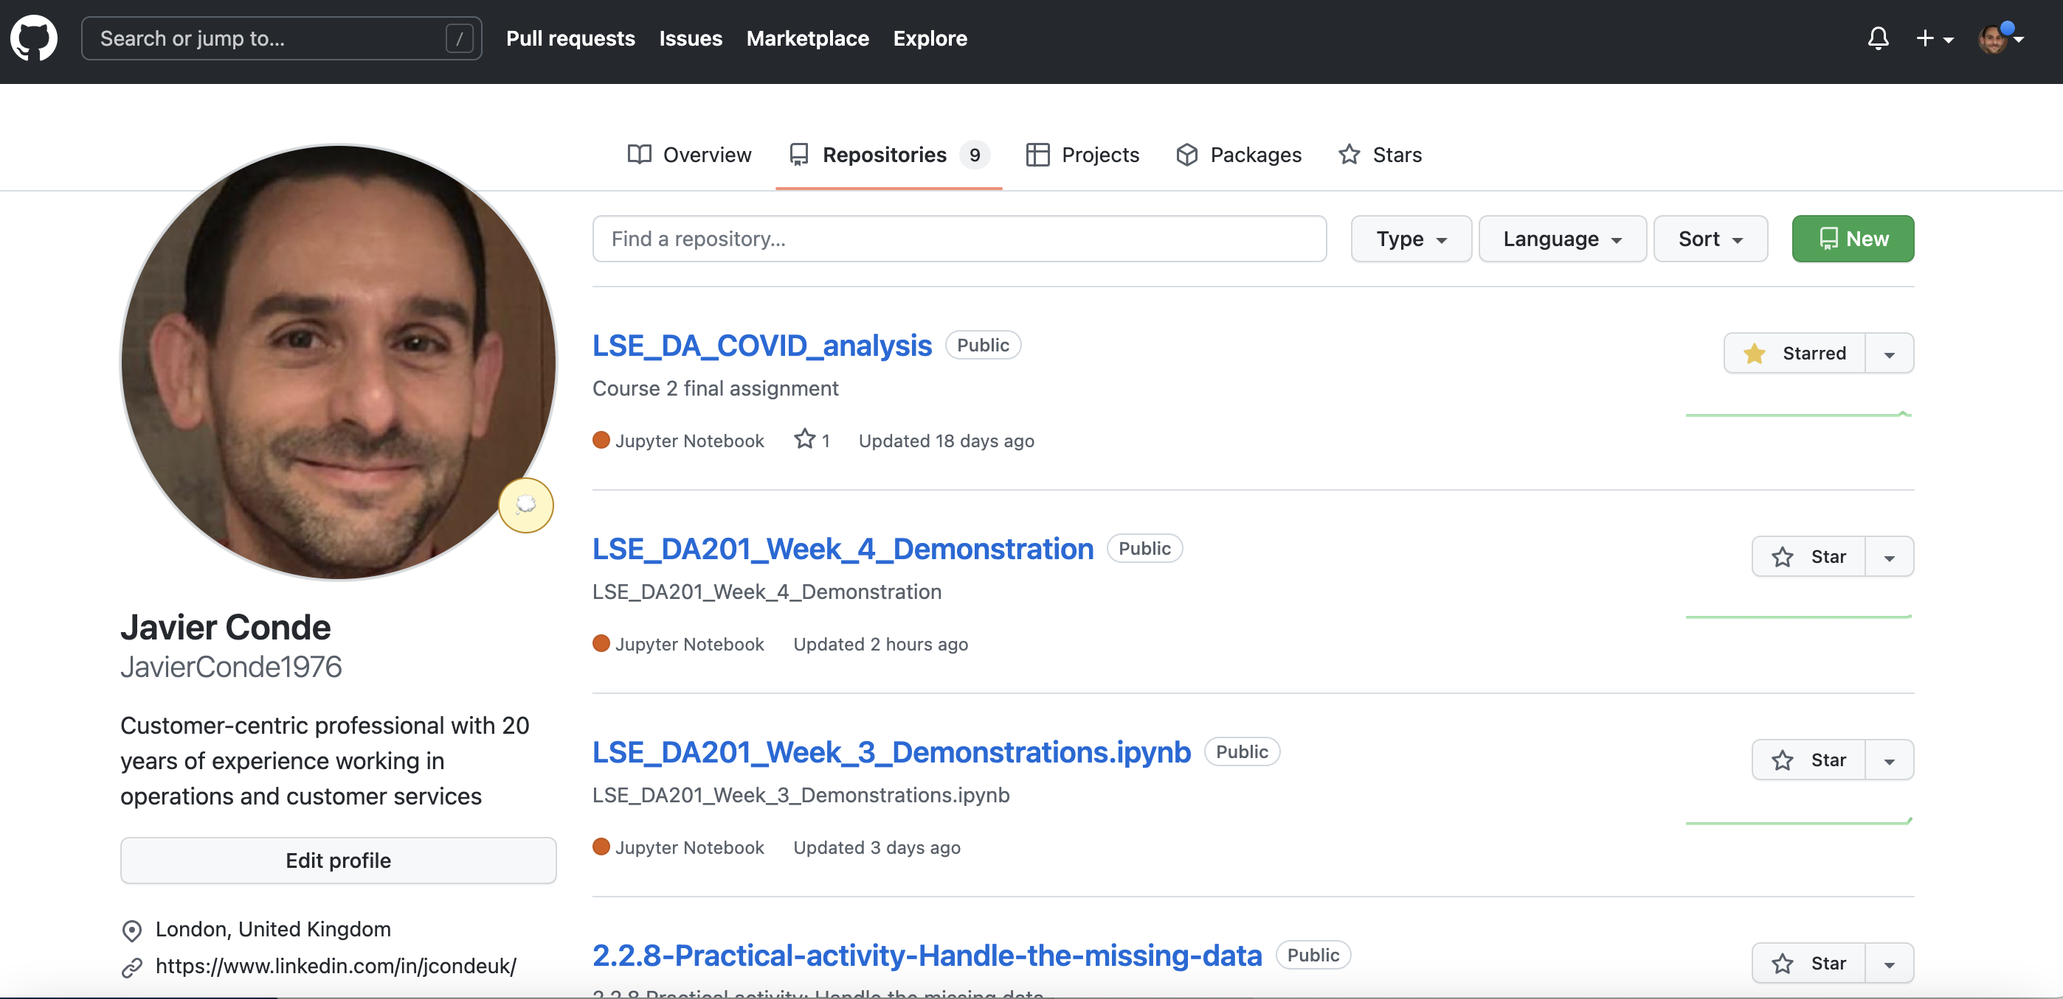
Figure 1.2: Project Github repository (I)
Source: Javier Conde (2022)
Javier Conde | 11th July 2022

Slide 4
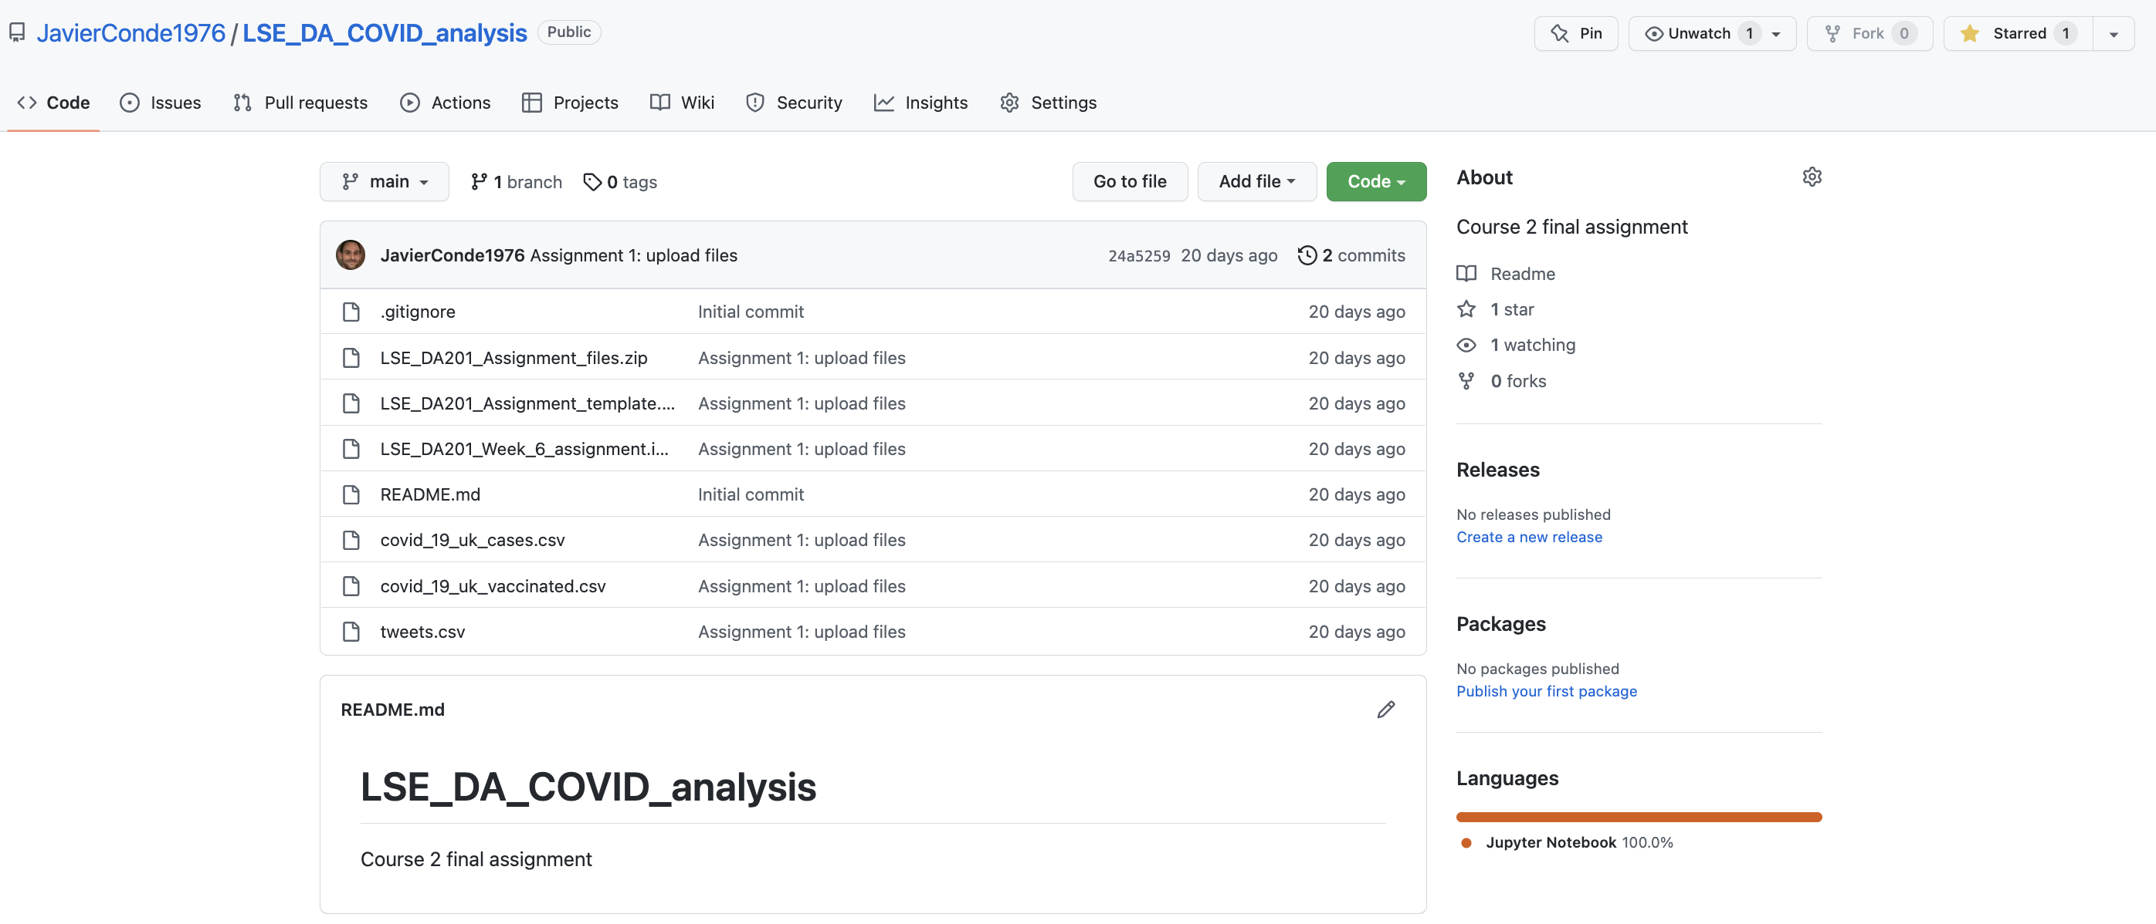
Figure 1.3: Project Github repository (II)
Source: Javier Conde (2022)
Javier Conde | 11th July 2022

Slide 5
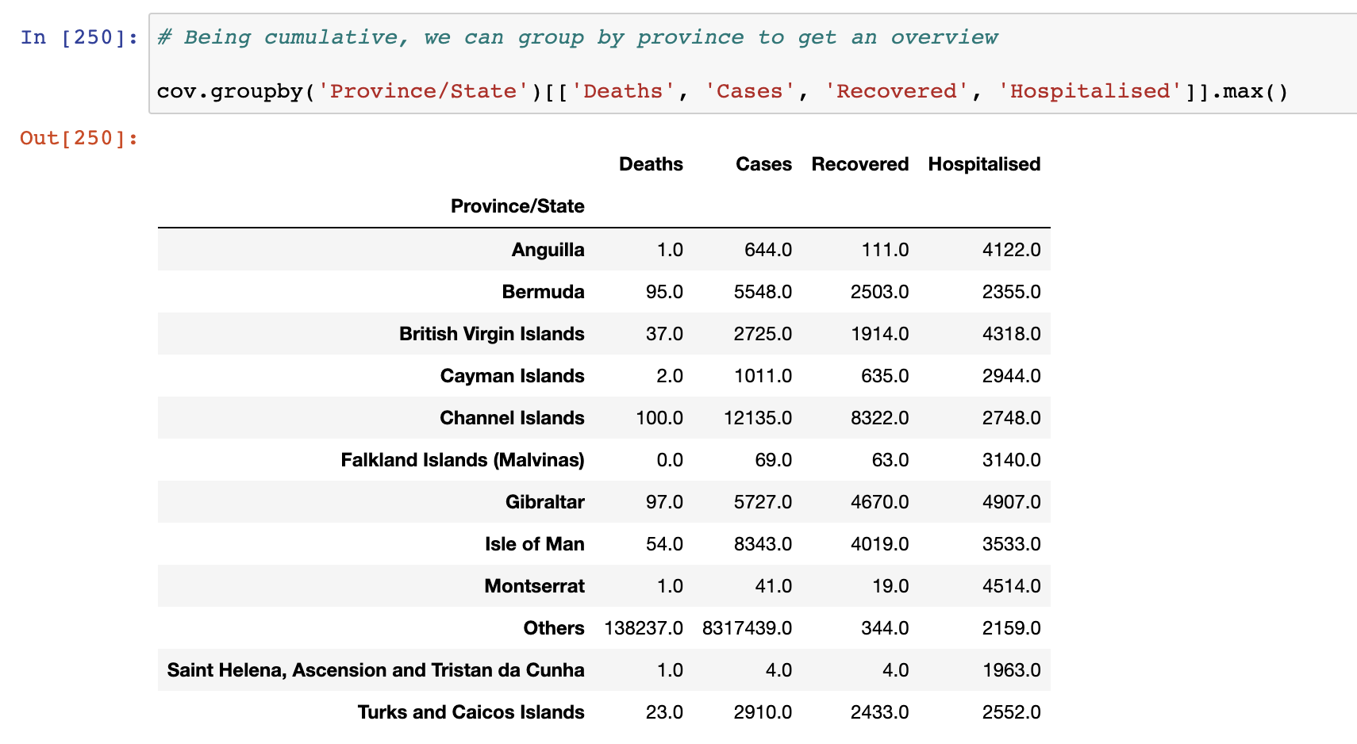
Figure 2.1: Overview of COVID cases x UK province
Source: Javier Conde (2022)
Javier Conde | 11th July 2022

Slide 6
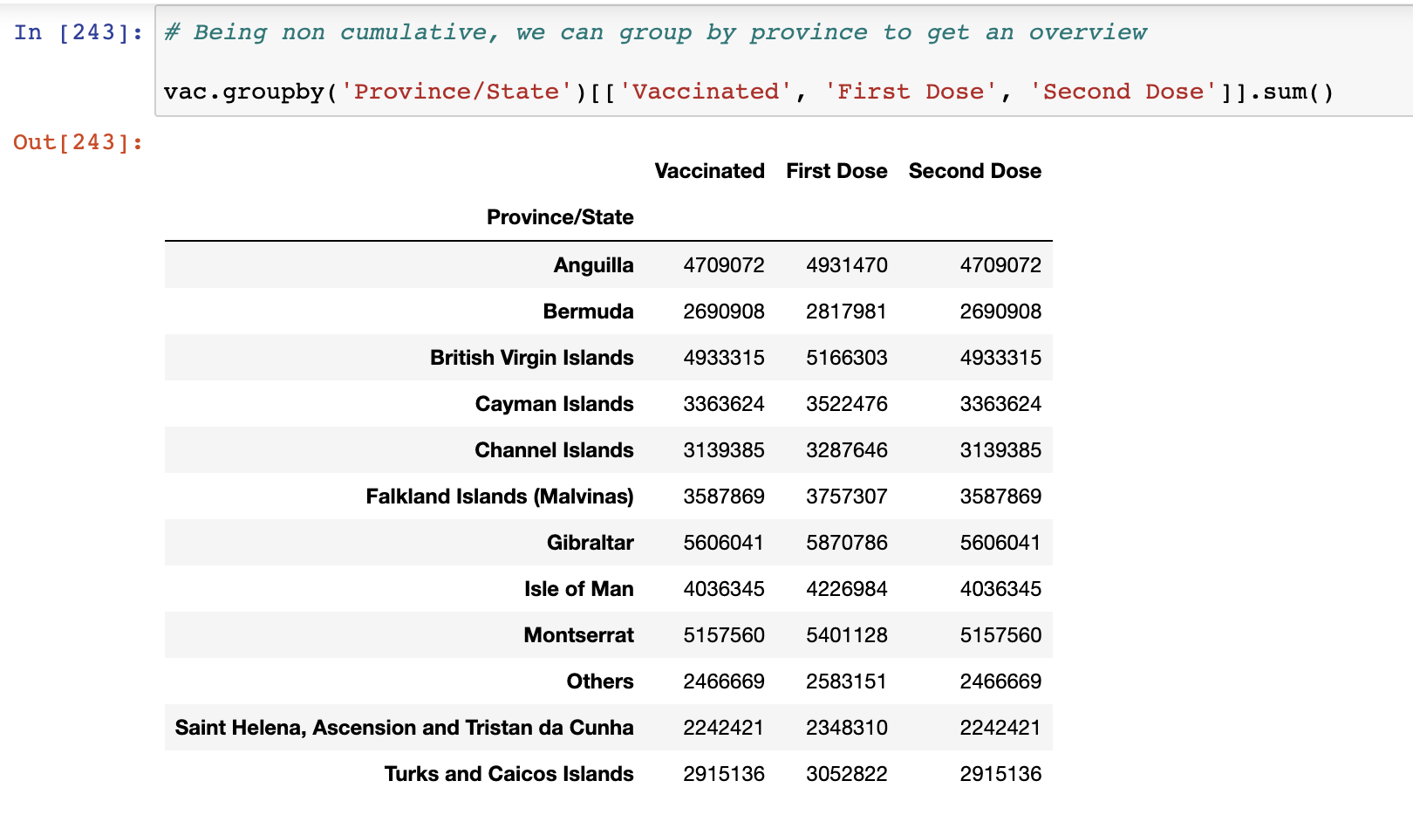
Figure 2.2: Overview of vaccinations x UK province
Source: Javier Conde (2022)
Javier Conde | 11th July 2022

Slide 7
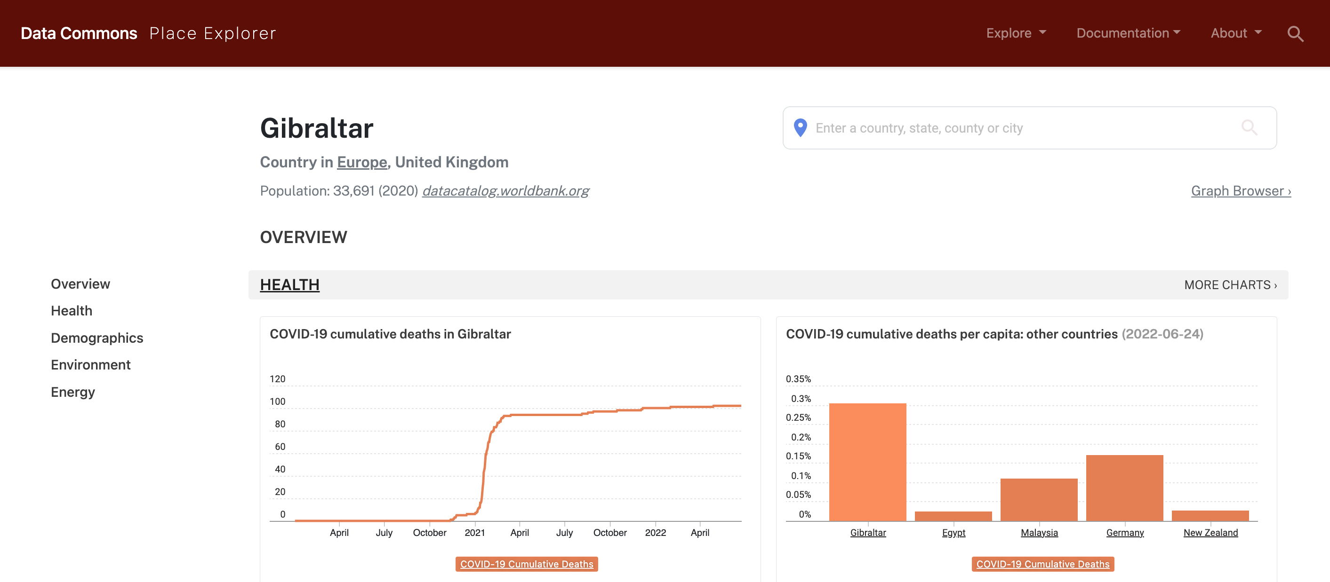
Figure 2.3: Cumulative deaths reported in UK province Gibraltar
Source: DataCommons.org (2022)
Javier Conde | 11th July 2022

Slide 8
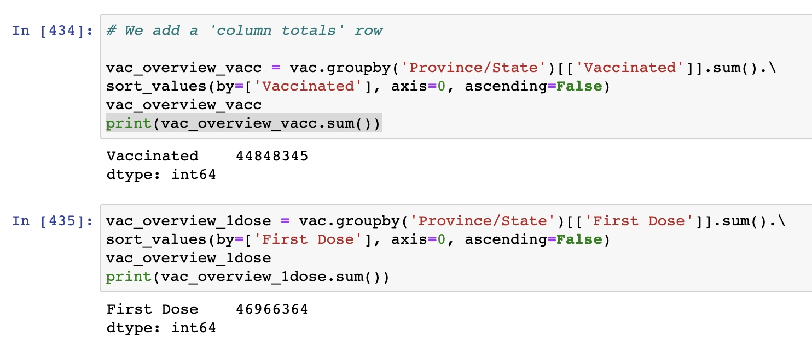
Figure 2.4: Overview of total country vaccinations
Source: Javier Conde (2022)
Javier Conde | 11th July 2022

Slide 9
GENERAL FINDINGS FROM FILE covid_19_uk_cases.csv
Total numbers:
44,848,345 of complete vaccination cycles, 95,5% of vaccinated with the first dose decided to go ahead with the second
Total of 8,356,596 reported COVID cases in the UK, with 138,648 reported deaths COVID-related (1,6% of reported cases), 39,255 reported hospitalisations (0,5% of cases) and 25,037 reported recoveries.
Key finding as province ‘Other’ values are not in line with rest of the provinces – outliers to be taken in account with calculations further along
FINDINGS FROM FILE covid_19_uk_cases.csv
Data cumulative already so no need for extra cumulative calculations
1st case reported in Gibraltar 2020-03-03
Data available only until 14 Oct 2021
Peak in year 2020: 31 December 2040 reported cases; peak 2021: increase of 280% with 5727 reported cases on 14 October (Figure 2.1)
Others’ region may be outlier on ‘Deaths’ (138,237) and ‘Cases’ (8,317,439) columns as very out of range with rest of the regions
FINDINGS FROM FILE covid_19_uk_vaccinated.csv
First vaccinations on 2021-01-11
Data quality questions as possible discrepancies on vaccination info vs real population uncovered: i.e., Gibraltar, 5,606,041 complete vaccination cycle (CVC) on total population of Gibraltar of 33,691 (Figure 2.2) (Source: https://datatopics.worldbank.org/). Cumulative deaths in line with real data (Figure 2.3) (Source: DataCommons.org)
CVC percentage (95.5%) consistent across all United Kingdom provinces
Figure 2.5: First findings
Source: Javier Conde (2022)
Javier Conde | 23rd May 2022

Slide 10
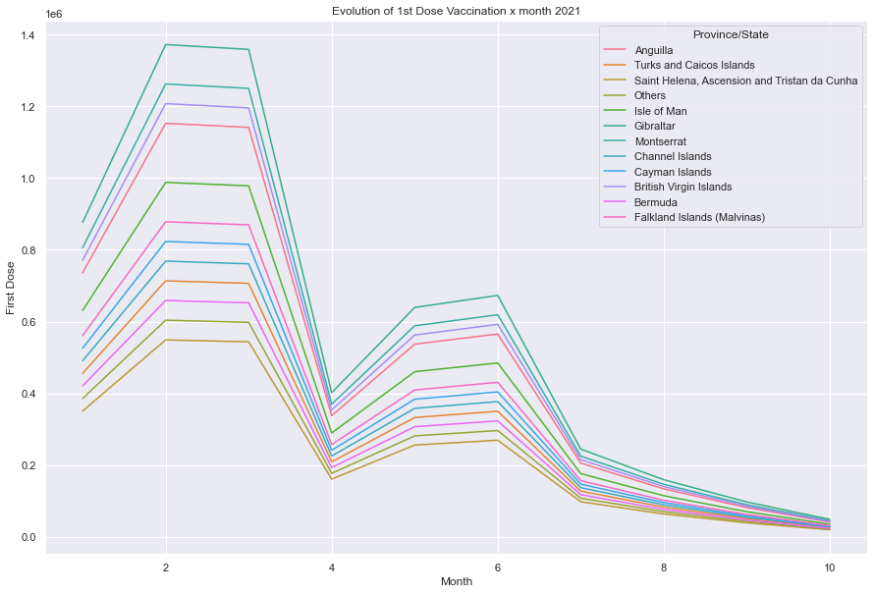
Figure 2.6: Evolution of 1st Dose Vaccination x month 2021
Source: Javier Conde (2022)
Javier Conde | 11th July 2022

Slide 11
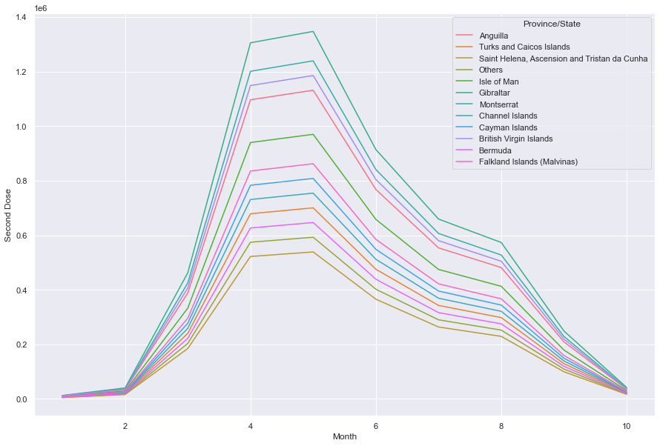
Figure 2.7: Evolution of 2nd Dose Vaccination x month 2021
Source: Javier Conde (2022)
Javier Conde | 11th July 2022

Slide 12
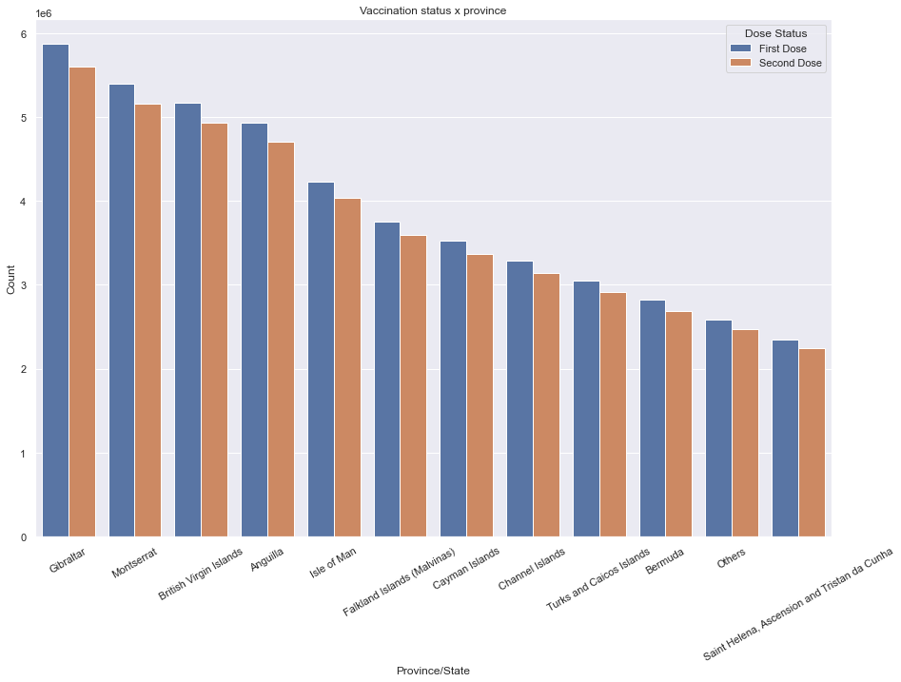
Figure 2.8: Vaccination status x province
Source: Javier Conde (2022)
Javier Conde | 11th July 2022

Slide 13
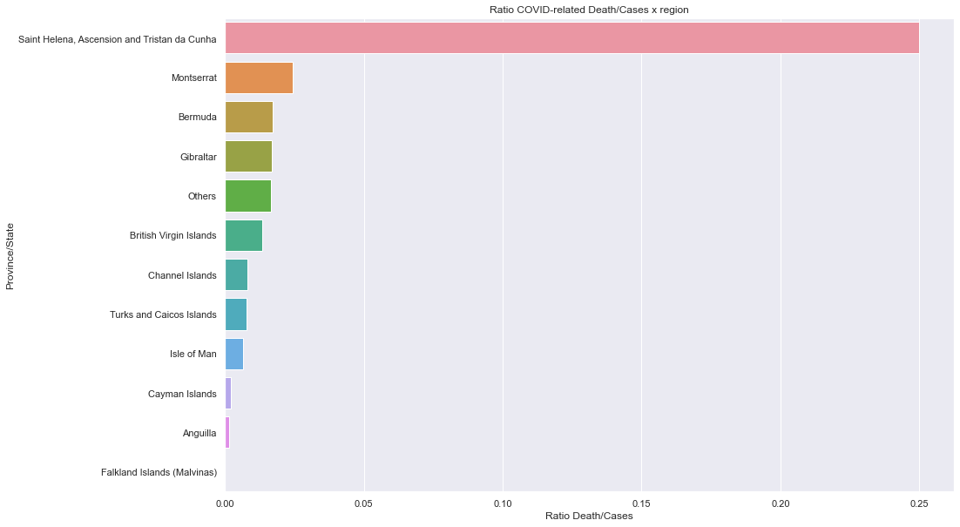
Figure 2.9: Ratio COVID-related Death/Cases x province
Source: Javier Conde (2022)
Javier Conde | 11th July 2022

Slide 14
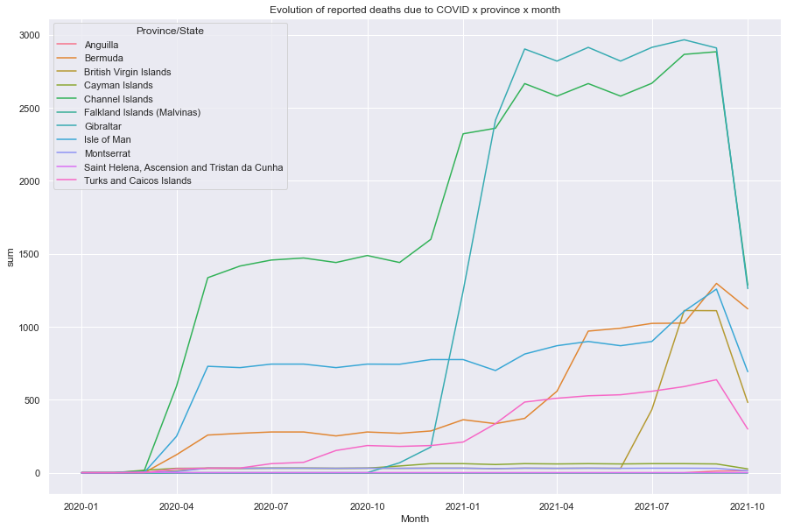
Figure 2.10: Evolution of reported deaths due to COVID x province x month
Source: Javier Conde (2022)
Javier Conde | 11th July 2022

Slide 15
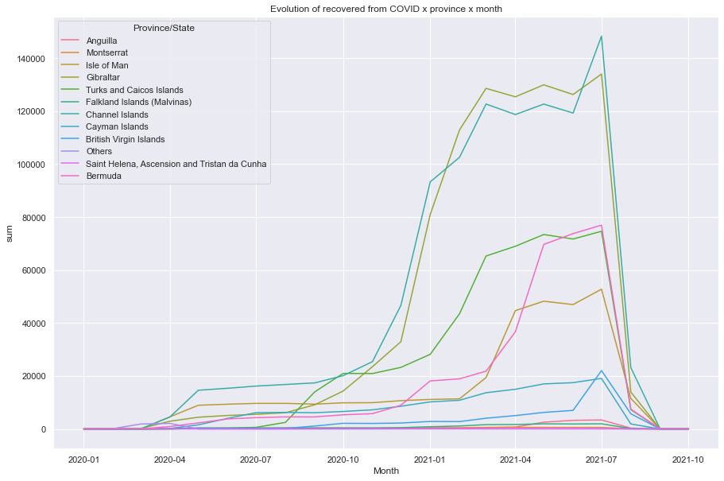
Figure 2.11: Evolution of recovered from COVID x province x month
Source: Javier Conde (2022)
Javier Conde | 11th July 2022

Slide 16
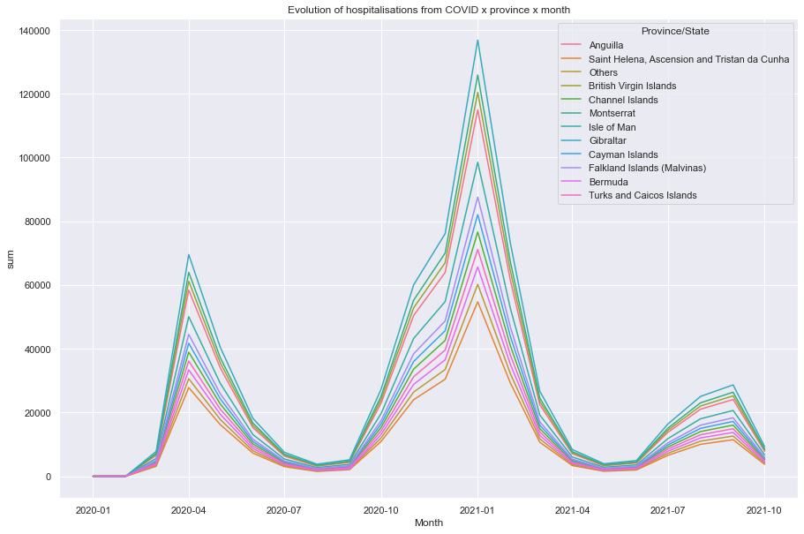
Figure 2.12: Evolution of hospitalisations due to COVID x province x month
Source: Javier Conde (2022)
Javier Conde | 11th July 2022

Slide 17
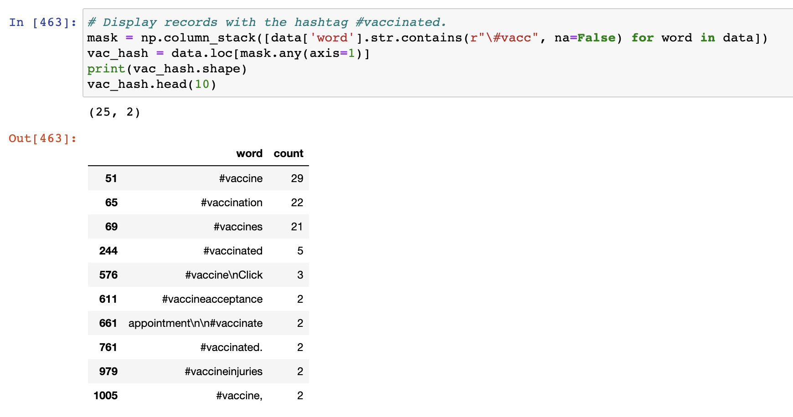
Figure 2.13: Mentions of hashtags containing #vacc- within #coronavirus
Source: Javier Conde (2022)
Javier Conde | 11th July 2022

Slide 18
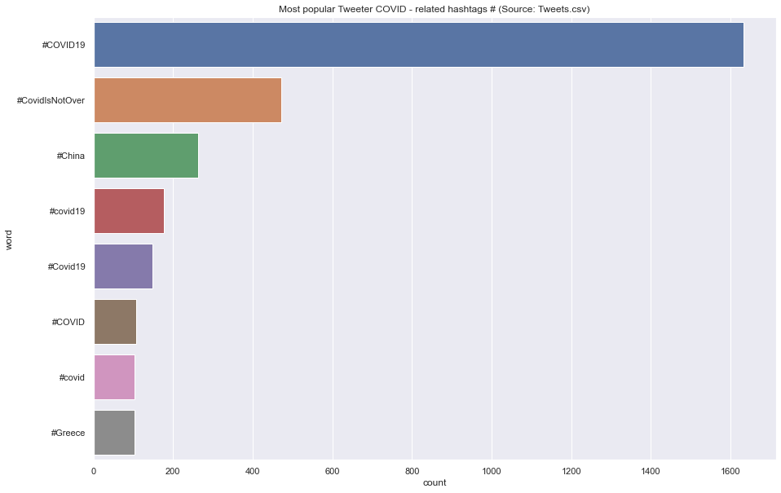
Figure 2.14: Most popular Twitter COVID-related hashtags
Source: Javier Conde (2022)
Javier Conde | 11th July 2022

Slide 19
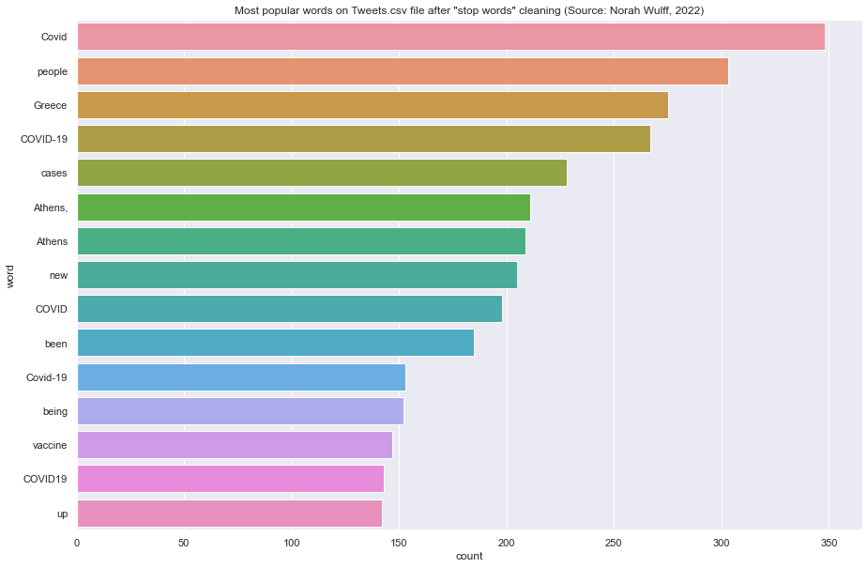
Figure 2.15: Most popular words on Twitter COVID-related after stop words cleaning
Source: Norah Wulff (2022)
Javier Conde | 11th July 2022

Slide 20
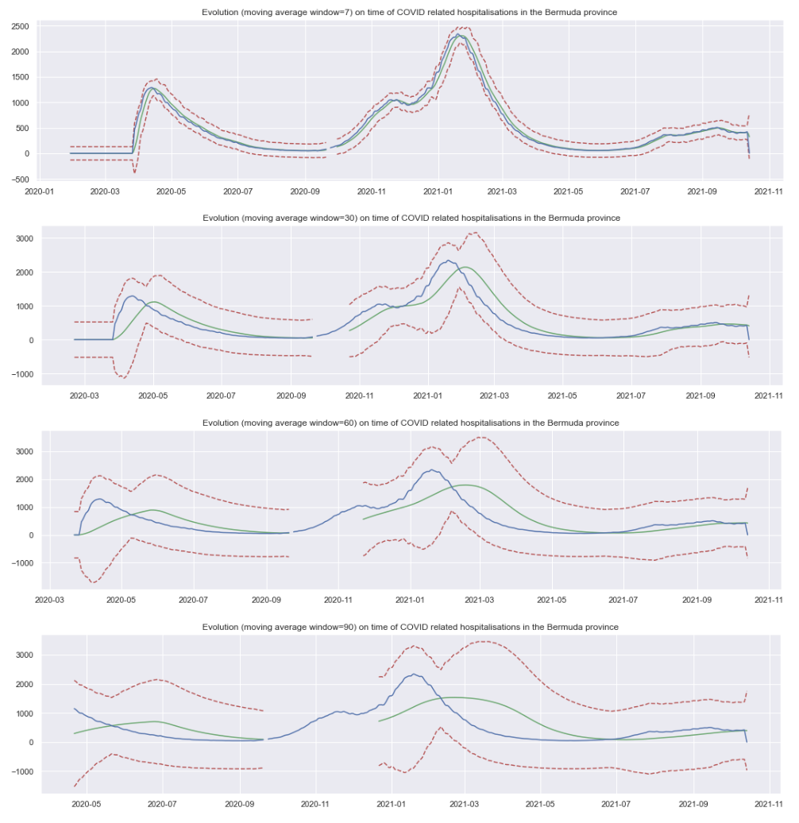
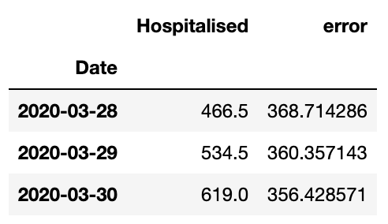
Figure 2.16: Evolution (MA window 7/30/60/90) on COVID hospitalisations in the Bermuda province
Source: Javier Conde (2022)
Top three days with biggest
difference between daily value
and rolling 7-day mean
Javier Conde | 11th July 2022

Slide 21
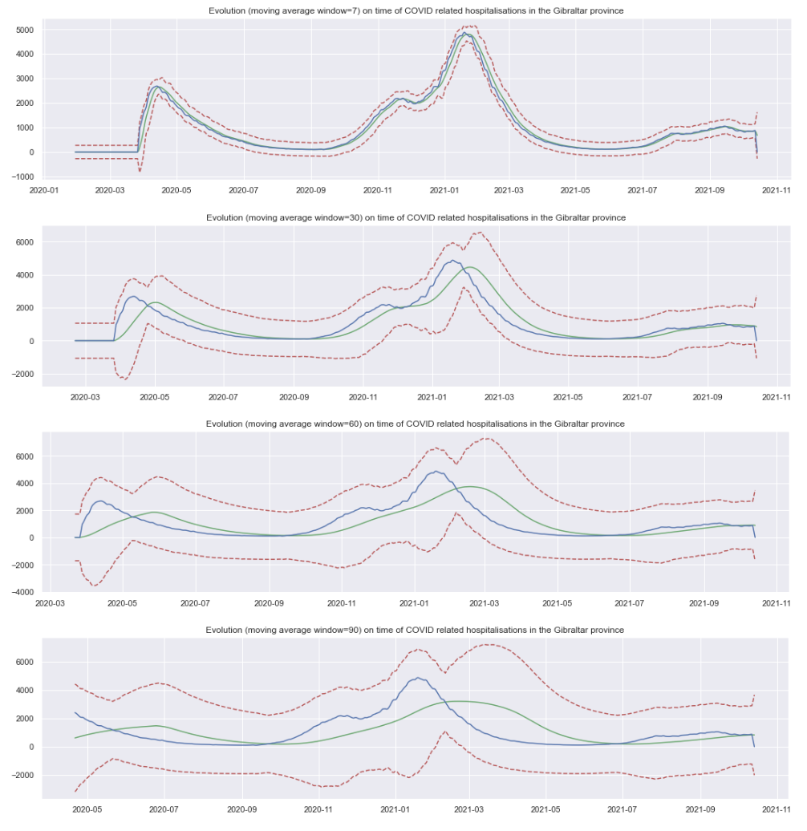
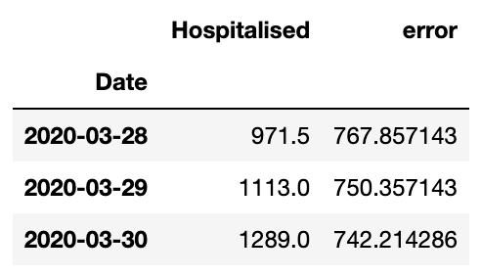
Figure 2.17: Evolution (MA window 7/30/60/90) on COVID hospitalisations in the Gibraltar province
Source: Javier Conde (2022)
Top three days with biggest
difference between daily value
and rolling 7-day mean
Javier Conde | 11th July 2022

Slide 22
Figure 2.18: Further findings and insights
Source: Javier Conde (2022)
Comparisons of cycles on vaccinations (evolution of 1st dose vs 2nd dose rollout) reach peak 4 months apart across the regions, which is in line with expected timelines
Statistical insignificance of the rollout difference between regions (consistent 95.5%)
Saint Helena, Montserrat, Bermuda and Gibraltar provinces with highest death/cases ratio. As only one death reported in both Saint Helena and Montserrat, Bermuda and Gibraltar are the provinces where we would advice to research aiming for a possible marketing campaign
Deaths reaching early plateaus (early 2020) in Channel Islands, Turks, Isle of Man and British Virgin Islands with another increase in early 2021. Stabilisation of reported deaths coincides with rollout of vaccination program.
Highest ratio reported recovered/ reported cases in Falklands (91.3%) and Turks (83.6%), followed by Gibraltar (81.5%) and Virgin Islands (70.23%). To consider when planning for the marketing campaign.
Declining trend on hospitalisation from peak January 2021 while trends reverses with increase of reported recovered from the same date. To consider possible relation with vaccine rollout program.
Only 0.8% of a total of 13,336 #coronavirus tweets analysed have hashtags #vacc-. Possible opportunity to research, moving forward with the marketing campaign, more popular COVID-related hashtags to be associated with (i.e. #COVID19 with 1,632 mentions)
Moving average (MA) techniques can really help with forecasting and visualisation of data trends. Key feature is being able to estimate the error in a possible future prediction.
ADVICE FOR TEAM & STAKEHOLDERS: Always important to keep an eye on data quality, understanding data shape & data types at all times and looking for:
Data types
Inconsistencies in column names
Possible duplicate entries
Inconsistent data entry & spelling
Start looking for possible outliers with the .describe() method)
Ways to improve code quality (PEP8 Style Guide)
Javier Conde | 23rd May 2022

Slide 23
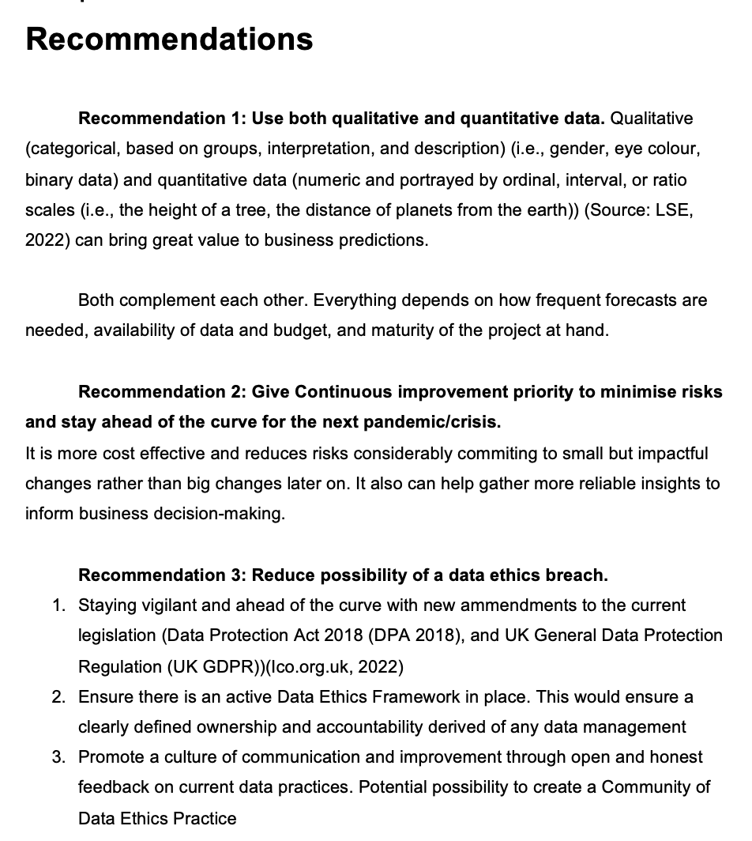
Source: Javier Conde (2022)
Javier Conde | 11th July 2022

Slide 24
Javier Conde Pascual | 14th April 2022
Thank You

