Slide 1



SuMo (GP) Verification
Javier Garcia Ordonez, Application Engineer
Cedric Bujard, Mathematical Modeler

Slide 2


Content
Background
Methods
Results
Next Steps / Ideas

Slide 3

Background

Slide 4
Background
OptiStim MicroScale Model
investigate the influence of different geometrical & tissue parameters on scalp nerve excitability
implement surrogate modelling techniques (global SA and UQ)
adequate predictions
validation of surrogate models
development of SA and UQ pipelines
assess convergence

Slide 5
Methods

Slide 6
Results

Slide 7
Results – Norm20D
Norm20D
current normalization was introduced – mishap, wasn’t necessary during initial geometric investigation, and wasn’t initially added when introducing thicknesses and conductivities
reparameterization of nerve & electrode depths to be relative to SCT and LAT layers – all parameter combinations are now valid
“fake” 20D – POSITION (e.g. relative nerve – electrode displacement) is not included
position is hypothesized to have a very large influence on the predictions and thus not allow the model to capture the influence of the other parameters

Slide 8
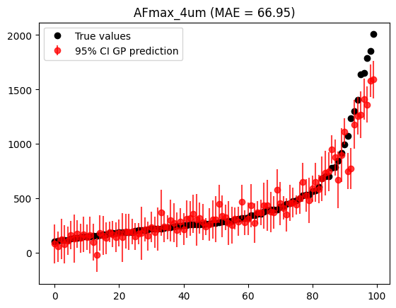
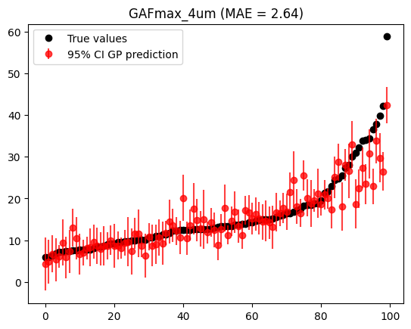
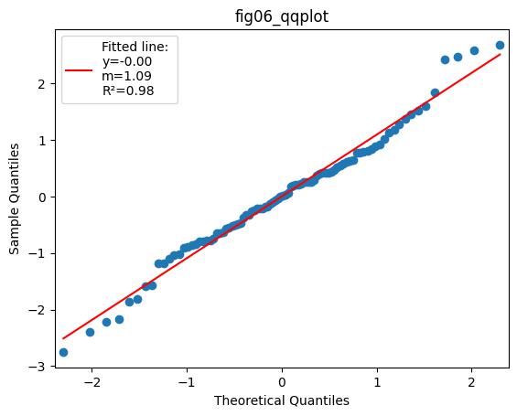
Results – Norm20D
Norm20D
GP training (1000 LHS) cross-validation metrics
AF MAE / RMSE: 67 / 119 (over ~650 mean value)
GAF MAE / RMSE: 2.0 / 2.96 (over ~20 m.v.)
e.g. MAE is ~10% for both
GP test (100 LHS) yields suitable results
correctly looking QQ plot (k=1.5)
same MAE and good truth-prediction (sorted) match for the AF
not so good for GAF
a(n)res to be evaluated

Slide 9
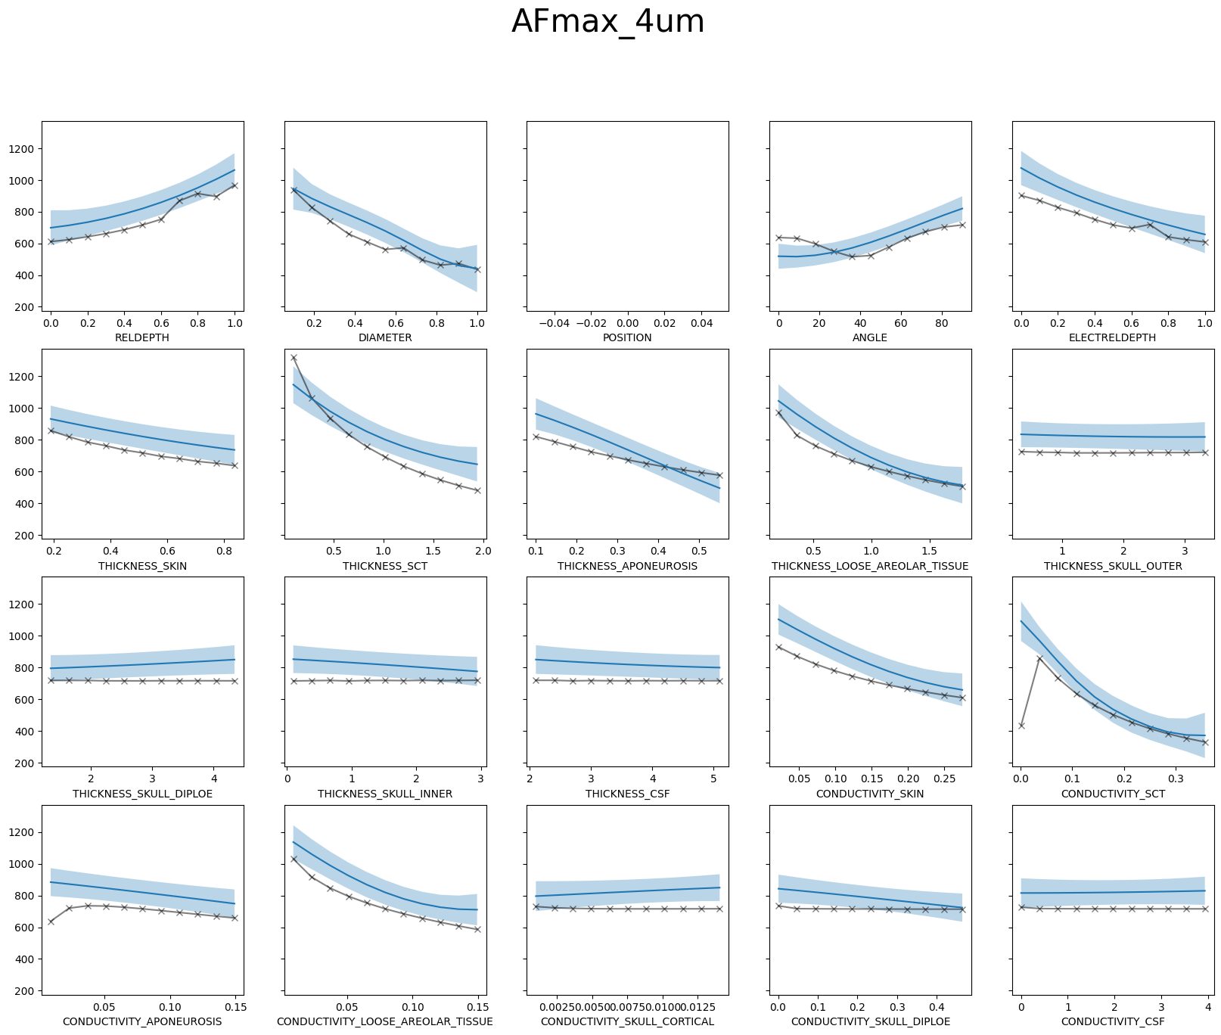
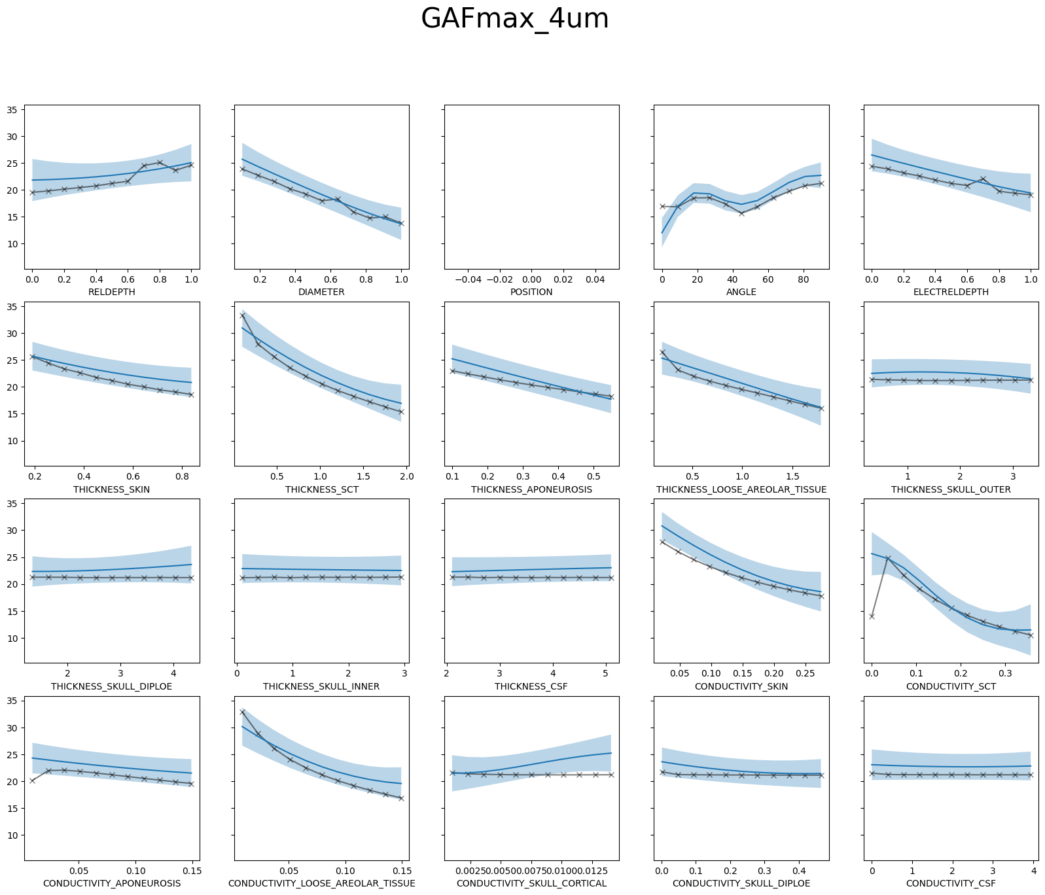
Results – Norm20D
Norm20D
prediction curve comparison with 1D cross-sections
reasonable fit overall
GAF is generally better (with 95% CI area)
some unreasonable “truth” evaluations – to be inspected

Slide 10
Results – Norm20DPosition
Norm20DPosition
current normalization was introduced – mishap, wasn’t necessary during initial geometric investigation, and wasn’t initially added when introducing thicknesses and conductivities
reparameterization of nerve & electrode depths to be relative to SCT and LAT layers – all parameter combinations are now valid
real 20D – position (e.g. relative nerve – electrode displacement) IS included
position is hypothesized to have a very large influence on the predictions and thus not allow the model to capture the influence of the other parameters

Slide 11
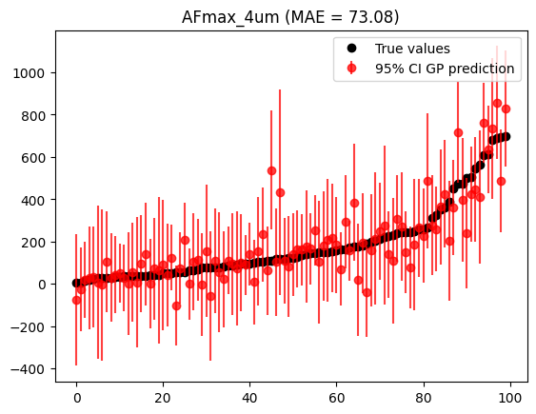
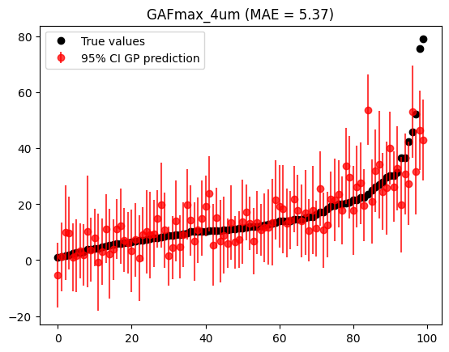
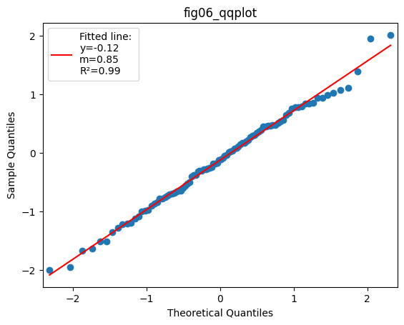
Results – Norm20DPosition
Norm20DPosition
GP training (1000 LHS) cross-validation metrics
AF MAE / RMSE: 104 / 186 (over ~XXX mean value)
GAF MAE / RMSE: 5.6 / 8.8 (over ~xx m.v.)
e.g. MAE is ~xx% for both
GP test (100 LHS) yields suitable results
correctly looking QQ plot (k=1.5)
both AF & GAF look reasonable; test MAE for AF is lower than CV5
a(n)res to be evaluated
extremely high test-GAF values to be inspected

Slide 12
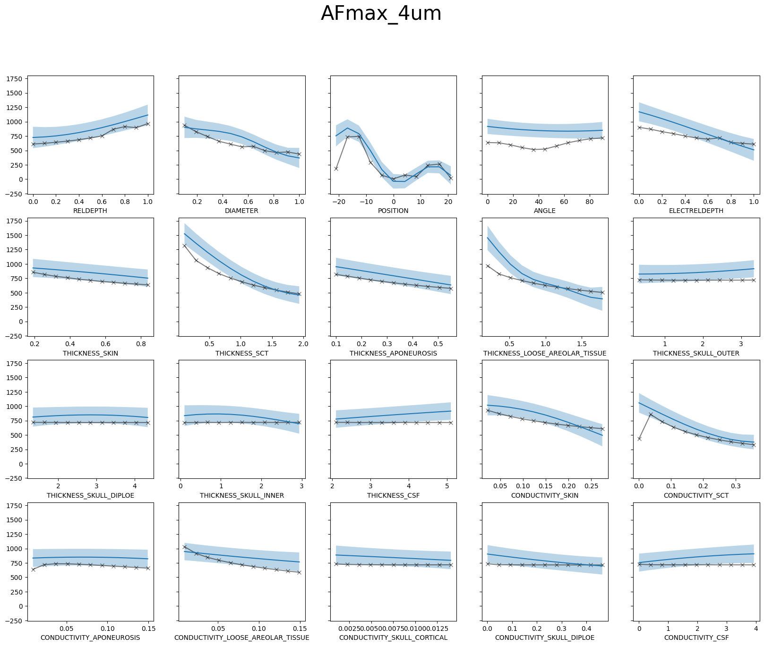
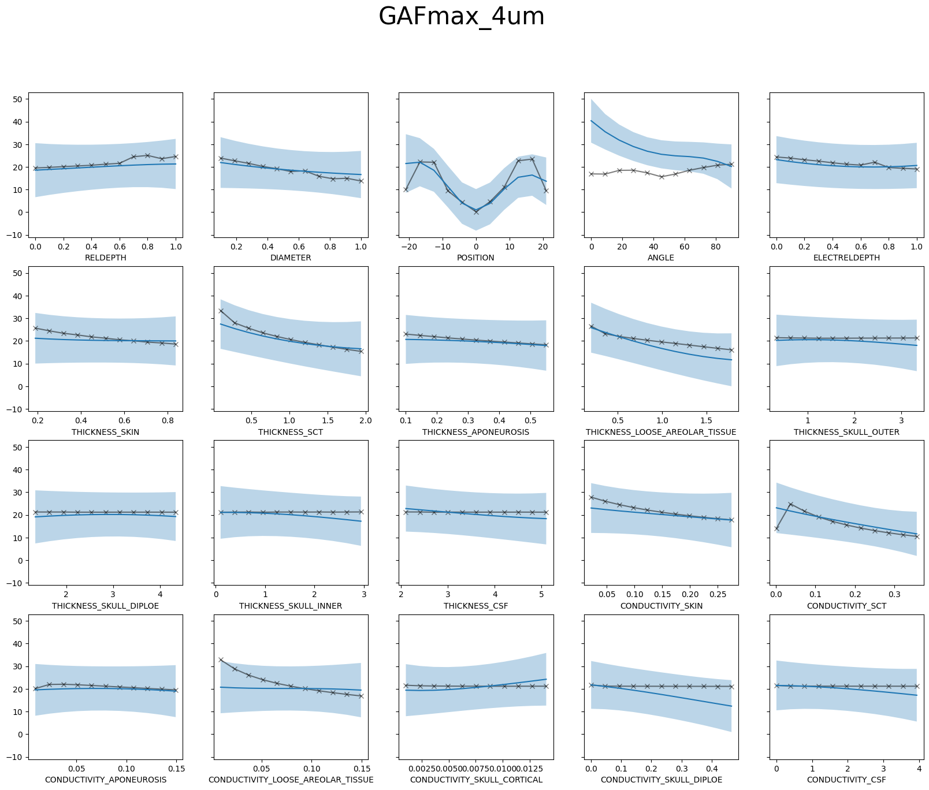
Results – Norm20DPosition
Norm20DPosition
prediction curve comparison with 1D cross-sections
NB Im using comfort pulse – the recovery phase could be even more excitating than the 5x1ms, thus anodic excitation (POSITION = +14) is high

Slide 13
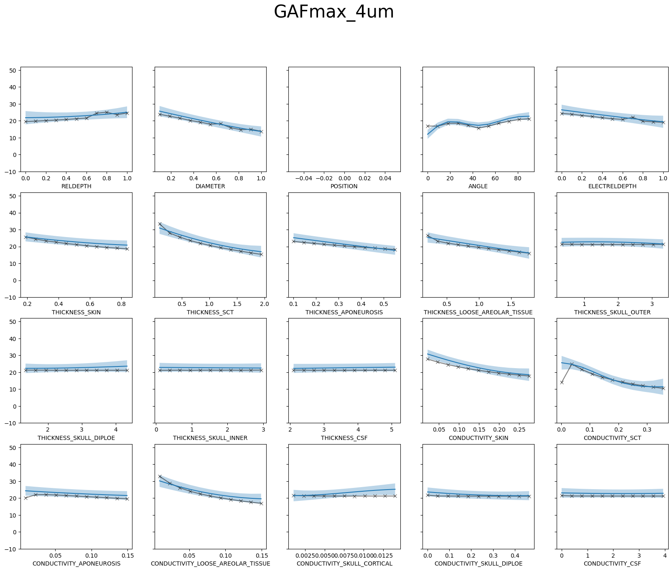
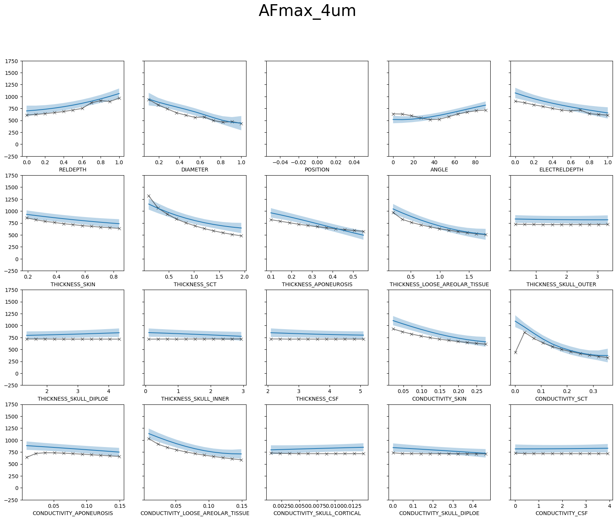
Results – Norm20DPosition
Norm20D
for comparison with Norm20DPosition

Slide 14
Next Steps
check abnormal train / test values
check a(n)res values

Slide 15
Conclusions – Evaluation Metrics
fitting quality of the uncertainty
…
prediction accuracy
MAE, RMSE of (test) residuals

