Slide 1
Credit Card Late Payment Detection

Slide 2
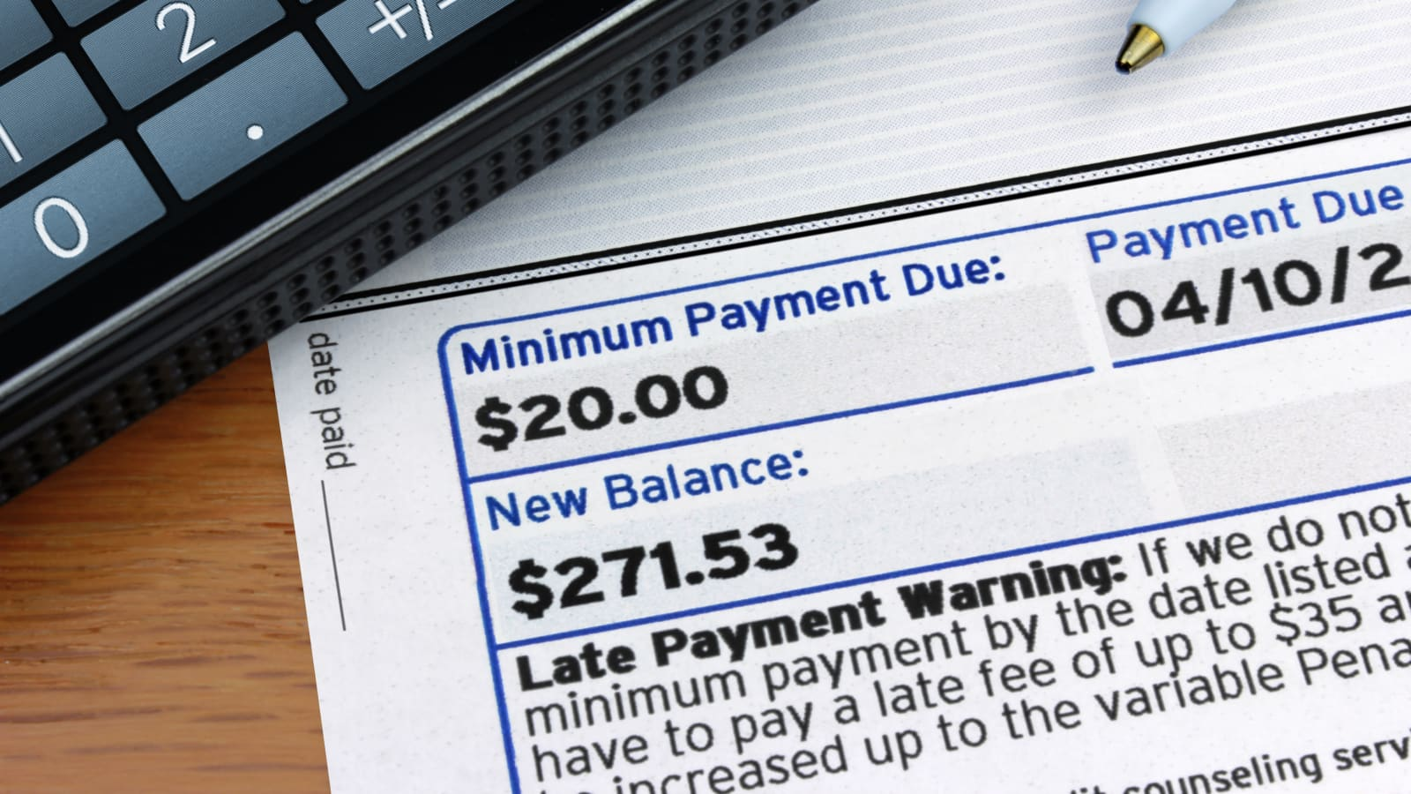
Background
After customers making loans in credit card, they may have difficulty paying the loans. Banks need to take actions to these risky customers such as denying the loan, reducing the amount of loan, lending at a higher interest rate to avoid this circumstance.
Therefore, it's necessary for bank to ensure the credit card applicants are not risky customers.
Goal
Identify patterns which indicate if a client has difficulty paying their installment loans
Help bank and financial institution minimize the risk of of losing money when lending to customers

Slide 3
Dataset summary

Slide 4
Data cleaning

Slide 5
Re-format data

Slide 6
Deal with imbalance data

Slide 7
Correlation of features

Slide 8
Feature selection

Slide 9
Model
Why we use this model
Algorithm

Slide 10
Cross validation

Slide 11
Feature rank

Slide 12
Accuracy

Slide 13
Results
Insights from results

Slide 14
Next step

