Slide 1

The Simpsons Classifier

Slide 2

The Simpsons Classifier
By Javier olcoz

Slide 3

TREEHOUSE OF HORROR
XXIX
THE
SIDESHOW BOB REVENGE

Slide 4


Slide 5


Slide 6


Slide 7


Slide 9


Slide 11


Slide 13
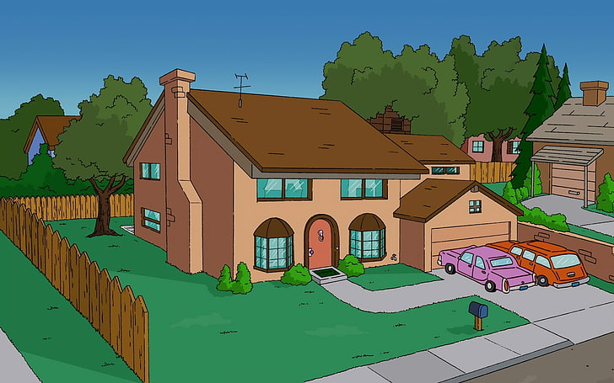

Slide 15




HIPOTESIS

Slide 16
Transfer learning

Slide 17
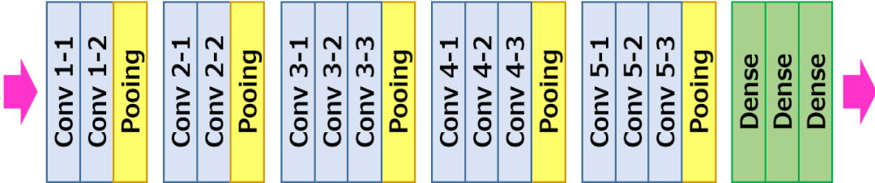
Transfer learning
VGG-16
INPUT
OUTPUT

Slide 18
Transfer learning
VGG-16
INPUT
OUTPUT

Slide 19
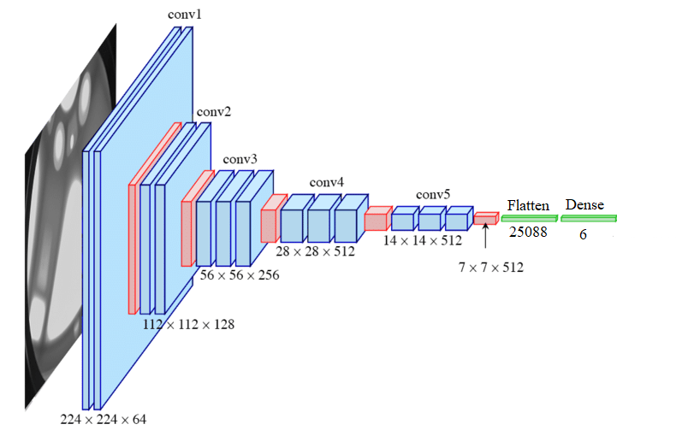
Transfer learning

Slide 20
Transfer learning

Slide 21

DASHBOARD
http://127.0.0.1:8050/

