Slide 1
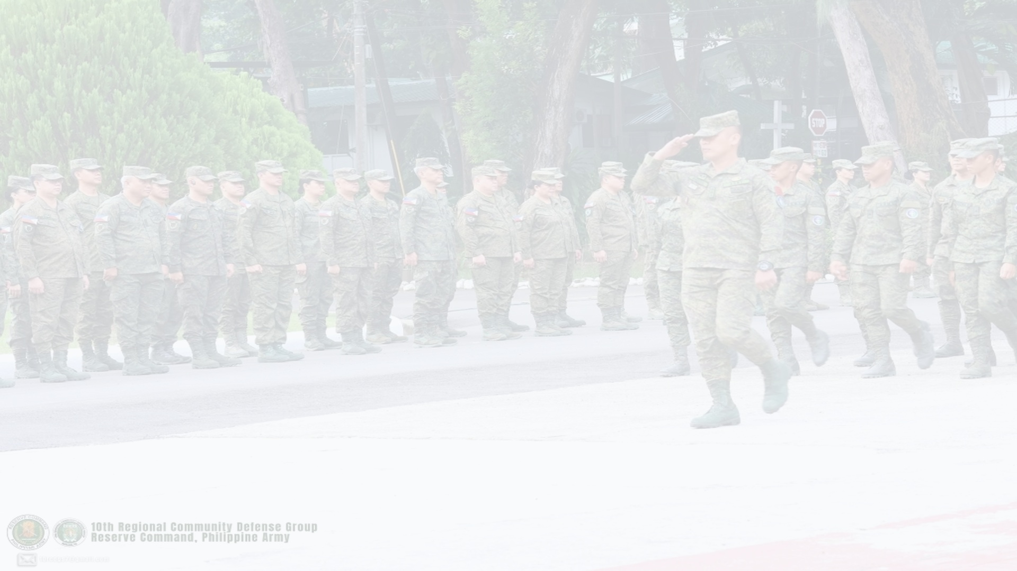


PHILIPPINE ARMY RESERVE COMMAND
10RCDG RESCOM ALERT
Tactical Mass Emergency Siren & Rapid Mobilization Notification Architecture
10th Regional Community Defense Group • Camp General Manuel T Yan Sr, Mawab
Fast Group SMS
Offline GSM Payload
Hardware Siren Override
Bypasses Silent / Mute
Instant Headcount
Real-Time Telemetry
Presented by: Javier Siliacay (aka vier from USTP Autotronics)
Technical Briefing & Command Defense • October 2026
Notes:
SPEAKER SCRIPT:
Good day, Colonel, and members of the 10RCDG Command Staff.
Today I am presenting RESCOM-ALERT — a purpose-built tactical technology designed to solve one critical problem: ensuring emergency mobilization orders wake up and alert our reservists, even when their phones are locked, muted, or offline.

Slide 2
THE PROBLEM
Why Conventional Messaging Fails in Emergencies
74% SILENT
NO DATA
NO HEADCOUNT
Phones on Mute & DND
Troops sleep through or miss standard SMS dings and chat notifications during Red Alerts.
Chat Apps Fail in Storms
Messenger and Viber require active internet. When cell towers lose data, chat groups fail.
Zero Acknowledgment
Commanders have no way to verify who received the order and who is actively en route.
10RCDG RESCOM-ALERT • Technical Briefing & Command Defense
02 / 07

Slide 3


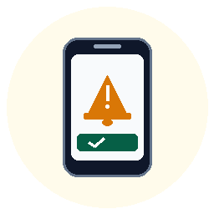

SYSTEM ARCHITECTURE
System Design: Signal Flow & Hardware Override
API / Cloud
GSM Cellular
OS Wake
01. DISPATCH
Command Web Portal
02. TRANSMIT
Telco Airwave
03. OVERRIDE
Android Field App
04. ACKNOWLEDGE
Troop Compliance
• Officer initiates alert
• Targets CDC battalions
• Fires Siren Command
• Smart / Globe network
• Basic GSM cellular text
• ZERO mobile data req.
• Bypasses Silent / Mute
• Wakes locked screen
• Loud siren sounds
• Soldier reads order
• Taps '✓ I Received Order'
• Siren silences instantly
CLOSED-LOOP FEEDBACK
Real-Time Command Telemetry
100% Troop Accountability
◄── Returning Telemetry: Instant Verification to HQ Dashboard
When the soldier taps '✓ I RECEIVED THIS ORDER', the siren kills immediately and confirmation is transmitted back. The Headquarters Web Dashboard updates live in real time with individual soldier response timestamps, CDC battalion tallies, and true mobilization readiness.
10RCDG RESCOM-ALERT • Technical Briefing & Command Defense
03 / 07

Slide 4
CORE CAPABILITIES
The 4 Pillars of the Mobile Engine
1
Hardware Alarm Override
Bypasses Silent, Mute, and Do Not Disturb by using privileged Android USAGE_ALARM stream at maximum hardware volume.
2
Lockscreen Takeover
Forces the phone display ON even while locked, presenting the official 10RCDG emblem and mobilization order.
3
100% Offline Capability
Triggered over basic GSM text message payload. Does NOT require mobile data, Wi-Fi, or internet connection on the soldier's phone.
4
Instant Acknowledgment
Soldier taps '✓ I Received This Order' to silence the siren and confirm their mobilization status to Headquarters.
10RCDG RESCOM-ALERT • Technical Briefing & Command Defense
04 / 07

Slide 5
LIVE DEMONSTRATION
Hands-On Test: Web Dispatch to Soldier Siren
STEP 1
STEP 2
STEP 3
Officer Dispatches Alert
Commander selects target unit (e.g. 1001st CDC) on the web portal and clicks 'TRANSMIT EMERGENCY SIREN'.
Phone Lights Up & Sounds Siren
The soldier's muted, locked phone immediately turns on, displays the 10RCDG emblem, and sounds a loud tactical siren.
Troop Acknowledges Order
Soldier taps '✓ I RECEIVED THIS ORDER'. The alarm silences and compliance is recorded for headquarters.
10RCDG RESCOM-ALERT • Technical Briefing & Command Defense
05 / 07

Slide 6
STRATEGIC REQUIREMENT
The Goal: Securing an Official Alphanumeric SENDER ID
CURRENT PROTOTYPE (SIM Gateway)
WITH OFFICIAL SENDER ID ('10RCDG')
✗ Sent from an ordinary 11-digit number (0917-xxx-xxxx)
✗ Telco firewalls block all web links (.com, .app) due to NTC anti-smishing laws
✗ Slow speed: limited to 10–15 SMS per minute on SIM cards
✓ Displays official military sender name: '10RCDG' or 'RESCOM-PA'
✓ 100% Whitelisted by Globe & Smart: Zero spam blocking, allows official download links
✓ High-speed broadcast: Dispatches 100+ SMS per second to thousands of troops instantly
10RCDG RESCOM-ALERT • Technical Briefing & Command Defense
06 / 07

Slide 7
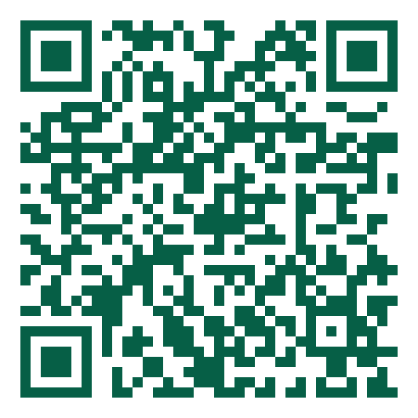
LIVE HANDS-ON DEMONSTRATION
Install & Test on Your Phone Now
Official Public Mobile Download Portal:
👉 https://rescom-alert.vercel.app/download
1. Open your phone camera and scan the QR code.
2. Tap 'DOWNLOAD SOLDIER APP' (No login required).
3. If prompted, tap 'Download anyway' (Official military APK).
4. Open app & tap 'Enable' for Full-Screen Siren permissions.
SCAN WITH ANDROID CAMERA
⚡ LIVE DEDUPLICATION COUNTER DEMO:
Every officer who installs will appear as +1 Unique Device on the Commander Dashboard in real time!
Compatible with Android 7.0 to Android 15+
Javier Siliacay • USTP Autotronics
Notes:
SPEAKER SCRIPT:
Colonel, Sir/Ma'am, to conclude this presentation:
I invite all officers in this room to point your phone cameras at this QR code right now.
It will take you directly to our live military download portal at https://rescom-alert.vercel.app/download.
As you tap download, watch my laptop screen — our live system will register each unique device on the Commander Dashboard in real time.
Thank you very much. The floor is now open for questions and live testing.

