Slide 1
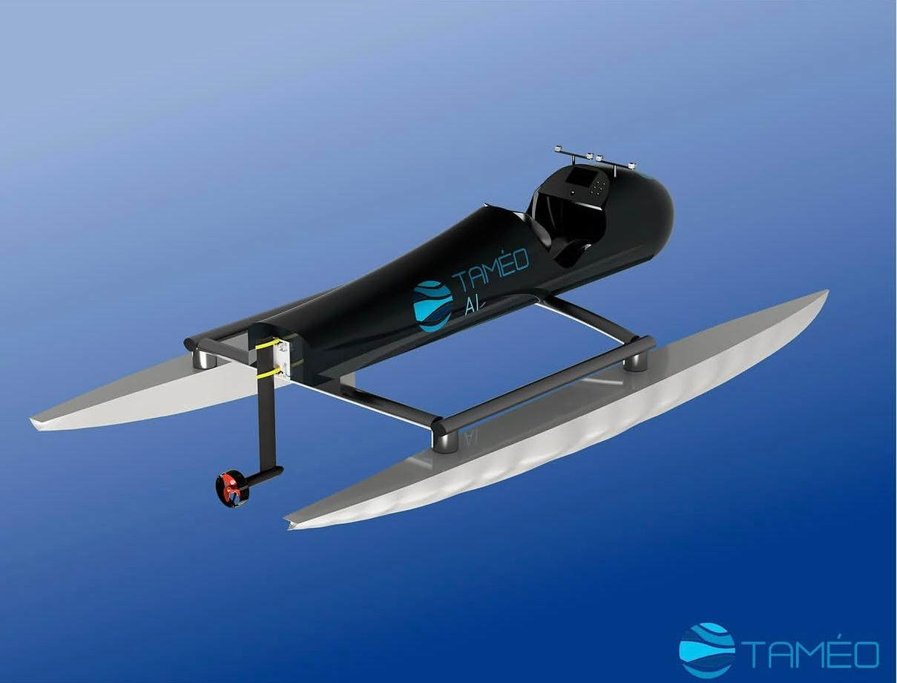

ENSTA LOGO
Replace placeholder
A Data-Centric
Simulation-to-Real Pipeline
for Autonomous Buoy Detection
MEBC 2026 Innovation Prize | AI Class
A concise pitch deck for a 2-minute innovation video: real, useful, and already validated on BlueBoat.
Train -> plan -> validate -> scale to the competition boat
Video beat: Open with the promise: a practical bridge from AI development to real autonomous navigation.
1/6

Slide 2
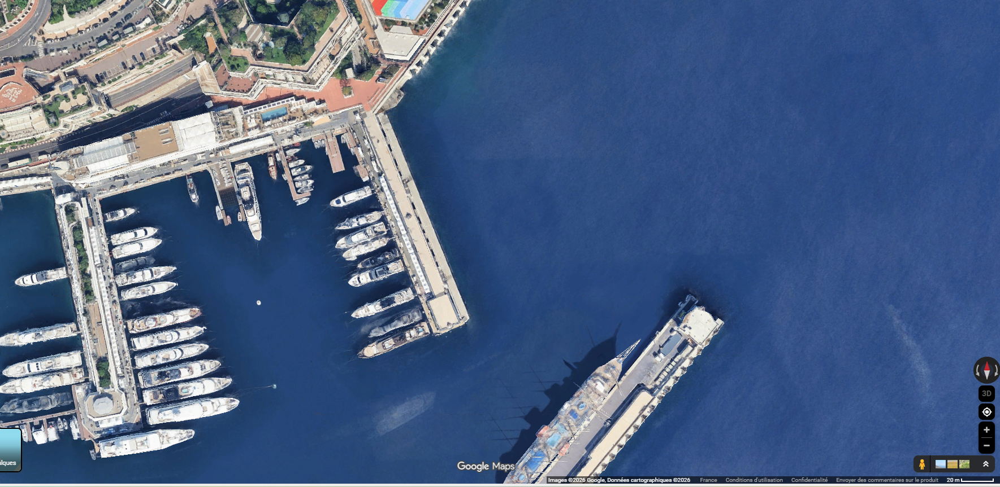
MEBC AUTONOMY BOTTLENECK
The Problem
1
Late final chassis
Software, perception, and control could have been blocked before the MEBC boat was ready.
2
Limited maritime data
Clean buoy and docking images were initially scarce, reducing robustness for real sea scenes.
3
Water tests are costly
Full-scale trials require time, logistics, safety preparation, weather windows, and risk control.
The challenge: validate autonomy before depending on the final boat.
Autonomous navigation fails when validation arrives too late.
Video beat: Frame the need: earlier, safer, repeatable validation for MEBC AI autonomy.
2/6

Slide 3
STARTUP-STYLE ANSWER
The Innovation
Not just a detector: an integrated data-to-boat validation pipeline.
Maritime
Data
Targeted
Augmentations
YOLO26
Detection
DWA Local
Planner
BlueBoat
Validation
MEBC Boat
Transfer
Novelty
Value
Scalability
Perception, planning, and validation are treated as one pipeline, not separate demos.
Earlier validation reduces dependency on final hardware and lowers unnecessary early-test risk.
The same workflow can be adapted to other autonomous maritime platforms and routes.
Video beat: Explain the integrated pipeline in one breath: data, model, planner, BlueBoat, final boat.
3/6

Slide 4
TEACHING THE MODEL MARITIME REALITY
Data-Centric Perception
Designed for MEBC-like visual conditions
PLACEHOLDER: YOLO + augmentation montage
Replace with a grid of: original buoy image, sunlight change, reflection, camera angle, scale change, partial occlusion, blur/noise, and YOLO detection boxes.
Sunlight
Reflections
Camera angle
Buoy scale
Partial view
Water background
Noise
Motion blur
mAP50
0.99253
mAP50-95
0.88753
Avg conf.
0.93135
Metrics concern documented buoy detection results; docking is prepared but not claimed as quantitatively validated.
Video beat: Make the claim precise: not more images, but data shaped for maritime generalization.
4/6

Slide 5
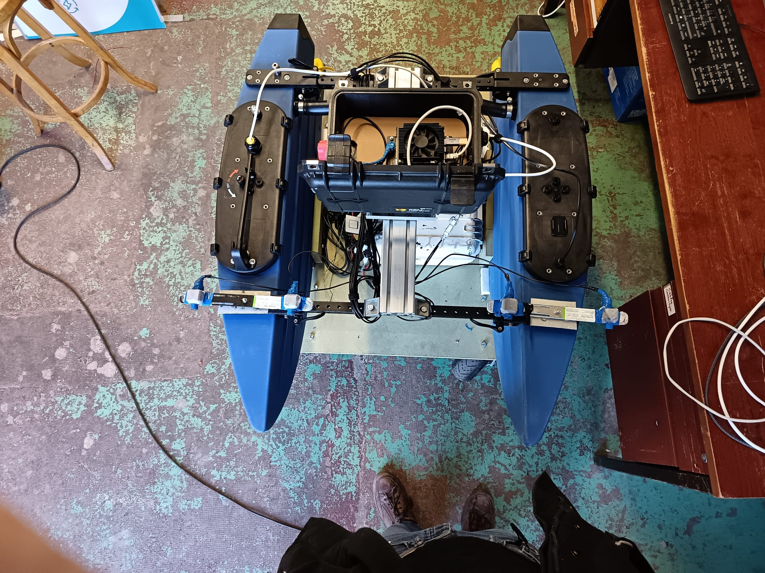
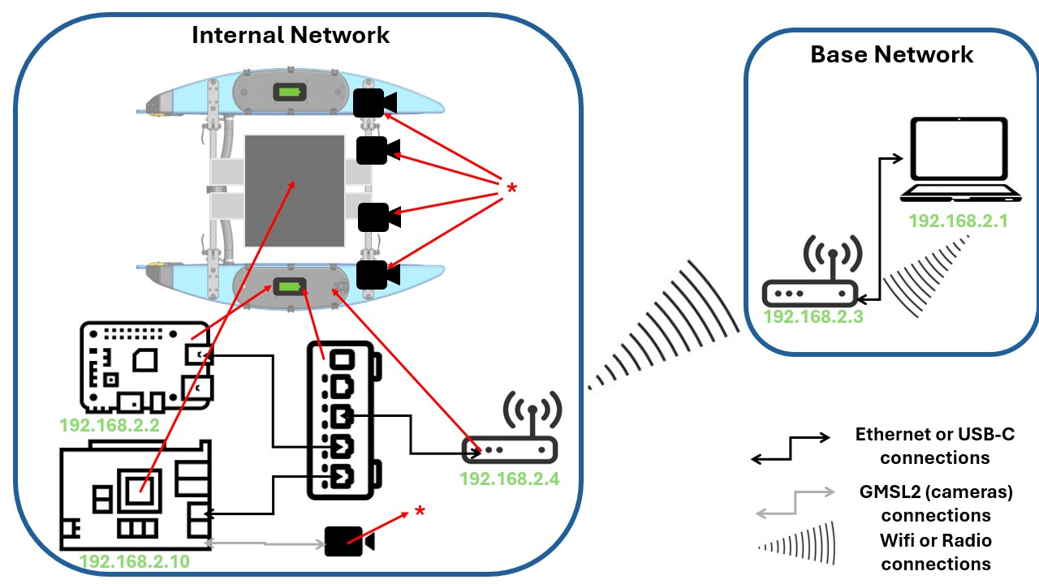
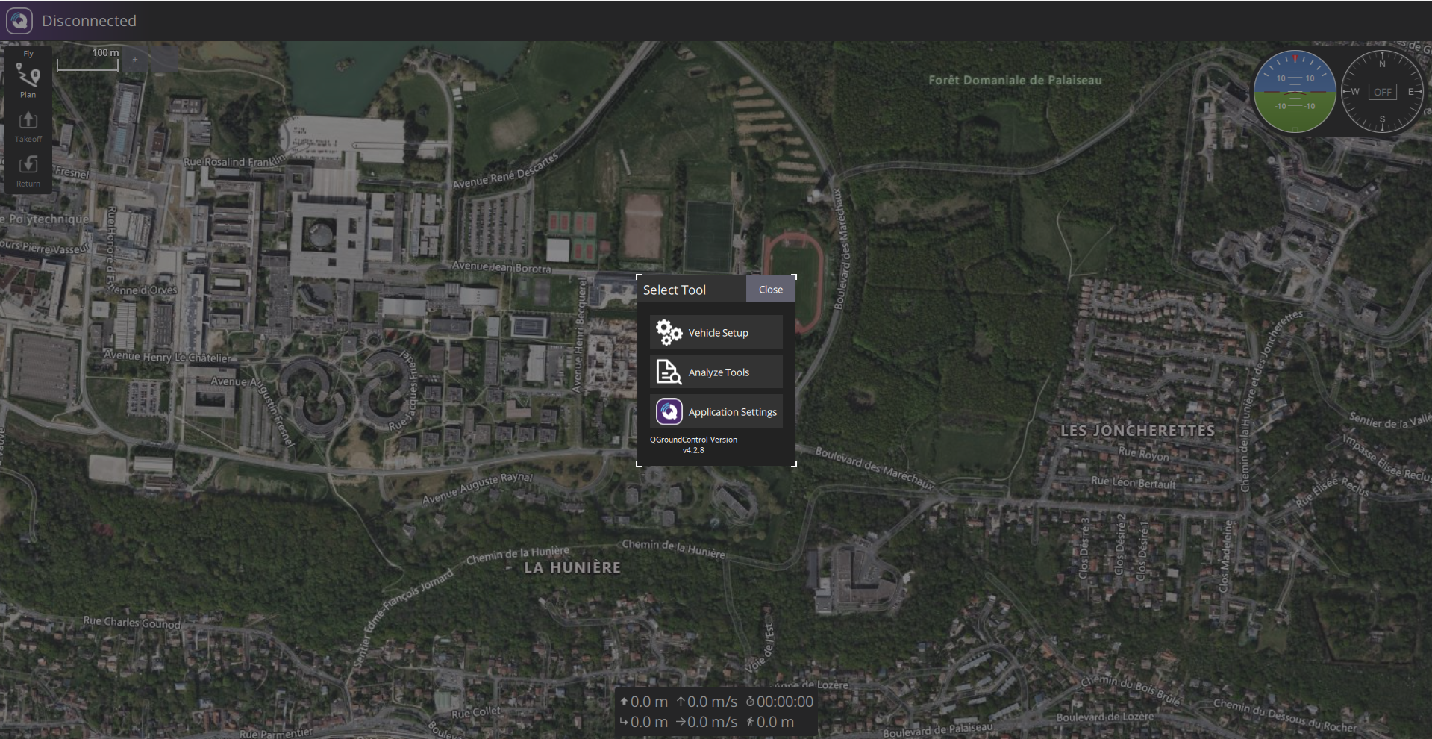
INSTALLED AND RUNNING
BlueBoat + DWA Proof of Concept
DWA outputs
speed / yaw command
GPS target point
PLACEHOLDER: DWA trajectory
Replace with path-planning screenshot showing predicted short-horizon trajectory and obstacles.
BlueBoat validation
Feasible motion
Safe wording
Jetson, cameras, network, remote access, MAVLink, and QGroundControl are integrated.
DWA samples reachable speed/yaw commands and predicts short-horizon trajectories.
Live vision detections are not claimed as active DWA obstacles in the current code path.
Video beat: Show the proof: the innovation is not theoretical; the BlueBoat platform validates the bridge.
5/6

Slide 6
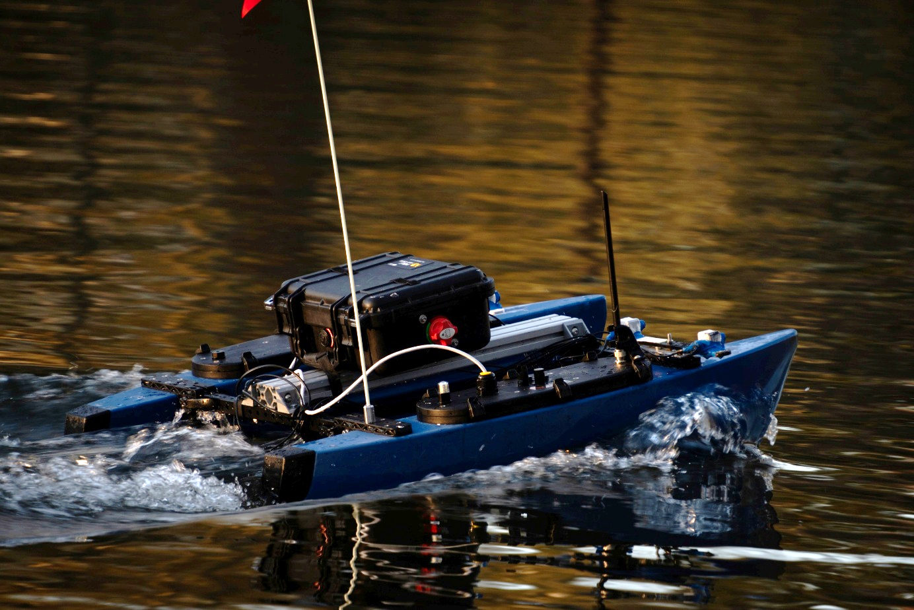
Why It Matters
A repeatable bridge from data to boat: train, plan, validate, scale.
Novel
Pipeline links data, planner, and real test platform.
Useful
Addresses late hardware, scarce data, and risky trials.
Market
Transferable to autonomous maritime inspection and testing.
Feasible
Built from available BlueBoat, Jetson, ZED, YOLO, DWA.
Scalable
Reusable method for new boats, routes, and datasets.
Proof
Proof of concept integrated on BlueBoat before MEBC boat.
The innovation is real, useful, and already works as a BlueBoat validation pipeline.
MEBC 2026 Innovation Prize | TAMEO AI
Video beat: Close with the jury criteria: novel, useful, feasible, scalable, and proven on BlueBoat.
6/6

