Slide 1
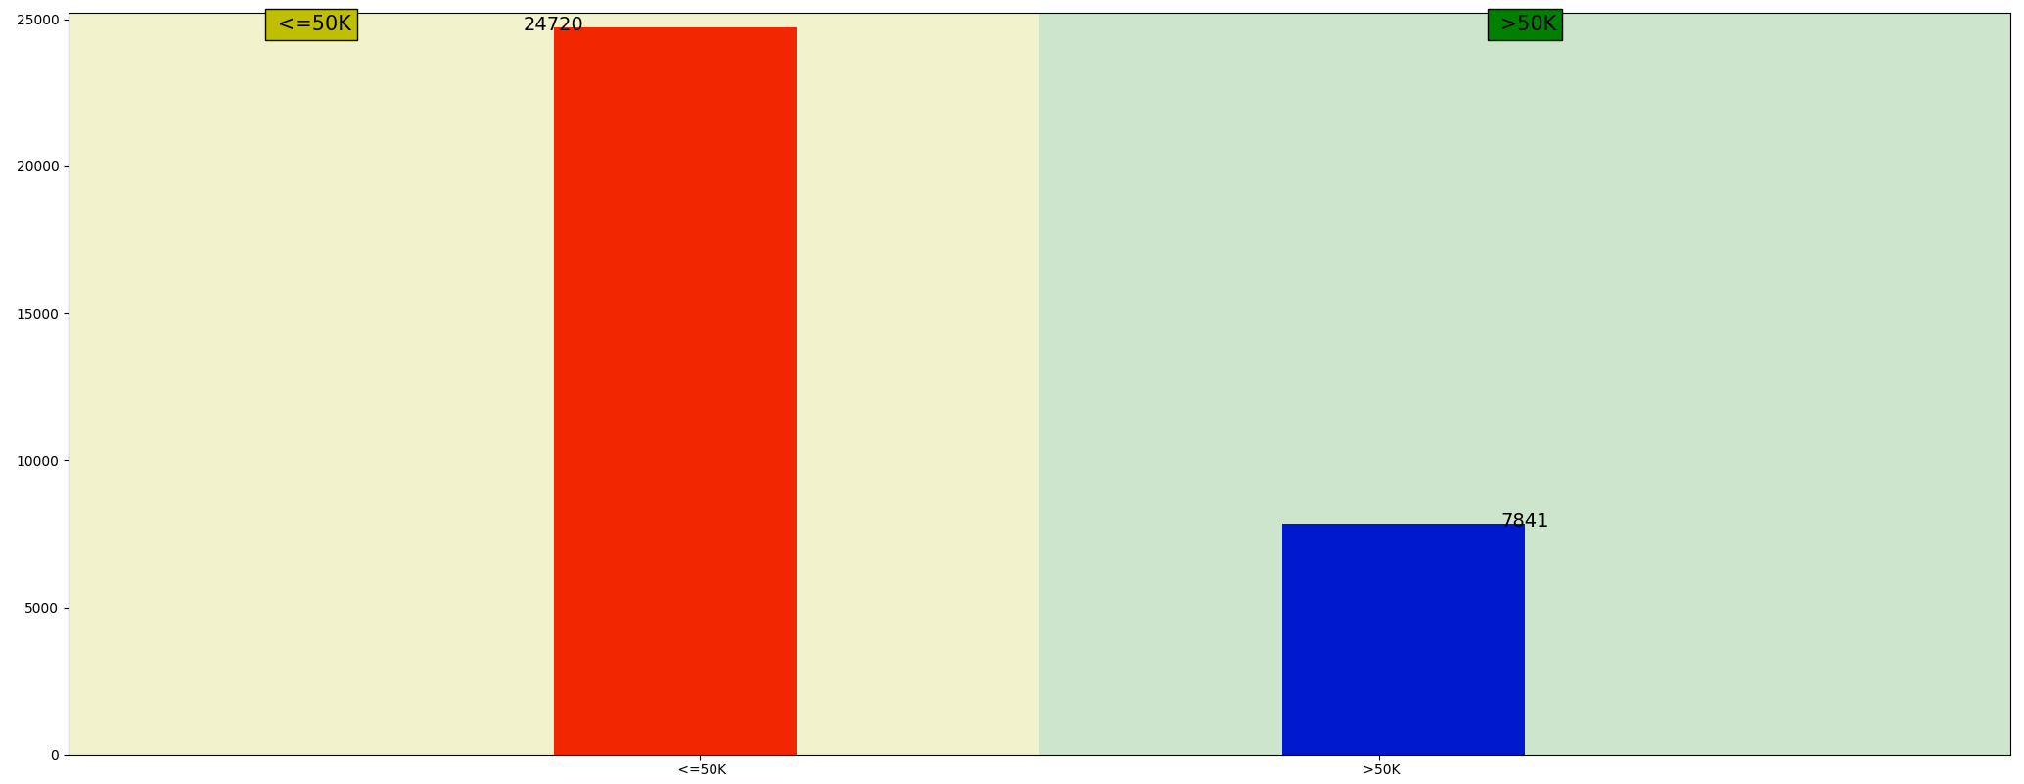
Income Plot

Slide 2
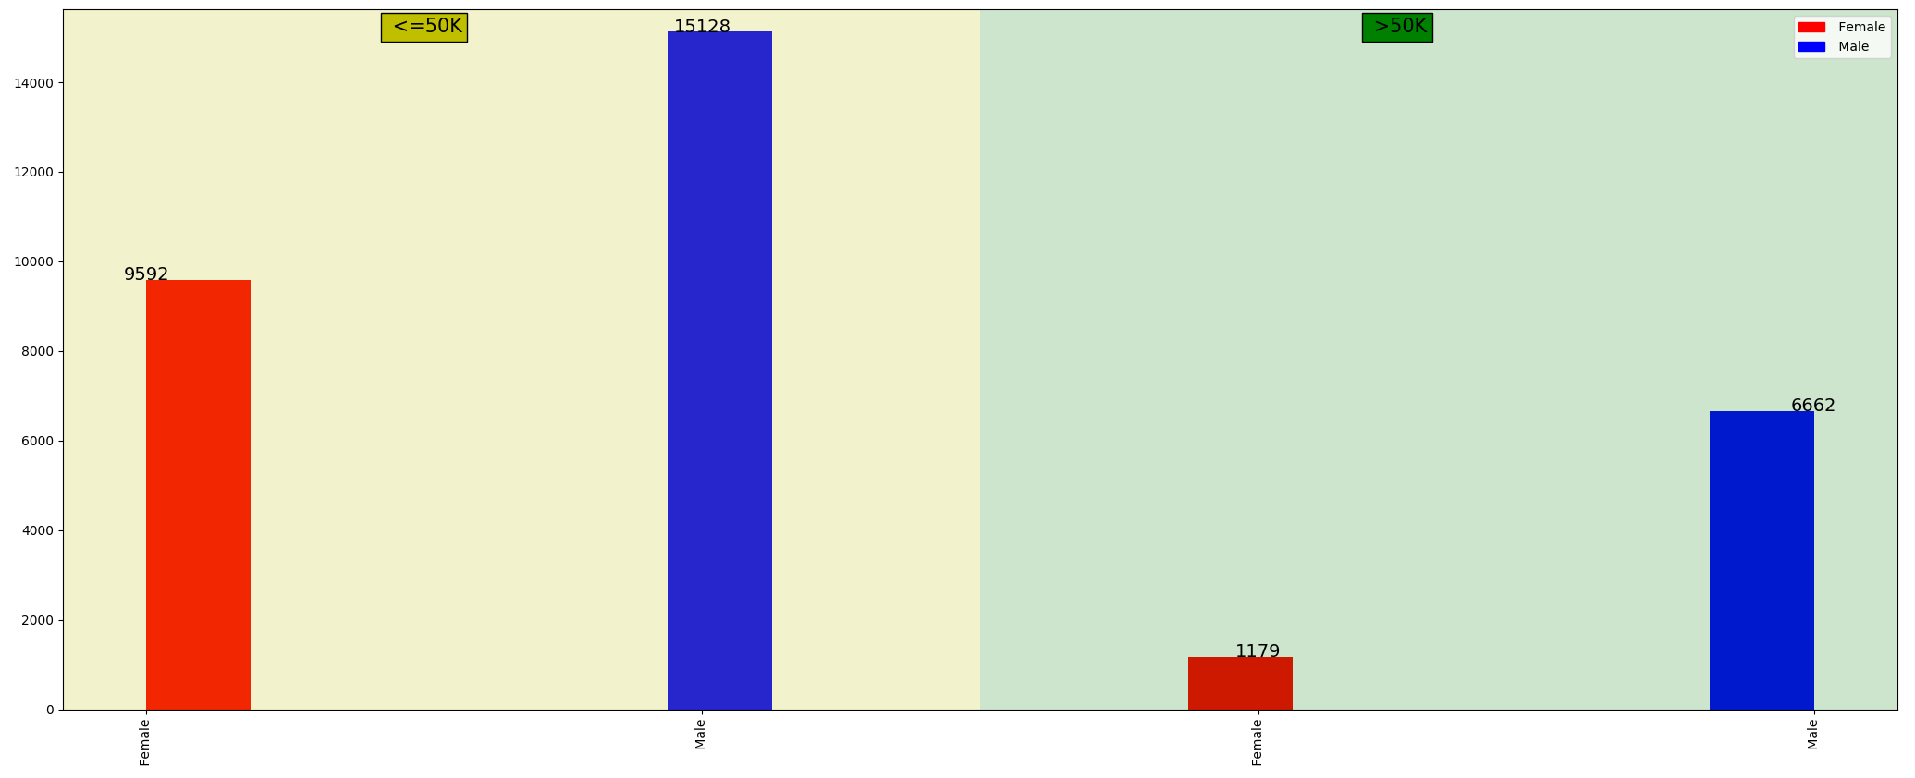
Income – Sex Plot

Slide 3
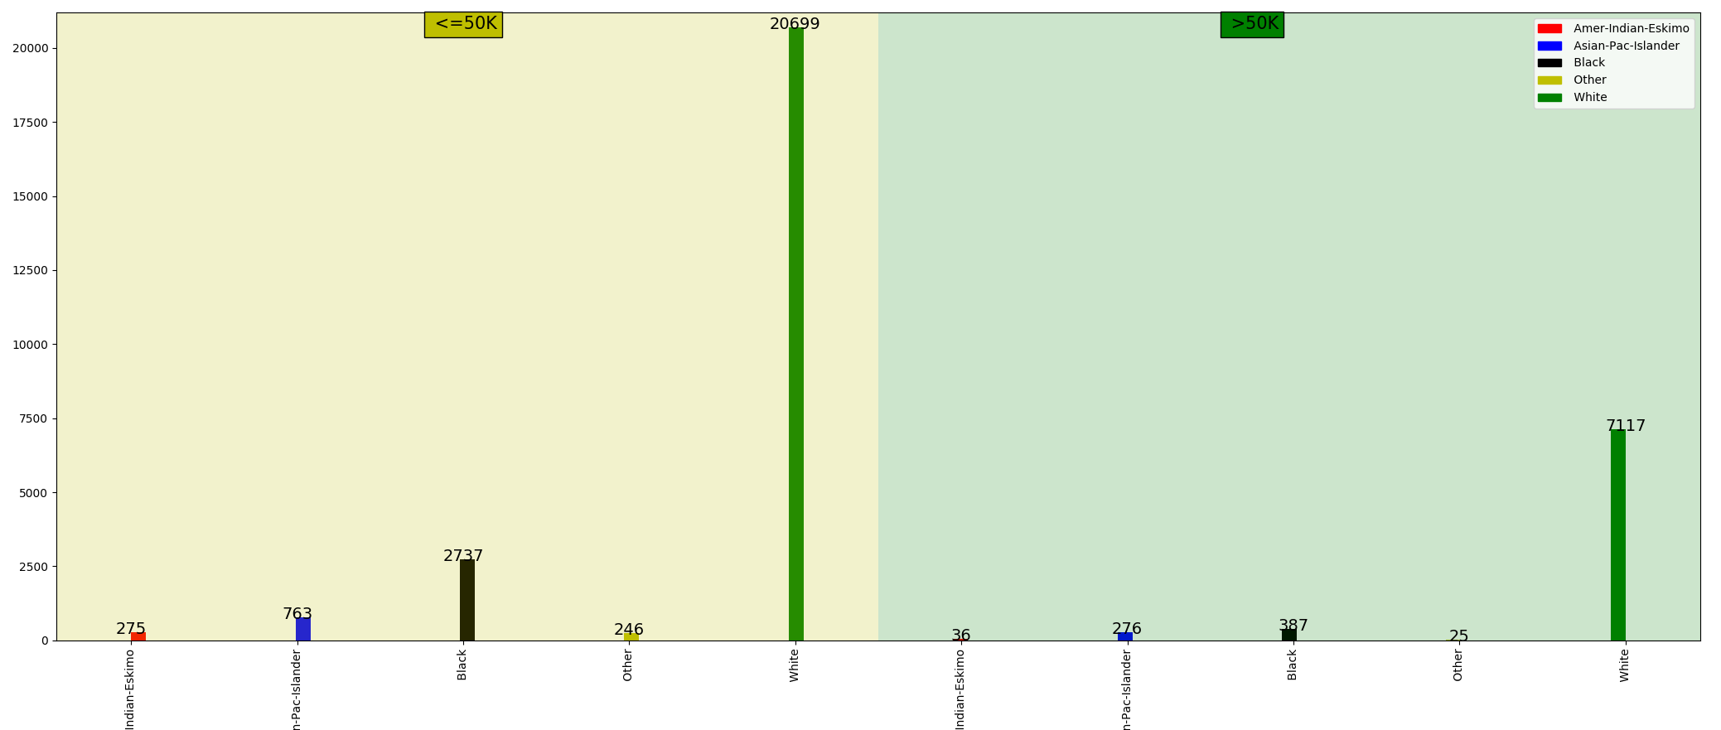
Income – Race Plot

Slide 4
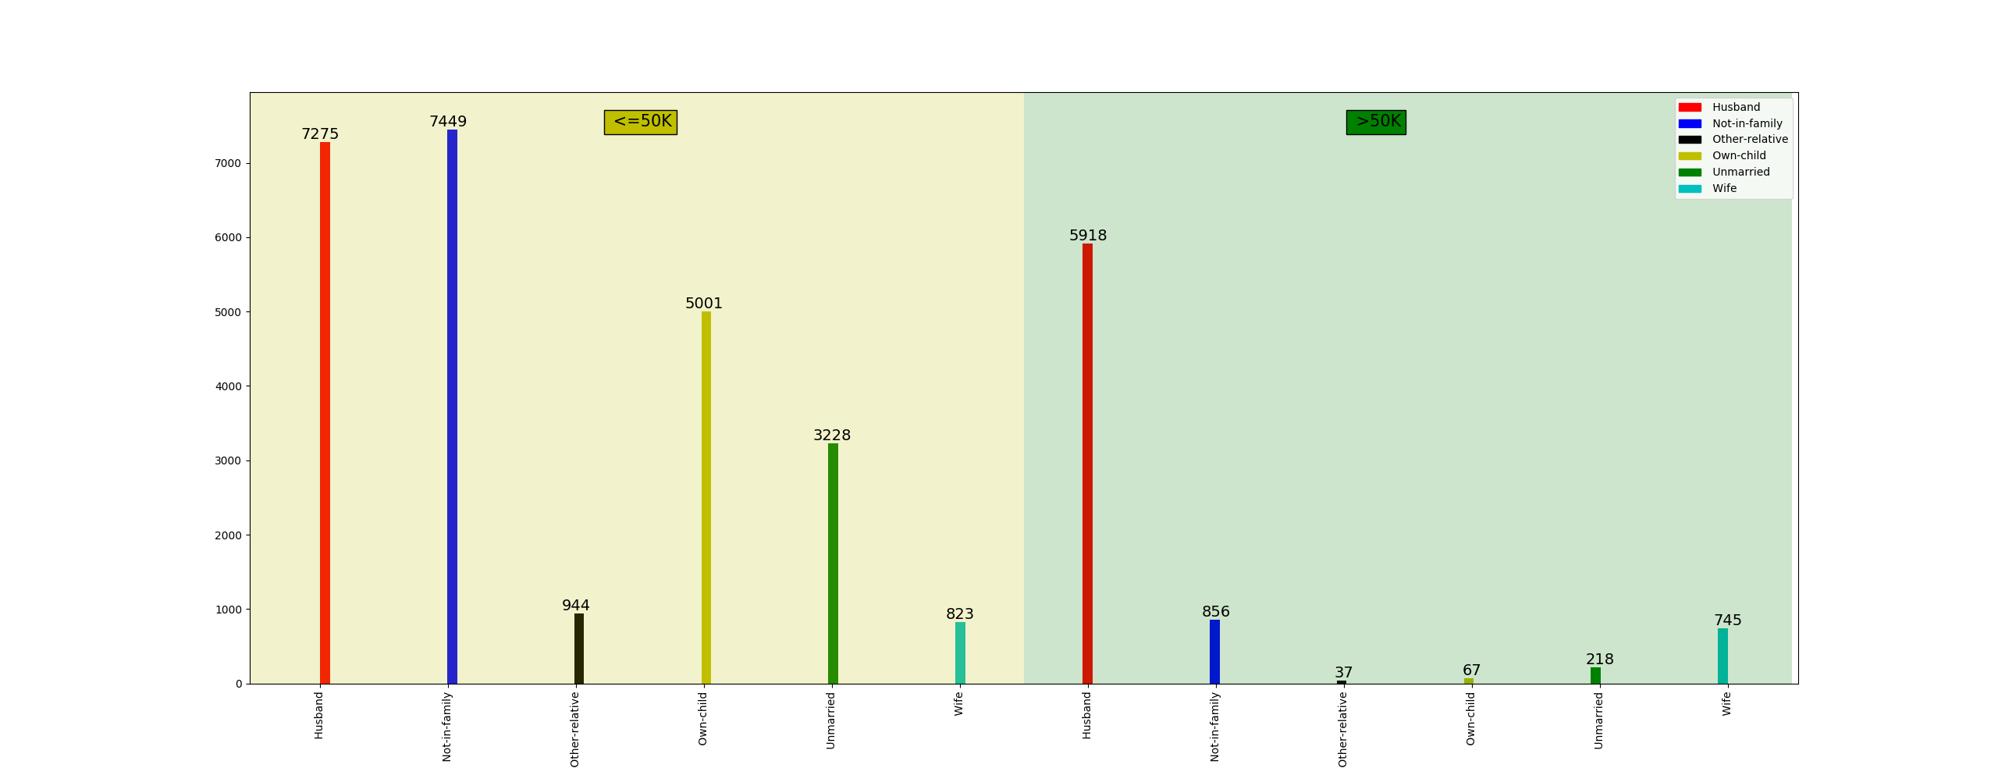
Income – Relationship Plot

Slide 5
Income – Marital Plot

Slide 6
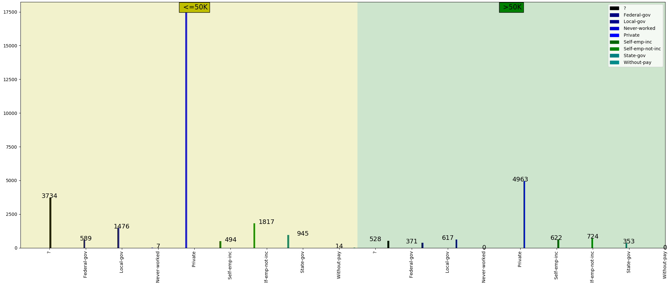
Income – Work class Plot

Slide 7
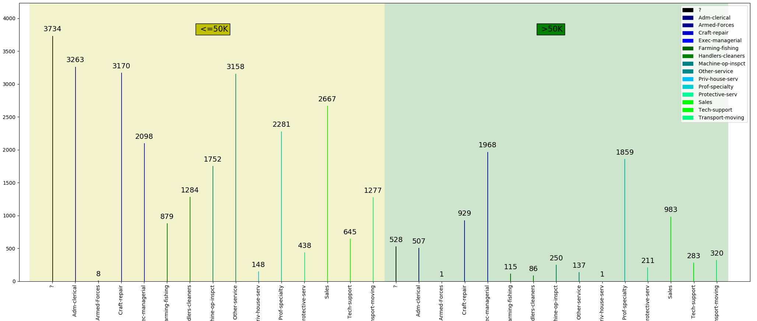
Income – Occupation Plot

Slide 8
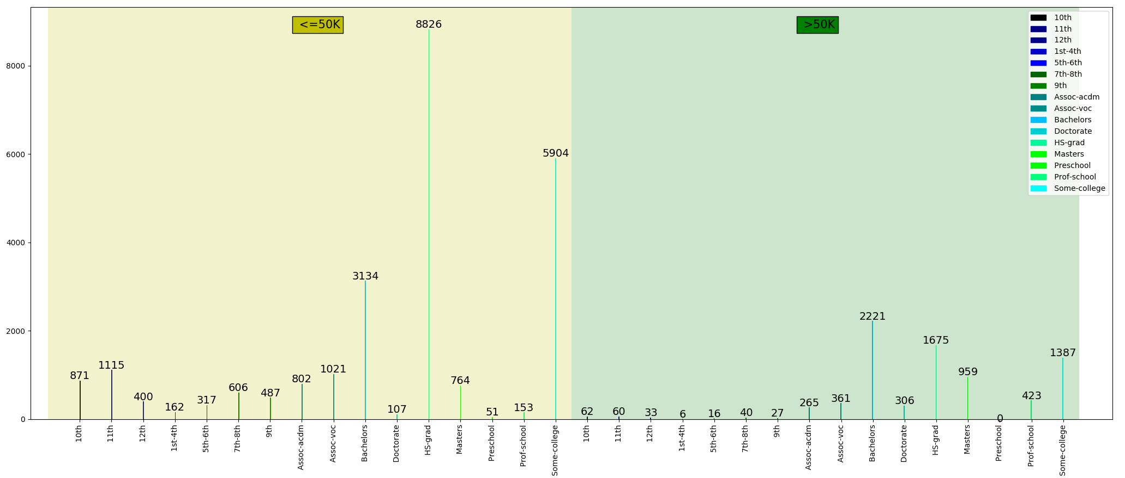
Income – Education Plot

Slide 9
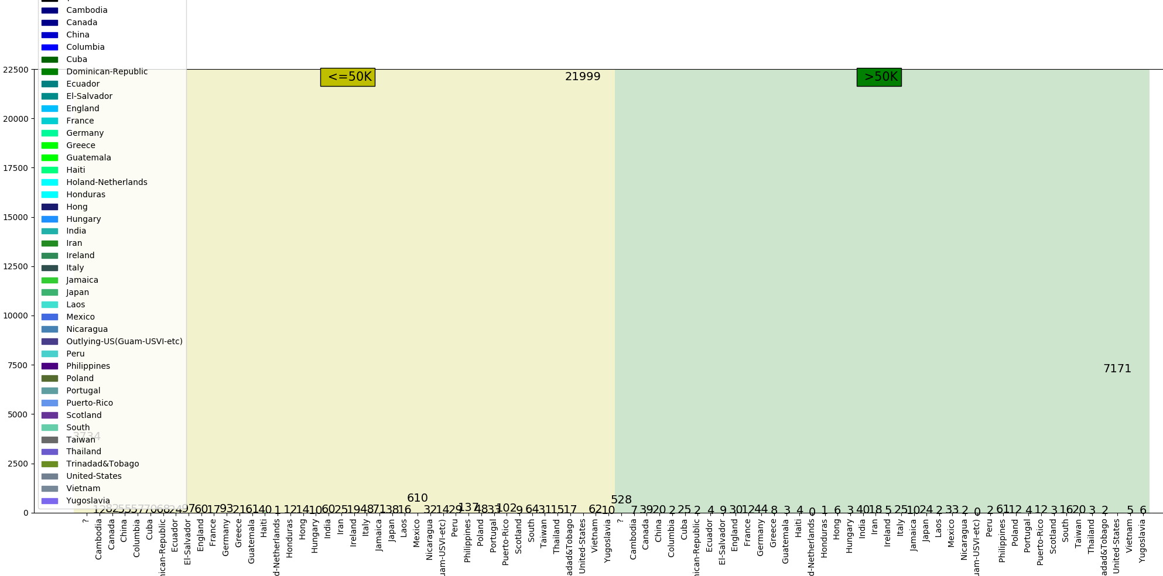
Income – Country Plot

Slide 10
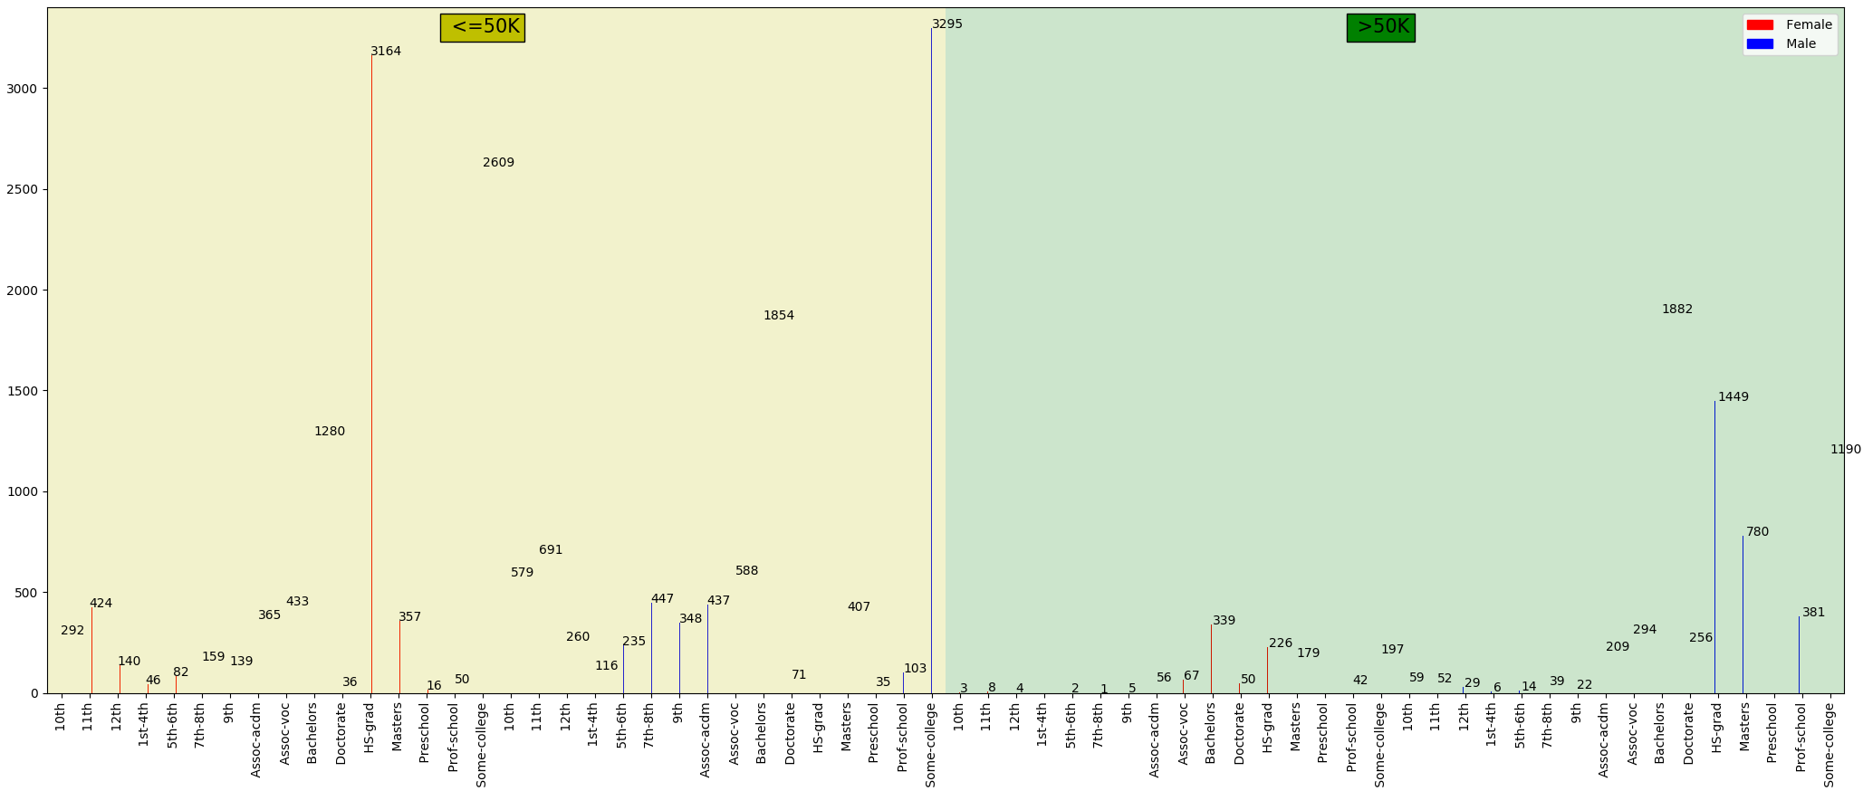
Income – Sex – Education Plot

