Slide 1
Kakuma Food Distribution Analysis
Name: Akau Bior
Course: Data analytics
Date: 17/7/2025
Capstone Project Presentation
⚠️ Disclaimer: Data is fictional and for academic use.

Slide 2
Introduction
• Kakuma Refugee Camp hosts thousands of displaced people.
Food distribution is critical to support welfare.
Kakuma experiences the problem of ration insufficiency.
Ration is distributed at the end of every month.
• Project analyzes trends using a simulated dataset.

Slide 3
Project Objectives
Analyze Distribution Trends Assess food distribution patterns across different zones and time periods within Kakuma.
Evaluate Household Allocations Identify variations or irregularities in food allocation per household size or type.
Segment Beneficiaries Classify beneficiaries by zone and household size for targeted insights.
Generate Actionable Insights Provide data-driven recommendations to improve fairness, consistency, and efficiency in food distribution.

Slide 4
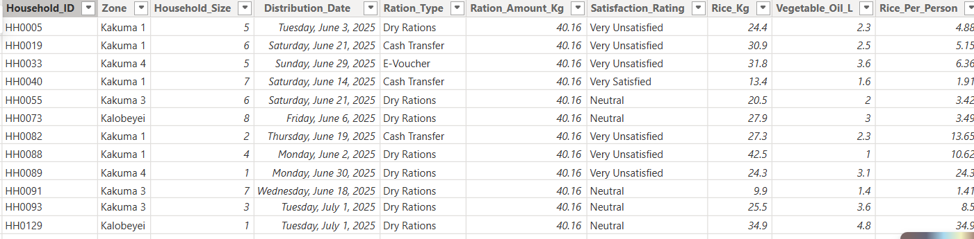
Dataset Overview
Simulated dataset (not real).
The dataset has 16 columns and 1000 rows.

Slide 5
Methodology
Data cleaning
Filled the 100 missing values using necessary methods. example bfill and ffill for distribution date and median for Ration amount.
First to eighth colum had 100 missing values.
Data transformation
Calculated per person ratings
Created monthly and quarterly totals

Slide 6
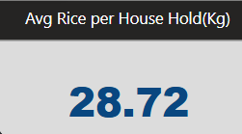
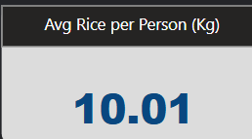
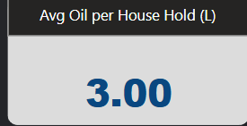
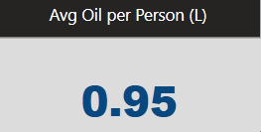
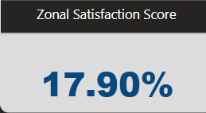
Key Performance Indicators

Slide 7
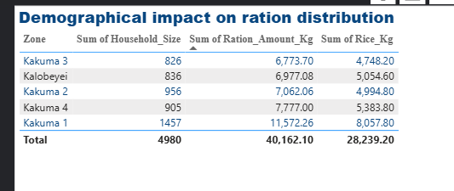
Distribution vs Household Size
Insight: I realized that larger households get more and there should be equal food allocation.

Slide 8
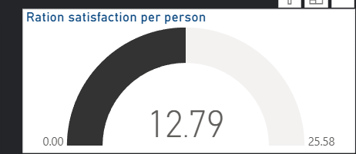
Satisfaction Score
Every individual in Kakuma is 12.8% satisfied with ration.
This is due to the meagre food items supplied in the camp and I believe the UN can do better in that breath.

Slide 9
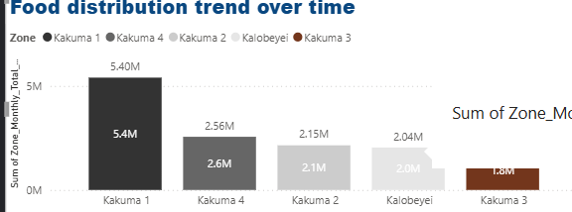
Food Distribution by Zone IN A MONTH
Insight: I found out that Kakuma one and four get more food and that is because of their higher population.

Slide 10
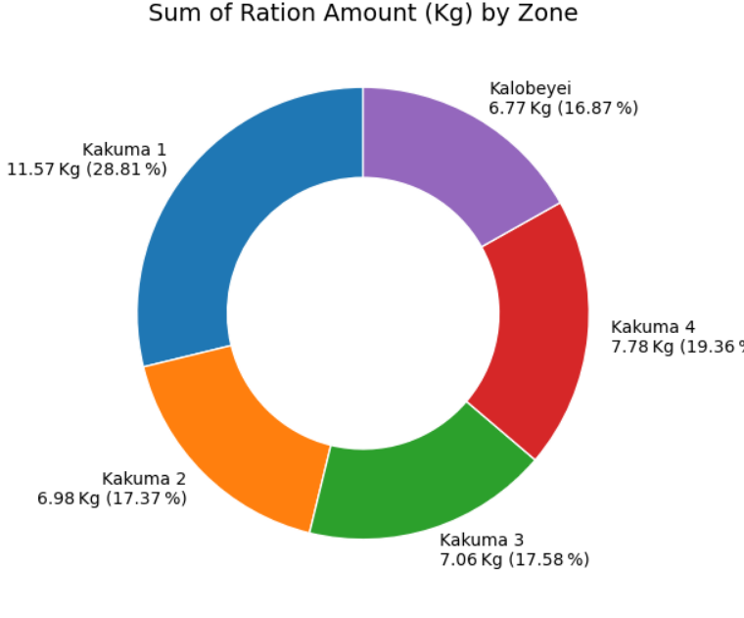
Food Type Analysis
I deduced that Kakuma 1 and Kakuma 4 get more ration due to their soaring population.

Slide 11
Inefficiencies & Gaps
High population, low supply zones.
Irregular household allocations.
Need for better tracking & planning.

Slide 12
Recommendations
• Distribute based on household size.
• Track distribution more closely.
• Gather community feedback regularly.

Slide 13
Conclusion
Kakuma faces high population pressure with limited food supply zones.
Household allocations are irregular, causing unfair distribution.
There's a need for better tracking and planning systems.
Improving these areas will lead to fairer and more efficient food distribution.

