Slide 1
Ruby程序设计语言 第五章：Ruby on Rails敏捷开发实践1 ——基本CRUD
沃天宇 <woty@act.buaa.edu.cn>
2018-10-18

Slide 2
内容提要
还是从脚手架（scaffold）说起
MVC再强化
Rails路由
增量式开发与Migration
数据关联
Convention over Configuration

Slide 3
一个简单的例子
菜谱管理程序（cookbook3）
功能需求
菜谱包含多个菜品（recipe）
每个菜品有1个属性：名称（title）
实现菜品的增删改查管理
菜品的列表
添加新菜品
修改菜品
删除菜品
Recipe
+title:string

Slide 4
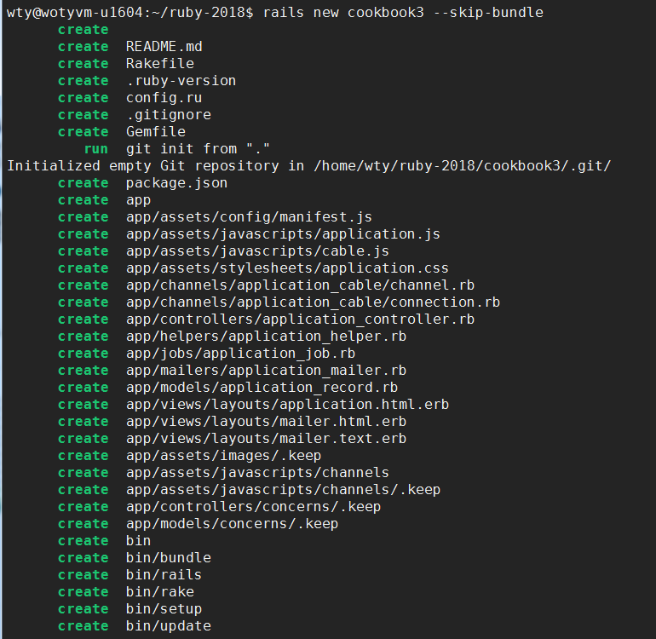
实现步骤
1. rails new cookbook3 --skip-bundle
关于bundler
管理rails应用的依赖环境（rails包），保证在不同的机器上迁移应用是的一致性。

Slide 5

小专题：
http://bundler.io/
问题：
rails升级太快，版本太多，合作开发环境难以统一，部署运营时环境和开发环境不一致，造成很多错误
一个Rails环境实际上是一系列gem包组成
执行gem list 或者bundle show
activejob (5.2.1, 4.2.4, 4.2.1, 4.2.0)
activemodel (5.2.1, 4.2.4, 4.2.1, 4.2.0)
activerecord (5.2.1, 4.2.4, 4.2.1, 4.2.0)
activesupport (5.2.1, 4.2.4, 4.2.1, 4.2.0)
actionmailer (5.2.1, 4.2.4, 4.2.1, 4.2.0)
actionpack (5.2.1, 4.2.4, 4.2.1, 4.2.0)
actionview (5.2.1, 4.2.4, 4.2.1, 4.2.0)
…
上面这些gem包都是干什么的？请检索资料后写在自己的project的RubyGems.md文件里，提交到git
http://guides.rubyonrails.org/index.html

Slide 6
小专题：bundler
Gemfile——把所需要的gem包和它们的版本列出来，这个rails工程就依赖这些包
#source 'https://rubygems.org'
source 'https://gems.ruby-china.com'
git_source(:github) { |repo| "https://github.com/#{repo}.git" }
#ruby '2.5.1'
# Bundle edge Rails instead: gem 'rails', github: 'rails/rails'
gem 'rails', '~> 5.2.1'
# Use sqlite3 as the database for Active Record
gem 'sqlite3'
# Use Puma as the app server
gem 'puma', '~> 3.11'
# Use SCSS for stylesheets
gem 'sass-rails', '~> 5.0‘
…

Slide 7

rails server启动流程
config.ru
config/environment.rb
# This file is used by Rack-based servers to start the application.
require_relative 'config/environment‘
run Rails.application
https://rack.github.io/
Rack provides a minimal interface between webservers that support Ruby and Ruby frameworks.
# Load the Rails application.
require_relative 'application‘
# Initialize the Rails application.
Rails.application.initialize!

Slide 8
rails server启动流程
config/application.rb
boot.rb
require_relative 'boot'
require 'rails/all'
# Require the gems listed in Gemfile, including any gems
# you've limited to :test, :development, or :production.
Bundler.require(*Rails.groups)
…
ENV['BUNDLE_GEMFILE'] ||= File.expand_path('../Gemfile', __dir__)
require 'bundler/setup' # Set up gems listed in the Gemfile.
require 'bootsnap/setup' # Speed up boot time by caching expensive operations.

Slide 9
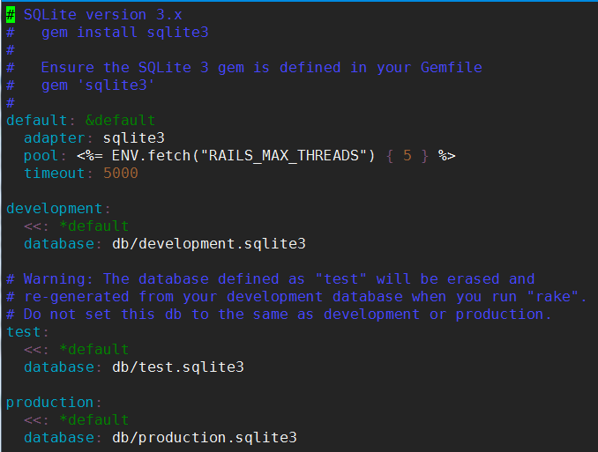
实现步骤
2. 配置、创建数据库
config/database.yml
创建：rake db:create
删除：rake db:drop
可以暂时不改, 除非你要用其他数据库

Slide 10
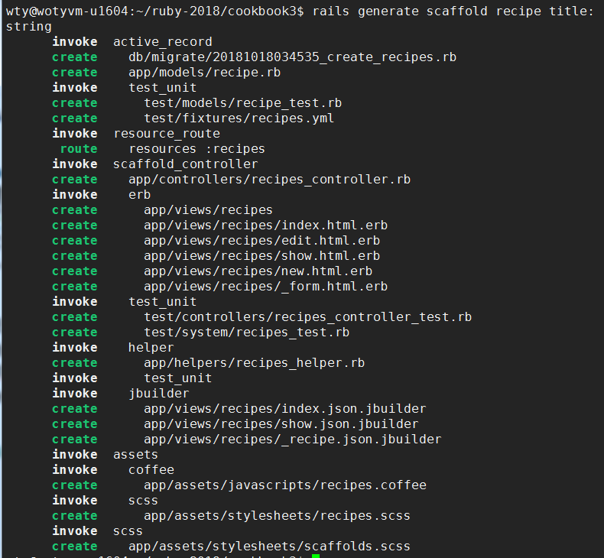
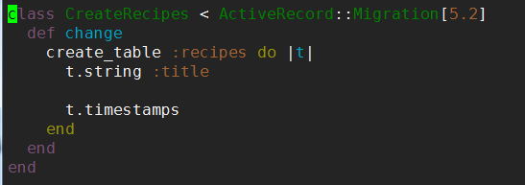
实现步骤
3. 用脚手架生成器自动生成代码框架
rails generate scaffold recipe title:string
vi db/migrate/20181018034535_create_recipes.rb
为什么要用ruby 代码建立数据库？

Slide 11
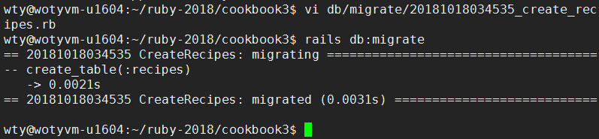
实现步骤
4. 创建数据表
rails db:migrate
或者也可以用rake db:migrate

Slide 12
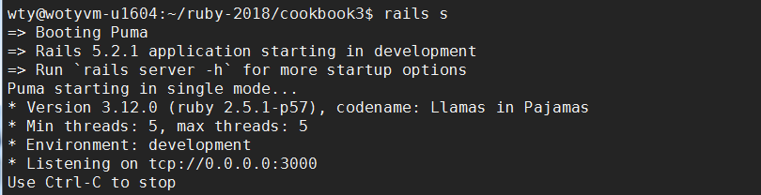
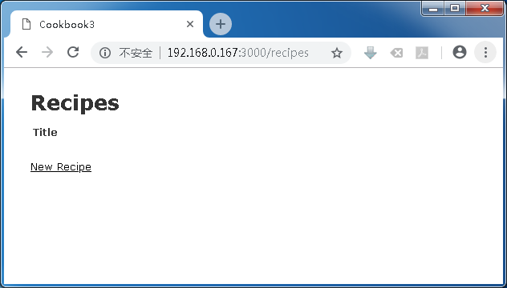
访问一下
启动服务器：rails s -b 0.0.0.0

Slide 13

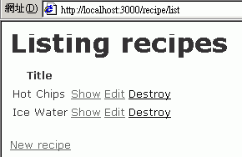
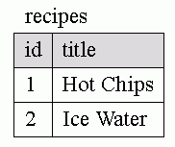


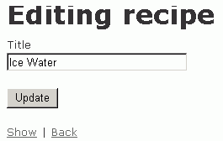

recipes
cookbook3
recipes/1
list
recipes/new
http://localhost:3000/recipes
recipes/1/edit

Slide 14
使用dbconsole
rails dbconsole
SQLite version 3.8.2 2013-12-06 14:53:30
Enter ".help" for instructions
Enter SQL statements terminated with a ";"
sqlite> .schema
CREATE TABLE "schema_migrations" ("version" varchar(255) NOT NULL);
CREATE UNIQUE INDEX "unique_schema_migrations" ON "schema_migrations" ("version”);
CREATE TABLE "recipes" ("id" INTEGER PRIMARY KEY AUTOINCREMENT NOT NULL, "title" varchar(255), "created_at" datetime NOT NULL, "updated_at" datetime NOT NULL);
sqlite> select * from recipes;
1|Hot Chips|2013-10-23 13:47:54.404576|2013-10-23 13:47:54.404576
2|Ice Water|2013-10-23 13:48:04.402148|2013-10-23 13:48:04.402148

Slide 15
Model-View-Controller
Model
list
Title
Hot Chips
Ice Water
Edit
Edit
edit
function update{
}
View
Title: __Hot Chips_____
保存
Controller
From: kphsu@ntu.edu.tw

Slide 16
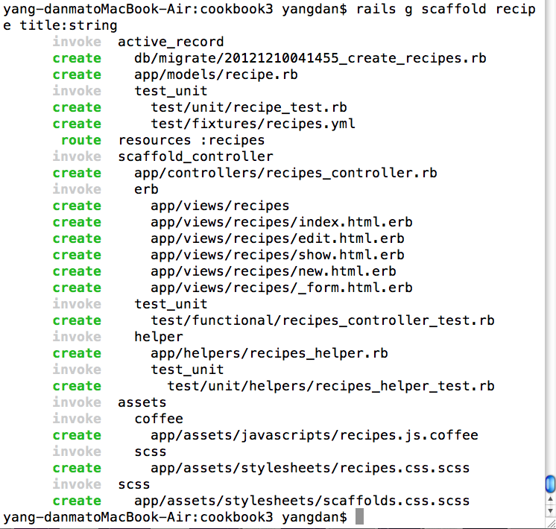
app目录下的MVC相关文件
由脚手架（scafflod）生成
M
C
V

Slide 17
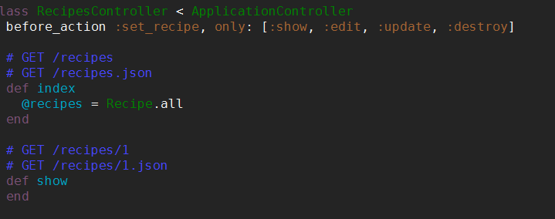
看一下源代码——控制器
app/controllers/recipes_controller.rb
注意命名Convention
Action：确定一次服务的行为，主要是准备数据
数据从模型获取，存入“成员变量”

Slide 18
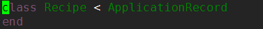
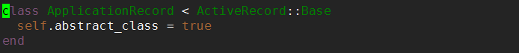
模型
Recipe.all方法在哪里定义的？
app/models/recipe.rb
魔法诞生地：ActiveRecord::Base
会根据数据库结构进行自动O-R mapping
Recipe.all：获取所有recipes表中的数据，并转换为对象，返回这些所有对象的“数组”
app/models/application_record.rb
http://guides.rubyonrails.org/active_record_basics.html

Slide 19
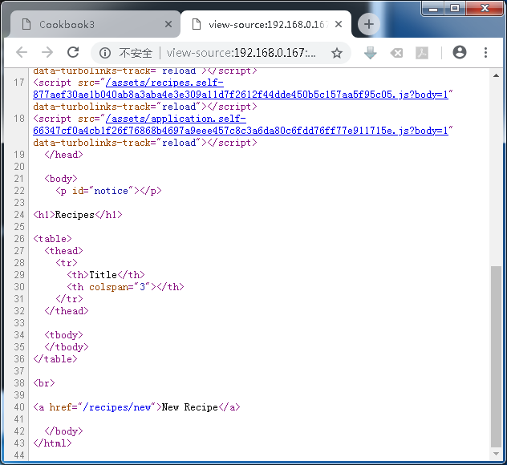
怎么形成的html页面——视图
app/views/recipes/index.html.erb
ERB (Embedded RuBy)

Slide 20
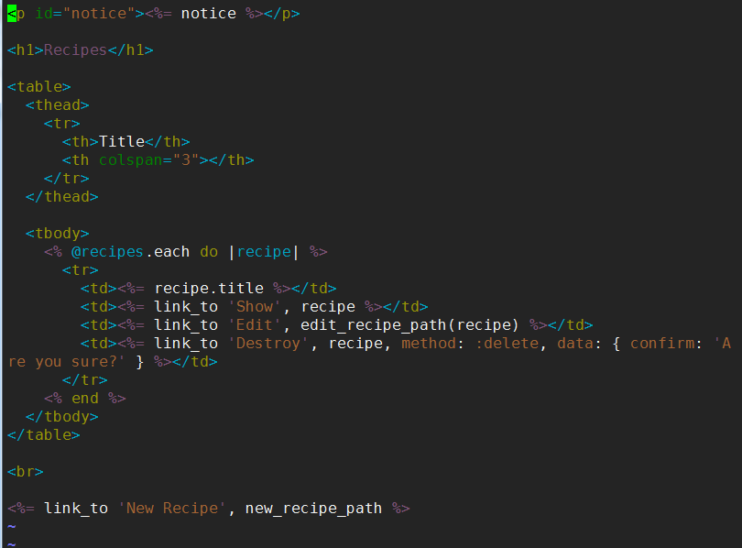
怎么形成的html页面——视图
app/views/recipes/index.html.erb
ERB (Embedded RuBy)
<% %>括起来的是ruby代码

Slide 21

RoR MVC基本原理
HTTP Request（URL）
http://localhost:3000/recipes
route.rb
Response
根据router.rb分析URL
确定controller、action、参数
browser
ROR server
controller = RecipesController
action = index
返回客户端浏览器
调用相应controller方法准备返回数据
调用erb模板，生成响应视图（HTML）
class RecipesController < ApplicationController
# GET /recipes
# GET /recipes.json
def index
@recipes = Recipe.all
…
views/recipes/index.html.erb
<h1>Listing recipes</h1>
<table>
<tr>
<th>Title</th>
…

Slide 22
难点：rails路由
在用户输入的URL（HTTP请求）与controller/action之间建立联系
config/routes.rb
资源化路由
Rails.application.routes.draw do
resources :recipes
# Example of regular route:
# get 'products/:id' => 'catalog#view‘
end
常规路由

Slide 23
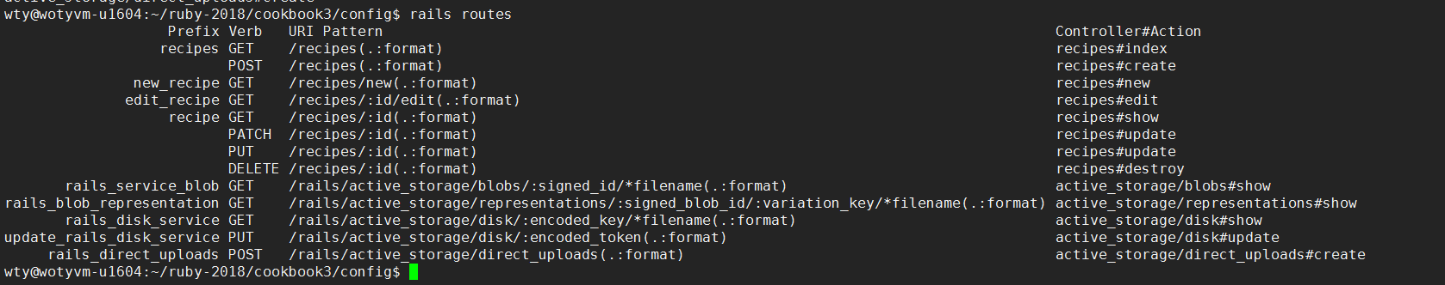
rake routes
config/route.rb
Rails.application.routes.draw do
resources :recipes
end

Slide 24
例如
用户输入URL
http://localhost:3000/recipes
http://localhost:3000/recipes/1
http://localhost:3000/recipes/new
http://localhost:3000/recipes/2/edit
http://localhost:3000/xxx/yyy
匹配的Entry?

Slide 25
rake routes
>rake routes
recipes GET /recipes(.:format) recipes#index
POST /recipes(.:format) recipes#create
new_recipe GET /recipes/new(.:format) recipes#new
edit_recipe GET /recipes/:id/edit(.:format) recipes#edit
recipe GET /recipes/:id(.:format) recipes#show
PATCH /recipes/:id(.:format) recipes#update
PUT /recipes/:id(.:format) recipes#update
DELETE /recipes/:id(.:format) recipes#destroy
如何使得http://localhost:3000/welcome/index可以访问？ ——添加路由。
http://localhost:3000/recipes
http://localhost:3000/recipes/new
http://localhost:3000/recipes/2/edit
http://localhost:3000/recipes/1
http://localhost:3000/welcome/index

Slide 26
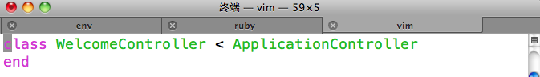
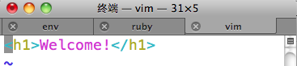
常规路由
1. 修改config/route.rb
Rails.application.routes.draw do
resources :recipes
get 'welcome/index' => 'welcome#index'
end
2. 执行rails g controller welcome
3. 生成app/views/welcome/index.html.erb

Slide 27
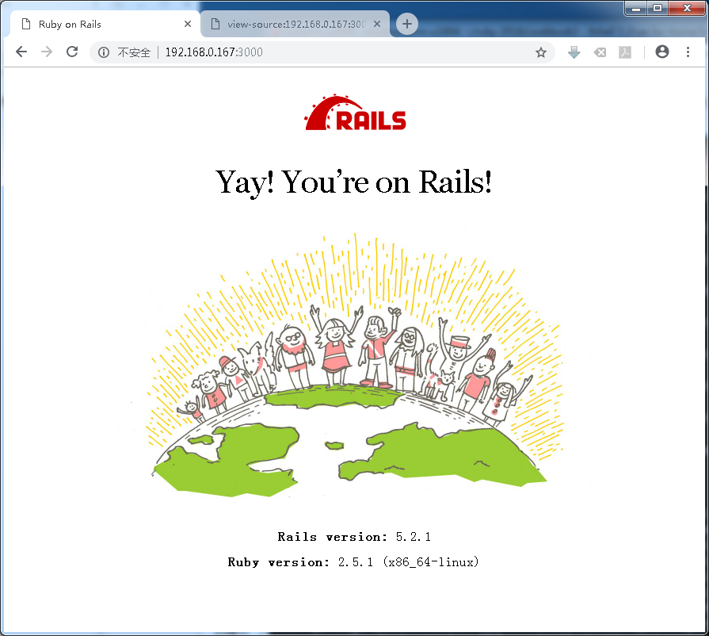
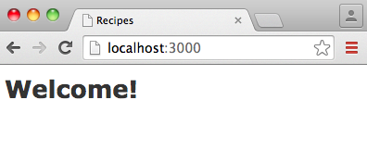
根路由
如果希望直接访问域名，出现首页
1. 修改config/route.rb
Rails.application.routes.draw do
resources :recipes
get 'welcome/index' => 'welcome#index'
root 'welcome#index'
end

Slide 28
rake routes
>rake routes
recipes GET /recipes(.:format) recipes#index
POST /recipes(.:format) recipes#create
new_recipe GET /recipes/new(.:format) recipes#new
edit_recipe GET /recipes/:id/edit(.:format) recipes#edit
recipe GET /recipes/:id(.:format) recipes#show
PUT /recipes/:id(.:format) recipes#update
PATCH /recipes/:id(.:format) recipes#update
DELETE /recipes/:id(.:format) recipes#destroy
prefix
verb
URI Pattern
Controller#action

Slide 29
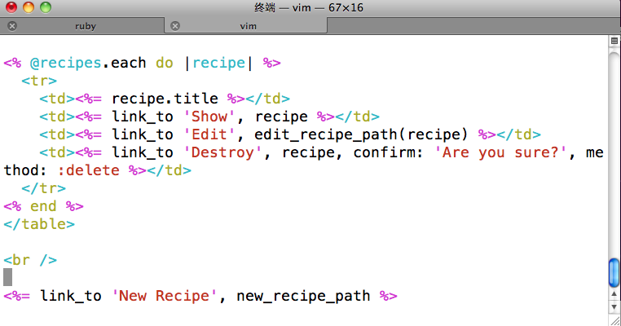
app/views/recipes/index.html.erb

Slide 30
需求变化了
增加一个“类别（Category）”的概念：
每道菜品“属于”一个类别
每个类别可以“拥有多个”菜品
Category举例：Snacks、Beverages
在Recipe的添加、修改、列表页面中添加相应Category信息
Category
1
n
Recipe

Slide 31
一样的动作
rails generate scaffold category name:string
新数据表：categories
db/migrate/20181018051228_create_categories.rb
增量修改数据库
rake db:migrate
class CreateCategories < ActiveRecord::Migration[5.2]
def change
create_table :categories do |t|
t.string :name
t.timestamps
end
end
end

Slide 32
Model recipe belong_to category
DB: recipes add field category_id
rails g migration AddCategoryRefToRecipes category:references
rake db:migrate
class AddCategoryRefToRecipes < ActiveRecord::Migration[5.2]
def change
add_reference :recipes, :category, foreign_key: true
end
end

Slide 33
修改model
这是正式写的 第1行code
app/models/recipe.rb
belongs_to :category
app/models/category.rb
has_many :recipes
这是第2行
Category
1
n
Recipe

Slide 34
rails console
Loading development environment (Rails 4.2.4)
irb(main):002:0> c=Category.new
=> #<Category id: nil, name: nil, created_at: nil, updated_at: nil>
irb(main):003:0> r=Recipe.new
=> #<Recipe id: nil, title: nil, created_at: nil, updated_at: nil, category_id: nil>
irb(main):004:0> r.category=c
=> #<Category id: nil, name: nil, created_at: nil, updated_at: nil>
irb(main):006:0> c.name="drink"
=> "drink"
irb(main):007:0> r.title="coke"
=> "coke"
irb(main):008:0> r.save
(0.2ms) begin transaction
Category Create (2.5ms) INSERT INTO "categories" ("name", "created_at", "updated_at") VALUES (?, ?, ?) [["name", "drink"], ["created_at", "2018-10-18 05:21:47.044423"], ["updated_at", "2018-10-18 05:21:47.044423"]]
Recipe Create (0.3ms) INSERT INTO "recipes" ("title", "created_at", "updated_at", "category_id") VALUES (?, ?, ?, ?) [["title", "coke"], ["created_at", "2018-10-18 05:21:47.067898"], ["updated_at", "2018-10-18 05:21:47.067898"], ["category_id", 1]]
(4.4ms) commit transaction
=> true

Slide 35
1.创建/修改Recipe的时候可以选择类别
app/views/recipes/_form.html.erb
<%= form_with(model: recipe, local: true) do |form| %>
<% if recipe.errors.any? %>
…
<% end %>
<div class="field">
<%= form.label :title %>
<%= form.text_field :title %>
</div>
<div><%= form.collection_select(:category_id, Category.all, :id, :name) %></div>
<div class="actions">
<%= form.submit %>
</div>
<% end %>
这是第3行
ActionView::Helpers::FormOptionsHelper

Slide 36
2.列Recipe列表的时候可以显示类别
app/views/recipes/index.html.erb
这是第4行
<h1>Recipes</h1>
<table>
<tr>
<th>Title</th>
<th>Category</th>
</tr>
<% @recipes.each do |recipe| %>
<tr>
<td><%= recipe.title %></td>
<td><%= recipe.category.name if recipe.category %></td>
<td><%= link_to 'Show', recipe %></td>
<td><%= link_to 'Edit', edit_recipe_path(recipe) %></td>
<td><%= link_to 'Destroy', recipe, :confirm => 'Are you sure?', :method => :delete %></td>
</tr>
<% end %>
</table>
…
这是第5行

Slide 37
3.显示Recipe的时候可以显示类别
app/views/recipes/show.html.erb
这是第6-9行
<p>
<b>Title:</b>
<%= @recipe.title %>
</p>
<p>
<b>Category:</b>
<%= @recipe.category.name if @recipe.category%>
</p>
<%= link_to 'Edit', edit_recipe_path(@recipe) %> |
<%= link_to 'Back', recipes_path %>

Slide 38
4.显示Category详细信息时列出所有该类的Recipe
app/views/categories/show.html.erb
这是第12-15行
…
<p>
<b>Name:</b>
<%=h @category.name %>
</p>
<p>
<b>Recipes of this category:</b>
<%= (@category.recipes.collect { |recipe| recipe.title }).join(", ") %>
</p>
<%= link_to 'Edit', edit_category_path(@category) %> |
<%= link_to 'Back', categories_path %>

Slide 39
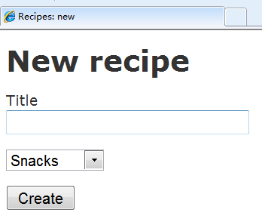
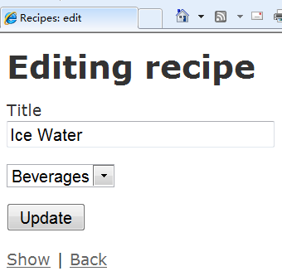
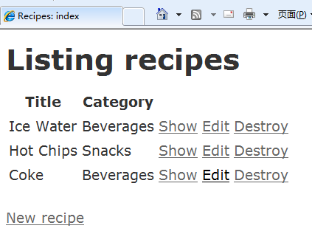
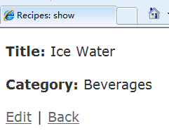
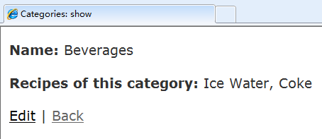
That’s it 看看效果
1
2
3
4
5

Slide 40
Naming convention
基本命名规则
数据模型名称：单数，大写字母开头的单词组成
HighSchool
关系名（表名）：复数，全小写，单词间下划线(“_”)隔开
high_schools
Controller：
文件名：high_schools_controller.rb
类名：HighSchoolsController
操作名（action）：小写字母，e.g. show
View:
high_schools/show.html.erb

Slide 41
复数化(pluralize)
Model: Order
Controller: OrdersController
View: Orders
数据库表名：orders
注意不规则变化、不可数名词：
person的复数形式：people
money ➔ money

Slide 42
数据关联（Associations）
1:1
has_one
belongs_to
1:n
has_many
belongs_to
n:m
has_and_belongs_to_many
http://guides.rubyonrails.org/association_basics.html
http://api.rubyonrails.org/classes/ActiveRecord/Associations/ClassMethods.html

Slide 43
需求又变化了
给Recipe增加一个“制作方法（instructions）”的属性：
创建migration，增加相应字段
rails g migration AddInstructionToRecipe
在Recipe的添加、修改、列表页面中添加相应Instructions信息
Recipe
+ title: string
+ instructions: string

Slide 44
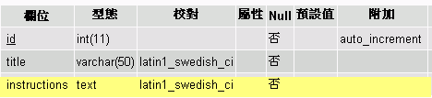
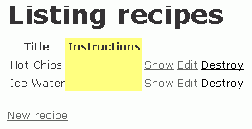
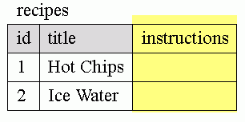
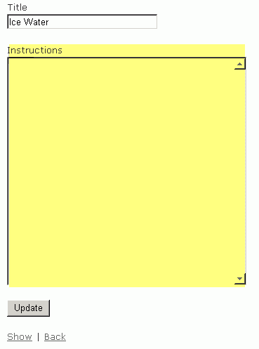
recipe
cookbook3
recipe/2/edit

Slide 45
作业
本节课作业：
安装Ruby，Rails
实践一遍cookbook3
完成对recipe数据模型的instructions属性的添加
可以通过http://localhost:3000/recipes访问
提交代码到git代码库的cookbook3分枝

Slide 46
谢谢！
联系方式：沃天宇
办公室：新主楼G506
电话：8233924
电子邮件：woty@act.buaa.edu.cn

