Slide 1
FORECASTING BATTERY HEALTH
YOU CAN TRUST
A physics-informed digital twin with calibrated uncertainty for grid-scale energy storage
Javier Marin · State-of-Health & Remaining-Useful-Life forecasting with calibrated prediction intervals
IEEE PES General Meeting 2026 · Panel: AI-powered Digital Twins for Grid-Scale Energy Storage

Slide 2
PROBLEM & TASK
Forecast capacity fade before it bites — with an error bar
State of Health SoH(n) = Qn / Q0 — fraction of original capacity at cycle n. End of life conventionally at SoH = 0.80.
The forecasting task
Predictive maintenance
Act before a unit drops offline.
Given SoH for cycles 1…K (early life), predict SoH for cycles K+1…N (the rest of life) — and a calibrated interval for each.
This is extrapolation, not interpolation: we never see the test cycles during fitting. It is the regime where naive models quietly fail and overconfident error bars become dangerous.
Safety & warranty
Stay ahead of thermal/limit risk.
No live SoH sensor
It must be inferred and forecast.
Trustworthy AI for critical systems · J. Marin
2

Slide 3
ARCHITECTURE
The hybrid digital twin
Physics prior fθ(n)
port-Hamiltonian or empirical law
Measured history
Q(n) per cycle
Σ → SoH(n)
+ calibrated σ(h)
RUL to 80%
+ decision
ML residual gφ(n)
GP on what physics misses
new measurement → data assimilation (Kalman update)
The physics block is a port-Hamiltonian model when conservation structure is known (the library's core), or a lighter empirical law for degradation like SoH — same hybrid pattern. The loop folds in new data as it arrives.
Trustworthy AI for critical systems · J. Marin
3

Slide 4
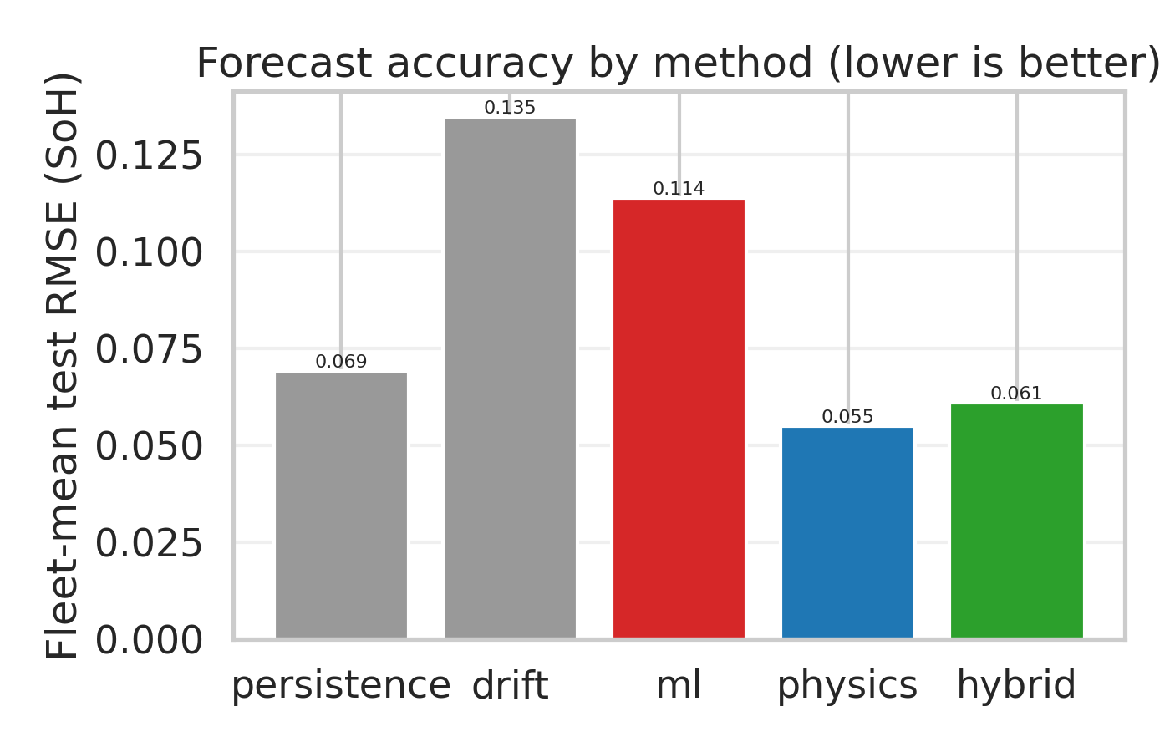
WHY HYBRID
Neither physics nor ML alone is enough
Approach | Extrapolates? | Captures cell detail? | Calibrated uncertainty?
Physics only | Yes | Limited | No
ML only | No | Yes | Partial
Hybrid (this work) | Yes | Yes | Yes
Physics constrains the forecast to stay physically admissible far ahead; ML corrects what the law misses but cannot extrapolate on its own; the hybrid keeps both — and only it carries a calibrated error bar. The bars at right show it in numbers.
Trustworthy AI for critical systems · J. Marin
4

Slide 5
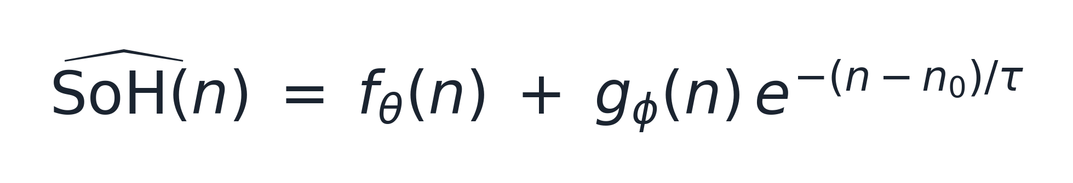
THE MODEL
Structured prior + learned correction
1 · Empirical degradation prior (SEI film growth ~√n, cycling ~ linear)
2 · Hybrid forecast = physics prior + damped ML residual (fθ: a fade law here; a port-Hamiltonian model when structure is known)
3 · Structure-preserving core of the library (passive by construction → no runaway)
Trustworthy AI for critical systems · J. Marin
5

Slide 6
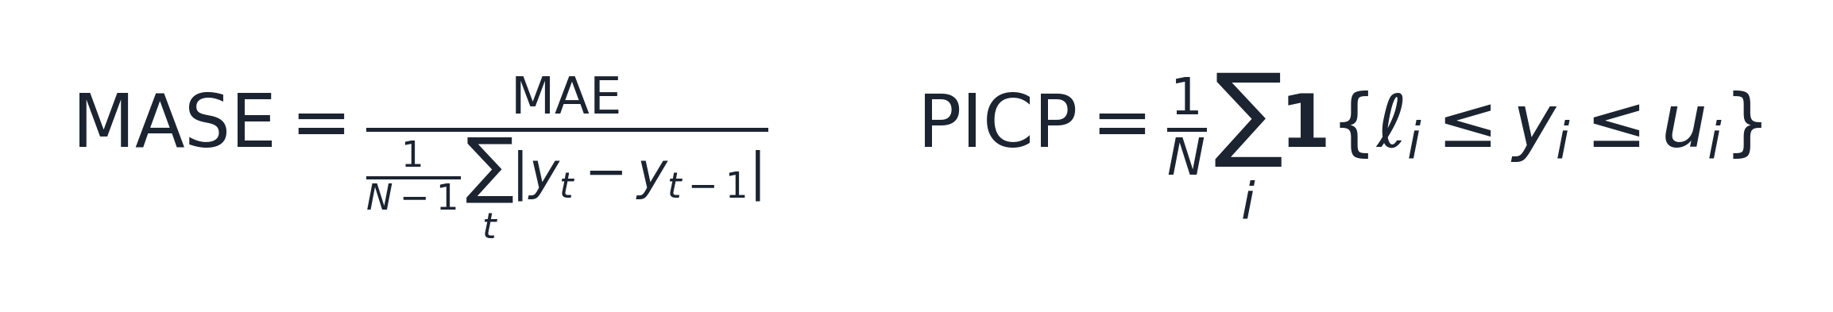
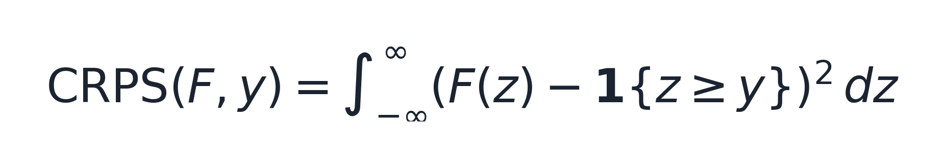
UNCERTAINTY & SCORING
Calibrated bands and how we grade them
Calibrated interval — split-conformal scale that grows with the horizon h
Graded against a naive baseline — skill, and whether the bands mean what they say
PICP = coverage · MASE < 1 beats the naive forecast · CRPS scores the whole predictive distribution
Trustworthy AI for critical systems · J. Marin
6

Slide 7
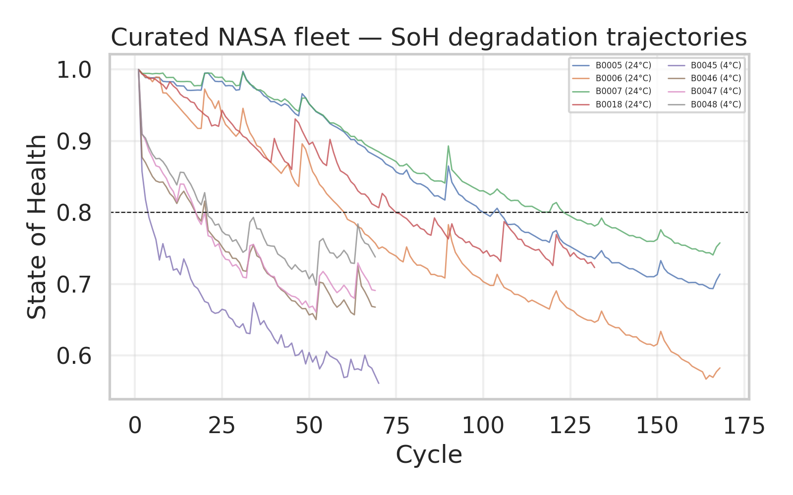
DATA & CURATION
Rigor starts before the model
NASA Li-ion dataset (public, Saha & Goebel).
Of 34 cells, 8 are genuine full-discharge degradation trajectories. The other 26 are reference / impedance / partial-cycle tests — SoH that 'grows', collapses and revives, or starts near zero.
Inclusion criteria are explicit:
≥ 40 cycles · plausible C0 · monotone-ish fade · no recovery glitches. Two operating temperatures (24 °C, 4 °C) are kept on purpose, to test calibration across conditions.
Trustworthy AI for critical systems · J. Marin
7

Slide 8
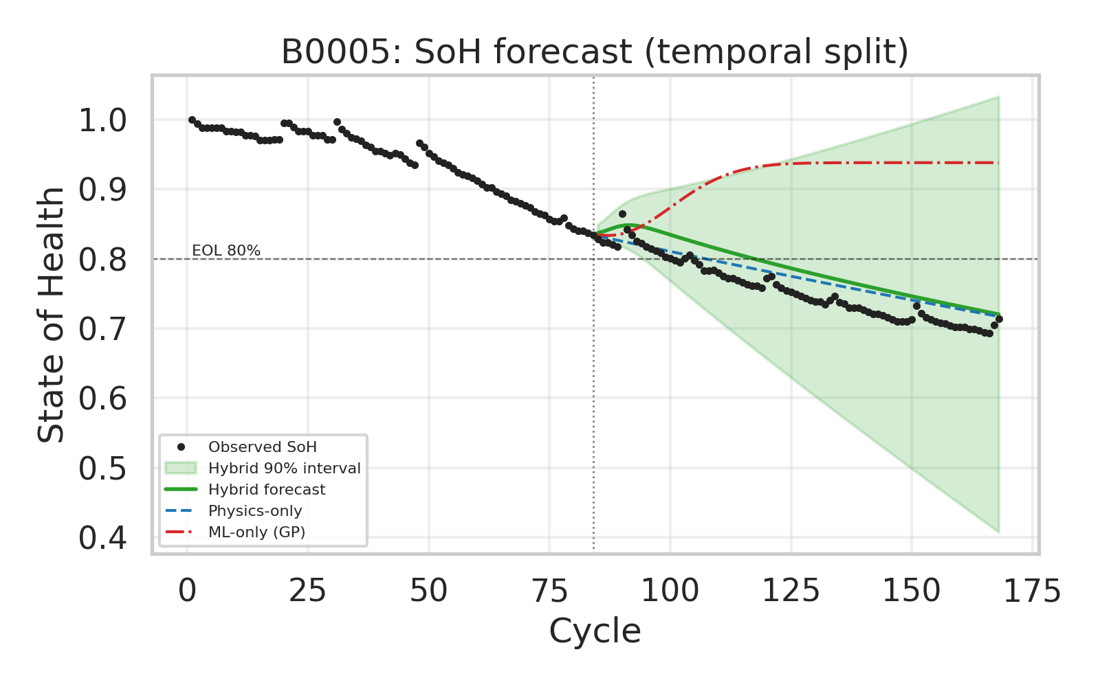
RESULT · FORECAST
Forecast the second half of life from the first
Tracks the true fade
Trained only left of the split line, the hybrid follows the real decline.
ML-only drifts off
Without physics it flattens and misses the trend.
Band widens with horizon
Uncertainty grows the further ahead — and keeps containing the truth.
Trustworthy AI for critical systems · J. Marin
8

Slide 9
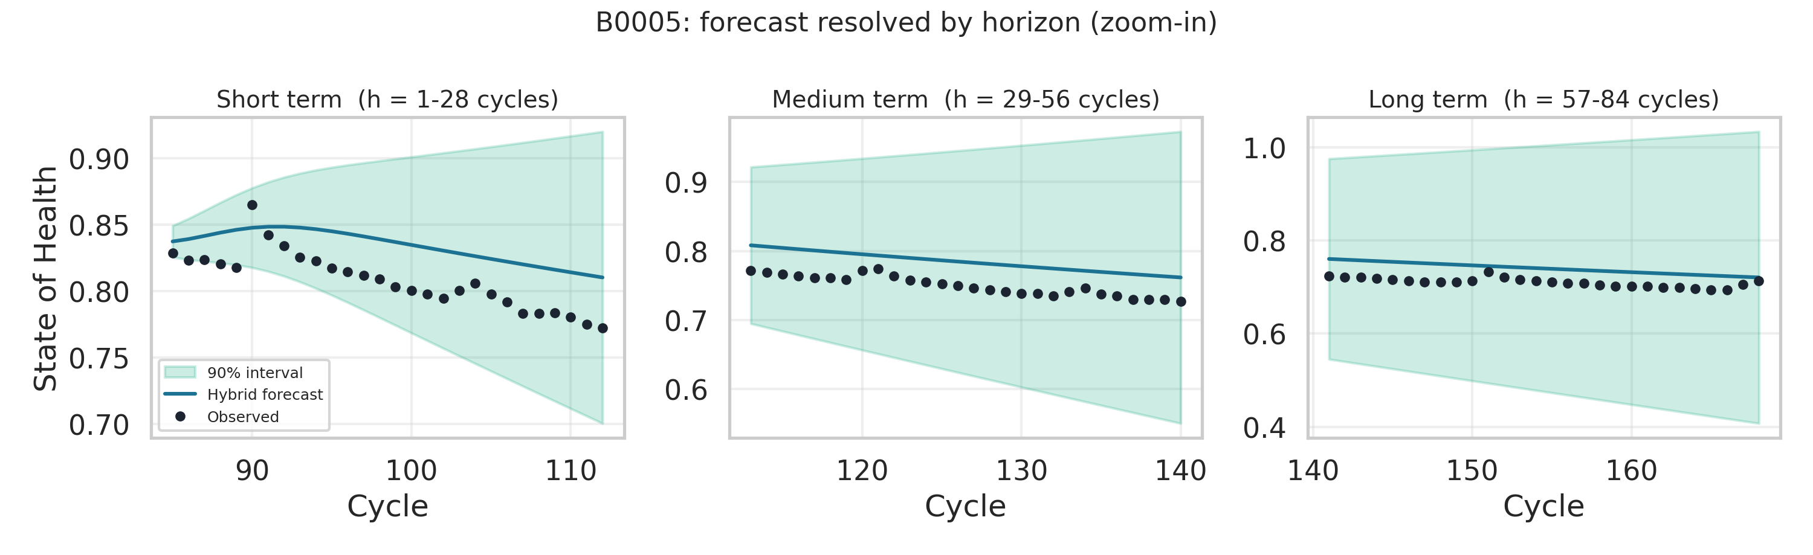
RESULT · BY HORIZON
Short, medium, long term — resolved
Short term: tight band, the correction still informs the mean. Medium: the physics trend carries; band opens steadily. Long: wide but earned — the interval owns the growing risk.
Trustworthy AI for critical systems · J. Marin
9

Slide 10
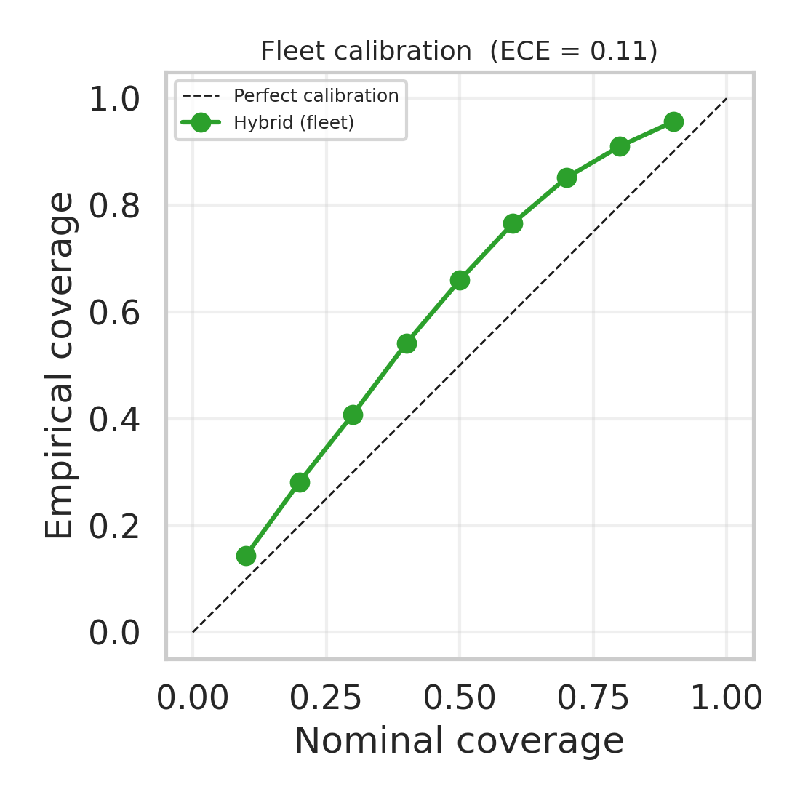
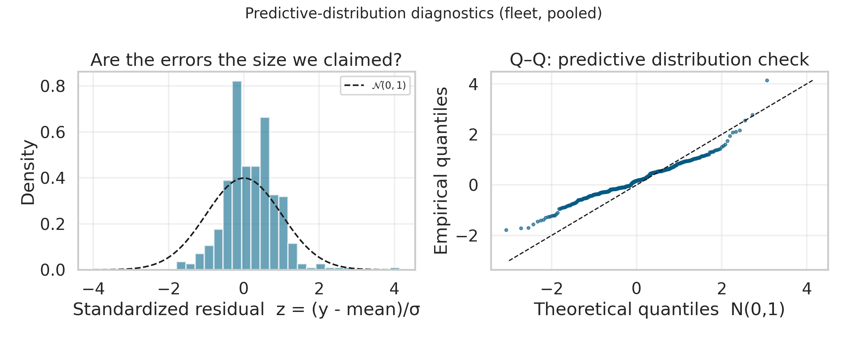
RESULT · IS THE UNCERTAINTY REAL?
Calibration and predictive-distribution checks
Left: a stated 90% interval contains the truth ~90% of the time across the fleet (ECE = 0.11), sitting just above the diagonal — slightly conservative. Right: standardized residuals are close to N(0,1), a touch narrower — the bands are trustworthy, with a little room to tighten.
Trustworthy AI for critical systems · J. Marin
10

Slide 11
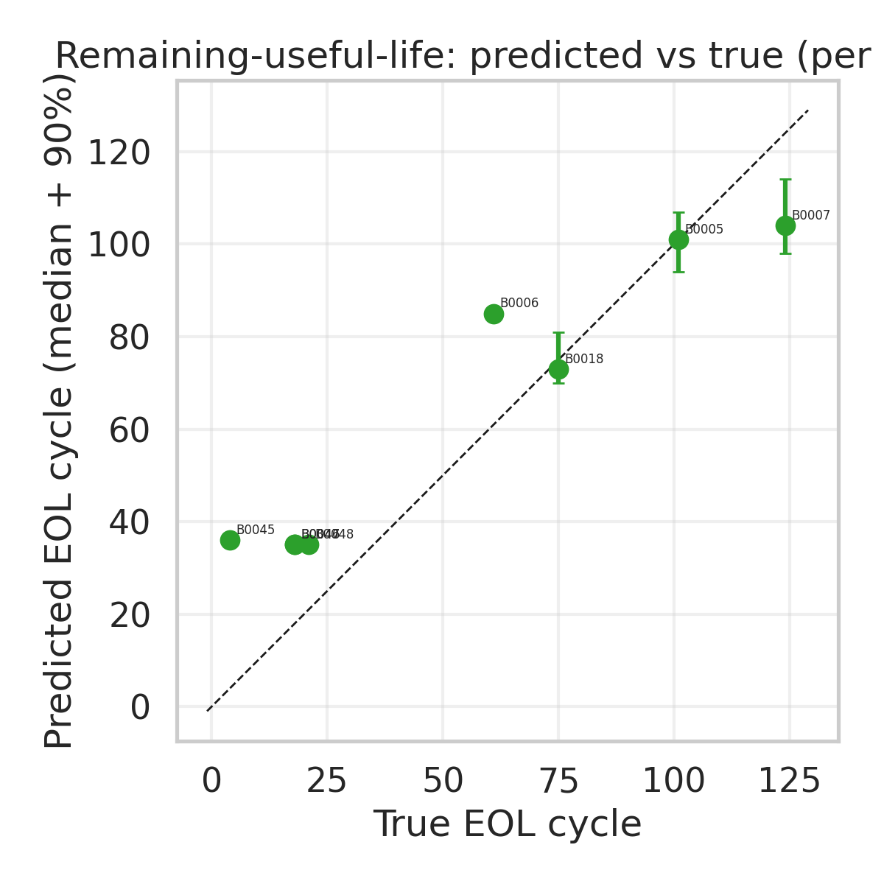
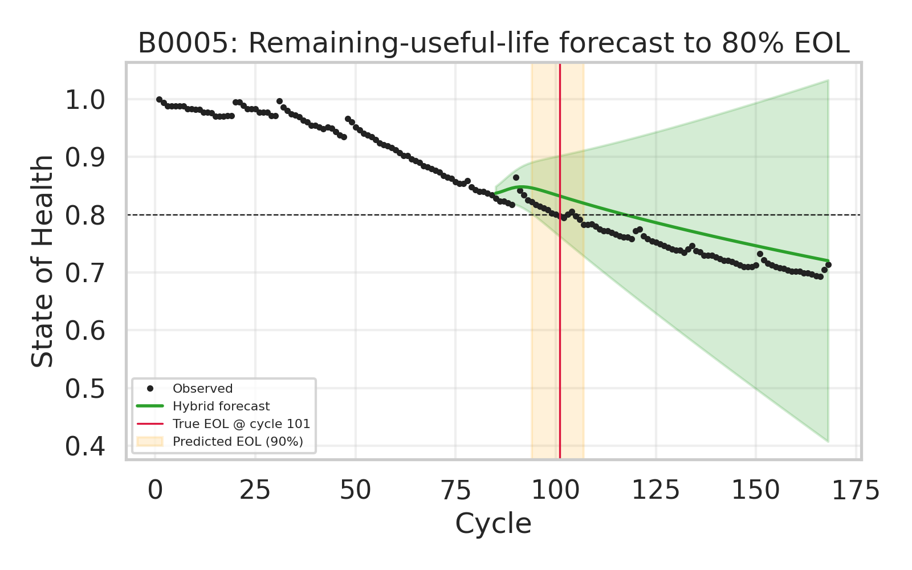
RESULT · THE DECISION
From curve to maintenance call: Remaining Useful Life
RUL = cycles to 80% SoH. The twin returns a distribution of end-of-life cycles (left); across cells the predicted EOL tracks the true EOL with an interval you can schedule against (right).
Trustworthy AI for critical systems · J. Marin
11

Slide 12
GENERALIZATION
The same engine, across utilities
Energy storage
Water networks
Rotating & static assets
SoH / RUL for grid batteries — shown here.
Pump wear, membrane fouling, leak-rate drift.
Transformers, motors, heat exchangers.
What makes it deployable
Lightweight & CPU-only (laptop, no cluster) Auditable & deterministic (traceable — EU AI Act-ready) Calibrated by default (plan against the interval)
Trustworthy AI for critical systems · J. Marin
12

Slide 13
BROADER CONTEXT
Where this sits: the world-models family
This work — structured digital twin
ML world models (Dreamer, JEPA, Cosmos)
State: observable, physical (SoH)
Structure: known a priori (physics)
Uncertainty: calibrated, first-class
Nature: white-box, auditable, CPU
State: learned latent representation
Structure: learned from data
Uncertainty: typically weak
Nature: black-box, high-dim, GPU
Same substrate — state, conservation, dissipation, coupling to outside — at opposite ends of the observable ↔ latent axis. Critical-infrastructure decisions need the structured, auditable end.
Trustworthy AI for critical systems · J. Marin
13

Slide 14
SELECTED REFERENCES
Where the modelling choices come from
Data
Physics-informed ML
Saha & Goebel (2007), NASA Ames Prognostics Data Repository — Li-ion battery data set.
Karniadakis et al. (2021), Nature Reviews Physics — physics-informed ML.
Degradation physics
Willard et al. (2023), ACM Computing Surveys — knowledge + ML for science/eng.
Pinson & Bazant (2013), J. Electrochem. Soc. — SEI growth & √t capacity fade.
Conformal & calibration
Birkl et al. (2017), J. Power Sources — degradation diagnostics for Li-ion cells.
Vovk, Gammerman & Shafer (2005), Algorithmic Learning in a Random World.
Xu et al. (2018), IEEE Trans. Smart Grid — cell-life degradation modelling.
Angelopoulos & Bates (2023) — gentle introduction to conformal prediction.
Data-driven life
Kuleshov, Fenner & Ermon (2018), ICML — calibrated regression.
Severson et al. (2019), Nature Energy — cycle-life prediction before fade.
Scoring & accuracy
GP for SoH / UQ
Gneiting & Raftery (2007), JASA — proper scoring rules (CRPS).
Richardson, Osborne & Howey (2017), J. Power Sources — GP regression for SoH.
Hyndman & Koehler (2006), Int. J. Forecasting — MASE.
Rasmussen & Williams (2006), Gaussian Processes for Machine Learning, MIT Press.
Port-Hamiltonian core: van der Schaft & Jeltsema (2014), Foundations and Trends in Systems and Control.
Trustworthy AI for critical systems · J. Marin
14

Slide 15
WHAT TO TAKE AWAY
Forecast the health and the error bar together.
In a critical system, a point forecast without calibrated uncertainty is a liability.
Structure extrapolates; data-fitting interpolates.
Physics + ML beats either alone, and beats the naive baseline by 3-8× on the standard cells.
Rigor is the product: curated data, extrapolative evaluation, checked calibration.
The same engine carries from batteries to water to rotating assets.
Javier Marin · I build the math that tells you when AI is wrong · javier@jmarin.info · github.com/Javihaus

