Slide 1

Challenge “Developing a multi-object tracker”
Deep Learning for Video Signal Processing
Javier Muñoz Manuel Otero

Slide 2
Outline
Improvements in data association
Hungarian algorithm
Kalman Filter
Deep Features
Improvements in track creation and deletion
Patient Init
Patient Remove
Improvements in object detection
Fine-tuning models & NMS optimal search
Selection of the best Hyperparameters and results

Slide 3
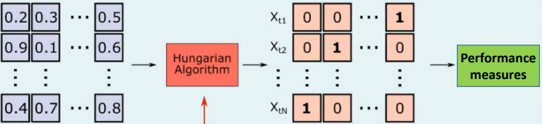
Improvements in data association
Hungarian algorithm
Optimal allocation algorithm.
Objective: Minimize cost.
Improves results significantly (from 27% to 57% in MOTA in our case).
Hungarian Algorithm
Performance measures
Image credit: Aljosa Osep, TUM, Germany

Slide 4
Improvements in data association
Kalman Filter
Obtain an “accurate” estimate of the true state of a tracked object.
The Kalman filter needs several frames to adapt to the movement of the tracked object:
Not reliable at first initialization.
Warm-up parameter to mitigate this problem.
Even with the warm-up we had a hard time optimizing it, marginal improvements…
Before Warm-up
After Warm-up
Distance IoU tracks
Distance IoU tracks
Data Association
Data Association
Distance IoU Kalman estimations
weighing

Slide 5
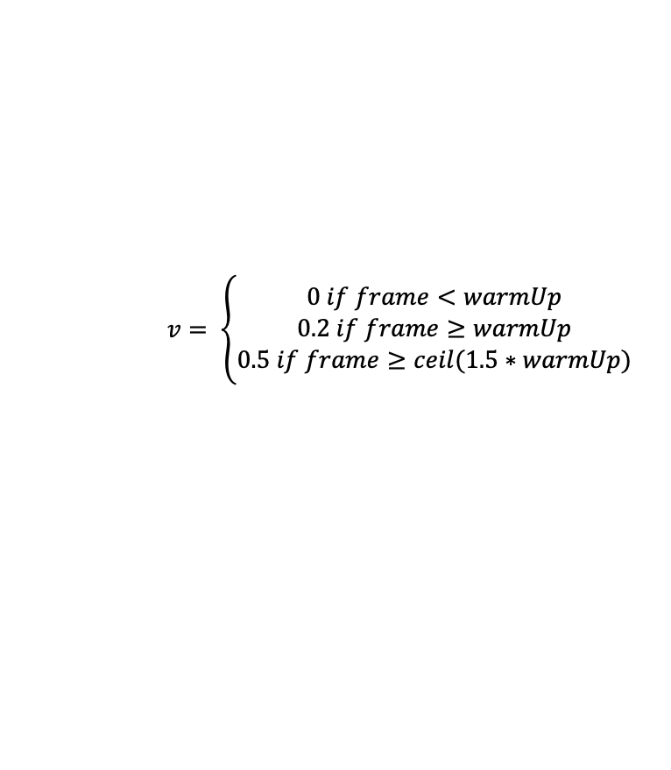

Improvements in data association
Kalman Filter. Warm-up
After warm-up
IoU distances are weighted (tracks and Kalman estimations)
$$IoU weighted=\left(1−v\right)∗iou_tracks+v∗iou_kalman_estimations$$
$v configuration$:
After Warm-up
$$v= \left\{\begin{aligned}0 if frame<warmUp \\ 0.2 if frame≥warmUp \\ 0.5 if frame≥ceil(1.5∗warmUp)\end{aligned}\right.$$
Distance IoU tracks
Data Association
Distance IoU Kalman estimations
IoU weighted

Slide 6
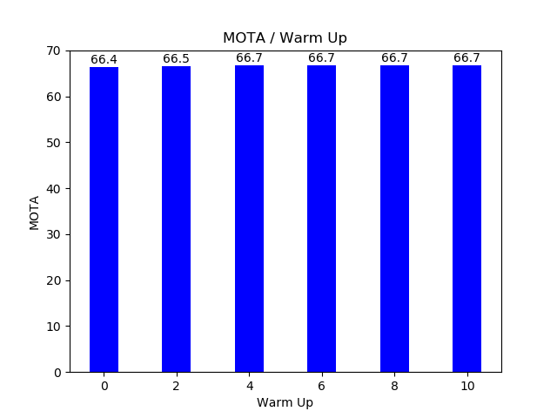
Improvements in data association
Kalman Filter. Warm-up
Tests with differents Warm-ups
A Warm-up greater than or equal to 4 is necessary.
The result of MOTA without the Kalman filter is 66.7%:
It is the same result as using the filter with a warm-up equal to 4.
Best results

Slide 7
Improvements in tracker creation and deletion
Patient Init / Remove
Tracker Creation: Patient Init
Wait to initialize the tracker
Robustness to miss-detected objects by the detector.
Tracker Deletion: Patient Remove
Save the tracker some frames
Robustness to small occlusions.
Robustness to non-identification of an object from the object detector in a frame.​
Avoid false positives detections
Avoid false negatives detections

Slide 8
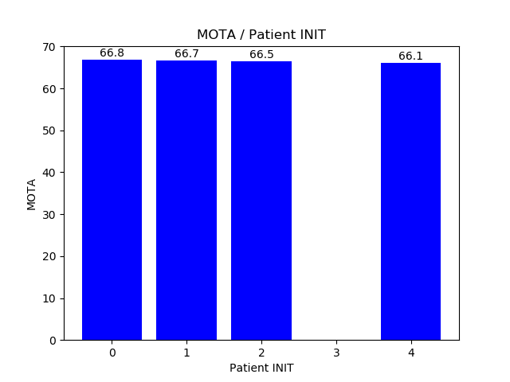
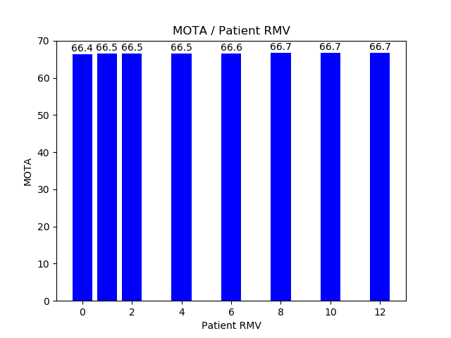
Improvements in tracker creation and deletion
Tests
Tracker Creation: Patient Init
Tracker Deletion: Patient Remove
More robust
More robust

Slide 9
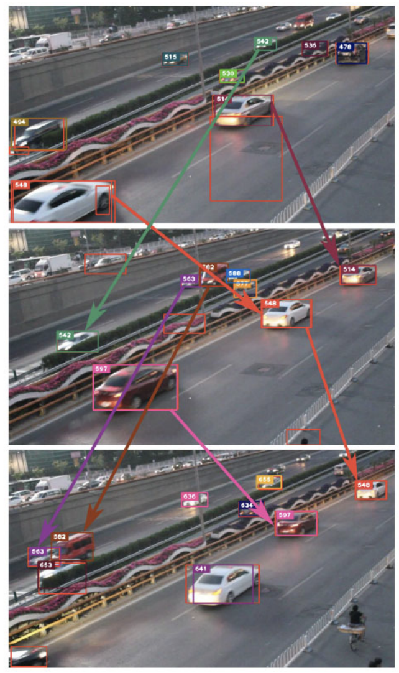
Improvements in data association
Deep Features - Intuition
Idea borrowed from DeepSORT.
We only based our estimations of inter frame association on the position. But, what about spatial features?
Hypothesis: Given a track collected in frame t-1, if the track still present in frame t, then the appearance should not change much.
Solution:
Step 1: Add a feature extractor to the tracker (ResNet-50), and for each track, save the last N features obtained from past frames.
Step 2: Then, for each detection, extract features and compare them to all the features from past frames using cosine distance.
Step 3: Select the detection with less cost from all the saved features from past frame for one track.
Step 4: Repeat this process for all detections and all tracks.
X. Hou, et al, "Vehicle Tracking Using Deep SORT with Low Confidence Track Filtering," AVSS 2019

Slide 10
Improvements in data association
Deep Features – Details on implementation
Hard to implement since a lot of computations are made.
Lots of loops to iterate between tracks, bounding boxes, N features stored for each track... not optimal!
Functional programming (map –reduce) to reduce computation overhead. Along with vectorial operations in PyTorch.
At first, just to process MOT16-05 sequence it would last 40 mins! After introducing functional programming, roughly 1 min 10 sec.
Update the cost matrix:
$Final Cost=\left(λ\right)·IoU weighted+\left(1−λ\right)·Deep Features Cost$ with $λ$ = 0.4

Slide 11
Improvements in object detection
Models Fine-tuning & NMS parameter
Not-Successful:
Faster – RCNN model finetuning – No improvement achieved, already performs well.
Mask – RCNN model finetuning - Synthetic Mask creation using bounding boxes, not good with occluded objects.
DINO (SOTA object detector based on transformers) – Hard to run, the instructions for fine-tuning are not clear on the GitHub repository.
Successful:
Search for an optimal NMS. Gave us a better MOTA (marginal improvement)
NMS | AP Score (%) | Precision(%) | Recall(%) | TP | FP
0.2 | 82.47 | 93.75 | 86.86 | 74483 | 4964
0.25 | 83.17 | 93.01 | 89.67 | 75784 | 5276
0.3 | 86.08 | 92.25 | 91.67 | 78607 | 6598
0.36 | 86.8 | 91.25 | 93.3 | 79832 | 7655
0.4 | 87.0 | 89.9 | 94.17 | 80753 | 9067

Slide 12
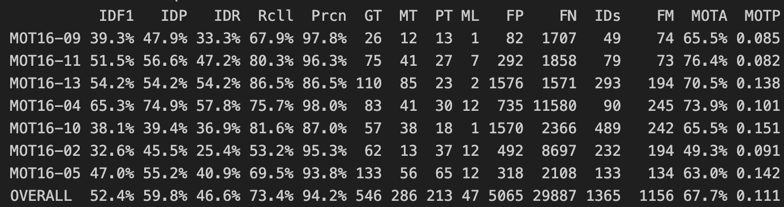
Selection of the best hyperparameters and results
Final Set-up
Hungarian Algorithm
Warm-Up -> 4
Patient Init -> 0
Patient Remove -> 10
Δt Kalman -> 1
Deep Features
NMS -> 0.36

Slide 13
Conclusions
The Hungarian algorithm was the steppingstone for our tracker.
Kalman filter was hard to optimize, sometimes even counter-intuitive in the way it behaved.
Patience for removing and adding tracks can help with the FP and FN, but in a marginal way.
Hyper-parameter tuning is a costly job, but rewarding if done right.
Optimizing computational resources can give a lot of benefits: less time running, more time for experiments!
Deep Features works well, but we expected to work better…
Although results are not what we would have expected, we had fun developing the tracker!

Slide 14
Thank you for your attention!

Slide 15
References
X. Hou, et al, "Vehicle Tracking Using Deep SORT with Low Confidence Track Filtering," AVSS 2019
Wojke, et al, “Simple Online and Realtime Tracking with a Deep Association Metric”, 21 Mar 2017

Slide 16
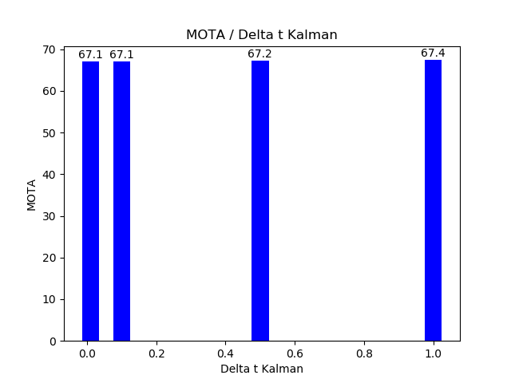
Improvements in data association
Kalman Filter. Δt de Kalman
Tests with differents Δt (less than 1)
Best result

Slide 17
Failed Experiments
Mask - RCNN
e

Slide 18
Failed Experiments
Transformers (modelo)
e

Slide 19
Failed Experiments
Ground-truth in the segmentation
e

Slide 20
Conclusion
e

