Slide 1

Challenge “Developing a multi-object tracker”
Deep Learning for Video Signal Processing
Javier Muñoz Manuel Otero

Slide 2
Outline
Improvements in data association
Hungarian algorithm
Kalman Filter
Improvements in tracker creation and deletion
Patient Init
Patient Remove
Improvements in object detection
Fine-tuning Faster R-CNN. NMS
Selection of the best Hyperparameters and results

Slide 3
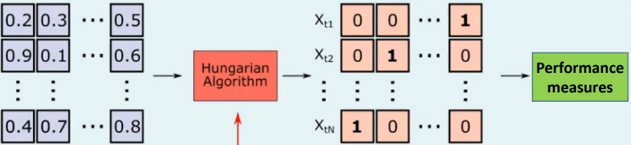
Improvements in data association
Hungarian algorithm
Optimal allocation algorithm
Objective: Minimize cost
Improves results significantly
Hungarian Algorithm
Performance measures
Image credit: Aljosa Osep, TUM, Germany

Slide 4
Improvements in data association
Kalman Filter
Obtain an accurate estimate of the true state of a tracked object
The Kalman filter needs several frames to adapt to the movement of the tracked object
Not reliable at first initialization
We have created the Warm-up parameter
Before Warm-up
After Warm-up
Distance IoU tracks
Distance IoU tracks
Data Association
Data Association
Distance IoU Kalman estimations
weighing

Slide 5
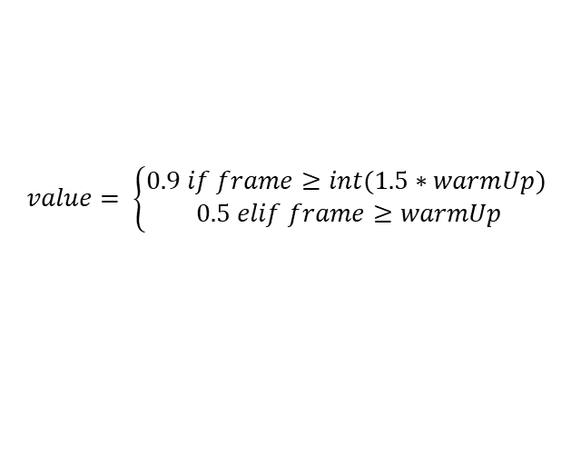
Improvements in data association
Kalman Filter. Warm-up
After warm-up (filter is updated)
IoU distances are weighted (tracks and Kalman estimations)
$$IoU weighted=\left(1−value\right)∗tracks+value∗kalman estimations$$
$$value= \left\{\begin{aligned}0.9 if frame≥int(1.5∗warmUp) \\ 0.5 elif frame≥warmUp\end{aligned}\right.$$
After Warm-up
Distance IoU tracks
Data Association
Distance IoU Kalman estimations
IoU weighted

Slide 6
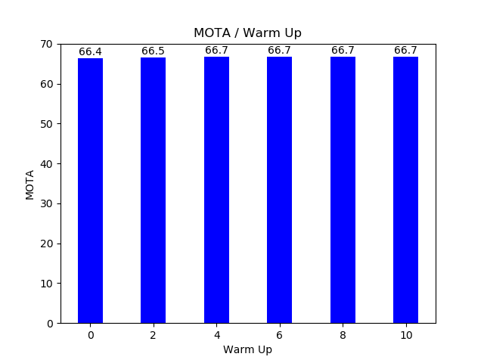
Improvements in data association
Kalman Filter. Warm-up
Tests with differents Warm-ups
A Warm-up greater than or equal to 4 is necessary
The result of MOTA without the Kalman filter is 66.7%
It is the same result as using the filter with a warm-up equal to 4
Best results

Slide 7
Improvements in tracker creation and deletion
Patient Init / Remove
Tracker Creation: Patient Init
Wait to initialize the tracker
Robustness to objects misdetected by the object detector
Tracker Deletion: Patient Remove
Save the tracker some frames
Robustness to small occlusions
Robustness to non-identification of an object from the object detector in a frame​
Avoid false acceptances in trackers
Avoid false rejections in trackers

Slide 8
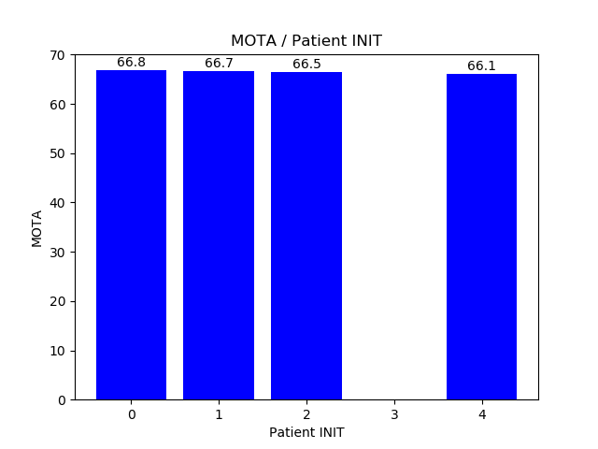
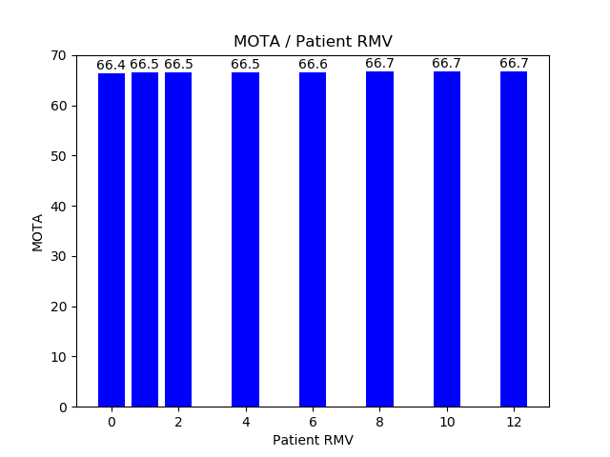
Improvements in tracker creation and deletion
Tests
Tracker Creation: Patient Init
Tracker Deletion: Patient Remove
More robust
More robust

Slide 9
Improvements in object detection
Fine-tuning Faster R-CNN. NMS
Search for an optimal NMS

Slide 10
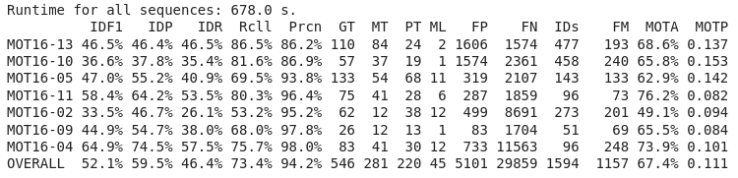
Selection of the best hyperparameters and results
Conclusion
Hungarian Algorithm
Warm-Up -> 4
Patient Init -> 0
Patient Remove -> 10
Δt Kalman -> 1
NMS -> 0.35

Slide 11
References
e

Slide 12
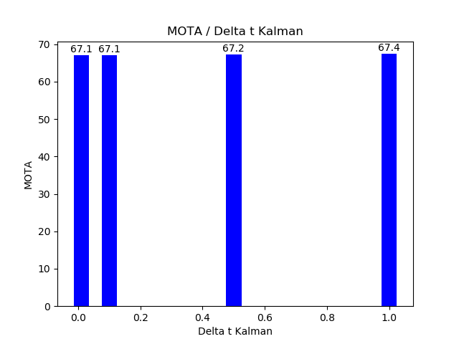
Improvements in data association
Kalman Filter. Δt de Kalman
Tests with differents Δt (less than 1)
Best result

Slide 13
Failed Experiments
Mask - RCNN
e

Slide 14
Failed Experiments
Transformers (modelo)
e

Slide 15
Failed Experiments
Ground-truth in the segmentation
e

Slide 16
Conclusion
e

