Slide 1

Challenge “Developing a multi-object tracker”
Deep Learning for Video Signal Processing
Javier Muñoz Manuel Otero

Slide 2
Outline
Improvements in data association
Hungarian algorithm
Kalman Filter
Kalman Δt
Improvements in tracker creation and deletion
Improvements in object detection
Fine-tuning Faster R-CNN. NMS
Selection of the best Hyperparameters and results

Slide 3
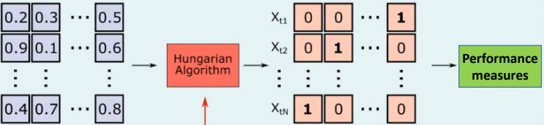
Improvements in data association
Hungarian algorithm
Optimal allocation algorithm
Objective: Minimize cost
Improves results significantly
Hungarian Algorithm
Performance measures
Image credit: Aljosa Osep, TUM, Germany

Slide 4
Improvements in data association
Kalman Filter
Obtain an accurate estimate of the true state of a tracked object
The Kalman filter needs several frames to adapt to the movement of the tracked object
Not reliable at first initialization
We have created the Warm-up parameter
Before Warm-up
After Warm-up
Distance IoU tracks
Distance IoU tracks
Data Association
Data Association
Distance IoU Kalman estimations
weighing

Slide 5
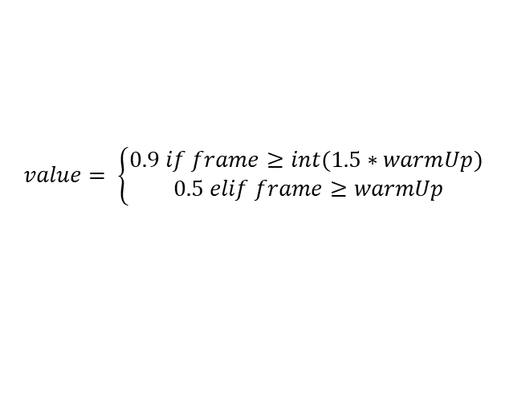
Improvements in data association
Kalman Filter. Warm-up
After warm-up (filter is updated)
IoU distances are weighted (tracks and Kalman estimations)
$$IoU weighted=\left(1−value\right)∗tracks+value∗kalman estimations$$
$$value= \left\{\begin{aligned}0.9 if frame≥int(1.5∗warmUp) \\ 0.5 elif frame≥warmUp\end{aligned}\right.$$
After Warm-up
Distance IoU tracks
Data Association
Distance IoU Kalman estimations
IoU weighted

Slide 6
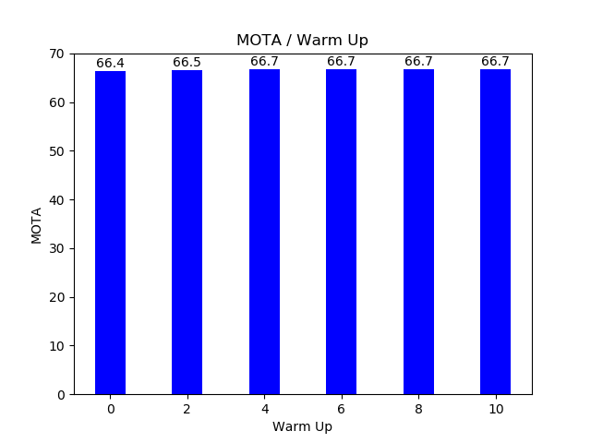
Improvements in data association
Kalman Filter. Warm-up
Tests with differents Warm-ups
A Warm-up greater than or equal to 4 is necessary
The result of MOTA without the Kalman filter is 66.7%
It is the same result as using the filter with a warm-up equal to 4
Best results

Slide 7
Improvements in tracker creation and deletion
Patient Init / Remove
Tracker Creation: Patient Init
Wait to initialize the tracker
Robustness to objects misdetected by the object detector
Tracker Deletion: Patient Remove
Save the tracker some frames
Robustness to small occlusions
Robustness to non-identification of an object from the object detector in a frame​
Avoid false acceptances in trackers
Avoid false rejections in trackers

Slide 8
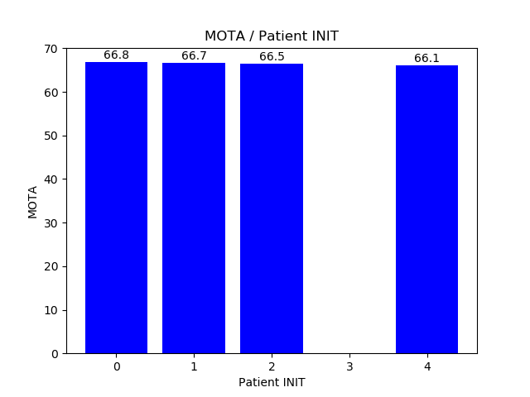
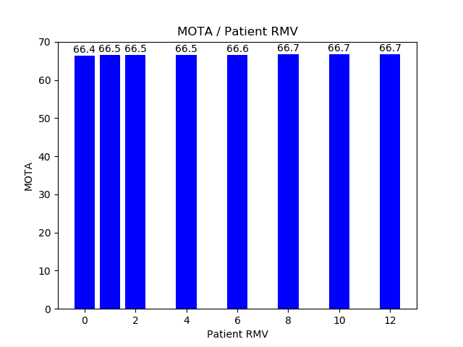
Improvements in tracker creation and deletion
Tests
Tracker Creation: Patient Init
Tracker Deletion: Patient Remove
More robust
More robust

Slide 9
Improvements in object detection
Fine-tuning Faster R-CNN. NMS
Search for an optimal NMS

Slide 10
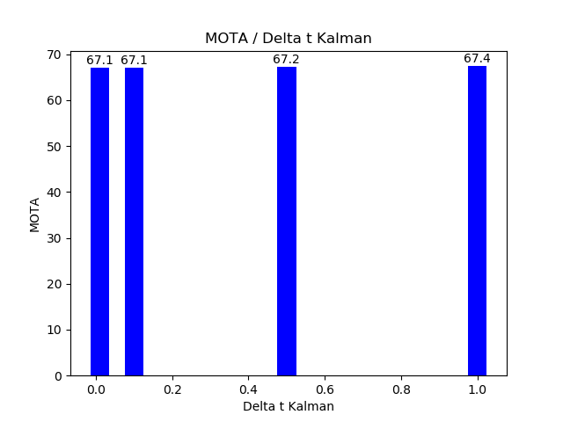
Improvements in data association
Kalman Filter. Δt de Kalman
Tests with differents Δt (less than 1)
Best result

Slide 11
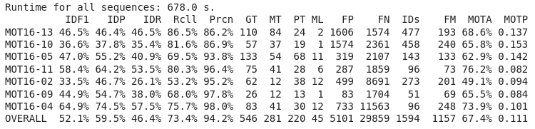
Selection of the best hyperparameters and results
Conclusion
Hungarian Algorithm
Warm-Up -> 4
Patient Init -> 0
Patient Remove -> 10
Δt Kalman -> 1
NMS -> 0.35

Slide 12
References
e

Slide 13
Failed Experiments
Mask - RCNN
e

Slide 14
Failed Experiments
Transformers (modelo)
e

Slide 15
Failed Experiments
Ground-truth in the segmentation
e

Slide 16
Conclusion
e

