Slide 1

Challenge “Developing a multi-object tracker”
Deep Learning for Video Signal Processing
Javier Muñoz Manuel Otero

Slide 2
Outline
Improvements in object detection
Fine-tuning Faster R-CNN
Improvements in data association
Hungarian algorithm
Kalman Filter
Failed Experiments
Conclusion

Slide 3
Improvements in object detection
Fine-tuning Faster R-CNN
e

Slide 4
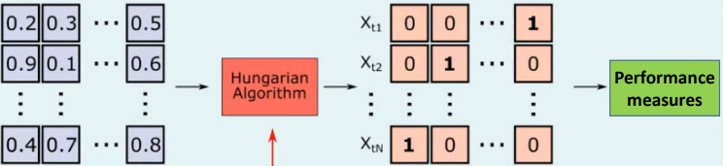
Improvements in data association
Hungarian algorithm
Optimal allocation algorithm
Objective: Minimize cost
Improves results significantly
Hungarian Algorithm
Performance measures
Image credit: Aljosa Osep, TUM, Germany

Slide 5
Improvements in data association
Hungarian algorithm
Image credit: Aljosa Osep, TUM, Germany

Slide 6
Improvements in data association
Kalman Filter
Obtain an accurate estimate of the true state of a tracked object
The Kalman filter needs several frames to adapt to the movement of the tracked object
Not reliable at first initialization
We have created the Warm-up parameter
Before Warm-up
After Warm-up
Distance IoU tracks
Distance IoU tracks
Data Association
Data Association
Distance IoU Kalman estimations
weighing

Slide 7
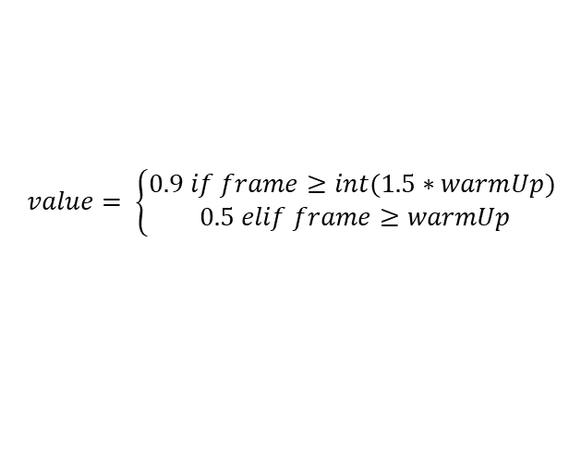
Improvements in data association
Kalman Filter
After warm-up (filter is updated)
IoU distances are weighted (tracks and Kalman estimations)
$$IoU weighted=\left(1−value\right)∗tracks+value∗kalman estimations$$
$$value= \left\{\begin{aligned}0.9 if frame≥int(1.5∗warmUp) \\ 0.5 elif frame≥warmUp\end{aligned}\right.$$
After Warm-up
Distance IoU tracks
Data Association
Distance IoU Kalman estimations
IoU weighted

Slide 8
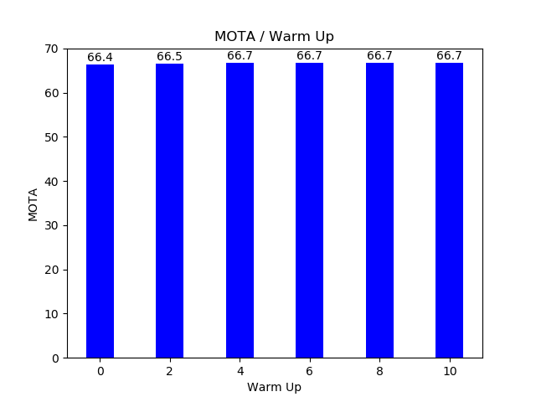
Improvements in data association
Kalman Filter.
Tests with differents Warm-ups
A Warm-up greater than or equal to 4 is necessary
The result of MOTA without the Kalman filter is 66.7%
It is the same result as using the filter with a warm-up equal to 4
Best results

Slide 9
Improvements in tracker creation and deletion
Patient Init / Remove
Tracker Creation: Patient Init
Wait to initialize the tracker
Robustness to objects misdetected by the object detector
Tracker Deletion: Patient Remove
Save the tracker some frames
Robustness to small occlusions
Robustness to non-identification of an object from the object detector in a frame​
Avoid false acceptances in trackers
Avoid false rejections in trackers

Slide 10
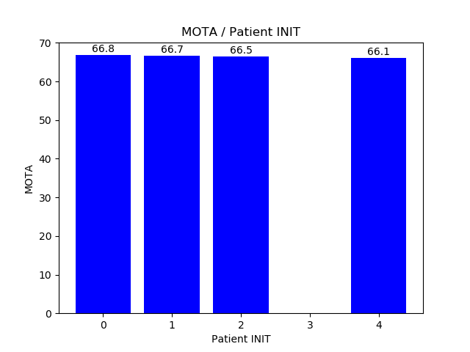
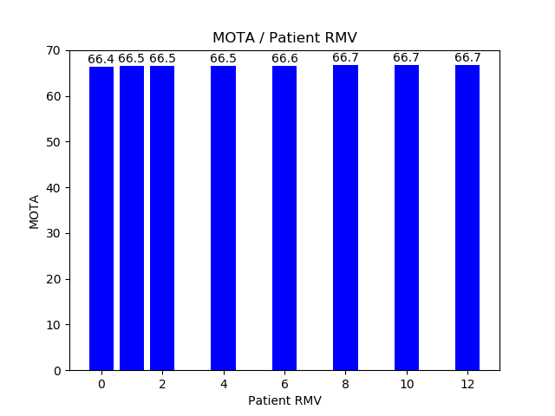
Improvements in tracker creation and deletion
Tests
Tracker Creation: Patient Init
Tracker Deletion: Patient Remove
More robust
More robust

Slide 11
Failed Experiments
Mask - RCNN
e

Slide 12
Failed Experiments
Transformers (modelo)
e

Slide 13
Failed Experiments
Ground-truth in the segmentation
e

Slide 14
Conclusion
e

Slide 15
References
e

