Slide 1

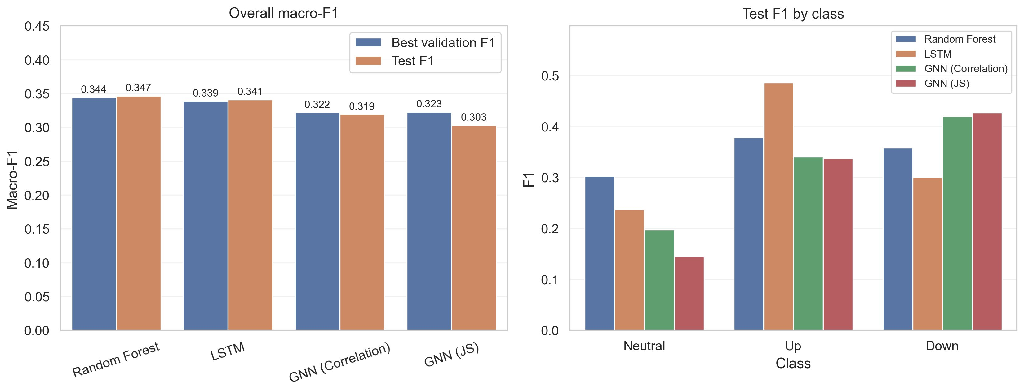




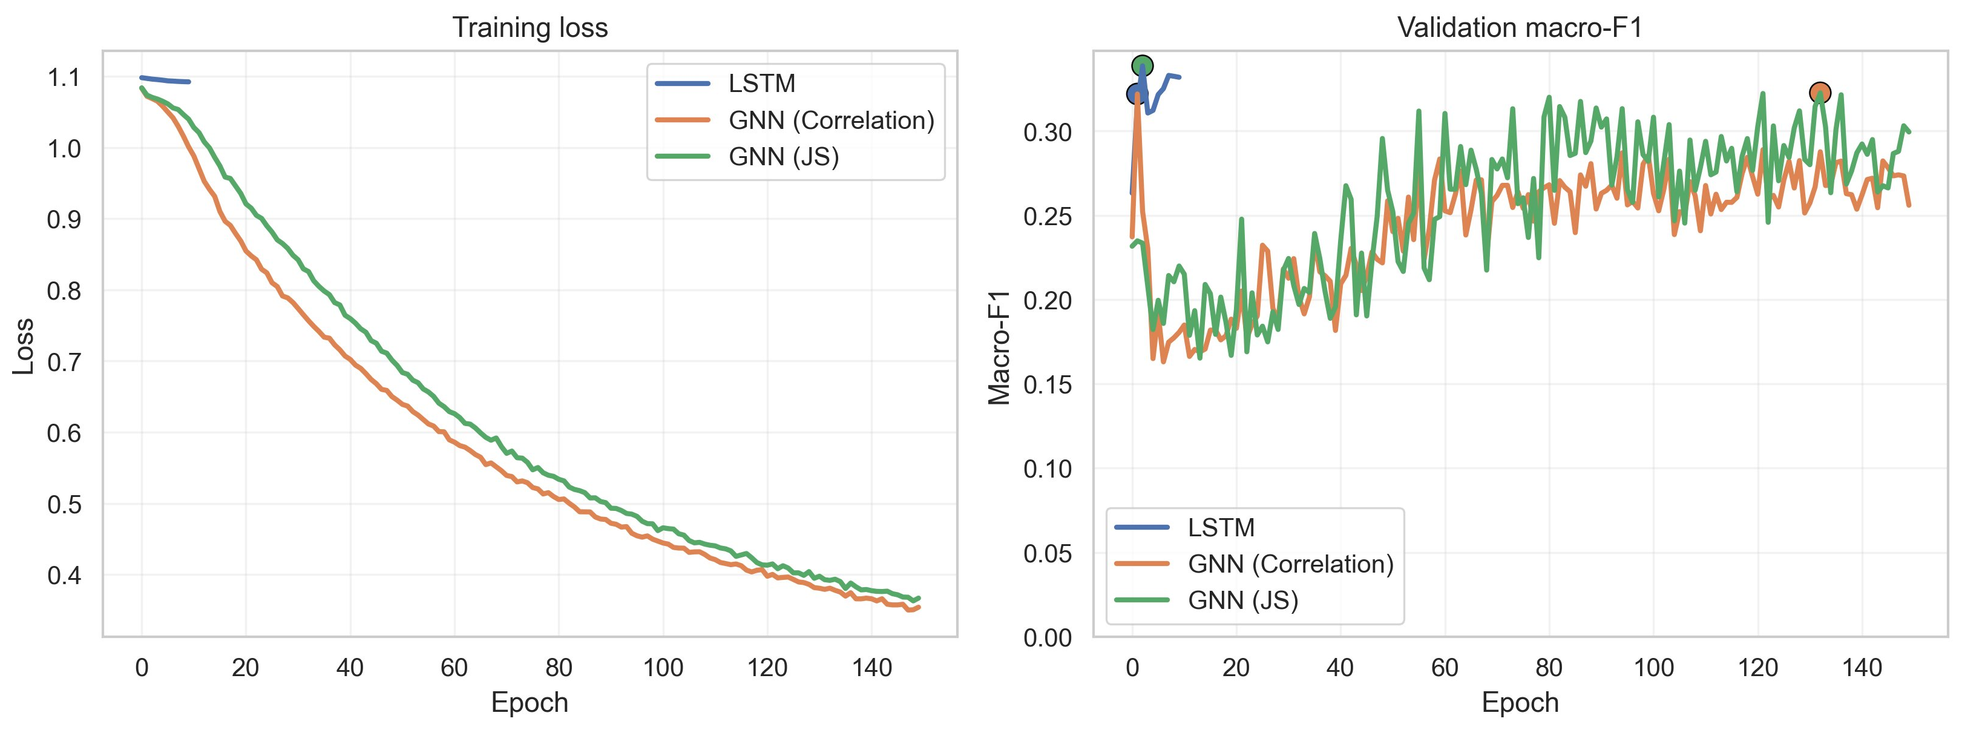

Does Graph Geometry Help Forecasting S&P 100 Stocks?
Geometric Deep Learning · Oral Defense
Static graph structure did not outperform simpler baselines in noisy weekly stock movement prediction.
METHODOLOGY
RESULTS
Yahoo Finance
OHLCV, 2021-2025
Features & Labels
BEST TEST MACRO-F1
Rolling technicals, weekly returns
Random Forest
0.347
✓ Best
Models
RF · LSTM · Corr-GNN · JS-GNN
LSTM
0.341
✓ Best
Graph Neural Network variants:
Test macro-F1 and class-wise F1 across models
GNN-Correlation
0.319
Corr-GNN
Top-5 Pearson return neighbors
GNN-JS
0.303
JS-GNN
Top-5 Jensen-Shannon neighbors
+ Sector edges on all graph variants
🔒 Graphs built from train split only
Training loss and validation macro-F1 over epochs
① Graph inductive bias did not improve performance in this setup.
② Static financial graphs are likely too noisy and non-stationary.
③ Next: dynamic graphs, learned edges, richer market signals.

