Slide 1

MOBILE PLAN ANALYSIS
An analysis of MOBILE PLANs using Java
Group Number: 5
By: Chirayu Baliyan (110167380), Nilkanth Suthar (110160785), tushar sharma (110162072), Yuchen liu (110176225), javith hussain Shareef(110165595),

Slide 2
Role of each member
Team Member | Roles
Chirayu Baliyan | Spell Checking, Web Parsing
Nilkanth Suthar | Search Frequency, Frequency count
Tushar Sharma | Word Completion, Search count
Yuchen Liu | Page ranking, Inverted Indexing
Javith Hussain | Web Crawling, Data Validation

Slide 3
Roles and their description

Slide 4
Javith Hussain: Web Crawling, Data Validation
Javith played a pivotal role in the project by leading the web crawling efforts. Using advanced tools like Selenium and Jsoup, he simulated user inputs to crawl and collect data on various mobile carriers, such as Rogers, Bell, and Telus. His meticulous work ensured the comprehensive collection of HTML pages and plan details, capturing essential information such as plan type, data allowance, and monthly costs. Additionally, Javith implemented robust data validation and analysis mechanisms, ensuring the accuracy and reliability of user data, which facilitated insightful comparisons and informed decision-making for mobile plan selection.

Slide 5
Nilkanth Suthar: Web Parsing, Inverted Indexing
Nilkanth excelled in web parsing and plan ranking, contributing significantly to the project's data processing and analysis phase. Leveraging the Jsoup library, he efficiently parsed HTML pages, extracting essential mobile plan details and mapping them to the "PlanInfo" object. This recursive process was applied to all carrier plans, resulting in the creation of a structured JSON file, "filtered_mobile_plans.json." Tanzeel also implemented a sophisticated plan ranking system using a Priority Queue, providing a meaningful order to the mobile plans based on their relevance and user preferences.

Slide 6
Chirayu Baliyan: Frequency Count, Spell Checking
Chirayu brought expertise to multiple facets of the project. His contributions included implementing a frequency count mechanism using Jackson's ObjectMapper and Java's HashMap, providing insights into the popularity of different mobile plans. Additionally, Chirayu implemented a spell-checking feature using a Trie data structure with insert and search operations, ensuring accuracy in textual data for mobile plan analysis.

Slide 7
Tushar Sharma: Word Completion, Search count
Tushar's focus on enhancing user experience was evident in their roles. Tushar implemented a word completion feature using a Trie data structure with an edit distance algorithm, offering users suggestions for mobile plan search queries. Additionally, Tushar worked on search frequency functionality, employing a TreeMap to track and present the number of previous searches done for specific features or keywords. Their contributions aimed at improving user interaction and search efficiency in mobile plan analysis.

Slide 8
Yuchen Liu: Page Ranking, Inverted Indexing
Yuchen Liu's focus on enhancing user experience was evident in their roles. Yuchen Liu implemented a page ranking system using a Priority Queue to organize mobile plans based on their relevance to user preferences. This ensured that users received the most pertinent plans at the top of their search results. Additionally, Yuchen Liu worked on search frequency functionality, employing a TreeMap to track and present the number of previous searches conducted for specific features or keywords. Their contributions significantly improved user interaction, search efficiency, and the overall relevance of search results in mobile plan analysis.

Slide 9

Outline of the project
Mobile plan price analysis is a project that aims to extract the best plans from various mobile network providers and present them in a structured and user-friendly format.
The five websites used here for demo are
Rogers
Bell
Telus
Koodo
Freedom

Slide 10
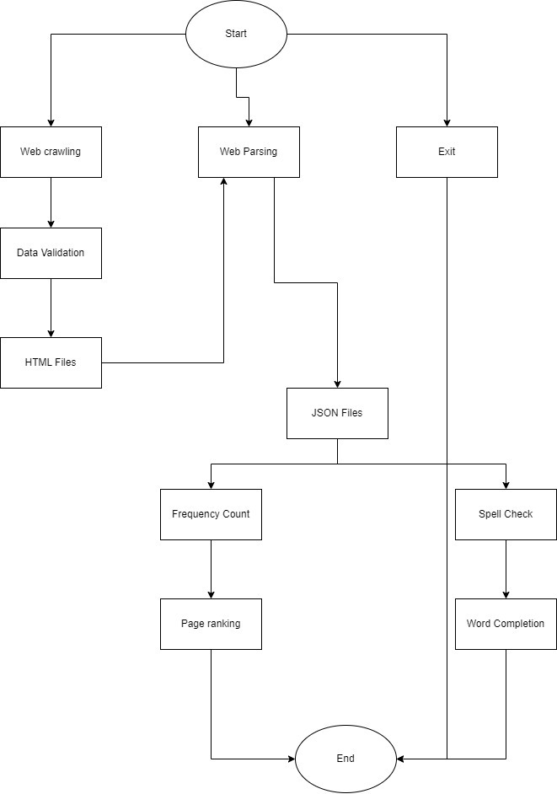

Slide 11
Features implemented
Web Crawling
HTML Parser
Page Ranking
Word Completion
Search Frequency
Data Validation Using Regex
Spell Checking

Slide 12
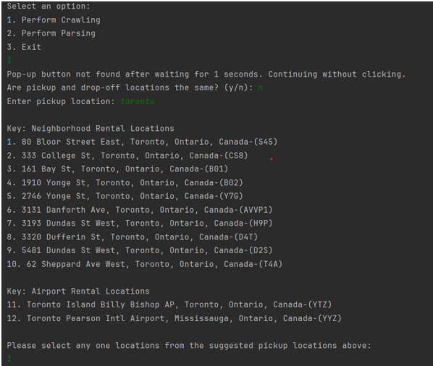
Feature Implementation
Web crawling systematically navigates websites for data extraction.
Selenium was utilized to simulate various user inputs such as selecting carrier services, plan types, monthly cost ranges, and specific data features. HashMaps and lists were employed to display similar mobile plan suggestions across multiple carriers, enabling users to make informed choices.
All three crawling class stores the .html page that is fetched from the website for all the available car deals based on the user preference: city, date, time
In the "ByteBuds.java" file, the system initializes multiple drivers to fetch data from all carrier websites concurrently, ensuring efficient and precise data retrieval for user-specified preferences.

Slide 13
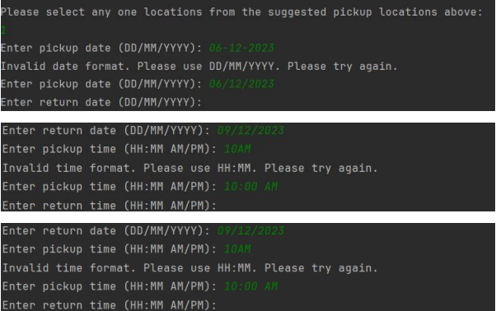
Feature Implementation
Data validation using regular expressions is performed to ensure the correct format of user inputs.
Four distinct Regex patterns validate carrier names, plan types, monthly costs, and data allowances.
The implemented algorithm uses the Pattern class from the Java standard library to match input strings against the specified patterns.
The code prompts users to enter information for analyzing mobile plans, continuously validating inputs until correct formats are provided.

Slide 14
Feature Implementation
HTML Parsing involves extracting information from HTML files.
The implementation utilizes Jsoup for parsing and Jackson Objectmapper for data extraction.
Using the Jsoup parser, it extracts the required data from the web elements and maps it to the "MobilePlanInfo" object. This process is repeated recursively for all the plans in the HTML page, storing the data in separate text files like "rogers_extracted_plans.txt", "bell_extracted_plans.txt", and "freedom_extracted_plans.txt“
In the "MobileDataParser.java" file, the parser class processes all available *.html files, applies filters, and generates structured JSON files to present the best mobile plans based on user-defined criteria.

Slide 15
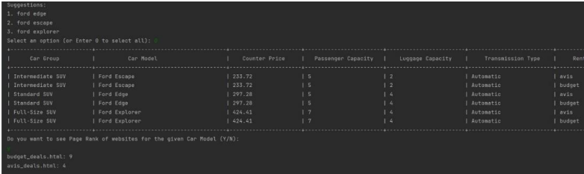
Feature Implementation
Page Ranking utilizes a basic ranking approach, primarily based on document frequencies.
It employs a map for page scores and a priority queue for sorting entries.
In the MobileDataPlanAnalysisCLI file, inside the filterByPlanName method, after users are displayed the mobile plans with filtered plan names, they are prompted to check page ranking for the given plan name. The PageRanking class is used by providing it with a keyboard, and it displays the plans in a sorted ranking manner.

Slide 16
Feature Implementation
Search Frequency uses a TreeMap to track and sort the search frequency of mobile plan names.
It employs methods to incrementally update counts and sort the list by frequency.
Fetches the number of previous searches performed for the specific feature or keyword given.
In MobileDataPlanAnalysisCLI file, inside the filterByPlanName method, when the user is asked to input a plan name to filter based on the plan.
Word Completion implements a word completion system using a Trie data structure.
The Trie efficiently stores and suggests words based on user input. The algorithm calculates edit distances for sorting suggestions.
Fetches all words with the given prefix by traversing all child nodes from the returned node by findNode, then it uses Levenshtein Distance Calculation to sort the suggestion list with the lowest edit distance being first.

Slide 17
Feature Implementation
Spell Checking class utilizes a Trie to efficiently store and retrieve words for spell checking.
It initializes the tree nodes with the words that are given in the *.json file.
After initializing the tree, the search operation can be used to check if such word exits in the tree or not by passing a keyword.

Slide 18
Conclusion
Challenges:
Overcoming intricacies in web crawling, including handling dynamic elements and pop-ups.
Addressing complexities in data parsing and ensuring accurate extraction of information from HTML pages.
Web pages may contain noise, irrelevant tags, or misleading information that could affect the accuracy of the extracted data
Future Scope:
Enhancing the project's scalability to include additional mobile carrier websites and diverse data sources.
Implementing advanced machine learning algorithms for personalized recommendations based on user preferences.

Slide 19
Project Acknowledgments
Professor Dr. Olena Syrotkina
For guidance, mentorship, and valuable insights throughout the project.
Graduate Assistant
Darpan Khanna
For aiding, support, and contributing to the success of the project.
Class Collaboration
Acknowledgment to the collaborative efforts of the entire class in sharing ideas and knowledge.

Slide 20
Thank you

