Slide 1
LECTURE 5

Slide 2
Control Structures
  Repetition structures
  Many application require certain operations to be carried out more than once. Such situations require repetition in control flow.
  C++ has three types while, do/while, for
  While Selection Structure: An action to be repeated while some conditions remains true.
  Do/While Selection Structure: . Similar to while structure.
  Tests the loop continuation after the loop body is performed.
  while structure the loop continuation condition is tested at the beginning of the loop before the body of loop is performed.

Slide 3
while Repetition Structure
Action repeated while some condition remains true.
When an action must be repeated a loop is used.
While loop syntax
while (boolean expression is true)
{
statements to repeat ; //braces are required for compound statement
statements to repeat ;.
}
While (boolean expression is true)
statement to repeat; // no braces are required for single statement

Slide 4
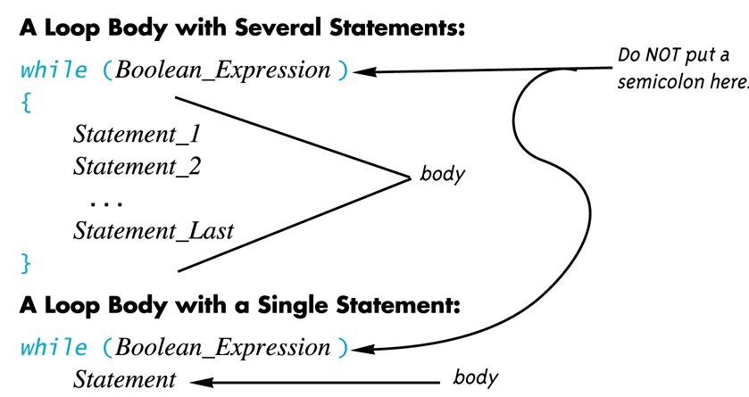
While Statement Syntax

Slide 5
While Repetition Structure
Flow chart
no
condition
yes
Statements in
Loop body

Slide 6
While loop Operation
First, the condition is evaluated
  If true, the body of the loop is executed and the control is transferred back to the condition for re-evaluation
    During execution, some item from the Boolean expression is changed
  If false, the while loop is exited and control is transferred to the statement after the while loop body.
A while loop might not execute at all if the Boolean expression is false on the first check

Slide 7
While Repetition Structure
  Psuedocode example
    while there are more items on my shopping list
    Purchase next item and cross it off my list
  while loop repeated until condition becomes false
  Condition there are more items on my shopping list is either true or false.
  If true, the action “Purchase next item and cross it off my list” is performed.
  The action will be performed repeatedly while the condition remains true.
  The condition will become false when the last item on the list is purchased and crossed of the list. The repetition will terminate.
  Then the first statement after the repetition structure is executed.

Slide 8
While Repetition Structure
Example statement
Consider a program segment designed to find the first power of 2 larger than 1000.
Suppose the integer variable product has been initialized to 2.
When while repetition structure finishes executing.
Product will contain the desired answer.
Lets observe the flow chart and the C++ code.

Slide 9
While Repetition Structure
Flow chart
C++ Code
      int product = 2;
      while ( product <= 1000 )
      product = 2 * product;
true
product <= 1000
product = 2 * product
false

Slide 10
Explanation
In the previous example the value of product is 2 when the while structure is entered.
The variable product is repeatedly multiplied by 2, taking values 4, 8, 16, 32, 64, 128, 256, 512, 1024.
At product = 1024 the while structure condition product<=1000, becomes false.
This terminates the repetition.
Observe that the final value of product is 1024.

Slide 11
example to print greetings using while repetition structure
//a while loop example
//program to print the hello greetings
//user give the number of times hello greeting to be printed.
#include <iostream.h>
int main()
{
int count_down; //declaring count_down as an integer variable
cout<<"How many greetings do u want\n"; //prompt user to enter the number for greetings
cin>>count_down; //reading value this value gives number of times greeting will appears
while(count_down > 0) //while loop condition, if countdown is greater than zero
{
cout<<"HELLO!\t"; //printing hello
count_down = count_down - 1; //decrementing the value in count_down (counter) by 1
} //while body ends here
cout<<endl;
cout<<"thats all \n"<<"have a great day";
return 0;
}

Slide 12
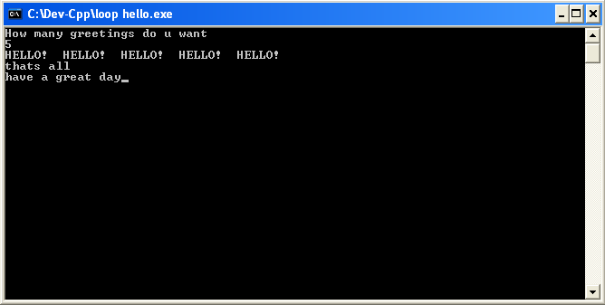
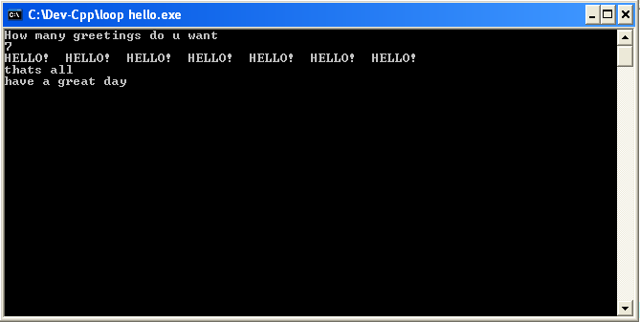
Out put for two different inputs
Input = 5
Printing hello 5 times
Input = 7
Printing hello 7 times

Slide 13
Counter Control Repetition
  Loop is repeated until counter reaches certain value.
  Number of repetitions known before the loop begins executing (Definite repetition).
  Counter variables should be initialized before the loop begins.
  An uninitialized counter may contain a garbage (undefined) value and the result of the program could be incorrect (LOGIC ERROR).
  Counter variables are normally initialized to zero, one or the heights value, depending on their use.

Slide 14
Essentials of Counter-Controlled Repetition
Counter-controlled repetition requires:
  Name of control variable/loop counter
  Initial value of control variable
  Condition to test for final value
  Increment/decrement to modify control variable when looping

Slide 15
Counter control repetition
//Consider a simple example to understand counter controlled //repetition structure.
//print 1 to 100 using a while loop
#include <iostream.h>
int main()
{
int count; //declaration of control variable count
count=1; //initialization of control variable
while (count<=100) //while count is less than 100 program will print the count
{
cout<<count<<“\t”;
count=count+1 //add one to the count every time the loop repeats.
} /*when count is greater than 100 then the loop will
terminate and the statement next to the while loop will execute*/
Return 0; //indicated successful termination
} //end of function main

Slide 16
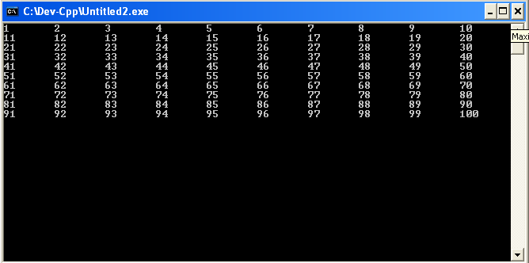
Output

Slide 17
Formulating algorithm with top down step wise refinement
To write a program
  Develop the algorithm that the program will use.
  Translate the algorithm into the programming language
Top Down Design
(also called stepwise refinement)
  Break the algorithm into subtasks
  Break each subtask into smaller subtasks
  Eventually the smaller subtasks are trivial to implement in the programming language

Slide 18
Formulating Algorithm with Top Down Step Wise Refinement.
Many programs have three phases
  Initialization
    Initializes the program variables
  Processing
    Input data values, adjusts program variables accordingly.
  Termination
    Calculate and print the final results
  Helps break up programs for top-down refinement

Slide 19
Benefits of Top Down Design
  Easier to understand
  Easier to change
  Easier to write
  Easier to test
  Easier to debug
  Easier for teams to develop

Slide 20
Counter Control Repetition Example
Example statement
Write a program to determine the average of a class grades, total number of students in class is 10.
Pseudocode
    Set total to zero
    Set grade counter to one
    While grade counter is less than or equal to ten
    Input the next grade
    Add the grade into the total
    Add one to the grade counter
    Set the class average to the total divided by ten
    Print the class average

Slide 21
Top-down Stepwise Refinement
Pseudocode
Initialization
      Initialize total to zero
      Initialize counter to zero
Processing
    While grade counter is less than or equal to ten
    Input the next grade
    Add the grade into the total
    Add one to the grade counter
Termination
    When grade counter is greater than 10
    Set the class average to the total divided by ten
    Print the class average

Slide 22
C++ code
// example
// Class average program with counter-controlled repetition.
#include <iostream.h>
// function main begins program execution
int main()
{
int total; // sum of grades input by user
int gradeCounter; // number of grade to be entered next
int grade; // grade value
int average; // average of grades
// initialization phase
total = 0; // initialize total
gradeCounter = 1; // initialize loop counter

Slide 23
C++ code
21 // processing phase
22 while ( gradeCounter <= 10 ) { // loop 10 times
23 cout << "Enter grade: "; // prompt for input
24 cin >> grade; // read grade from user
25 total = total + grade; // add grade to total
26 gradeCounter = gradeCounter + 1; // increment counter
27 }
28
29 // termination phase
30 average = total / 10; // integer division
31
32 // display result
33 cout << "Class average is " << average << endl;
34
35 return 0; // indicate program ended successfully
36
37 } // end function main
38 //observe the output on next slide
The counter gets incremented each time the loop executes. Eventually, the counter causes the loop to end.

Slide 24
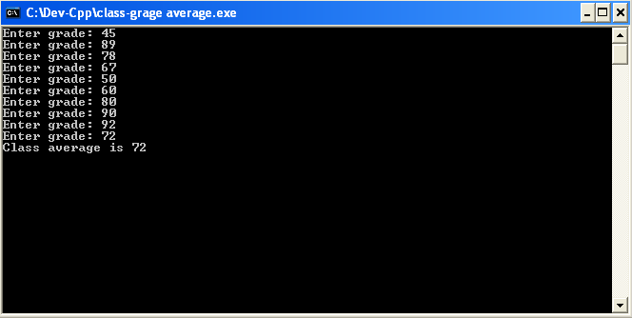
output
Note that total is 723
Average = 723 / 10 = 72.3(floatin point number)
Program produce an integer result 72,
because average is identified as integer type
To deal with such situation we use the explicit conversion which we will discuss latter.

Slide 25
Sentinel-Controlled Repetition
Also called indefinite repetition.
  The number of repetitions is not known before the loop begins executing.
  unknown number of inputs to the loop.
  Requires a sentinel value (to indicate end of data entry) to quit the loop.
Sentinel value
  Also called dummy value, signal value or a flag value.
  Indicates “end of data entry”
  Loop ends with sentinel input
  Sentinel value should be chosen so that it cannot be confused with an acceptable data value.
    For example (-1) in case of grade example.
    As -1 is not going to be any grade (grade is only + value) so this can be used to quit the loop.
Notes:
Sennaal

Slide 26
Formulating algorithm with top-down refinement of sentinel-controlled repetition
Suppose problem (finding average of class grades) becomes:
  Develop a class-averaging program that will process an arbitrary number of grades each time the program is run
  Unknown number of students
Top-down, stepwise refinement
pseudo code
  Begin with pseudocode representation of top
      Determine the class average for the quiz
  Divide top into smaller tasks, list in order
      Initialize variables
      Input, sum and count the quiz grades
      Calculate and print the class average

Slide 27
pseudocode and top-down stepwise refinement
Initialization phase
      Initialize variables
        goes to
      Initialize total to zero
      Initialize counter to zero
Processing
  Input, sum and count the quiz grades
        goes to
    Input the first grade (possibly the sentinel)
    While the user has not as yet entered the sentinel
    Add this grade into the running total
    Add one to the grade counter
    Input the next grade (possibly the sentinel)

Slide 28
pseudocode and top-down stepwise refinement
Termination
    Calculate and print the class average
        goes to
    If the counter is not equal to zero
    Set the average to the total divided by the counter
    Print the average
    Else
    Print “No grades were entered”
Observe C++ code on the next slides

Slide 29
C++ code
1 // grade example for sentinel controlled repitition
2 // Class average program with sentinel-controlled repetition.
3 #include <iostream.h>
4
10 #include <iomanip.h> // parameterized stream manipulators
11
12
13
14 // function main begins program execution
15 int main()
16 {
17 int total; // sum of grades
18 int gradeCounter; // number of grades entered
19 int grade; // grade value
20
21 double average; // number with decimal point for average
22
23 // initialization phase
24 total = 0; // initialize total
25 gradeCounter = 0; // initialize loop counter
Data type double used to represent decimal numbers.

Slide 30
C++ code
26
27 // processing phase
28 // get first grade from user
29 cout << "Enter grade, -1 to end: "; // prompt for input
30 cin >> grade; // read grade from user
31
32 // loop until sentinel value read from user
33 while ( grade != -1 ) {
34 total = total + grade; // add grade to total
35 gradeCounter = gradeCounter + 1; // increment counter
36
37 cout << "Enter grade, -1 to end: "; // prompt for input
38 cin >> grade; // read next grade
39
40 } // end while
41
42 // termination phase
43 // if user entered at least one grade ...
44 if ( gradeCounter != 0 ) {
45
46 // calculate average of all grades entered
47 average = <float >( total ) / gradeCounter;
As dividing two integers truncates the remainder, to deal with it unary cast operator is used. Its general form is <type>(operand)
<float>(total)is used in this program. It creates a temporary floating point copy of operand in the parenthesis.
Here it treats total as a float temporarily (casting). producing a floating point calculation with integer values.
. Using cast operator in this manner is called explicit conversion.
gradeCounter is an int, but it gets promoted to float by the compiler implicitly for the calculation purpose.

Slide 31
C++ code
49 // display average with two digits of precision
50 cout << "Class average is " << setprecision( 2 )
51 << fixed << average << endl;
52
53 } // end if part of if/else
54
55 else // if no grades were entered, output appropriate message
56 cout << "No grades were entered" << endl;
57
58 return 0; // indicate program ended successfully
59
60 } // end function main
setprecision(2)prints two digits past decimal point (rounded to fit precision).
Programs that use this must include <iomanip.h>
fixed forces output to print in fixed point format (not scientific notation). Also, forces trailing zeros and decimal point to print.
Include <iostream>

Slide 32
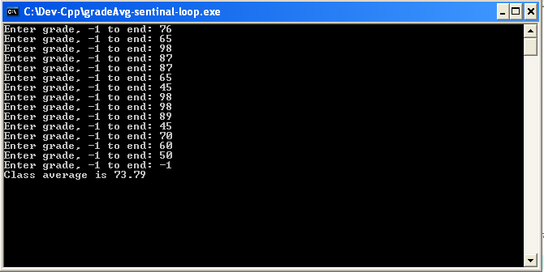
Output
Notice -1 (sentinel value) indicating the end of the data entry.

Slide 33
Difference between the program logic of counter-controlled and sentinel-controlled repetitions considering the grade examples.
Counter-controlled repetition
  The value from the user is read during each pass of while structure for the specified number of passes.
Sentinel-controlled repetitions
  One value was read before the program reached the while structure. Observe program’s line 30 (slide 7).
  This line is to determine if the program’s flow of control should enter the body of while structure.
  If the user first input is the sentinel value the program will not enter the loop, it will simply print “no grades were entered”.

Slide 34
Summary
Selection Structure
  Switch
Repetition structure
  While
  do while
Logical Operators
  And(&&), OR(||), NOT(!)
Next –
    ‘for’ repetition structure, Nested, Example programs

Slide 35
for Repetition Structure
for loop is used when the number of times to be repeated is fixed/known
It handles all the details of the counter controlled repetition
Execution continues as long as the Boolean expression is true
General format of the for loops
  for (initialization; Loop Continuation Test; update)
  {
  statement block;
  }
  Initialization action
    Done only once at the start
    Initialization expression initialize and declare the loop’s control variable e.g. int counter = 1;
    Notice that there is a semi colon after initialization statement

Slide 36
for Repetition Structure
  Loop continuation test
    Is a Boolean expression
    Expression contains the final value of the control variable for which the condition is true e.g. counter <= 10;
    Loop continuation test evaluates to true or false
    If true body of for is executed, else exit for loop
    Notice that there is also a semi colon after loop condition test
  Update
    Specifies how to update condition
    After the execution of the body of the loop, the condition of the loop is updated e.g. counter ++
    Notice that there is no semi colon after updat_action
Example
  for( int counter = 1; counter <= 10; counter++ )
    cout << counter << endl;
  Prints integers from one to ten

Slide 37
Components of typical for header
for keyword
Control variable name
Final value of control variable for which the condition is true
for ( var counter = 1; counter <= 7; ++counter )
Initial value of control variable
Increment of control variable
Loop-continuation condition

Slide 38
Examples Using the for Structure
  Vary control variable from 1 to 100 in increments of 1
    for (int i = 1, i <= 100; i++)
  Vary control variable from 100 to 1 in decrements of -1
    for (int i = 100, i >= 1; i--)
  Vary control variable from 7 to 77 in steps of 7
    for (int i = 7, i <= 77; i += 7)
  Vary control variable from 20 to 2 in steps of -2
    for (int i = 20, i >= 2; i -= 2)

Slide 39
For equivalent while Structure
In most cases, the for structure can be represented by an equivalent while structure as follow
    initialization;
    while ( loop Continuation Test)
    { statement
    increment;}
    for loop in previous example can be rewritten as while loop as following
    int counter = 1; //initialization
    While(counter<=10) //boolean expression to test the loop condition
    {
    cout<<“counter”<<endl; // print the value of counter
    counter++; //incriment counter
    }

Slide 40
Example
Problem statement
Print the integer numbers 1 to 10 on screen using for loop statement
Flowcharting a typical for repetition structure for the example.
Establish initial value of control variable
counter = 1
counter = 1
counter <= 10
true
cout << counter << endl;
counter++
Determine if final value of control variable has been reached
false
Increment
the control
variable
Body of loop
(this may be many statements)

Slide 41
C++ code
1 // example to print numbers 1 to 10
2 // Counter-controlled repetition with the for structure.
3 #include <iostream.h>
4
5
8 // function main begins program execution
9 int main()
10 {
11 // Initialization, repetition condition and incrementing
12 // are all included in the for structure header.
13
14 for ( int counter = 1; counter <= 10; counter++ )
15 cout << counter << endl;
16
17 return 0; // indicate successful termination
18
19 } // end function main

Slide 42
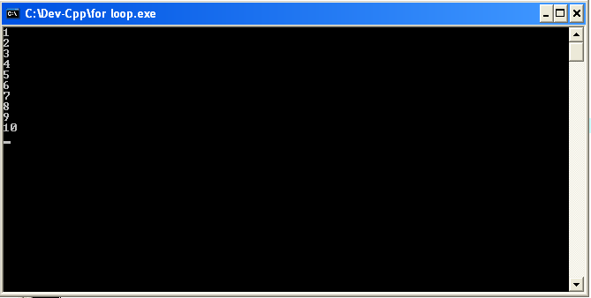
output

Slide 43
Example
Problem statement
“Write a For statement that computes the sum of all even integers up 100.”

Slide 44
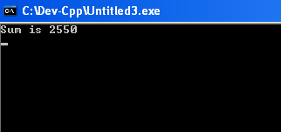
Example
1 // program to sum all even integers from 2 to 100
2 // Summation with for.e
3 #include <iostream.h>
4
5
8 // function main begins program execution
9 int main()
10 {
11 int sum = 0; // initialize sum
12
13 // sum even integers from 2 through 100
14 for ( int number = 2; number <= 100; number += 2 )
15 sum += number; // add number to sum
16
17 cout << "Sum is " << sum << endl; // output sum
18 return 0; // successful termination
19
20 } // end function main
output
Body of for structure can be merged into right most portion of for structure
for ( int number = 2; number <= 100; sum += number, number += 2 )
;
this semi colon should be placed otherwise result would be wrong.
Its not a good programming technique as it makes it difficult to read the program

Slide 45
Using multiple variables in for loop
There may be several variables in the for structure that must be initialized and updated (e.g. incremented or decrement)
Coma operator is used to enable the programmer to use multiple initialization and increment expressions
  For multiple variables, use comma-separated lists
    example
    for (int i = 0, j = 0; j + i <= 10; j++, i++)
    cout << j + i << endl;

Slide 46
Arithmetic Expressions in for Structure
The initialization, loop-continuation condition and increment portions of a for structure can contain arithmetic expressions
Example
  Assume x = 2, y = 10
  If x and y are not modified in loop body, the statement
    for (int j = x; j <= 4*x*y; j+=y/x )
    Is equivalent to the statement
    for (int j = 2; j <= 80; j+=5)
    As 4*x*y = 4*2*10 = 80 and y/x = 10/2 = 5

Slide 47
Example Program
Problem statement
Program to calculate compound interest
“A person invests $1000.00 in a savings account yielding 5 percent interest. Assuming that all interest is left on deposit in the account, calculate and print the amount of money in the account at the end of each year for 10 years. Use the following formula for determining these amounts:
a = p(1+r)
p is the original amount invested (i.e., the principal),
r is the annual interest rate,
n is the number of years and
a is the amount on deposit at the end of the nth year

Slide 48
C++ code
1 // example program using for loop
2 // Calculating compound interest.
3 #include <iostream.h>
4
10 #include <iomanip.h>
11
15 #include <math.h> // enables program to use function pow
16
17 // function main begins program execution
18 int main()
19 {
20 double amount; // amount on deposit
21 double principal = 1000.0; // starting principal
22 double rate = .05; // interest rate
<math.h> header needed for the pow function (program will not compile without it).
<math.h> file tells the compiler to convert the value of year to a temporary double representation before calling the function pow (functions will be discussed latter)

Slide 49
C++ code
24 // output table column heads
25 cout << "Year" << setw( 21 ) << "Amount on deposit" << endl;
26
27 // set floating-point number format
28 cout << fixed << setprecision( 2 );
29
30 // calculate amount on deposit for each of ten years
31 for ( int year = 1; year <= 10; year++ ) {
32
33 // calculate new amount for specified year
34 amount = principal * pow( 1.0 + rate, year );
35
36 // output one table row
37 cout << setw( 4 ) << year
38 << setw( 21 ) << amount << endl;
39
40 } // end for
41
42 return 0; // indicate successful termination
43
44 } // end function main
Manipulator setw is defined in <iomanip> library
Sets the field width to at least 21 characters position.
If output less than 21, it is right-justified.
If the output is more than 21 the field width is extended to accommodated entire value
pow(x,y) = x raised to the yth power.
Principal*(1.0 + rate)^{year}

Slide 50
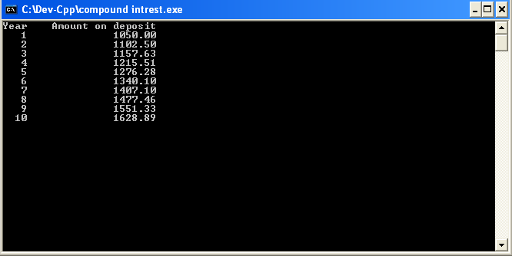
Output
Numbers are right-justified due to setw statements (at positions 4 and 21).

Slide 51
Break and continue Statements
The break and continue statements alter the flow of control
break statement
  Causes immediate exit from while, for, do/while or switch structure
  Program execution continues with first statement after structure
Common uses
  Escape early from a loop
  Skip the remainder of switch structure

Slide 52
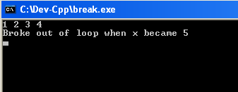
Example Program to demonstrate the break statement in for repetition structure
1 // Using the break statement in a for structure.
2 // the for loop will terminate as soon as x becomes 5
3 #include <iostream>
4
5 using std::cout;
6 using std::endl;
7
8 // function main begins program execution
9 int main()
10 {
11
12 int x; // x declared here so it can be used both in and after the loop
13
14 // loop 10 times
15 for ( x = 1; x <= 10; x++ )
16 {
17 // if x is 5, terminate loop
18 if ( x == 5 )
19 break; // break loop only if x is 5
20
21 cout << x << " "; // display value of x
22
23 } // end for
24
25 cout << "\nBroke out of loop when x became " << x << endl;
26
27 return 0; // indicate successful termination
28
29 } // end function main
Exits for structure when break is executed.
Output

Slide 53
Break and continue Statements
continue statement
  Used in while, for, do/while
  Skips remainder of loop body
  Proceeds with next iteration of loop
while and do/while structure
  Loop-continuation test evaluated immediately after the continue statement
  In while structure if counter control incrimination (i++) is done after the continue statement then its value will not be incremented
    Because Loop continuation test (condition) will be evaluate right after the continue statement
for structure
  Increment expression executed
  Next, loop-continuation test evaluated

Slide 54
Example program to demonstrate the continue statement in for repetition structure
1 // Fig. 2.27: fig02_27.cpp
2 // Using the continue statement in a for structure.
3 #include <iostream>
4
5 using std::cout;
6 using std::endl;
7
8 // function main begins program execution
9 int main()
10 {
11 // loop 10 times
12 for ( int x = 1; x <= 10; x++ ) {
13
14 // if x is 5, continue with next iteration of loop
15 if ( x == 5 )
16 continue; // skip remaining code in loop body
17
18 cout << x << " "; // display value of x
19
20 } // end for structure
21
22 cout << "\nUsed continue to skip printing the value 5"
23 << endl;
24
25 return 0; // indicate successful termination
26
27 } // end function main
Skips to next iteration of the loop.

Slide 55
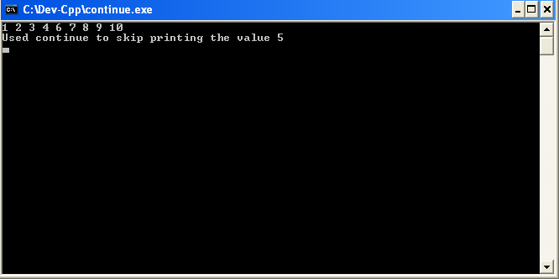
Output

Slide 56
Nested Control Structures
Control structure that rests entirely within another control structure
We are once again going to observe the top-down stepwise refinement of the algorithm
We are going to observe nesting of one control structure within another with the help of following example.
Problem statement
  A college has a list of test results (1 = pass, 2 = fail) for 10 students. Write a program that analyzes the results. If more than 8 students pass, print "Raise Tuition".
Notice that
  Program processes 10 results
    Fixed number, use counter-controlled loop
  Two counters are used
    One counts number of students passed
    Another counts number of students failed
  Each test result is 1 or 2
    If number is not 1, assume it is 2

Slide 57
Formulating algorithm with top-down stepwise refinement of the nested control structure example
Top level outline
    Analyze exam results and decide if tuition should be raised
First refinement
    Initialize variables
    Input the ten quiz grades and count passes and failures
    Print a summary of the exam results and decide if tuition should be raised
Refine
      Initialize variables
        to
      Initialize passes to zero
      Initialize failures to zero
      Initialize student counter to one
Notice that only the counters and totals are initialized

Slide 58
Formulating algorithm with top-down stepwise refinement of the nested control structure example
Refine
Input the ten quiz grades and count passes and failures
        to
    While student counter is less than or equal to ten
    Input the next exam result
    If the student passed
    Add one to passes
    Else
    Add one to failures
    Add one to student counter

Slide 59
Nested Control Structures
Refine
    Print a summary of the exam results and decide if tuition should be raised
        to
    Print the number of passes
    Print the number of failures
    If more than eight students passed
    Print “Raise tuition”

Slide 60
C++ code
1 // example to observe nested control structures
2 // Analysis of examination results.
3 #include <iostream.h>
4 // function main begins program execution
10 int main()
11 {
12 // initialize variables in declarations
13 int passes = 0; // number of passes
14 int failures = 0; // number of failures
15 int studentCounter = 1; // student counter
16 int result; // one exam result
17
18 // process 10 students using counter-controlled loop
19 while ( studentCounter <= 10 ) {
20
21 // prompt user for input and obtain value from user
22 cout << "Enter result (1 = pass, 2 = fail): ";
23 cin >> result;
24

Slide 61
C++ code
25 // if result 1, increment passes; if/else nested in while
26 if ( result == 1 ) // if/else nested in while
27 passes = passes + 1;
28
29 else // if result not 1, increment failures
30 failures = failures + 1;
31
32 // increment studentCounter so loop eventually terminates
33 studentCounter = studentCounter + 1;
34
35 } // end while
36
37 // termination phase; display number of passes and failures
38 cout << "Passed " << passes << endl;
39 cout << "Failed " << failures << endl;
40
41 // if more than eight students passed, print "raise tuition"
42 if ( passes > 8 )
43 cout << "Raise tuition " << endl;
44
45 return 0; // successful termination
46
47 } // end function main

Slide 62
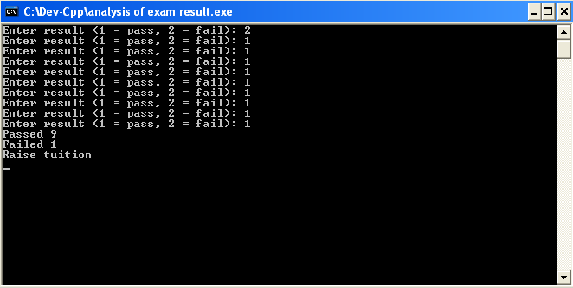
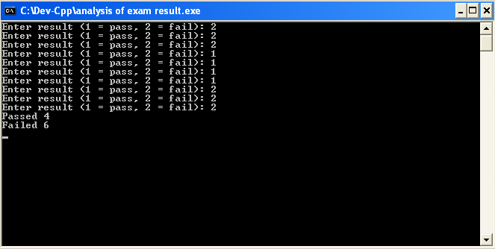
Output
Pass=9 which is >8 satisfies the condition to print raise tuition
Passed=4which is <8 do not satisfies the condition to print raise tuition

