Slide 1
Operator
Overloading

Slide 2
OBJECTIVES
What operator overloading is and how it makes programs more readable and programming more convenient.
To redefine (overload) operators to work with objects of user-defined classes.
The differences between overloading unary and binary operators.
To convert objects from one class to another class.
When to, and when not to, overload operators.
To use overloaded operators and other member functions of standard library class string.
To use keyword explicit to prevent the compiler from using single-argument constructors to perform implicit conversions.

Slide 3
Introduction
Use operators with objects (operator overloading)
  Clearer than function calls for certain classes
Examples
  <<
    Stream insertion, bitwise left-shift
  +
    Performs arithmetic on multiple items (integers, floats, etc.)

Slide 4
Rules for Overloading Operator
Only existing operators can be overloaded . New operators cannot be created.
The overloaded operators must have at least one operand that is of user defined type.
We cannot change the basic meaning of an operator. That is to say, we cannot redefine the plus(+) operator to subtract one value from other.
Overloaded operators follow the syntax rules of the original operators. They cannot be overridden.
There are some operators that cannot be overloaded.
We cannot use friend function to overload certain operators. However, member functions can be used to overload them.
When using binary operators overloaded through a member function, the left hand operand must be an object of the relevant class.
Binary arithmetic operators such as +,-,* and / must explicitly return a value . They must not attempt to change their own arguments.

Slide 5







Operators that cannot be overloaded
Sizeof | Size of operator
. | Membership operator
* | Pointer -to -member operator
:: | Scope resolution operator
?: | Conditional Operator

Slide 6
Where a friend function cannot be used
= | Assignment operator
( ) | Function call operator
[ ] | Subscripting operator
→ | Class member access operator

Slide 7
Fundamentals of Operator Overloading
Types for operator overloading
  Can use existing operators with user-defined types
  Cannot create new operators
Overloading operators
  Create a function for the class
  Name of operator function
  Keyword operator followed by symbol
      Example: operator+ for the addition operator +

Slide 8
Good Programming Practice
Overloaded operators should mimic the functionality of their built-in counterparts—
for example,
the + operator should be overloaded to perform addition, not subtraction.

Slide 9
Fundamentals of Operator Overloading
Using operators on a class object
  It must be overloaded for that class
      Assignment operator (=)
        Memberwise assignment between objects
Overloading provides concise notation
  object2 = object1.add( object2 );
  vs.
  object2 = object2 + object1;

Slide 10
The process of overloading involves the following steps:
Create a class that defines the data type that is to be used in the overloading operations.
Declare the operator function operator operator() in the public part of the class .
It may be either a member function or a friend function.
Define the operator function to implement the required operations.

Slide 11
Operator Functions
Class Members vs. Global Members
Operator functions
  As member functions
    Leftmost object must be of same class as operator function
    Use this keyword to implicitly get left operand argument
    Called when
      Left operand of binary operator is of this class
      Single operand of unary operator is of this class
  As global functions
    Need parameters for both operands
    Can have object of different class than operator
    Can be a friend to access private or protected data

Slide 12
Operator functions must be either member functions (non-static) or friend functions.
A basic difference between them is that friend function will have only one argument for unary operators and two for binary operators, while a member function has no argument for unary operators and only one for binary operators.
2. This is because the object used to invoke the member function is passed implicitly and therefore is available for the member function. This is not the case with friend functions.
3. Arguments may be passed either by value or by reference.

Slide 13
Overloading
Stream Insertion and Stream Extraction Operators
<< and >> operators
  Already overloaded to process each built-in type
  Can also process a user-defined class
    Overload using global, friend functions
Example program
  Class PhoneNumber
    Holds a telephone number
  Print out formatted number automatically
    (123) 456-7890

Slide 14
#include<iostream>
#include<string>
using namespace std;
class Person
{
private:
string name;
int age;
public:
Person()
{name = "noname";
age = 0;
}
friend void operator<< (ostream &output, Person &p);
friend void operator>>(istream &input, Person &p);
};

Slide 15
void operator<< (ostream &output, Person &p)
{
output << “Its fun" << endl;
output << "my name is " << p.name << "and my age is" << p.age;
}
void operator>>(istream &input, Person &p)
{
input >> p.name >> p.age;
}
int main()
{
Person ki;
cout << "Enter the name and age" <<endl;
cin >> ki;
cout << ki;
system("pause");
return 0;
}

Slide 16
Software Engineering Observation 11.3
New input/output capabilities for user-defined types are added to C++ without modifying C++’s standard input/output library classes.
This is another example of the extensibility of the C++ programming language.

Slide 17
Overloading Unary Operators
  Can overload as non-static member function with no arguments
  Can overload as global function with one argument
    Argument must be class object or reference to class object

Slide 18
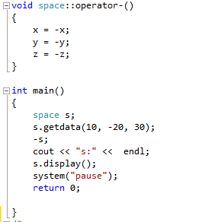
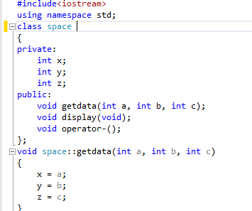
Unary minus operator is overloaded

Slide 19
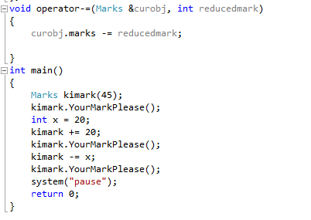
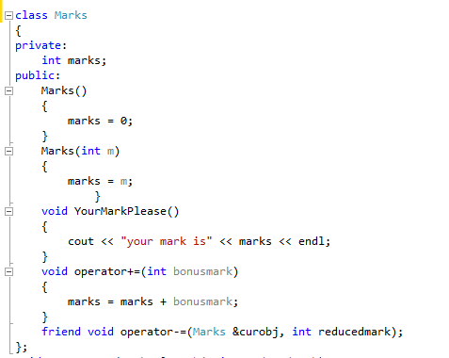
Program to overload shorthand operator

Slide 20
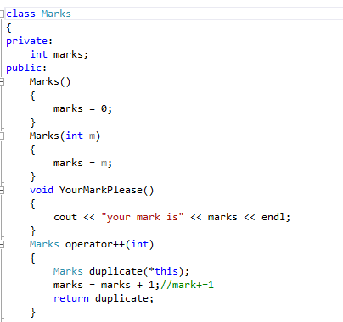
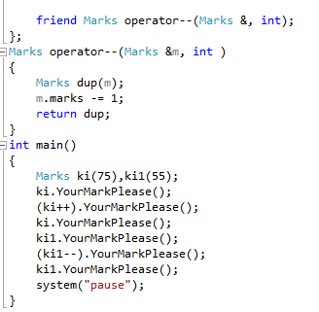
Program to overload Increment and Decrement operator (Postfix)

Slide 21
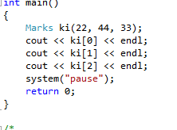
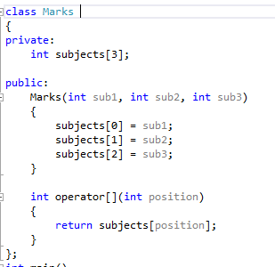
Program to overload array subscript operator

Slide 22
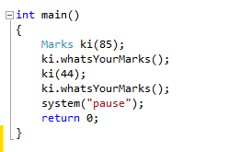
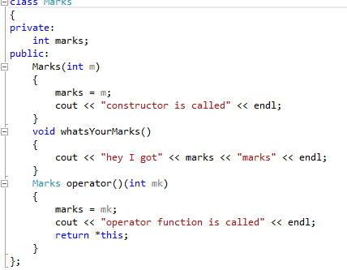
Program to overload Function Call operator

Slide 23
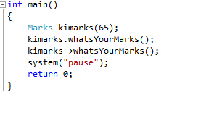
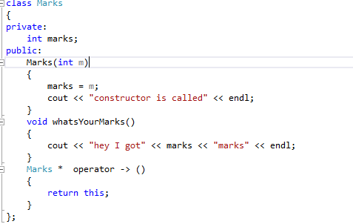
Program to overload the class member access operator

